Slide 1
ACED Datamodel

Slide 2
Overview

Slide 3


Project Flow
Data Model
FHIR R4
Data Instances
Now: synthetic data
Gen3 Setup
Submission
Later: lab data
Query
UI
Evaluation
Fit for purpose?
Adjustment Needed
Production Ready

Slide 4
Goals
Create a “ready-to-work” environment for:
Gen3 development
ACED Lab collaboration and data submission
https://guide.quickscrum.com/scrum-guide/definition-of-ready/
End product:
A set of PFB files ready for import into Gen3
Includes genomic and imaging data
Background
https://www.researchgate.net/publication/359859530_The_Coherent_Data_Set_Combining_Patient_Data_and_Imaging_in_a_Comprehensive_Synthetic_Health_Record

Slide 5
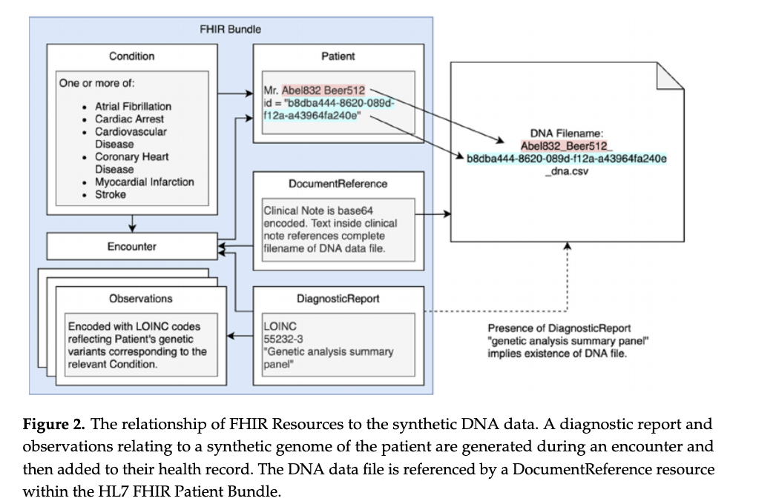
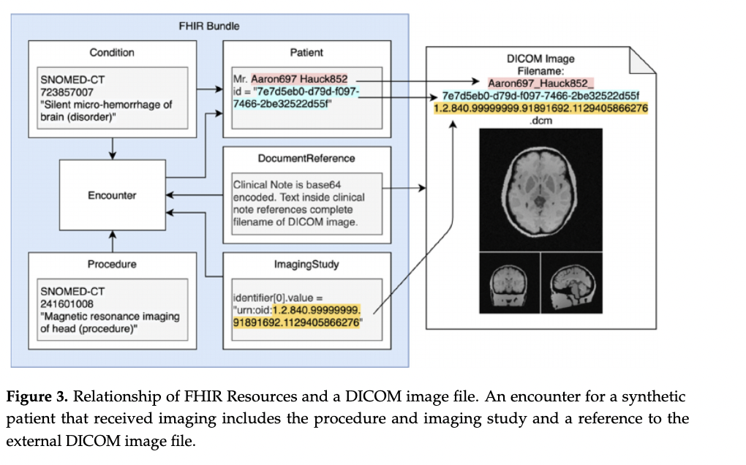
“As-Is”

Slide 6
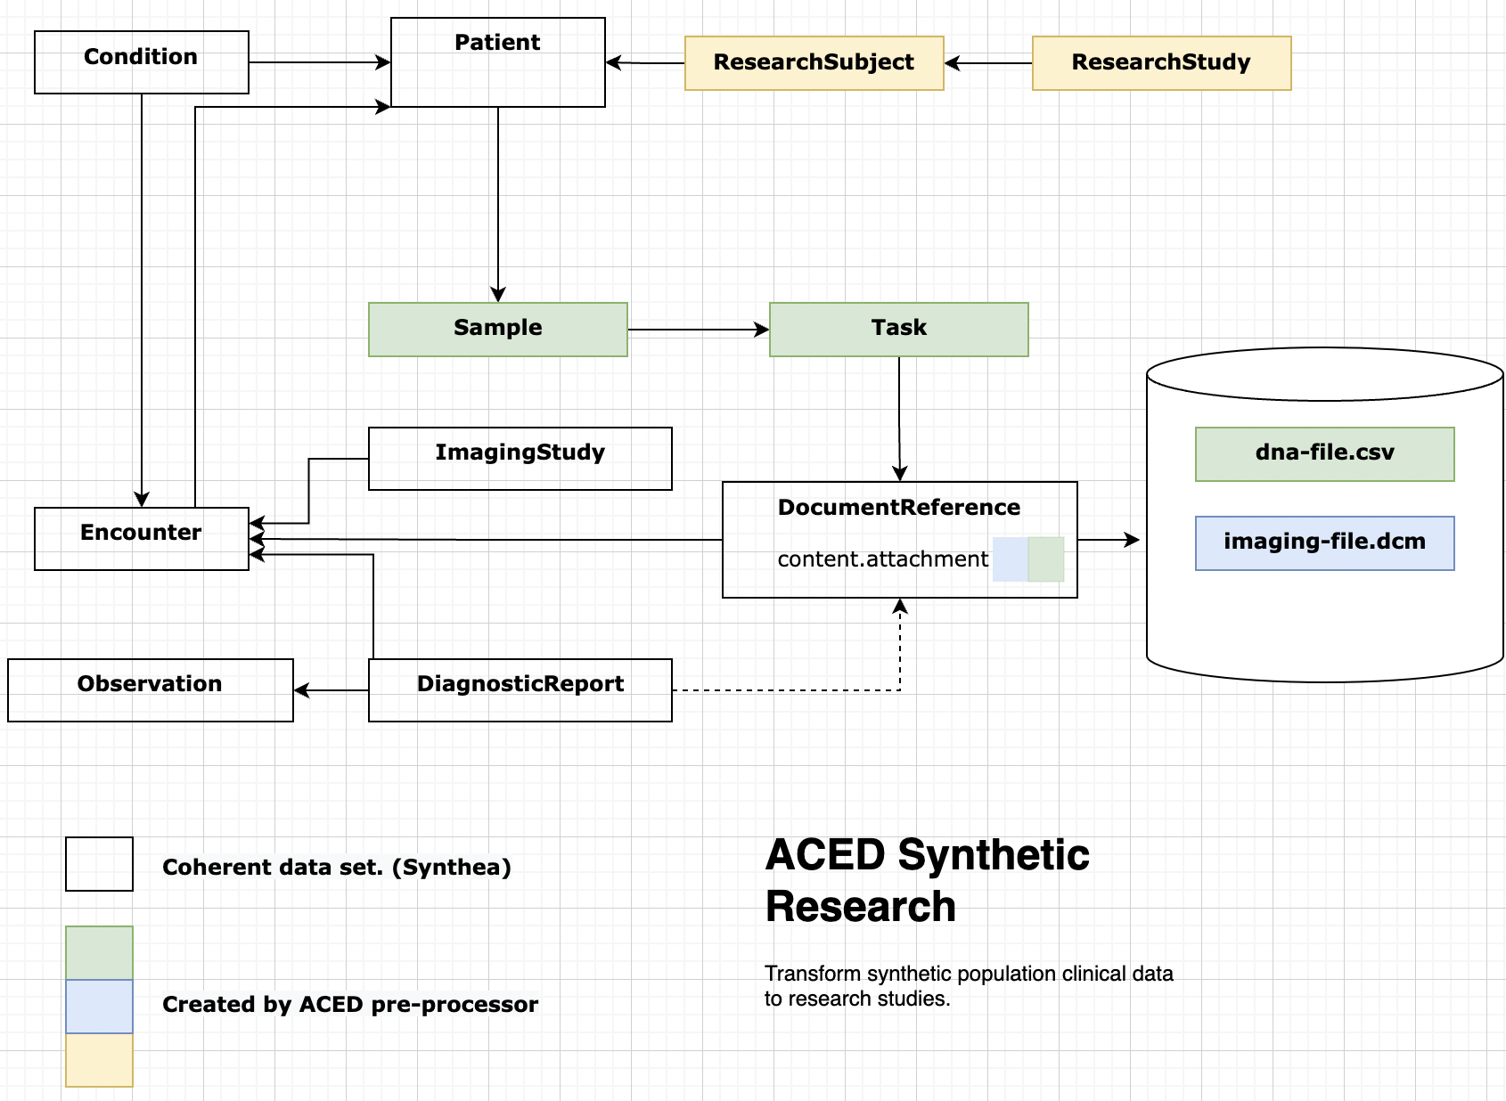
“To-Be”

