Slide 1

Digging Deeper Neural Networks
Dr Chris McCool

Slide 2
Time | Presentation | Practical Session
12.45am – 2.45pm | Digging Deeper: Neural networks 1. Overview of NNs 2. Convolutional NNs 3. Deep learning | NN analysis in Python
2.45pm – 3.00pm | Break
3.00pm – 4.30pm | Extended topics: NNs NNs for 2D images | NN analysis in Python
4.30pm – 5.00pm | Extended topics: NNs Deep Learning Systems Concluding remarks: Day 2 | No prac.

Slide 3
Part I Overview of Neural Networks

Slide 4

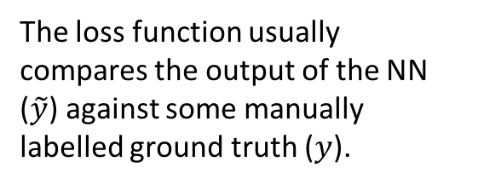

Overview of Artificial Neural Networks (NNs)
Often considered in terms of emulating a biological system
synapses and dendrites
Trains one or more layers based on a set of data and a loss function
The loss function usually compares the output of the NN ($\tilde{y}$) against some manually labelled ground truth ($y$).
$x$ (input)
$\tilde{y}$ (output)

Slide 5
Overview of Artificial Neural Networks (NNs)
Feed forwad neural networks
Input nodes: take information from the outside world
Hidden nodes: no direct connection to the outside world
Output nodes: transfer information from the network to the outside world
Input Nodes
Hidden Nodes
Output Nodes

Slide 6
Overview of Artificial Neural Networks (NNs)
a₁₁
w₁₁
w₂₁
a₂₁
$$a_{21}=w_{11}a_{11}+w_{21}a_{21}{+…+b}_{1}$$
a₁₂
w₃₁
a₃₁
a₂₂
a₁₃
a₃₂
a₂₃
a₁₄
w₄₁

Slide 7
Overview of Artificial Neural Networks (NNs)
a₁₁
w₁₂
a₂₁
a₁₂
w₂₂
$$a_{22}=w_{12}a_{11}+w_{22}a_{21}{+…+b}_{2}$$
a₃₁
w₃₂
a₂₂
a₁₃
a₃₂
a₂₃
a₁₄
w₄₂

Slide 8
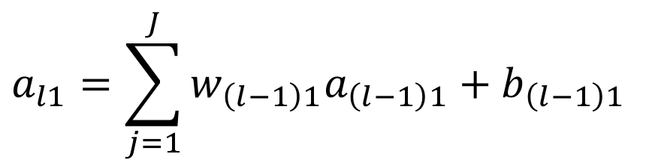


Overview of Artificial Neural Networks (NNs)
$$l−1$$
$$a_{l1}=\sum_{j=1}^{J}{w_{\left(l−1\right)1}a_{\left(l−1\right)1}+b_{\left(l−1\right)1}}$$
a₁₁
$$l$$
a₂₁
a₁₂
a₃₁
a₂₂
a₁₃
a₃₂
$$a_{l}=W_{\left(l−1\right)}a_{\left(l−1\right)}+b_{\left(l−1\right)}$$
a₂₃
a₁₄

Slide 9





Overview of Artificial Neural Networks (NNs)
tanh
$$a_{l}=f\left(W_{\left(l−1\right)}a_{\left(l−1\right)}+b_{\left(l−1\right)}\right)$$
ReLU
$$l−1$$
a₁₁
$$l$$
a₂₁
a₁₂
a₃₁
SoftPlus
a₂₂
a₁₃
a₃₂
a₂₃
a₁₄

Slide 10
Overview of Artificial Neural Networks (NNs)
Training the NN
Back-Propagation Algorithm
Define a loss function: compare the networks output to the desired output
The “error” is then propagated back to the previous layer
The weights are “updated” appropriately
Key for the back-propagation is that any non-linear function is differentiable
This is repeated until convergence or a terminating criterion is reached
$$L_{2}={\left(y−\tilde{y}\right)}^{2}$$

Slide 11


Neural Networks and Deep Learning
Deep Learning
Output ($y$)
Input ($x$)

Slide 12

Neural Networks and Deep Learning
Deep Learning
Is a NN with many hidden layers
Each layer learns features to solve the final task (based on the loss)
Instead of pre-defining our own features
Has been trained using large amounts of data
ImageNet: 1,000 classes each with 1,000 images
Effectively applied to many domains
Image, audio (speech), etc.
Output ($y$)
Input ($x$)

Slide 13
Introduction to Tensorflow
We’ll be doing examples in TensorFlow
Free framework from Google
Compatible with Keras (a wrapper)
Multiple online tutorials and resources to get you started
Can make use of multiple CPUs as well as GPUs
https://www.tensorflow.org/
We’ll be coding in Python
Rapid prototyping

Slide 14
Introduction to Tensorflow
Some tips for Python
GUIs: Atom a free editor (customisable)
scipy and numpy
A surprising number of numerical operations implemented efficiently
Has a statistics toolkit
R/Matlab cheat sheet (relationship between Matlab and scipy/numpy)
https://www.scipy.org/
sklearn
Free library with many useful algorithms implemented
Clustering, classification, and much more…
http://scikit-learn.org/stable/
skimage
Free library for image manipulation
http://scikit-image.org/

Slide 15
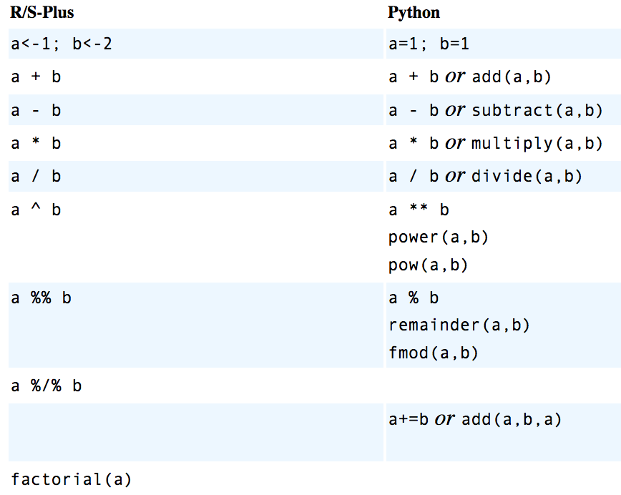
Introduction to Tensorflow
Cheatsheet for R users
http://mathesaurus.sourceforge.net/matlab-numpy.html
Cheatsheet for Matlab users
http://mathesaurus.sourceforge.net/r-numpy.html

Slide 16
Introduction to Tensorflow
We’ll be doing some coding examples
If you have no Python experience please pair up with someone that does
If you have questions please ask at any time
We’ll also be learning about how to use NNs for images
Let’s start with something simple

Slide 17

Introduction to NNs & Tensorflow
Let’s do an example using image data
Digits between 0-9, MNIST Digits
Small default to play with
Images are of size 28x28
But they come as a vector ($x$) of $D=784$
x₁
x₂
x_{D}

Slide 18

Introduction to NNs & Tensorflow
There are $C=10$ classes (digits 0-9)
The input is a vector ($x$) of dimension $D=784$
a₁₁
a₂₁
a₁₂
a₂₂
a₁₃
….............
….............
Output ($y$)
a_{2C}
a_{1D}
Input ($x$)

Slide 19
Coding
let’s get our hands dirty
Notes:
About 15 minutes to get to this point.

Slide 20
Introduction to NNs & Tensorflow
TensorFlow uses Graphs and Sessions
Define your TensorFlow graph
The Graph represents your computation in terms of dependencies between operators
Execute the graph using a session
The Session runs parts of the Graph on either a local or remote device
https://www.tensorflow.org/programmers_guide/graphs
TensorFlow Reference Material
https://www.tensorflow.org/programmers_guide/

Slide 21
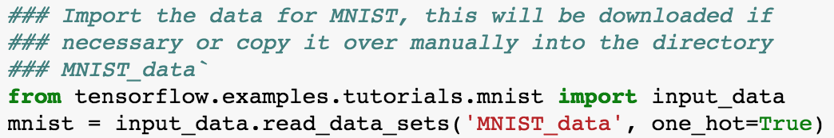
Introduction to NNs & Tensorflow
Change to the tutorial directory for Part I (NeuralNetworks)
This should contain the MNIST dataset which has an input loader
There’s an in-built loader in TensorFlow

Slide 22
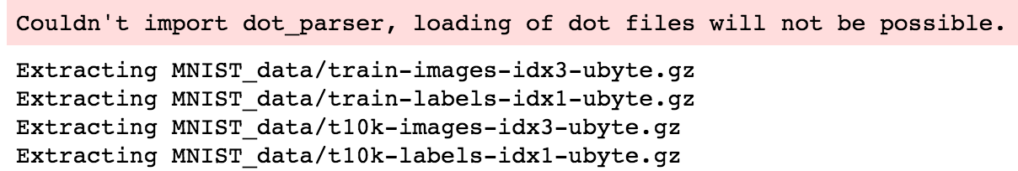
Introduction to NNs & Tensorflow
Normal execution should look something like

Slide 23

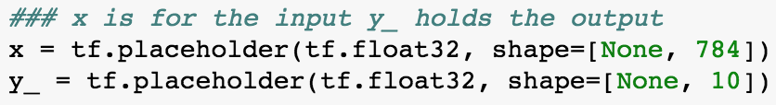
Introduction to NNs & Tensorflow
Import TensorFlow
Start defining the graph with the inputs and outputs
The None here refers to a variable number of inputs/outputs
In this case it indicates the number images passed as input
This is common for batch processing where we pass multiple observations (images) bundled together

Slide 24
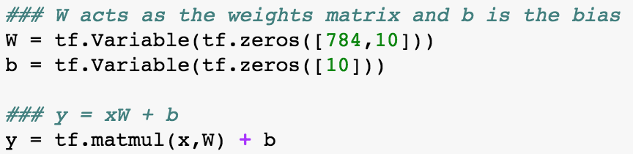

Introduction to NNs & Tensorflow
Define the relationship between the input and output
a₁₁
a₂₁
a₁₂
a₂₂
a₁₃
….............
….............
a_{2C}
a_{1D}
Output ($y$)
Input ($x$)

Slide 25


Introduction to NNs & Tensorflow
Define the relationship between the input and output
Output ($y$)
Input ($x$)

Slide 26
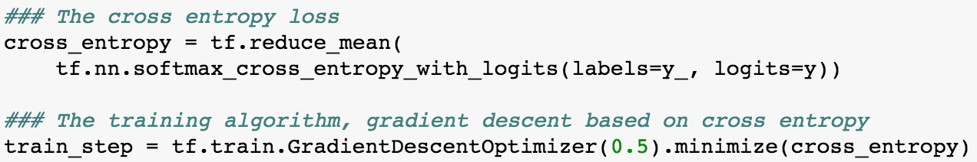
Introduction to NNs & Tensorflow
Let’s define the loss function that we want to use
The cross entropy loss is a classification loss
y is the estimated class value from the NN with an output for every possible class
y_ is the ground truth class with 1 for the class of interest and 0’s for the rest

Slide 27

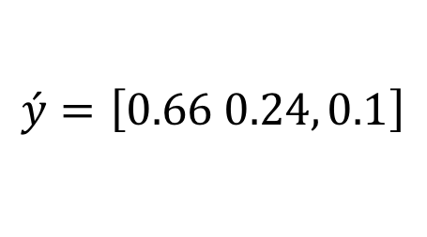


Introduction to NNs & Tensorflow
The softmax normalises the distribution
A quick example of this
After the softmax we get
The ground truth would be
Later we’ll show we can replace the loss to achieve different outcomes
$${\acute{z}}_{j}=\frac{e^{z_{j}}}{\sum{e^{z_{i}}}}$$
$$y=\left[2.0, 1.0, 0.1\right]$$
$$\acute{y}=\left[0.66 0.24, 0.1\right]$$
$$y_{l}=\left[1.0, 0.0, 0.0\right]$$

Slide 28
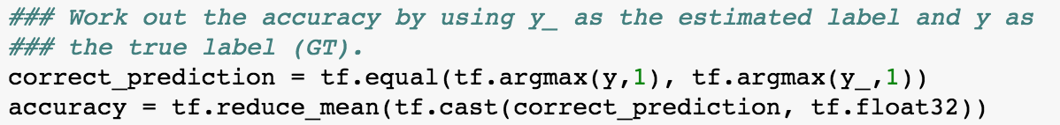
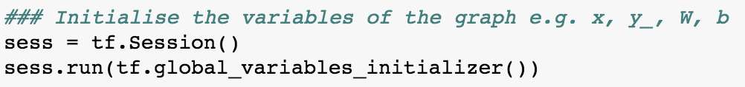
Introduction to NNs & Tensorflow
Let’s define a way to estimate the performance of the NN
Then we’ll initialise all the variables of the Graph

Slide 29
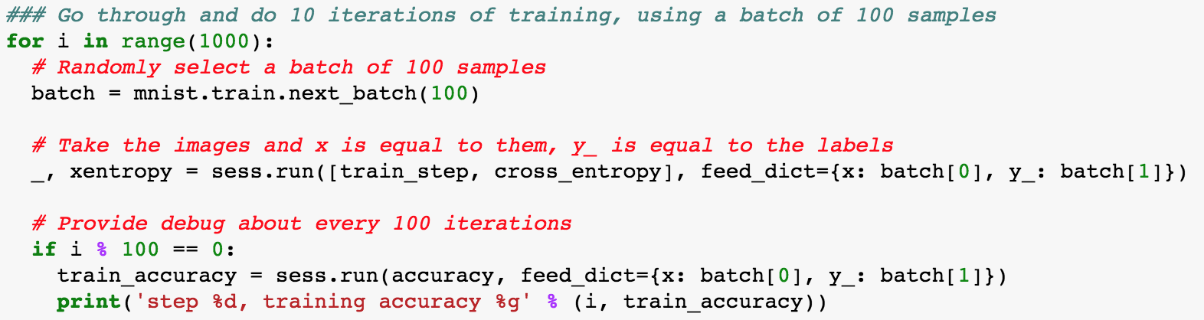
Introduction to NNs & Tensorflow
Now we’ll start looping through the data and passing patches for training

Slide 30
Introduction to NNs & Tensorflow
Then we’ll provide the performance of the trained system
Putting all this together we have a very basic NN
But not a very useful one
You can get this code here:
ABS_PartI_fullyconnected_NN.ipynb
It will be your template

Slide 31
Introduction to NNs & Tensorflow
The accuracy of this systems is 91-92%
This is actually isn’t great
What can we do to improve it?
Non-linear function
More hidden layers
I leave this to you to improve!

Slide 32
Coding/Break
Notes:
This should take another 15-20 minutes to get here

Slide 33


Introduction to NNs & Tensorflow
Let’s run through how to update this solution to something a bit more interesting
The solution that we’ll build up will look like the network below
Output ($y$)
n₂
n₁
Input ($x$)

Slide 34
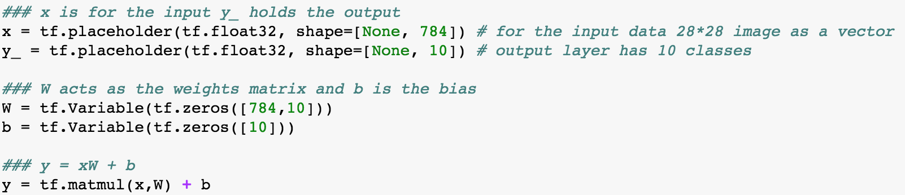
Introduction to NNs & Tensorflow
Fixing the deficiencies of the previous network

Slide 35
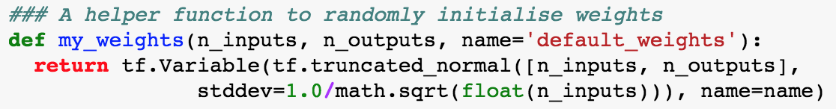
Introduction to NNs & Tensorflow
First we’ll add a helper function to quickly initialise some random weights

Slide 36
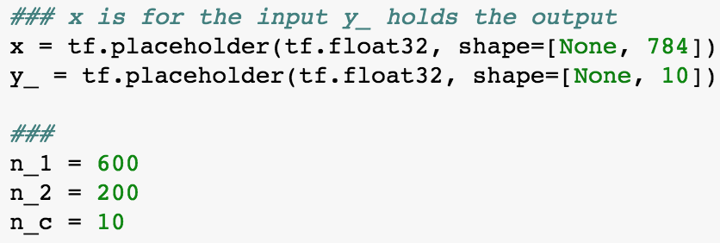
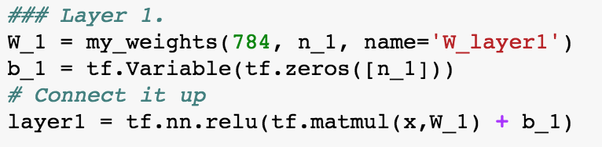
Introduction to NNs & Tensorflow
Let’s add a few more variables

Slide 37
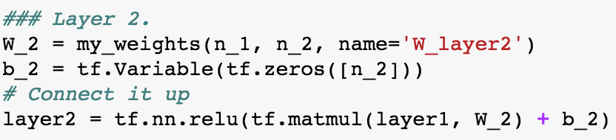
Introduction to NNs & Tensorflow
Let’s make the 1st layer more interesting
And then the 2nd layer

Slide 38
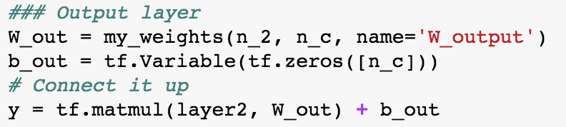

Introduction to NNs & Tensorflow
Finally the last layer
Output ($y$)
n₂
n₁
Input ($x$)

Slide 39
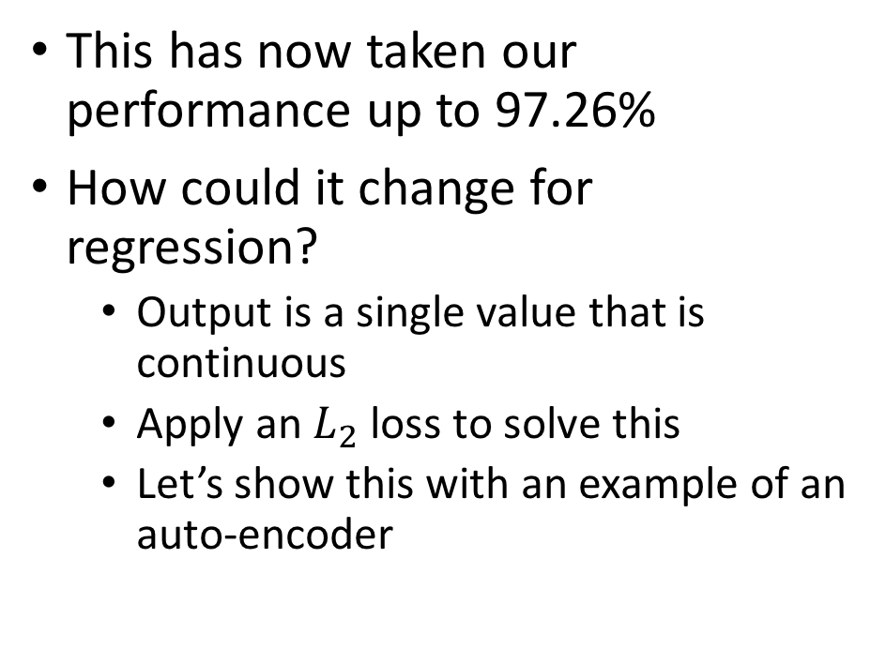
Overview of Artificial Neural Networks (NNs)
This has now taken our performance up to 97.26%
How could it change for regression?
Output is a single value that is continuous
Apply an $L_{2}$ loss to solve this
Let’s show this with an example of an auto-encoder
Output ($y$)
n₂
n₁
Input ($x$)

Slide 40

Overview of Artificial Neural Networks (NNs)
Auto-encoder
Unsupervised approach
Output ($y$) should match the input ($x$)
Often used for learning good features (low dimensionality)
n₂
n₁
n₁
Input ($x$)
Output ($y$)

Slide 41
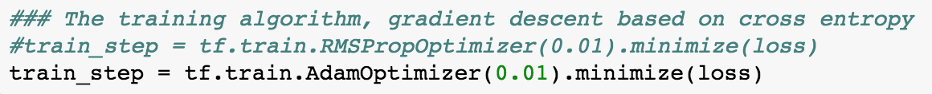

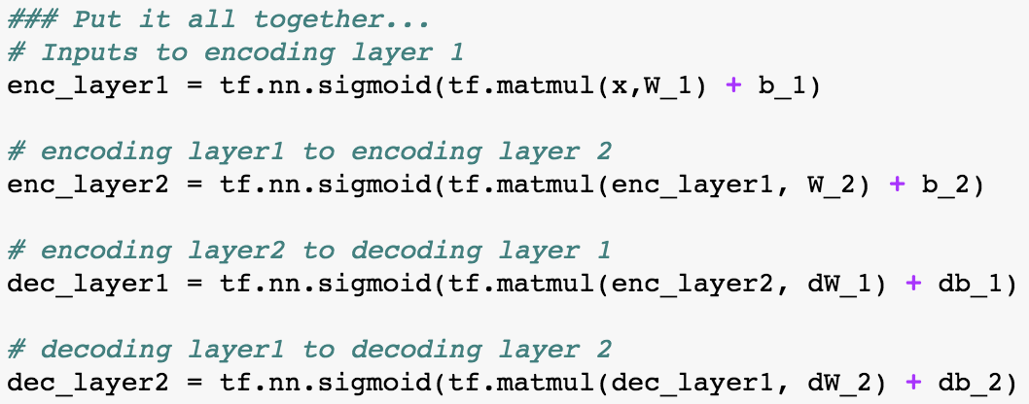

Auto-Encoder: I’ll leave this to you to code up!
Hints
Change the optimiser to the following (much faster..)
Change the loss
Use the sigmoid non-linearity
n₂
n₁
n₁
Input ($x$)
Output ($y$)
Notes:
Leave them coding this up for another 15-20 minutes (1 hour mark). Break for 5-10 minutes.

Slide 42
Coding/Break
Notes:
This should take about another 10 minutes to get here

Slide 43
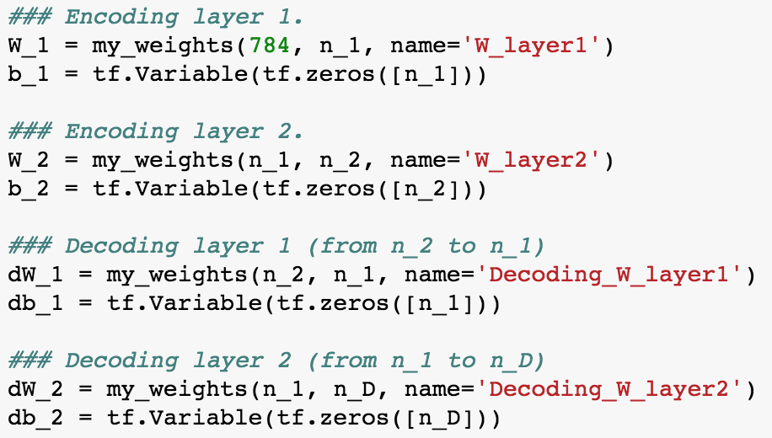
Overview of Artificial Neural Networks (NNs)
We’ll define the weights for the encoder and then the decoder
n₂
n₁
n₁
Input ($x$)
Output ($y$)

Slide 44
Overview of Artificial Neural Networks (NNs)
We’ll then connect the graph together and this time we’ll use the sigmoid
n₂
n₁
n₁
Input ($x$)
Output ($y$)

Slide 45
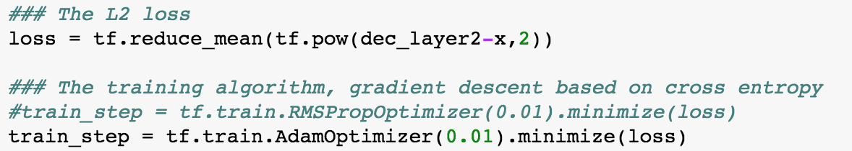

Overview of Artificial Neural Networks (NNs)
This time the loss is the average of the $L_{2}$
We’re using a different optimiser as this will be more efficient
D. Kingma and J. Ba, “Adam: A Method for Stochastic Optimization”, 2015
https://machinelearningmastery.com/adam-optimization-algorithm-for-deep-learning/

Slide 46
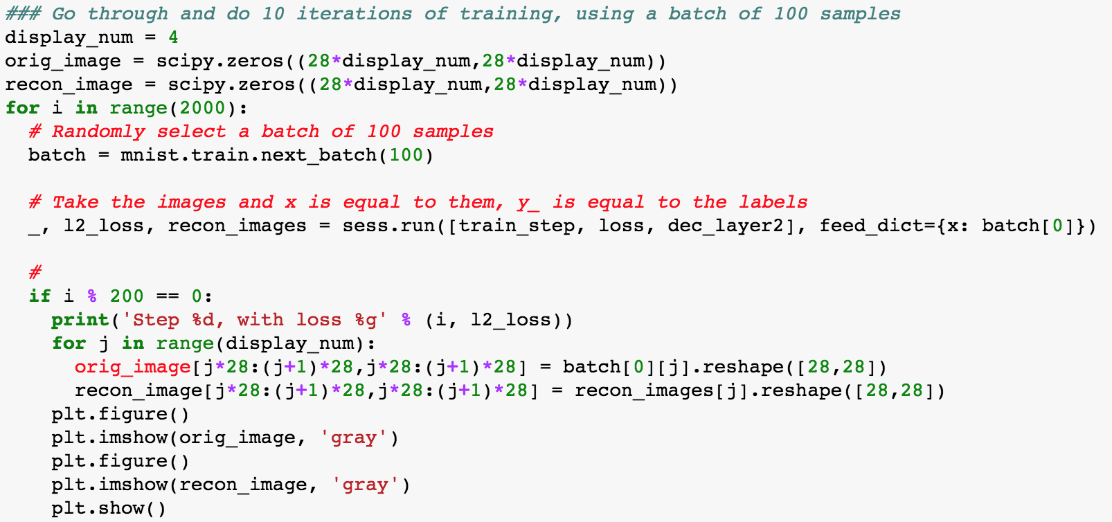
Overview of Artificial Neural Networks (NNs)
The rest of the code is for training and displaying some output

Slide 47
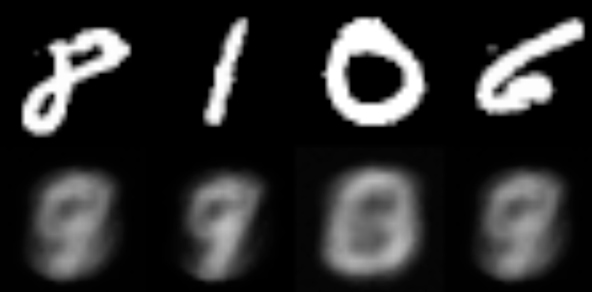
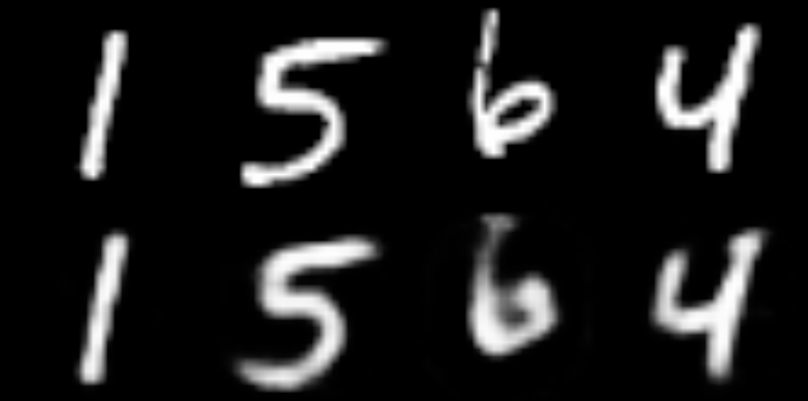
Overview of Artificial Neural Networks (NNs)
You can find this code here:
solutions/ ABS_PartI_fullyconnected_NN_AutoEncoder.ipynb
400 iterations
2000 iterations

Slide 48


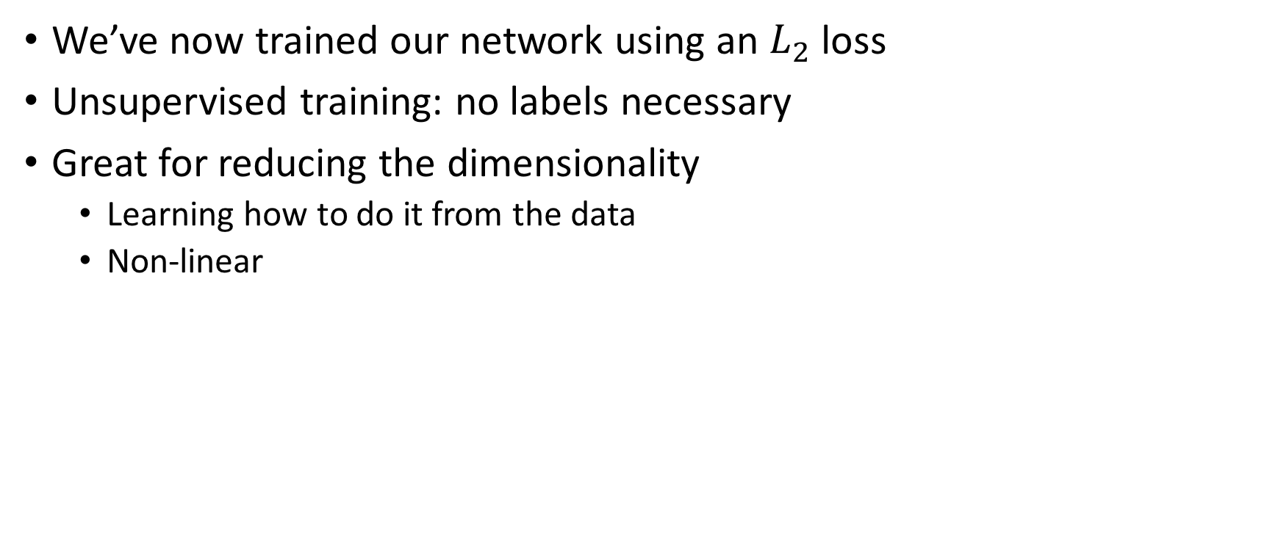
Overview of Artificial Neural Networks (NNs)
We’ve now trained our network using an $L_{2}$ loss
Unsupervised training: no labels necessary
Great for reducing the dimensionality
Learning how to do it from the data
Non-linear
n₂
n₁
n₁
Input ($x$)
Output ($y$)

Slide 49
Overview of Artificial Neural Networks (NNs)
But! We’re treating the image as a feature vector
This is rarely a good idea, we’ll explore why in the next part
We can already do a lot with the fully connected networks

Slide 50
Overview of Artificial Neural Networks (NNs)
Large-Scale Linear Models
Categorical, continuous, etc.
Dense/sparse
Wide and deep learning (beyond todays course)
https://www.tensorflow.org/tutorials/wide_and_deep
Convolutional Neural Networks (Part II of this course)
Images, audio (e.g. spectograms) and more
Recurrent Neural Networks (brief discussion today)
Making use of memory
https://www.tensorflow.org/tutorials/recurrent
Notes:
This should take another 10 minutes to get here.

Slide 51
Recap
Introduced Neural Networks
Trained a very simple network
Extended this to have multiple hidden layers
Changed the loss function to perform unsupervised learning (auto-encoder)
Got hands dirty with coding in TensorFlow

