Slide 1


General Model for Chronic Care and Effects of MonashWatch
Ali Tirdad
Department of Mathematics and Statistics
University of Melbourne
March 20, 2017

Slide 2
What is “Health”?
The World Health Organisation (WHO) defines health as a resource for everyday life, not the objective of living.
The experience of health is basically personal, and each individual has her/his way of being in good health.
Health is a positive concept emphasising social and personal resources, as well as physical capacities.

Slide 3
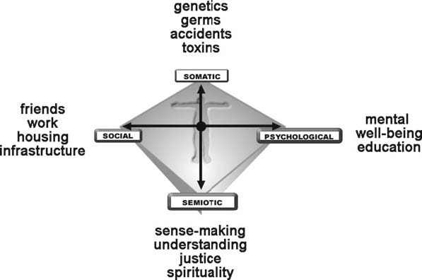
The somato-psycho-socio-semiotic Health model
This model describes health as a balance between the biological, emotional, social and sense-making dimensions affecting an individual.
Required help:
-Social services
-Family therapy
Required help:
-Psychotherapy
-Meditation

Slide 4
Patient Classification based on their health experience
Instead of focusing on the patients' type of chronic conditions, we look at their health as a combination of four factors.
Each individual has a unique experience about his health. However, people with the similar health factors can experience the same journey.
We classify the patients by the somato-psycho-socio-semiotic health model, and provide the similar service to each class.

Slide 5
MonashWatch
Each patient might goes through the health states regardless of the type of his dis-ease.
Based on the class of the patient, MonashWatch provides the proper/most related service.
For the patients with chronic conditions, the medical interventions are necessary. However, the other services could help them feel healther through their fight with their diseases.

Slide 6
Markov Decision Process
The Quality Adjusted Life Years (QALYs) is considered as the main measure to evaluate the health benefits of the interventions.
The idea of the mathematical modelling here, is to maximise the expected quality of life for all patients in MonashWatch program with respect to the available resources and services.
We decide the frequency of receiving service by MonashWatch for each patient to maximise the QALYs for all registered patients.
We correlate the quality of life with the health state.

Slide 7
Markov Decision Process
Planning horizon: Finite
Decision epochs: Every day
Population: Generally non- homogeneous; homogeneous inside each patient’s class
Health state: Common for all classes; 4 states; associated with QALYs
States for decision making: Health state, class, days passed from the last intervention for each patient
Decisions: Who to call each day
Objective: Maximise the QALYs w.r.t resources limitations

Slide 8
Markov Decision Process
Transition through the heath states for each patients consists of:
Natural disease transition (P)
Health transition after receiving a service (Q)
Both transitions are depends on the patient’s class.
The optimality equation:

Slide 9
How to Approach
Considering a holistic health model usually needs a vast range of general and/or specific data.
It is unlikely that all data exists in a centralised and easy-to-use format in hospital's database.
Interpreting existing data and producing information is part of the process. Some data might be necessary to collect, and data mining analysis might be required.
The optimisation problem can be solved for general values, and applied to the collected data later on.

Slide 10
Thank you!

