Slide 1


Overview of modern statistical methods in sports science
David Pyne PhD FACSM
Australian Institute of Sport
University of Canberra
QUT/QAS/AIS Workshop, 22-23 February 2018

Slide 2
Sport requirements
Inform clinical and practical decisions
Inform guidelines, position statements and policies
Generate new knowledge
Upskill practitioners (and researchers)
Spanning sport – exercise – physical activity
Spectrum of science, technology, business, media and practice of sport

Slide 3
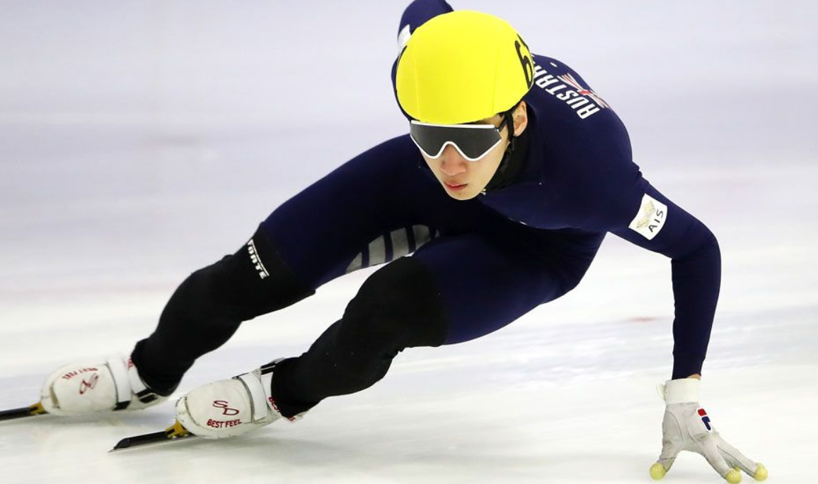
Statistics in Sport – key points
Our decisions
Individual athlete
Group /team
Cohorts / population
Data analysis should influence every decision
Training in statistics is poor
Organisations are poorly resourced
Data management is often poor

Slide 4
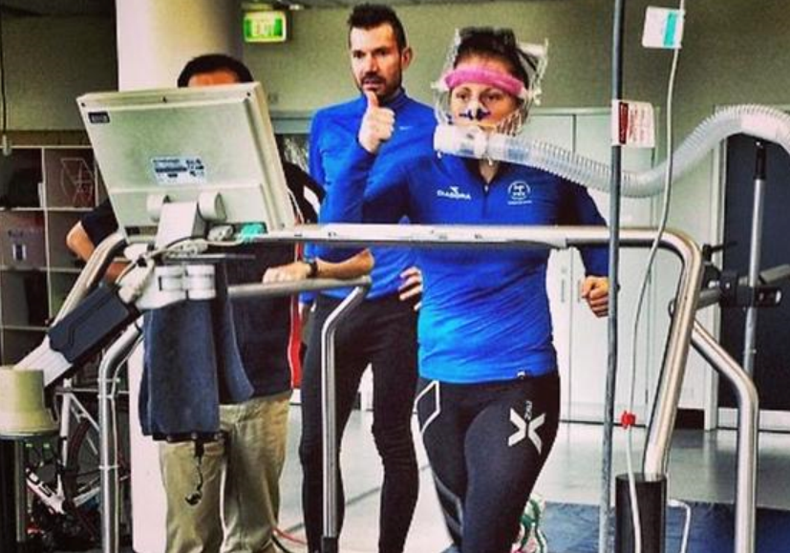
Statistics in Sport – key points
Chain of analysis and reporting
Design and analysis choices
Validity and reliability of measures
Data acquisition
Data collation, checking and cleansing
Data preparation
Analysis
Reporting

Slide 5
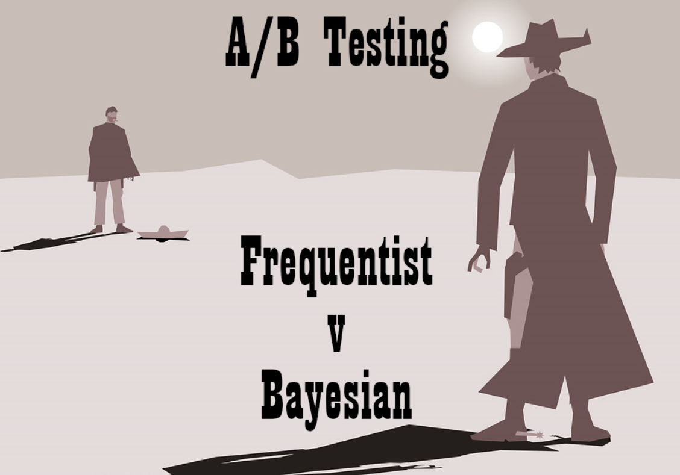
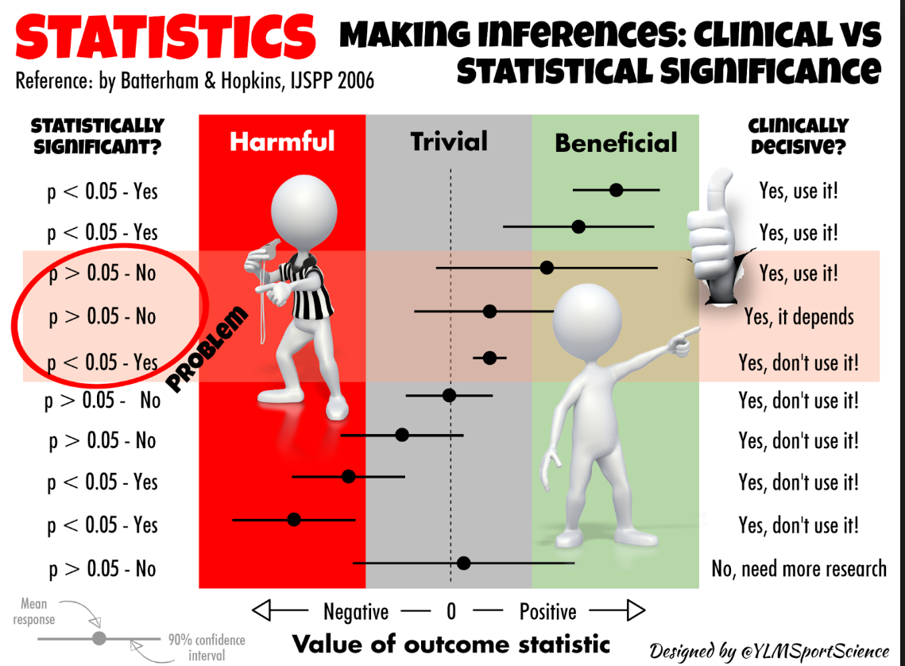
Statistics in Sport – key points
Specific requirements
Individuals (clinical / sporting decisions)
Small–large studies (inferential analysis)
Big data (modelling)
Choice of analytical approach
Frequentist
Bayesian
Quasi-Bayesian – Hybrid – Magnitude-based Inference

Slide 6
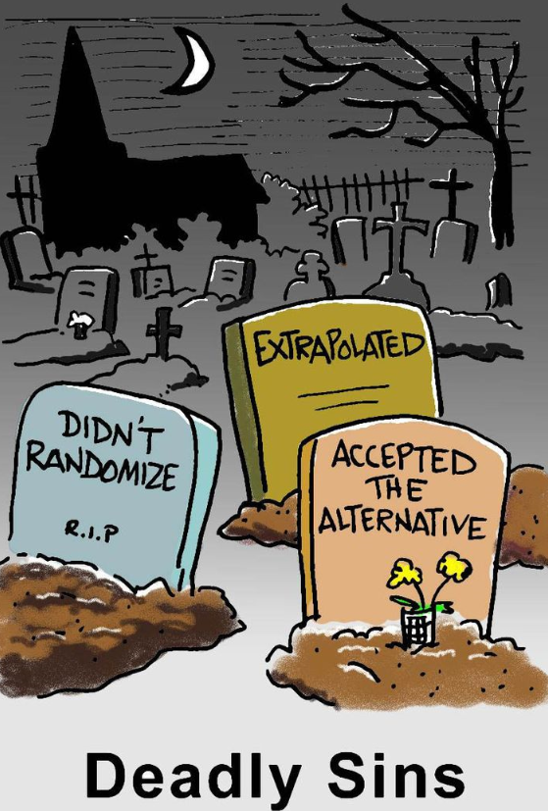
Statistics in Sport – key points
Good practices
Seek expert advice
Clear description of methods
Transparent reporting of outcomes
Defend the methods and outcomes
Plain language lay explanation

Slide 7
David Pyne PhD FACSM
Australian Institute of Sport
University of Canberra
david.pyne@ausport.gov.au
QUT/QAS/AIS Workshop, 22-23 February 2018

