Slide 1
Measuring influence of research beyond academia: Finding evidence of and enhancing research engagement and impact
Dr Quentin Pope

Slide 2
the intention of this minutes…
Map the sources to corroborate E&I
Maps are tools for the production of meaning (portals of discovery)
A map is not the territory it represents, but, if correct, it has a similar structure to the territory, which accounts for its usefulness.
— Alfred Korzybski, Science and Sanity (1933, p. 58)

Slide 3
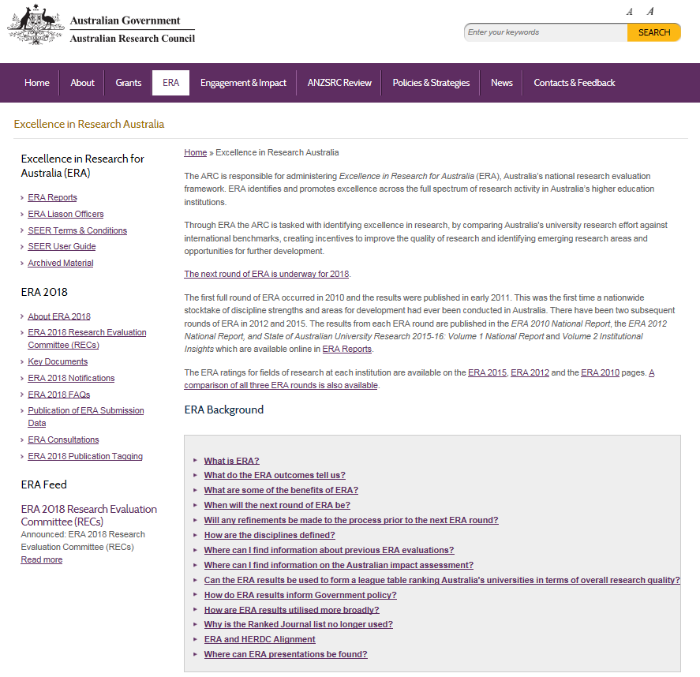

Slide 4
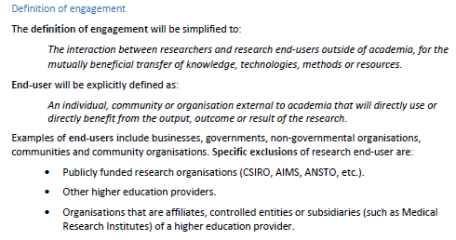

Slide 5
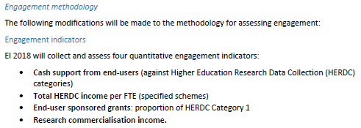
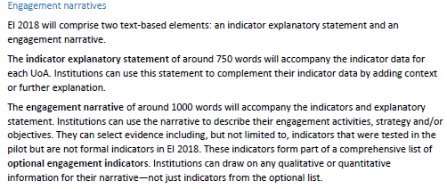

Slide 6

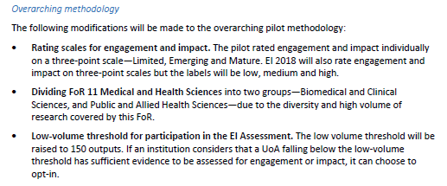

Slide 7

Engagement & Impact — real change
Translation of research into the ‘societal’ change
Must establish clear link to end user behavior, practice, process execution change and policy decision-making etc
Quantitative and Qualitative measures
Measures of the link between research and ‘societal’ significance and reach
Notes:
https://qutvirtual4.qut.edu.au/group/staff/research/research-impact

Slide 8
Gather intelligence and evidence on the effects that research is having in academia and beyond
Scientific ‘productivity’
Knowledge creation (publications/datasets/software etc) and transfer within academia
Engagement beyond academia
The interaction between researchers and research organisations and their larger communities/industries for the mutually beneficial exchange of knowledge, technologies and methods, understanding and resources in a context of partnership and reciprocity
Impact beyond academia
Research impact is the demonstrable contribution that research makes to the economy, society, culture, national security, public policy or services, health, the environment, or quality of life, beyond contributions to academia

Slide 9
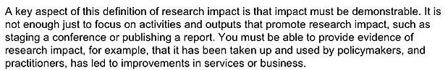
Types of engagement & impact
Instrumental impacts (e.g. actual changes in policy or practice)
Conceptual impacts (e.g. broad new understanding/ awareness raising)
Capacity building impacts (e.g. training of students or professionals, CPD etc.)
Attitudinal or cultural impacts (e.g. increased willingness in general to engage in new collaborations)
Enduring connectivity impacts (e.g. follow-up interactions such as joint proposals, reciprocal visits, shared workshops, lasting relationships)
https://www.fasttrackimpact.com/single-post/2015/9/4/Inspiration-or-trap-Should-you-be-tracking-the-impact-of-your-research

Slide 10

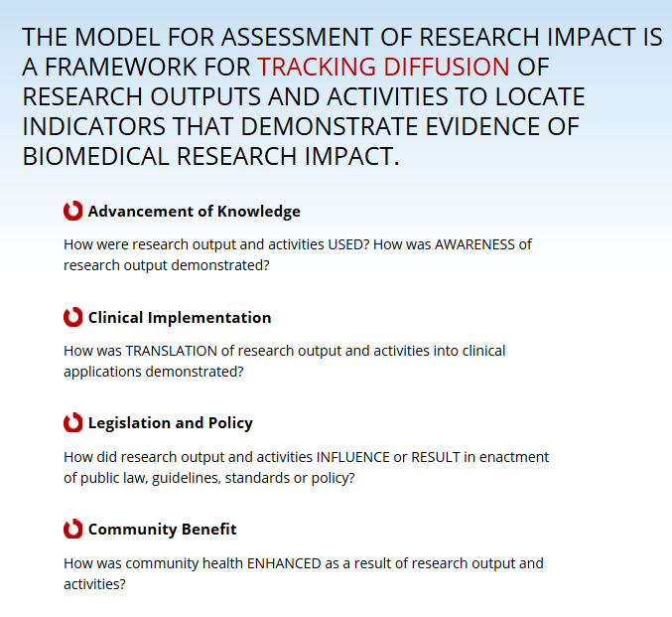
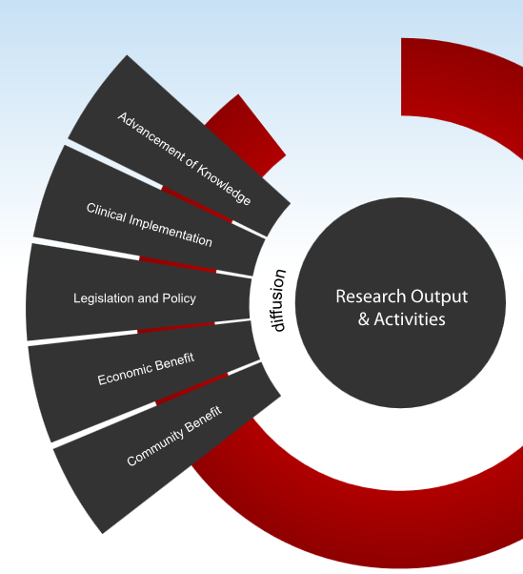
https://becker.wustl.edu/impact-assessment

Slide 11

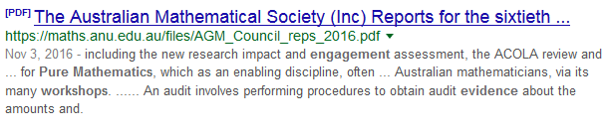
https://epsrc.ukri.org/newsevents/pubs/puremathsengagementworkshopreport/
https://maths.anu.edu.au/files/AGM_Council_reps_2016.pdf

Slide 12
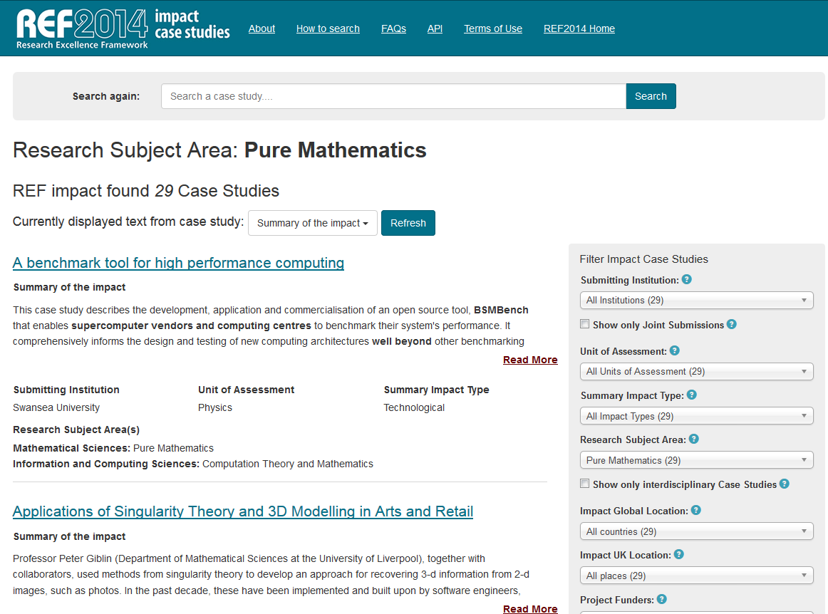

Slide 13
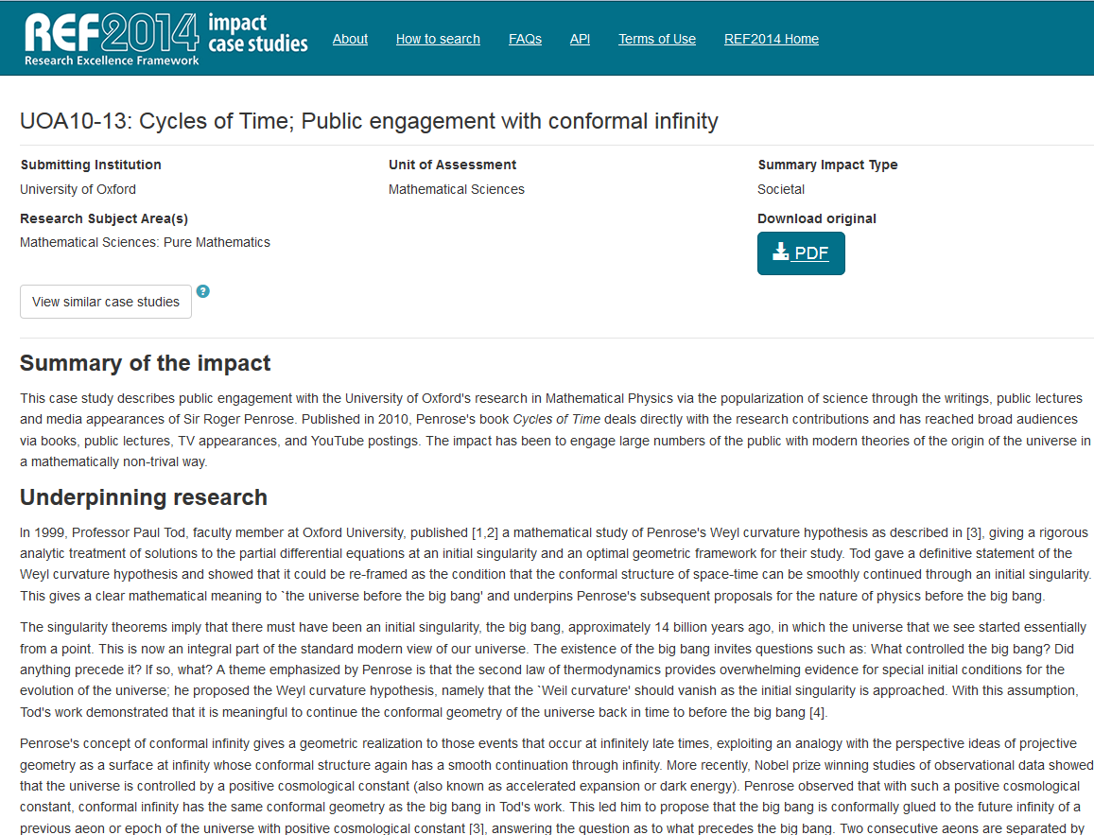
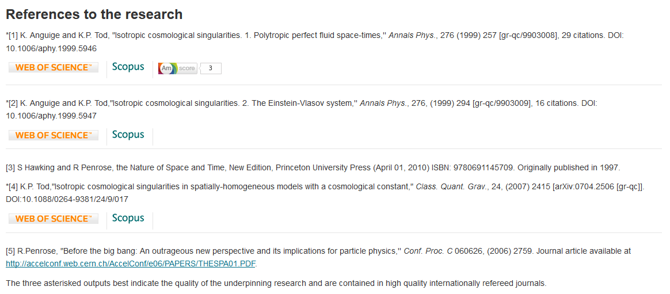
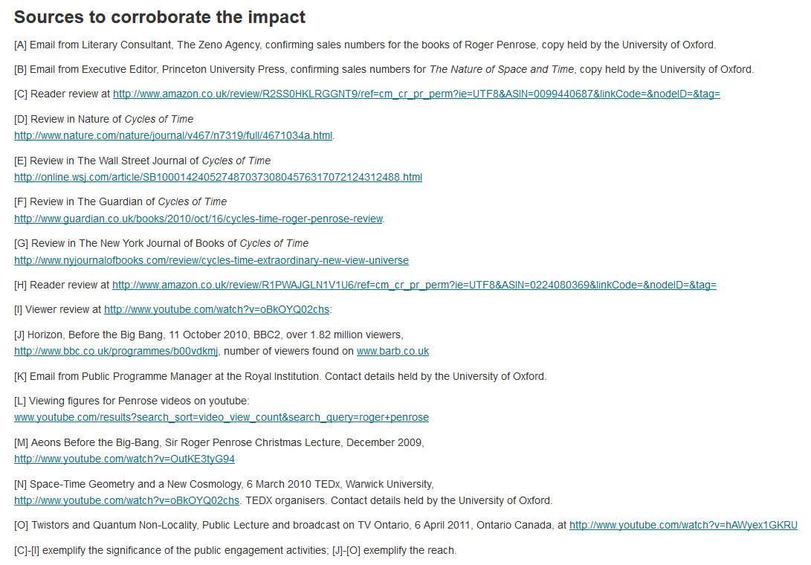

Slide 14
Research output: Underpinning research
Books, edited works, parts of books, special issues
Journal articles (including web-based), including articles in supplements of journals
Digital artefacts such as data sets, multi-use data sets, archives, software, film and other non-print media, web content such as interactive tools
Temporary artefacts, such as exhibitions
Other paper- or web-based outputs such as: case notes; conference papers; monographs; multilateral and international agencies’ research reports; outputs from projects commissioned by all levels of government, industry and other research funding bodies; policy evaluations/reports/commissioned reports; primary data reports; publications of development donors; published maps; patents; critical review articles; teaching, curriculum and assessment materials and textbooks (including those for training and/or for practice) where they embody original research; working papers

Slide 15
Generations of impact metrics
Journal-level metrics
Author-level metrics
Article-level metrics
Institution level metrics
Subject level metrics
Often metrics based (bibliometrics)
Important to triangulate
Discipline/Subject specific

Slide 16
Tools/Databases for Measuring and Interpreting Citation Impact
Google (incl. Domain-specific search)
Google Scholar
Scopus
Web of Science
MathSciNet
Subject specific databases — applied mathematics
Explain the data: sources, scope, limits, benchmarking criteria etc
Consider citation analysis as a portal of discovery for wider impact

Slide 17
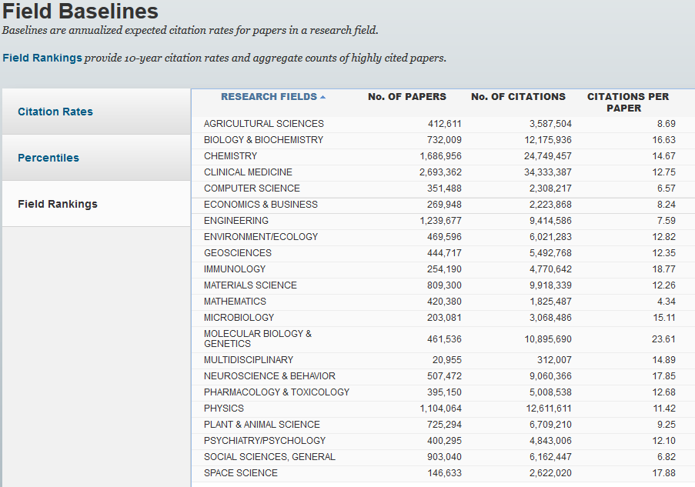

Slide 18
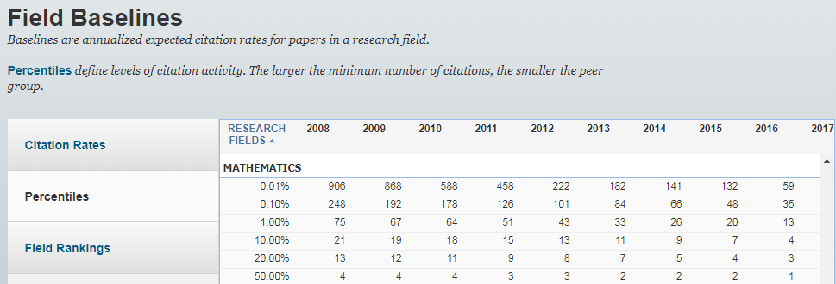
Benchmarking: example
Notes:
The slowest citation rates amongst all of the disciplines even thought, it shall be taken into account that the field is also the smallest according to the Web of Science data

Slide 19
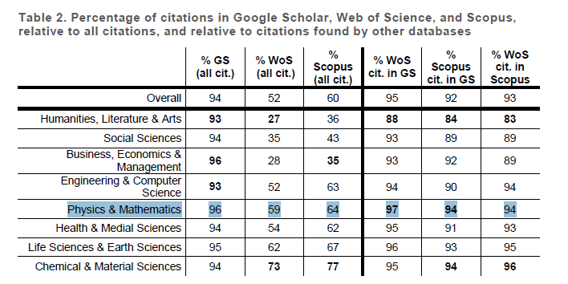
Coverage and discoverability of citations
https://arxiv.org/pdf/1808.05053

Slide 20
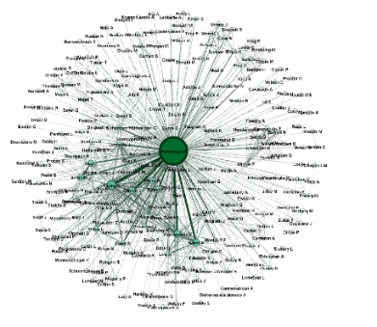
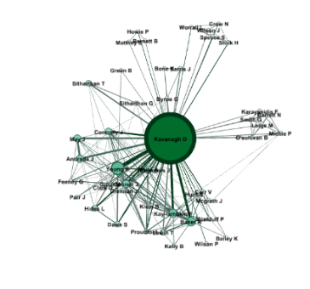
Reporting citation metrics: example
Reference. [JIF: xx.x; Ranked a (of b) in Subject Category; Citations: y; Scimago: xx.x; Ranked a (of b) in Subject Category; Citations: y (percentile)]
For example, below is an example from a list of publication taken directly from a job application:
Xu ZH, Ward S, Chen C, Blumfield TJ, Pope Q and Liu JH 2008 Soil carbon and nutrient pools, microbial properties and gross nitrogen transformations in adjacent natural forest and hoop pine plantations of subtropical Australia. Journal of Soils and Sediments, 8(2), 99-105.
[JIF: Ranked Q1 in Earth-Surface Processes, 68 citations; Scimago: Ranked Q1 in Environmental Sciences Category, 80 citations; Google Scholar: 99 citations (5th percentile Agricultural Sciences (Essential Science Indicators))]
Map of co-authors
Example: Prof D Kavanagh
Out of 17 publications indexed in Web of Science (ranging from 2007-2015), an h-index of 12 was obtained (Web of Science, February 17, 2015).
There are another five publications not indexed in Web of Science, one of which received 101 citations on Google Scholar (verified February 17, 2015).
Total citations 501, average citations per item 29.41, h-index 12, 4 papers with >50 citations; 2 with >100 (Scopus ranging 2007-2015, sourced February 17, 2016).

Slide 21
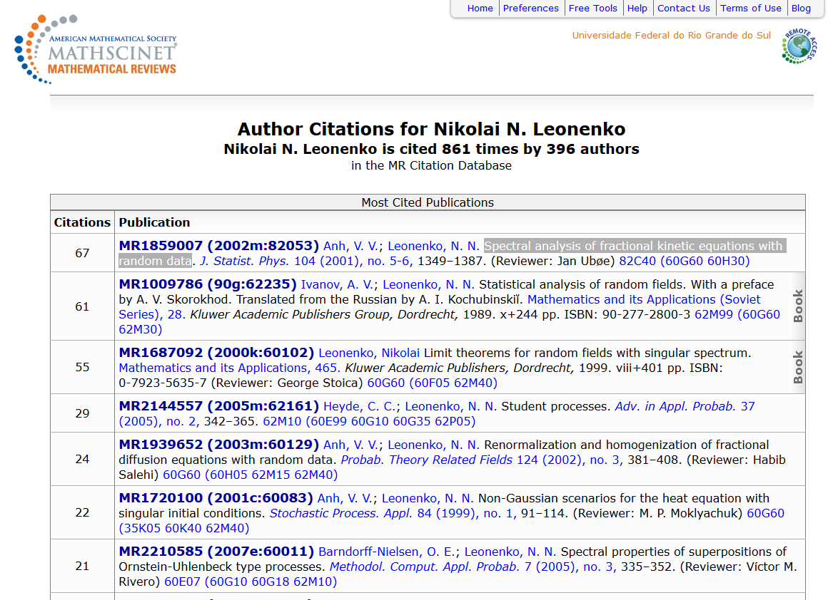
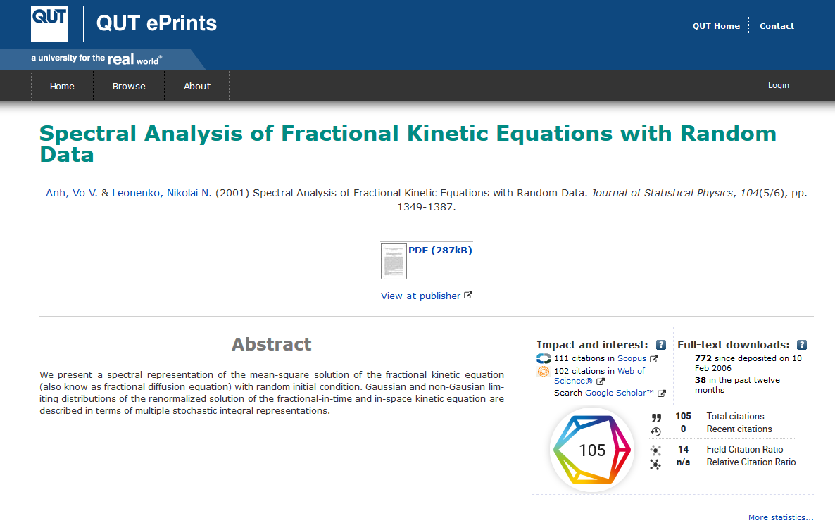
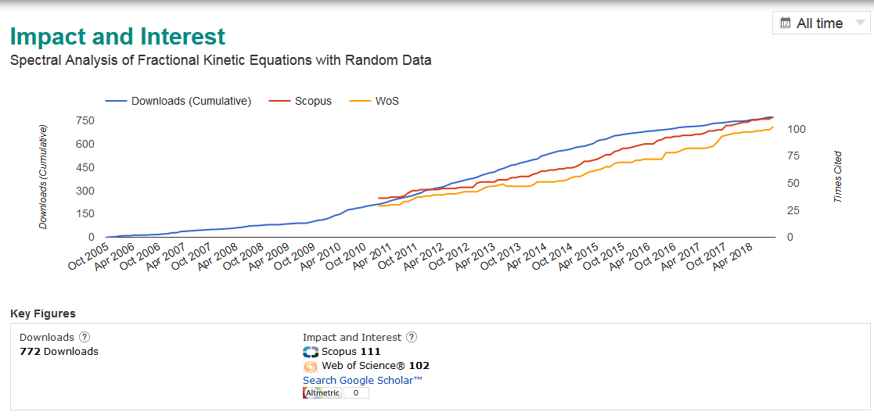
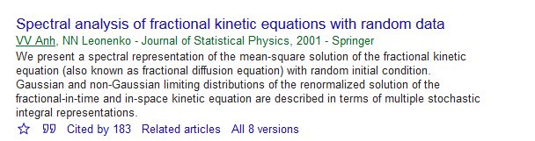
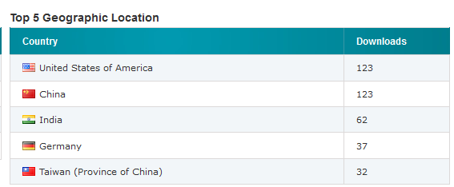
Example: importance of gathering information from various tools

Slide 22
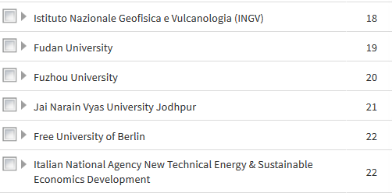
Cited by Industry entities

Slide 23
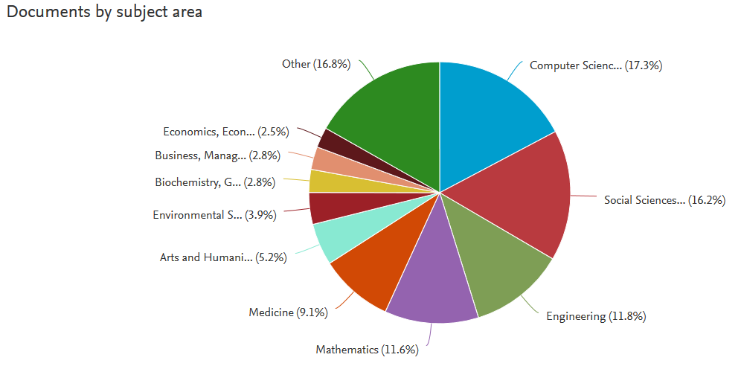
Demonstrating multidisciplinarity

Slide 25
Knowledge transfer and commercialization: Channels
Publishing | Most traditional and widespread mode of transmission of knowledge; mostly limited to published papers
Conferencing, networking | Professional conferences, informal relations, casual contact and conversations are among the channels ranked as most important by industry; important across sectors
Collaborative research and research partnerships | Situations where scientists and private companies jointly commit resources and research efforts to projects; research carried out jointly and may be co- funded (in relation to contract research); great variations (individual or institutional level); these range from small-scale projects to strategic partnerships with multiple members and stakeholders (i.e. public-private partnerships [P/PPs])
Contract research | Commissioned by a private firm to pursue a solution to a problem of interest; distinct from most types of consulting; involves creating new knowledge per the specifications or goals of client; usually more applied than collaborative research
Academic consulting | Research or advisory services provided by consulting researchers to industry clients; most widespread activities - yet least institutionalised-in which industry and academics engage; three different types: research-, opportunity - and commercialisation-driven consulting; important to industry, which usually does not compromise university missions
Industry hiring, student placement | Major motivations for firms to engage in industry-science linkages with main benefit for universities; occurs through (e.g.) joint supervision of theses, internships, or collaborative research
Patenting and Licensing | Ranked among the least important channels by both industry and researchers; substantial attention both in academic literature and among policy makers; little transfer of tacit knowledge
Public research spin-offs | Received substantial attention, although a rare form of spin-offs "entrepreneurship" compared to alumni and student start-ups
Personnel exchanges/ intersectoral mobility | May take many forms; usually university or industry researchers spending time in the alternate settings; most important form of "personnel mobility" is employment by industry
Standards (Box 1.1) | Documents based on various degrees of consensus; at least as important as patents as a knowledge transfer channel
Source: OECD, 2013, Commercialising Public Research: New Trends and Strategies, “Table 1.1. Summary of selected knowledge transfer and commercialisation channels”, p. 20

Slide 26
Identifying engagement indicators: Channels & Metrics
Engagement beyond academia
The interaction between researchers and research organisations and their larger communities/industries for the mutually beneficial exchange of knowledge, technologies and methods, understanding and resources in a context of partnership and reciprocity
Repeat business with end-user
Number of contracts, time period and dollar value
Internships involving students and/or researchers
Sponsored positions; Chairs, Fellowships, etc
Industry Adjuncts or Industry HDR Supervisors
Projects with income from HERDC Categories 2–4
Hosting conferences, symposia, colloquia, workshops
Industry partners on formal projects
Membership – Boards, government committees etc
Appointment of staff to commissions, enquiries etc
Professional education – both in formal award programs and in continuing education programs
Adviser appointments
Appearance as expert witness
Contribution to parliamentary or other democratic debate
Use in scrutiny or audit processes, such as Select Committees
Policy Briefings
Esteem measures - Non-academic prizes and awards for research
Public lectures incl. reference to your research, seminars, open days, school visits
Resources sharing (professional education, SSRN, and open repositories)
Media coverage (TV, Radio, Newspapers, Online) incl. quotes and secondary reach
Social media – followers, influence of followers, Trending, Blog mentions
Engagement with citizens abroad incl. reference to your research
Presentations to practitioner communities incl. quotes and secondary reach
Contribution to parliamentary or other democratic debate incl. quotes and secondary reach
Policy Briefings incl. quotes and secondary reach
Practitioner publications incl. quotes and secondary reach
http://www.arc.gov.au/sites/default/files/filedepot/Public/ARC/consultation_papers/ARC_Engagement_and_Impact_Consultation_Paper.pdf

Slide 27
Searching for citations in grey literature
Standards
Webinars
Videos
Committee reports
Working papers
Speeches
Company reports
Expert witness
Policy
Patents
For more see Becker model & EPSRC
https://epsrc.ukri.org/newsevents/pubs/puremathsengagementworkshopreport https://becker.wustl.edu/sites/default/files/becker_model-reference.pdf
Workflows
Protocols
Procedures
Guidelines
Curriculum
Hansard
Government reports
Changing the national discourse
Submissions to inquiries
Grey Literature definition as on the International Conference on Grey Literature, Luxembourg, 1997, expanded 2004)
http://apo.org.au/resource/where-evidence-realising-value-grey-literature-public-policy-and-practice
Notes:
Fragments – document delivery, library will pay
http://greynet.org/home.html
Datasets – an asset that may be shared and may be linked to further value/impact
Grey literature: where the producing body's primary activity is not publishing

Slide 28
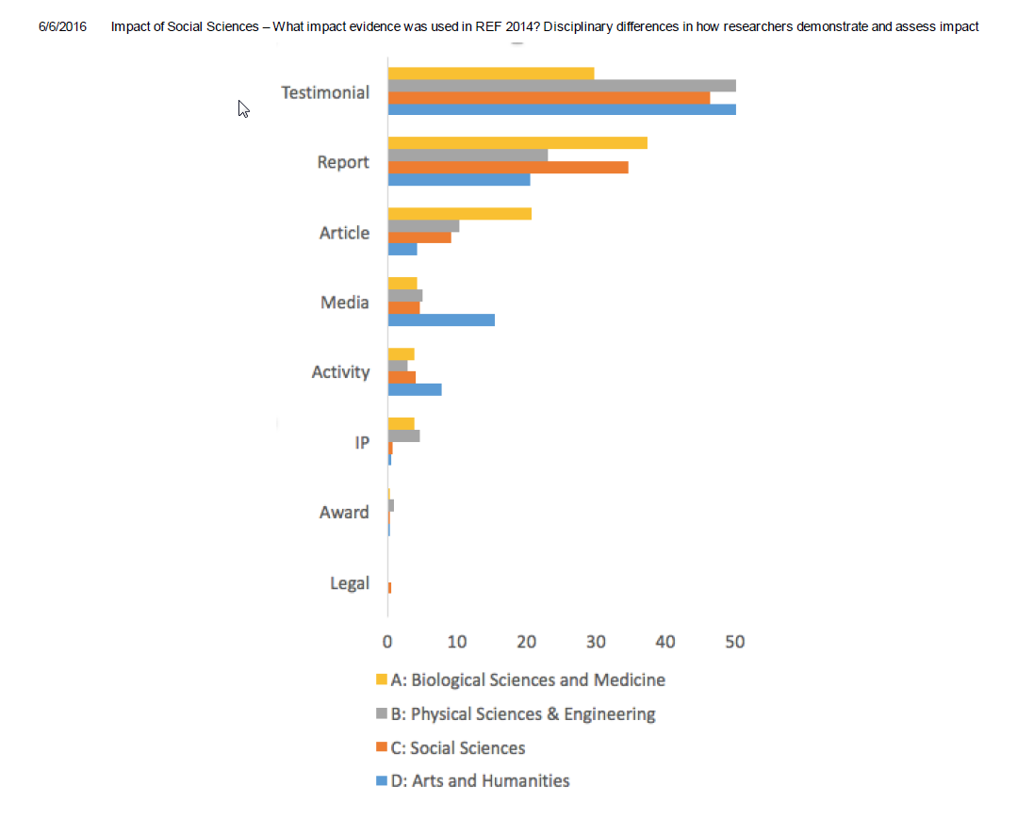
Evidence types used for REF
http://blogs.lse.ac.uk/impactofsocialsciences/2016/04/04/what-impact-evidence-was-used-in-ref-2014
Notes:
Audit trail
Stakeholder information
Testimonials
Online traffic
Positions of responsibility
Source: Loach, Tamar; Adams, Jonathan; Szomszor, Martin (2016): Digital Research Report: The Societal and Economic Impacts of Academic Research – International perspectives on good practice and managing evidence. Digital Science. figshare. https://dx.doi.org/10.6084/m9.figshare.3117928.v2
Science, Digital; Loach, Tamar; Adams, Jonathan; Szomszor, Martin (2016): Digital Research Report: The Societal and Economic Impacts of Academic Research - International perspectives on good practice and managing evidence. figshare.
https://dx.doi.org/10.6084/m9.figshare.3117928.v2 Retrieved: 00 47, Jun 07, 2016 (GMT)

Slide 29
Searching for Evidence: Tools
Google search and Google Advanced Search (e.g. within gov.au or edu.au domain etc): demonstrating diversity of end-user engagements
Social media citations: Altmetrics Explorer (Social Media), QUT ePrints downloads, Publisher web-sites downloads, Conversations analytics, Google Analytics, Wikipedia etc
Australian professional and practitioner journals and magazines: Informit database from QUT Library
Traditional Media: Newspapers and current affairs databases from QUT Library & News aggregators
Radio, documentaries, TV (with readership or coverage statistics)
Research non-patent citations in patents (the Lens)
Standards references
APO Australian Policy Online, Policy International
Hansard and transcripts of Committees hearings and other government documents incl. reports
Apply to government departments – document delivery
Testimonials: often harder to find – may need to contact your source directly
Internet archive: Way back machine, PandoraTrove
Notes:
APO – fact = $ AUD 30 billion on projects that produce grey literature in Australia – undiscoverable. No standardized method not made use of, invisible and not curated
27th April 2016
http://theconversation.com/how-australia-produces-30-billion-worth-of-grey-literature-that-we-cant-read-56584
Australia spends more than $30 billion a year on projects which produce “grey literature” - documents which are produced by government departments, academic institutions, private companies and more. But despite all this effort, Australia lacks a standardised mechanism to curate and freely distribute grey literature

Slide 30
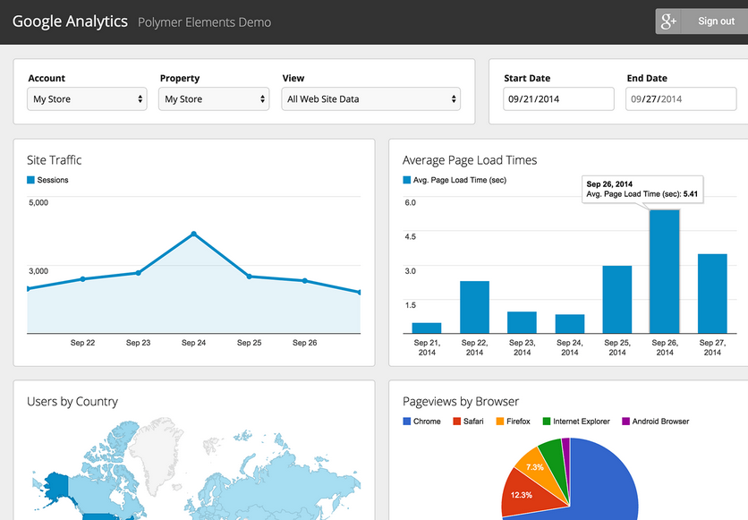

Slide 31
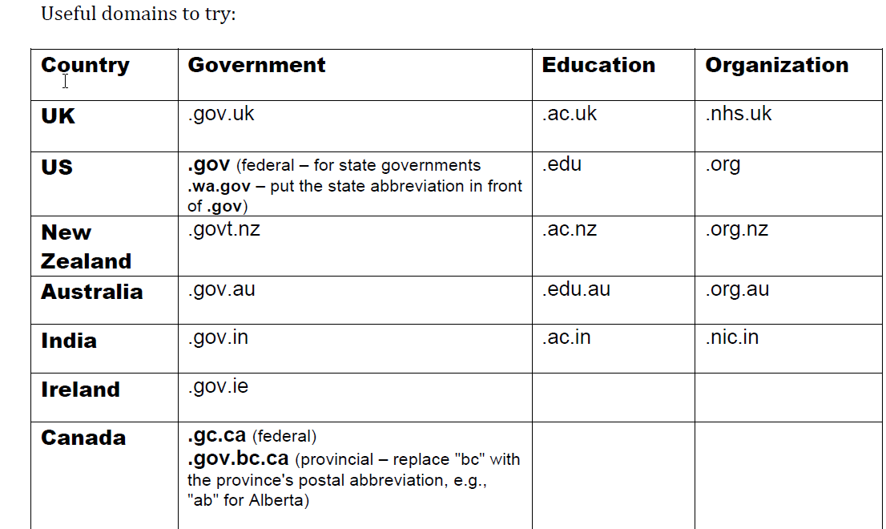
Google: Advanced search

Slide 32
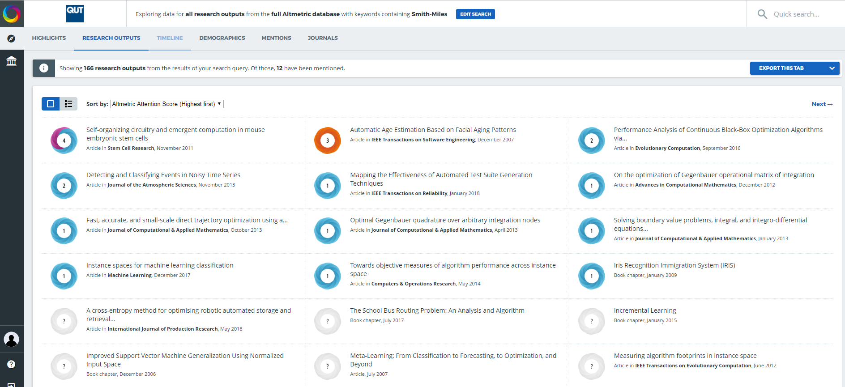
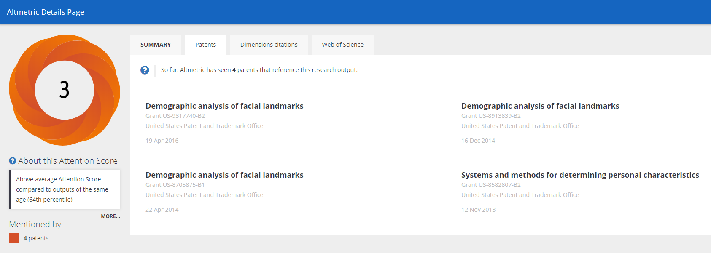
Alternative metrics or altmetrics
[A]ltmetrics is the creation and study of new metrics based on the Social Web for analysing, and informing scholarship
http://altmetrics.org/about/
https://www.altmetric.com/explorer/outputs?q=Smith-Miles&scope=all

Slide 33
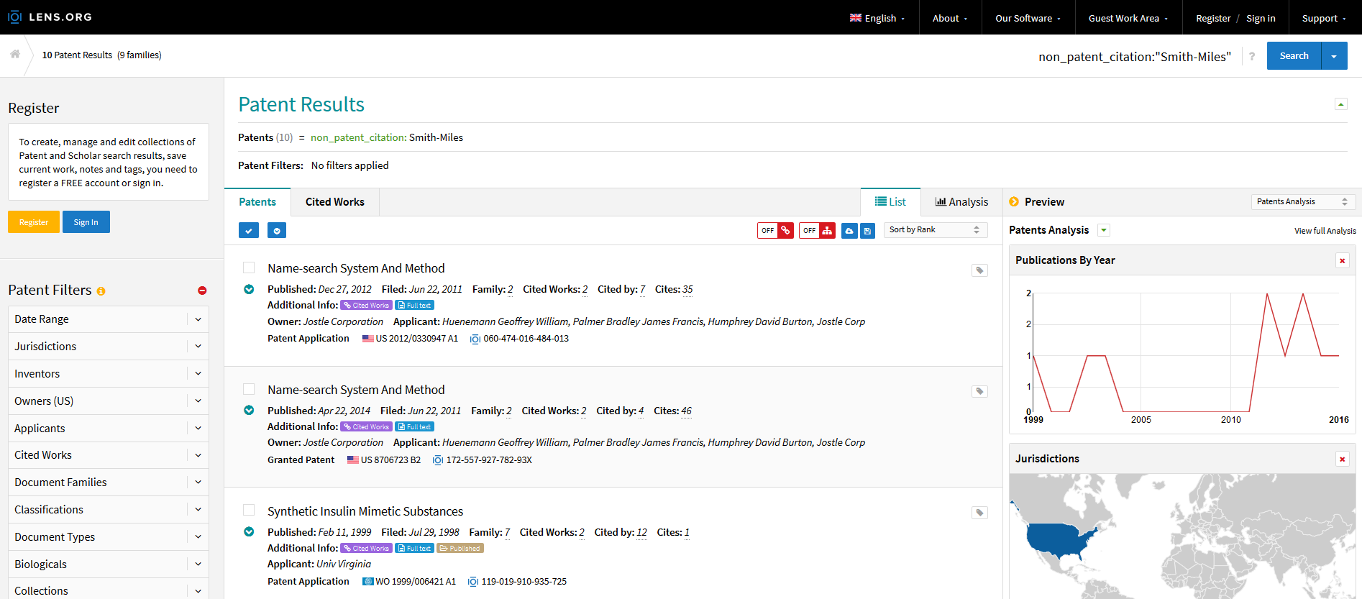
Citations to scientific studies in patents

Slide 34
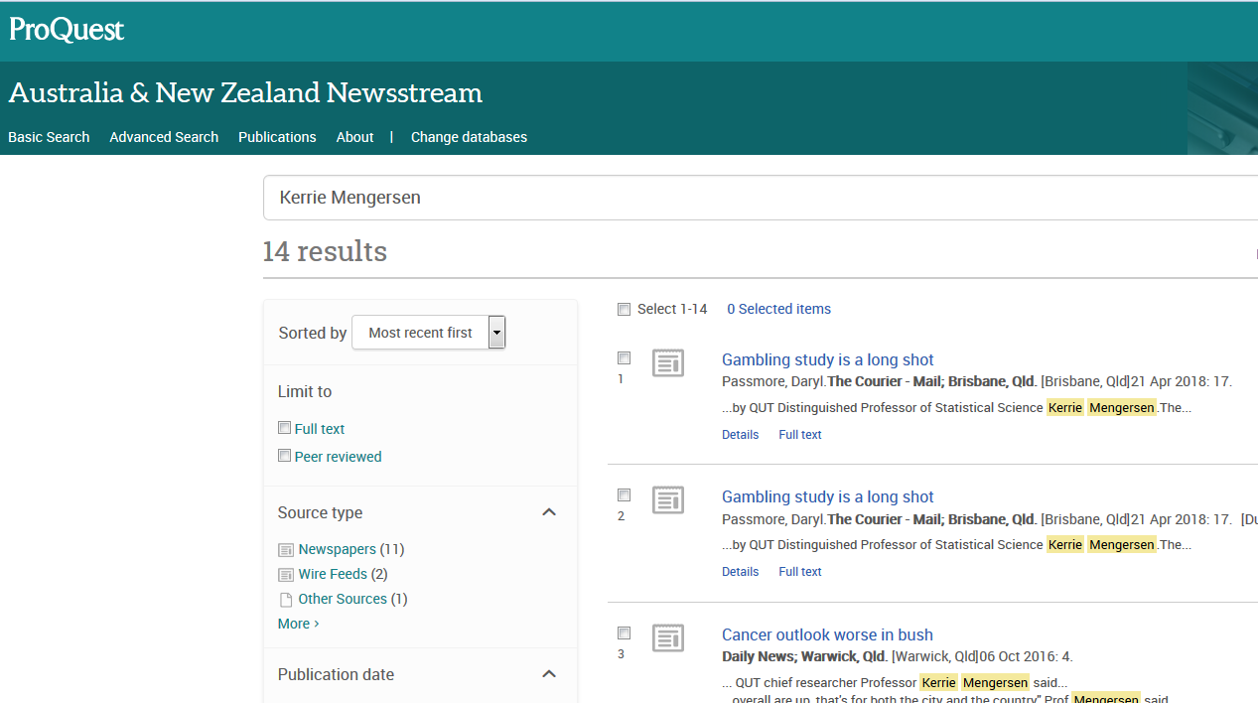
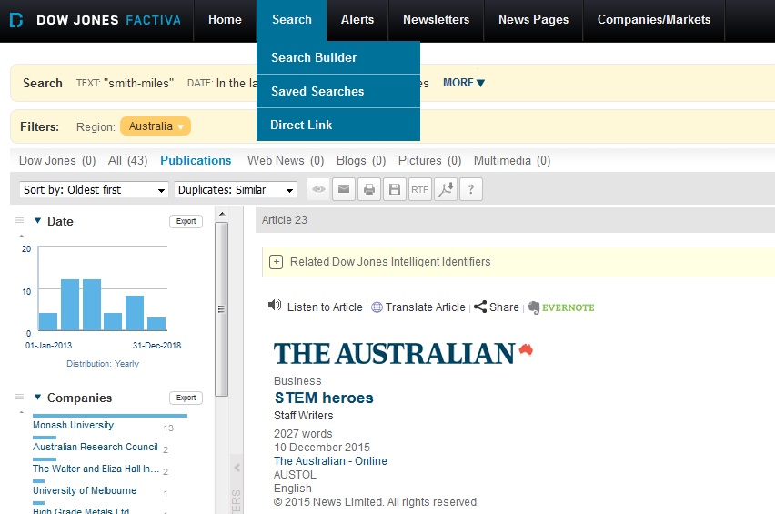
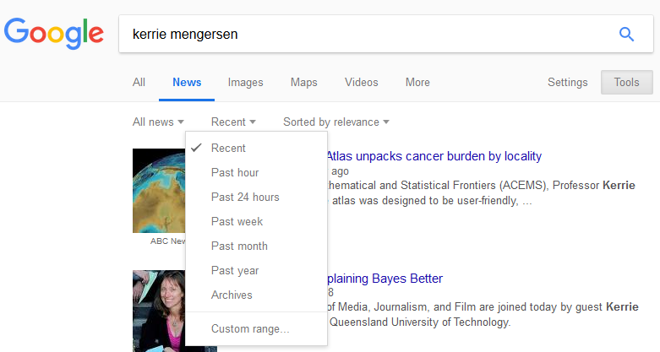
Monitoring of research studies or expert opinions in newspapers

Slide 35
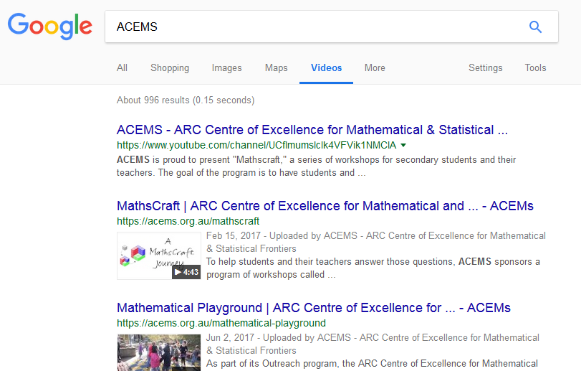
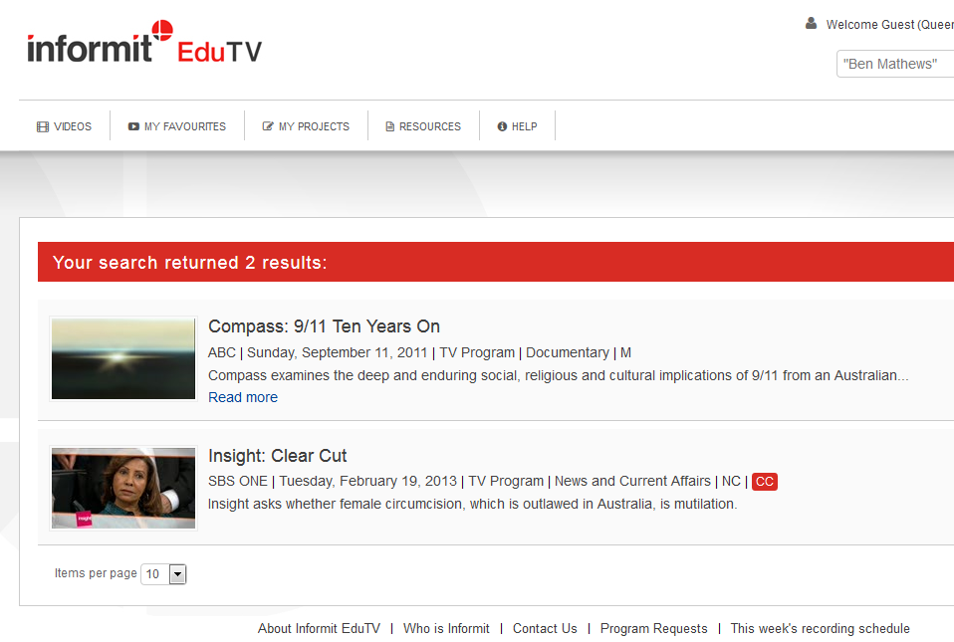
Mentioning of opinions or studies in TV programs

Slide 36
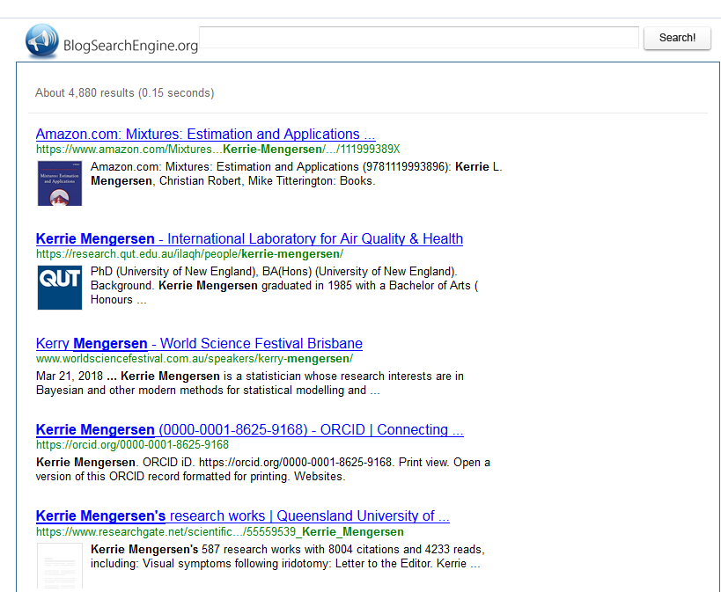
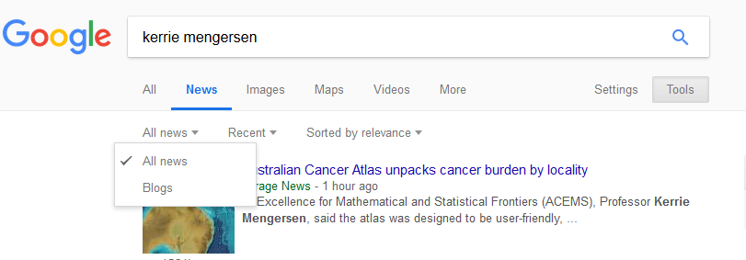
Citations to scientific studies and expert opinions in blogs: examples of presence in social media

Slide 37
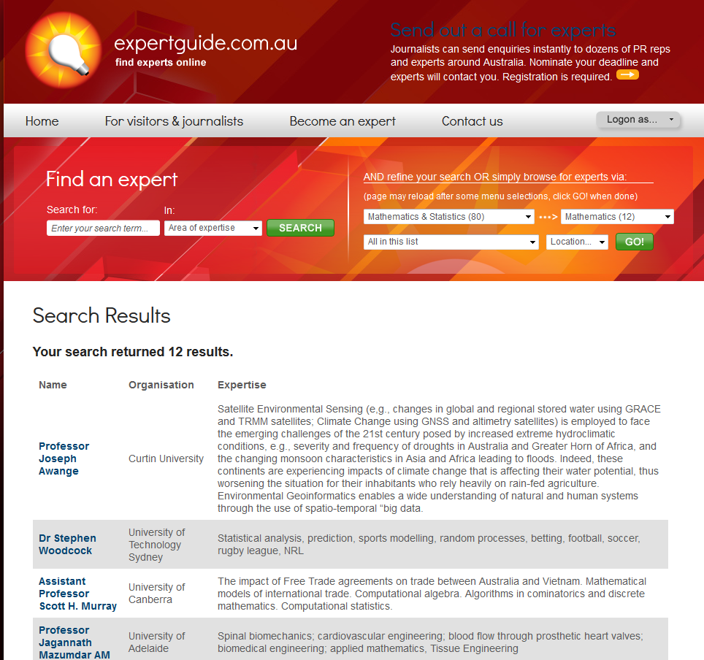

Slide 38
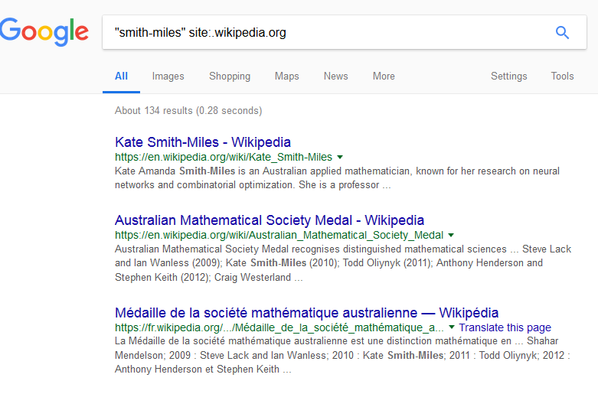
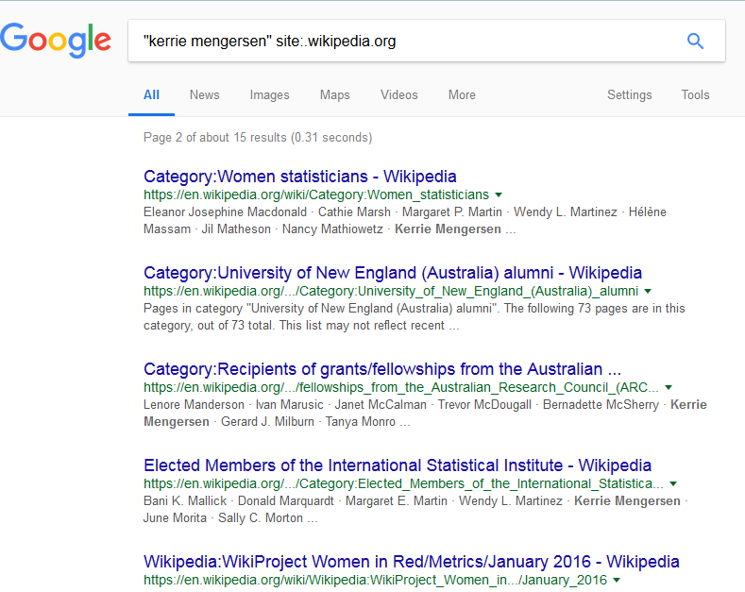
Wikipedia

Slide 39

Datasets (a quick aside…)
Reuse of data for new purposes
Brisbane taxi dataset used by CARRSQ to look at driver behaviour reused by the Smart Transport Group to look at traffic flow
Data on kangaroos that collected was reused to research climate change as weather had also been recorded
What data was re-used? What data could you use? And share?

Slide 40
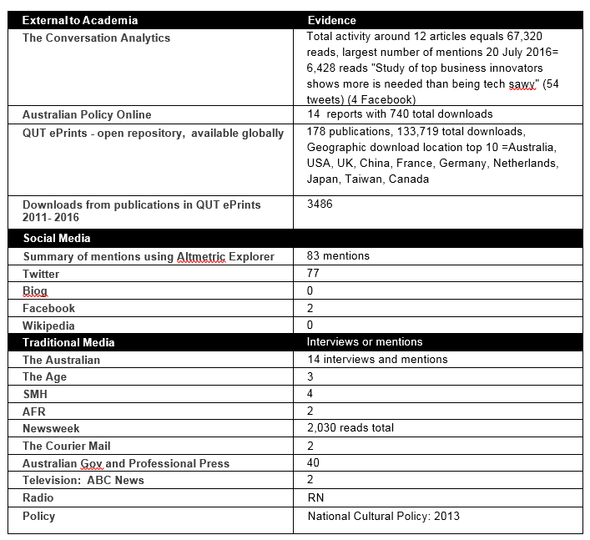
Example

Slide 41
Tools to Increase your Impact
Research Staff profiles (tag publications for RAD)
Google Scholar Citations
Expert guide
LinkedIn
ORCID
Researcher ID
Scopus Author ID
Open Access: Add the final accepted version to QUT ePrints
Blog/Twitter/Wikipedia your publications
YouTube videos
Google Analytics

Slide 42
Using social media to promote your work
An informal study suggests that blogging or tweeting about your publications, with a link to open access full text copies will increase downloads (& hopefully citations over time) http://blogs.lse.ac.uk/impactofsocialsciences/2012/04/19/blog-tweeting-papers-worth-it/

Slide 43
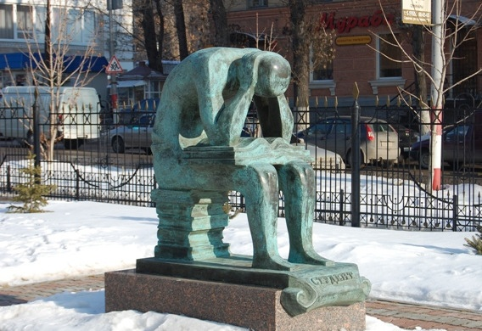
More help
Librarians
https://www.library.qut.edu.au/about/contact/liaisonlibrarians.jsp

