Slide 1
ACEMS
Demonstrating impact : experience with QUT E&I Assessment Impact Case Studies & preparing for the future
Janet Baker, Library
j2.baker@qut.edu.au

Slide 2
National Innovation and Science Agenda
Engagement and Impact Assessment (E&I)
Translation of research to end user “change”
Measures significance and reach
To run alongside traditional methods of measuring impact i.e. ERA
ERA – quantitative, citations, income and peer review
E&I – narrative about real change : must establish clear link to end user behavior change or policy decision-making
Notes:
https://qutvirtual4.qut.edu.au/group/staff/research/research-impact

Slide 3
Engagement and Impact Assessment 2018
What : Each 2 digit FoR code( except 07) plus Indigenous plus one Interdisciplinary case study
In tota; QUT submitted
22 Impact Case Studies,
20 Engagement Narratives,
22 Approach to Impact Statements
When: Submission started 15th June , Deadline 6th July,
Results will come late 2018 / early 2019

Slide 4
Notes:
QUT does not offer Field of Research Codes 21 for History, Archaeology, and 22 for Philosophy and Religious Studies

Slide 5
A good impact narrative
Examples in Impact Case Studies REF 2014
Best style – writing for educated end user, not for specialized knowledge level( so what factor = very important) for example – ‘Myopia ( short sightedness) currently affects about 5 million Australians and about 1 Billion of the worlds population.”
Sate the problem - in first sentence
The research (in language for end user) how does it connect
Describe those connections with end-users that relate to an indicator i.e. indicators approved by ARC e.g. income, co supervisions, standards, commissioned reports, projects generated, HDR completions.
Be clear who benefitted; the nature, extent, reach, and significance
Explain anomalies – e.g. change of regulations, other dynamics over the course of time
Be aware this information potentially will be publically available.

Slide 6
Good narrative - lessons from 2018
Employing writers ? – not at QUT
Case study not included if risk to commercial in confidence
Careful not to include aspirational claims
Impact has to be in the reference period
Clarity, don’t overstate the contribution
Framework = 1.Summary 2. Details 3. Associated research pathways/approaches to impact ( plus data and engagement statement from ERA) note character restrictions.

Slide 7
Your opportunity
Explain data – what is missing, what were the priorities, what was in development, transition, how was funding/collaborations shaped
How is the subject area developing i.e. strategy
Explain the use of income
Should match other statements
Most important -Tell the story of the ERA outputs

Slide 8
There are 4 reports required from QUT for each code
Engagement Narrative
Engagement Indicator Explanatory Statement ( explaining Category 2-4 grant research income, Linkage, CRC and how this relates to end-user engagement)
Impact Case Study
Approaches to Impact

Slide 9
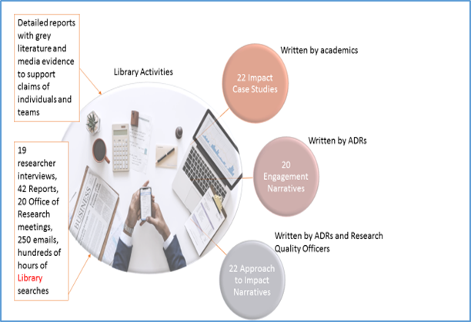

Slide 10
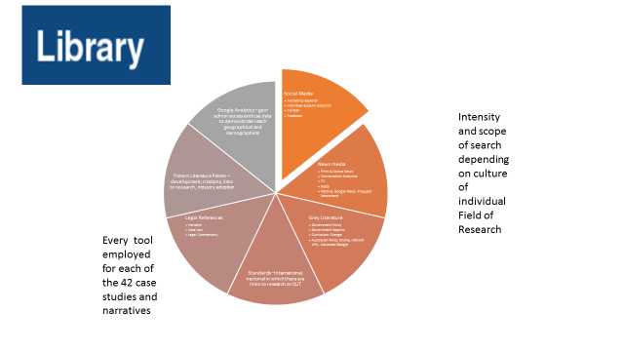
Establishing clear link with end user

Slide 11
Rating Scales
E&I 2018 uses a three-point rating scale for the engagement and impact ratings:
● High
● Medium
● Low

Slide 12
Recommendations for future
Social Media Curation Guidelines
Guidelines for archive of engagement activities
Set up analytics behind researcher twitter accounts, blogs, researcher sites
Staff changes means -engagement activities recorded with central research support
RAD storage for evidence
Guidelines for sourcing testimonials
Devise Additional Engagement Indicators

