Slide 1


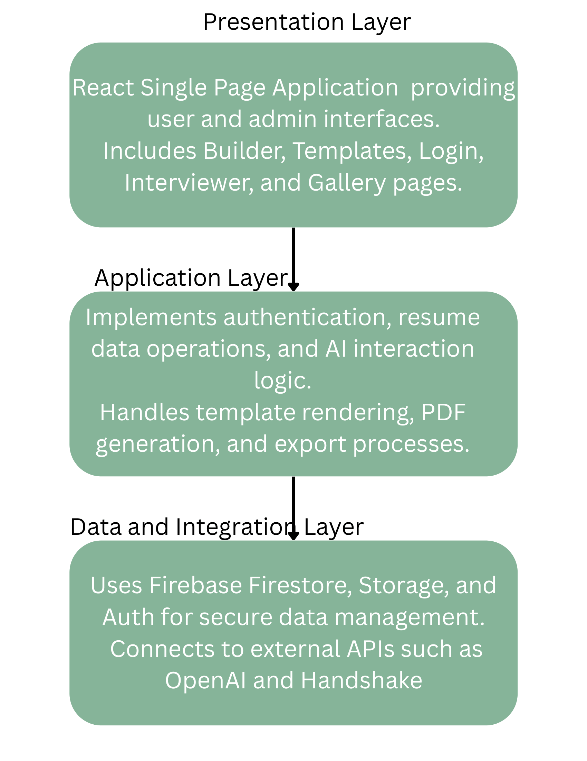
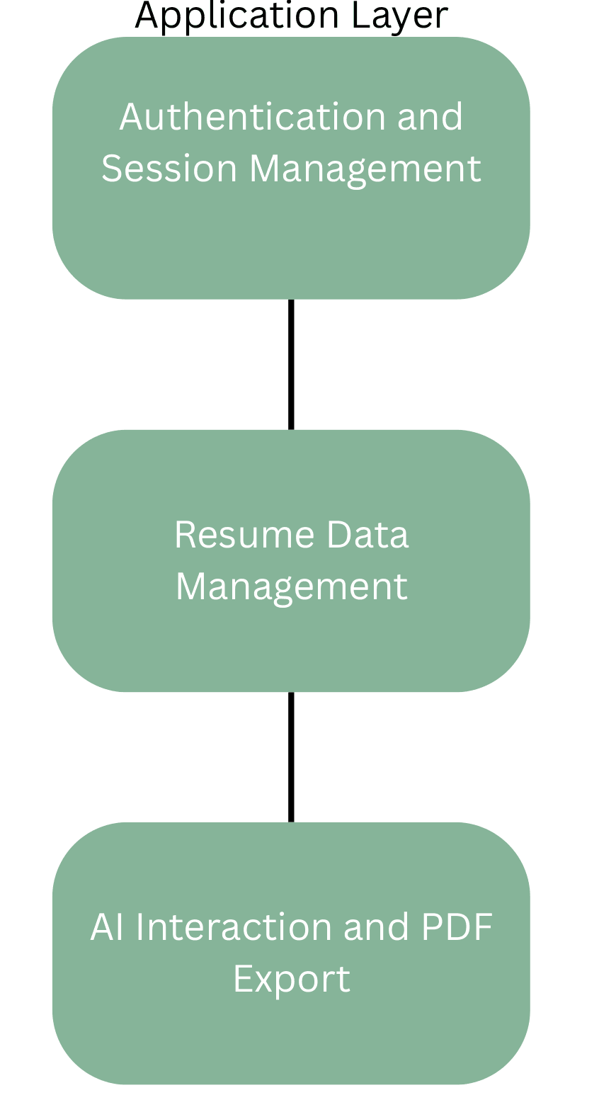
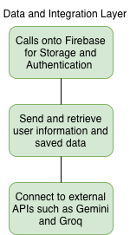

ByteBuddi: ATS-Driven Resume Builder
QR Code To Website or Paper Goes Here
Everly, Adalynn; Davis, Ryan; Salazar, Rene; Gallegos, Cesar; Acevedo, Alan; Lopez, Xavior
Advisor: Chenxi Wang
Background
Architectural Design
Applicant Tracking Systems filter resumes before human review
Many students lose visibility due to weak keyword alignment
Resume formatting and wording inconsistencies reduce match rates
ByteBuddi provides structured templates with automated ATS keyword feedback
Goal: improve resume-job alignment using an AI-driven analysis pipeline
Presentation Layer
React frontend UI
Resume builder and template gallery
ATS feedback visualization
AI chat roo, visuals
Cloud & Data Layer
Firebase Authentication
Firestore database
Cloud hosting environment
Application Layer
Resume parsing logic
Keyword extraction and matching engine
ATS scoring algorithm
AI chat-bot system
External Integration
Groq API for keyword analysis
Google Gemini 2.5 for AI Interviewer
Figure 2. Three layer architecture overview.
Figure 3. System data flow and integrations.
Figure 4. Data and integration layer details.
Implementation Details and Test Plan
Figure 1. ByteBuddi resume workflow with templates and ATS feedback.
Tech Stack
React (SPA frontend)
Node.js / Express backend
Firebase (Auth, Firestore, Storage)
Groq API for ATS keyword analysis
Gemini 2.5 API for AI interviewer
Core Implemented Features
User authentication and session handling
Resume CRUD operations
Template rendering engine
ATS scoring and keyword feedback
AI Interviewer chat system
PDF export generation
Mobile responsive layout
Key Requirements
Functional Requirements
Secure user authentication and persistent data storage
Resume creation, editing, and PDF export
Template selection and live preview
ATS keyword extraction and scoring
Job description comparison workflow
Non-Functional Requirements
Cross-browser compatibility
Mobile responsiveness
Cloud deployment stability
CI/CD integration
Reliable API communication
Table 1. Test categories applied across ByteBuddi
Conclusions and Future Work
References
Conclusions
End-to-end resume workflow fully operational
ATS engine produces scores and keyword feedback
System validated across desktop and mobile
Future Work
Mobile UI polish
Stronger semantic keyword matching
Expanded user testing
Groq API Docs: https://console.groq.com/docs ​
Firebase Auth State Persistence: https://firebase.google.com/docs/auth/web/auth-state-persistence ​
Cloud Firestore Docs: https://firebase.google.com/docs/firestore/query-data/get-data ​
Firebase Hosting Docs: https://firebase.google.com/docs/hosting ​
React Docs: https://react.dev ​
React Router Docs: https://reactrouter.com/en/main
Google Gemini 2.5 Docs: https://ai.google.dev/gemini-api/docs/models/gemini-2.5-flash
April 2026

