Slide 1




A Simulation Framework for the Multi-Period Vehicle Routing Problem with Profits in Smart Waste Collection
Afonso Cruz Fernandes¹
with Héctor Bonilla-Londoño², Diana Jorge², Manuel Lopes¹, Pedro A. Santos¹, Tânia Ramos²
¹ INESC-ID, Instituto Superior Técnico, University of Lisbon · ² CEGIST, Instituto Superior Técnico, University of Lisbon

Slide 2
Agenda
Introduction: Problem and Objective
Route Improvers
1
5
Simulator Overview
Experimental Methodology
2
6
Mandatory Node Selection Strategies
Experimental Results
3
7
Route Constructors
Conclusions & Limitations
4
8

Slide 3
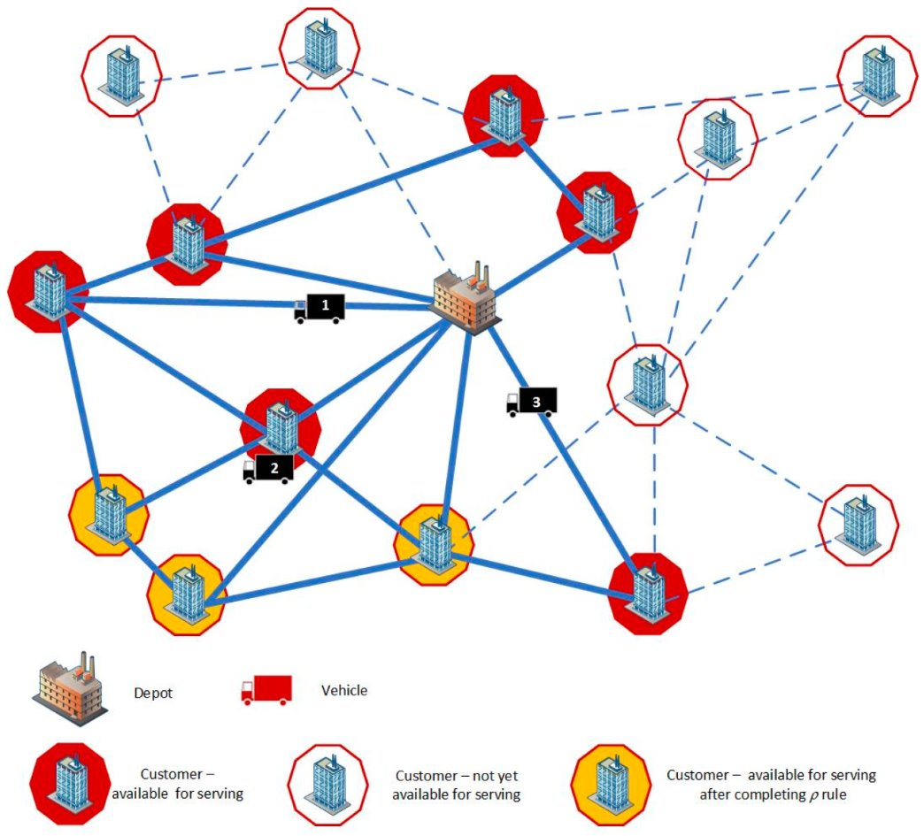
The Problem: Vehicle Routing Problem with Profits (VRPP)
Bin fill w_i,d accumulates stochastically (rate δ) and resets on a visit. Daily profit P nets collected-waste revenue r_w against travel cost c_km along the chosen route A_d. The policy π must maximise the expected profit summed over the full D-day horizon.
Notes:
Objective: maximise collected profit minus travel cost, choosing which nodes y to visit and how x routes them, subject to the vehicle capacity Q.

Slide 4
Objective: Build a simulator to test different algorithms
One framework to compare them all
Exact Methods
One Shared Simulator
Multi-day simulator: region × graph size × demand distribution
Fair Benchmarks (KPIs)
Meta-Heuristics
Hyper-Heuristics
Exact Methods
Meta-Heuristics
Hyper-Heuristics
BPC
HGS
ACO-HH
ALNS
SANS
SWC-TCF
PG-CLNS
PSOMA

Slide 5


Routing Simulator Philosophy — Modular Policy Pipeline
Mandatory bin
selection strategy
Route
constructor
Acceptance criterion
(optional)
Route improver
(optional)
LA · LM · SL
which bins today?
exact · meta-h. · hyper-h.
build the routes
constructor-dependent
e.g. BMC, OI
CLS · FTSP
post-optimisation
30%
30%
87%
87%
80%
80%
60%
55%
60%
55%
50%
50%
42%
20%
42%
20%

Slide 6
Big Picture: Policy Configuration Space
Mandatory Selection
Route Constructor
Route Improver
Look-Ahead (LA)
Exact Methods
BPC · SWC-TCF
Fast-TSP
Last-Minute (LM, CF70)
Meta-Heuristics
HGS · ALNS · SANS · PG-CLNS · PSOMA
Last-Minute (LM, CF90)
Local Search (CLS)
Service-Level (SL1)
Hyper-Heuristics
ACO-HH
Service-Level (SL2)
Figure 2: Every simulated policy is one path through the three columns: a mandatory selection strategy, a route constructor (exact / meta-heuristic / hyper-heuristic) and an optional route improver.

Slide 7
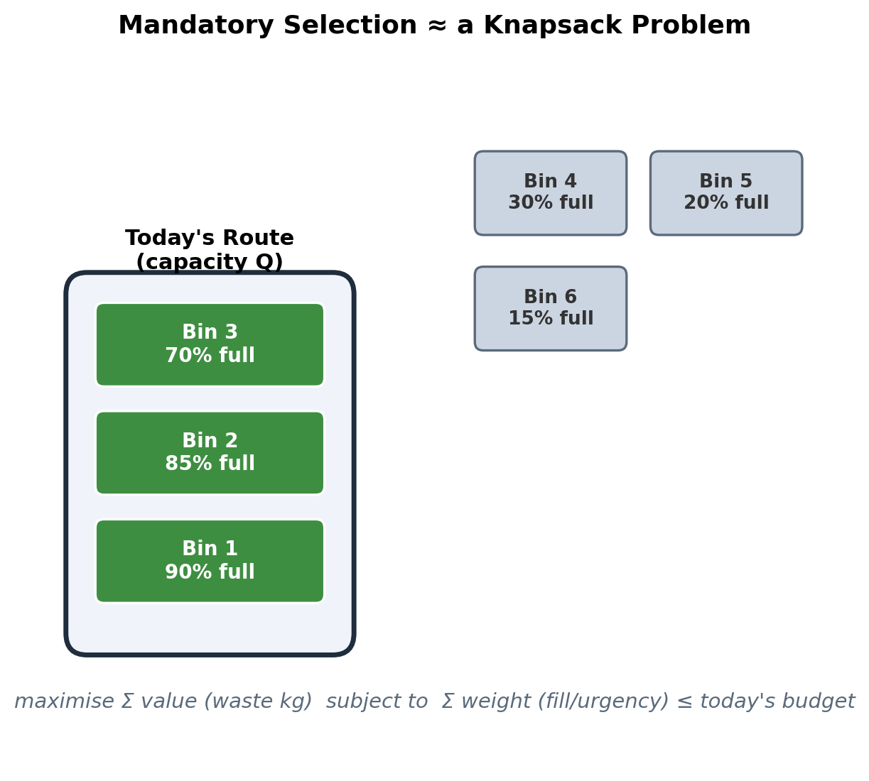
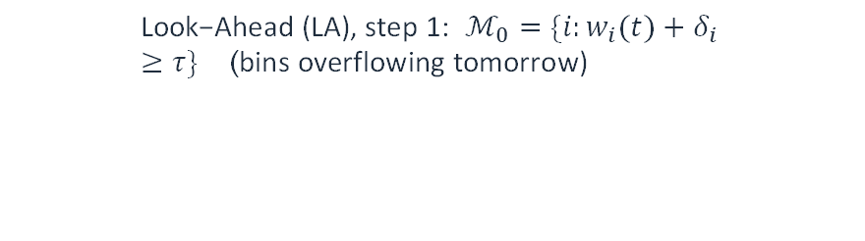
Mandatory Node Selection Strategies
$$\text{Look}\text{−}\text{Ahead}\text{ (}\text{LA}\text{), }\text{step} \text{1}\text{:} ℳ_{0}=\{i:w_{i}(t)+δ_{i}≥τ\} \text{(}\text{bins} \text{overflowing} \text{tomorrow}\text{)}$$
$$\text{Look}\text{−}\text{Ahead}\text{ (}\text{LA}\text{), }\text{step} \text{2}\text{:} \text{bundle} i∉ℳ_{0} \text{too} \text{if} \text{it} \text{would} \text{overflow} \text{before} ℳ_{0}\text{’}\text{s} \text{next} \text{collection}$$
$$\text{Service}\text{−}\text{Level}\text{ (}\text{SL}\text{):} w_{i}(t)+\overset{‾}{δ_{i}} n+z_{α} σ_{i} n ≥ τ ⇒ \text{collect}$$
$$\text{Last}\text{−}\text{Minute}\text{ (}\text{LM}\text{):} f_{i}(t)≥CF, CF∈\{70\%, 90\%\}$$
Equation 2: Look-Ahead first flags bins that would overflow tomorrow, then simulates forward to also bundle in any bin that would overflow before that same group's next natural collection day — avoiding an extra near-term trip. Service-Level flags a bin once its n-day-ahead worst case (mean fill + z_α standard deviations) crosses capacity τ. Last-Minute simply reacts once the fill ratio f_i crosses a fixed critical threshold CF. Choosing which bins to collect today is itself a knapsack-style decision (right): pick the subset of items that best fits the day's capacity/urgency budget.

Slide 8
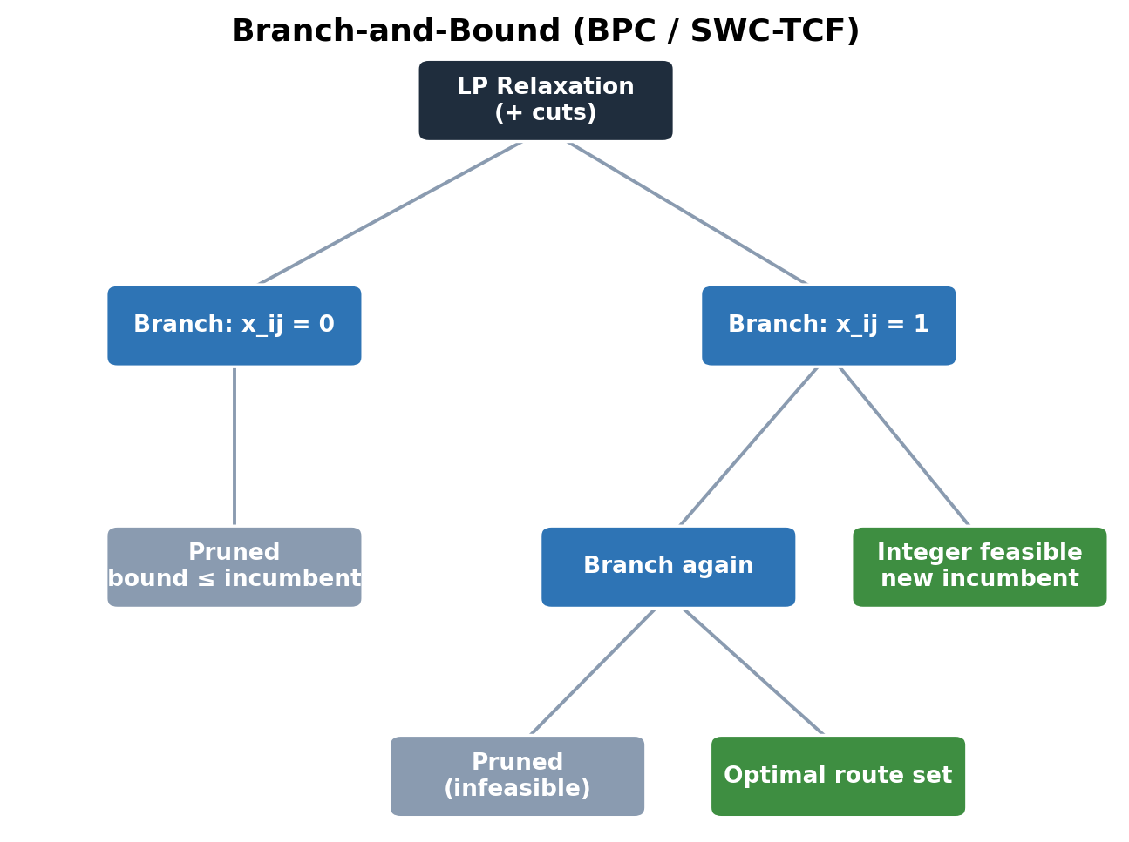

Exact Methods: BPC & SWC-TCF
$$\sum_{j}^{​}{f_{ij}}−\sum_{j}^{​}{f_{ji}}=S_{i} g_{i}, \sum_{j}^{​}{h_{ji}}−\sum_{j}^{​}{h_{ij}}=S_{i} g_{i}$$
$$f_{ij}+h_{ij}=Q x_{ij} \text{(}\text{waste}\text{ + }\text{empty} \text{space}\text{ = }\text{vehicle} \text{capacity}\text{, }\text{if} \text{arc} \text{used}\text{)}$$
$$max R\sum_{i}^{​}{S_{i}}g_{i} − 0.5 C\sum_{ij}^{​}{x_{ij}}d_{ij} − Ω k$$
$$\text{BPC} \text{master}\text{:} min\sum_{r∈Ω}^{​}{c_{r}} λ_{r} \text{s}\text{.}\text{t}\text{.} \sum_{r∈Ω}^{​}{a_{ir}} λ_{r}=1 ∀i∈V, λ_{r}∈\{0,1\}$$
Equation 3: SWC-TCF's two-commodity flow (Ramos, Morais & Barbosa-Póvoa, 2018): g_i marks a visited bin and x_ij the routing arcs; the waste commodity f_ij and the empty-space commodity h_ij are coupled to the vehicle capacity Q along every used arc. BPC instead solves a column-generation master problem (Barnhart et al., 1998): pick a minimum-cost combination of priced routes r ∈ Ω (weight λ_r) covering every node i exactly once (a_ir = 1 iff route r visits i), pricing new columns and adding cuts at every Branch-and-Bound node.

Slide 9
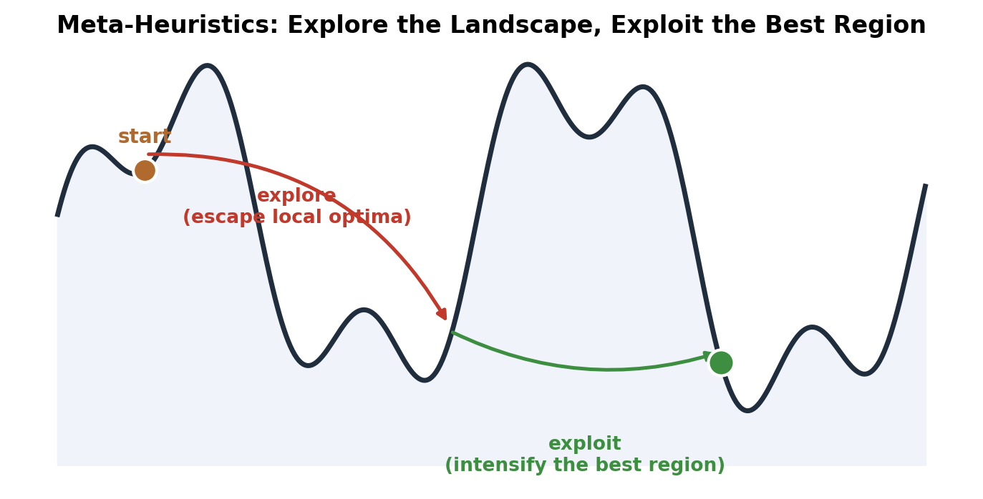
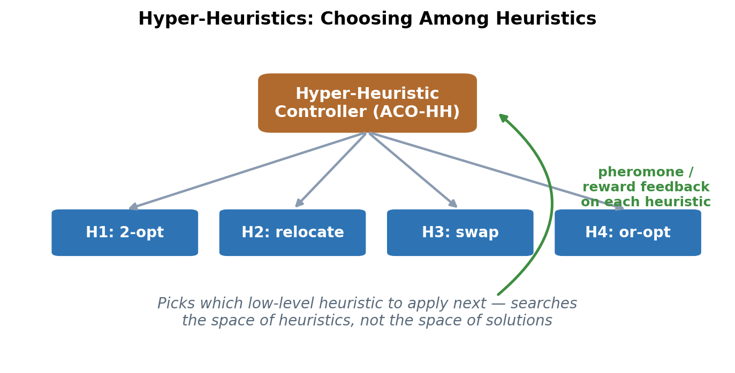
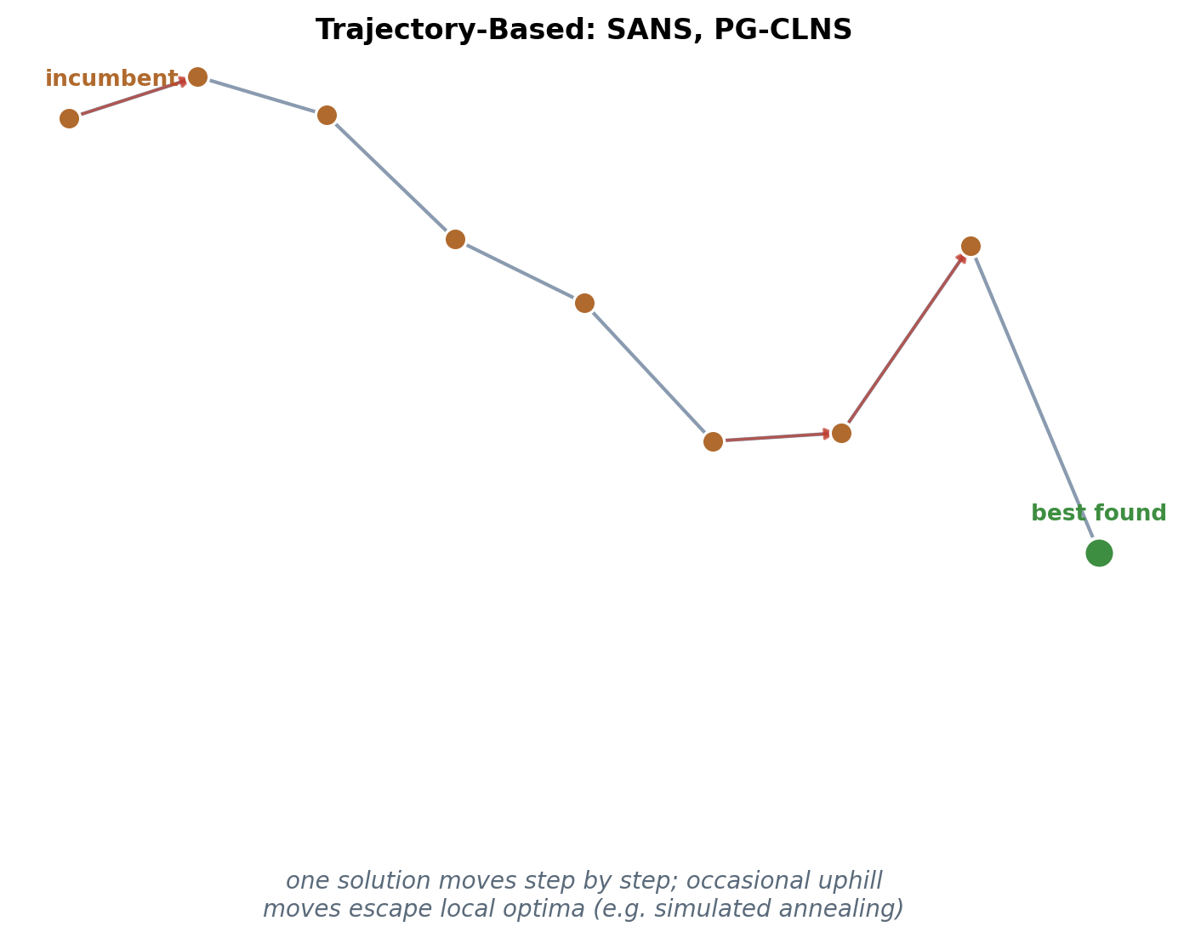
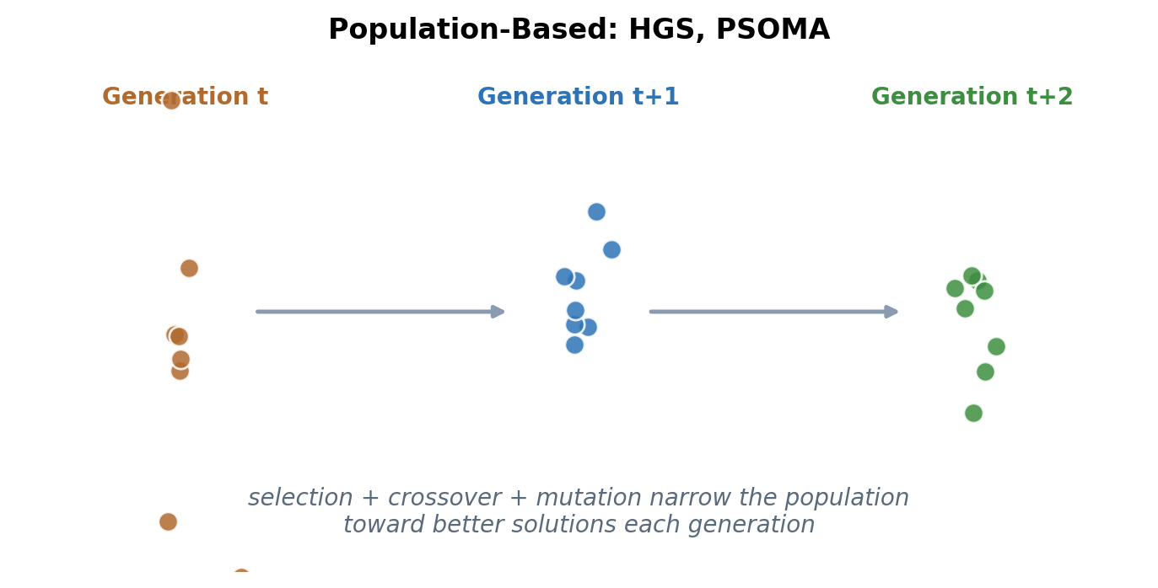
Meta-Heuristics & Hyper-Heuristics — Overarching Philosophy
Figure 3: Meta-heuristics (HGS, PSOMA, SANS, PG-CLNS, ALNS) search the solution space directly; the hyper-heuristic (ACO-HH) instead searches the space of low-level heuristics. Within meta-heuristics, trajectory-based methods refine one incumbent solution while population-based methods evolve many candidates in parallel.

Slide 10
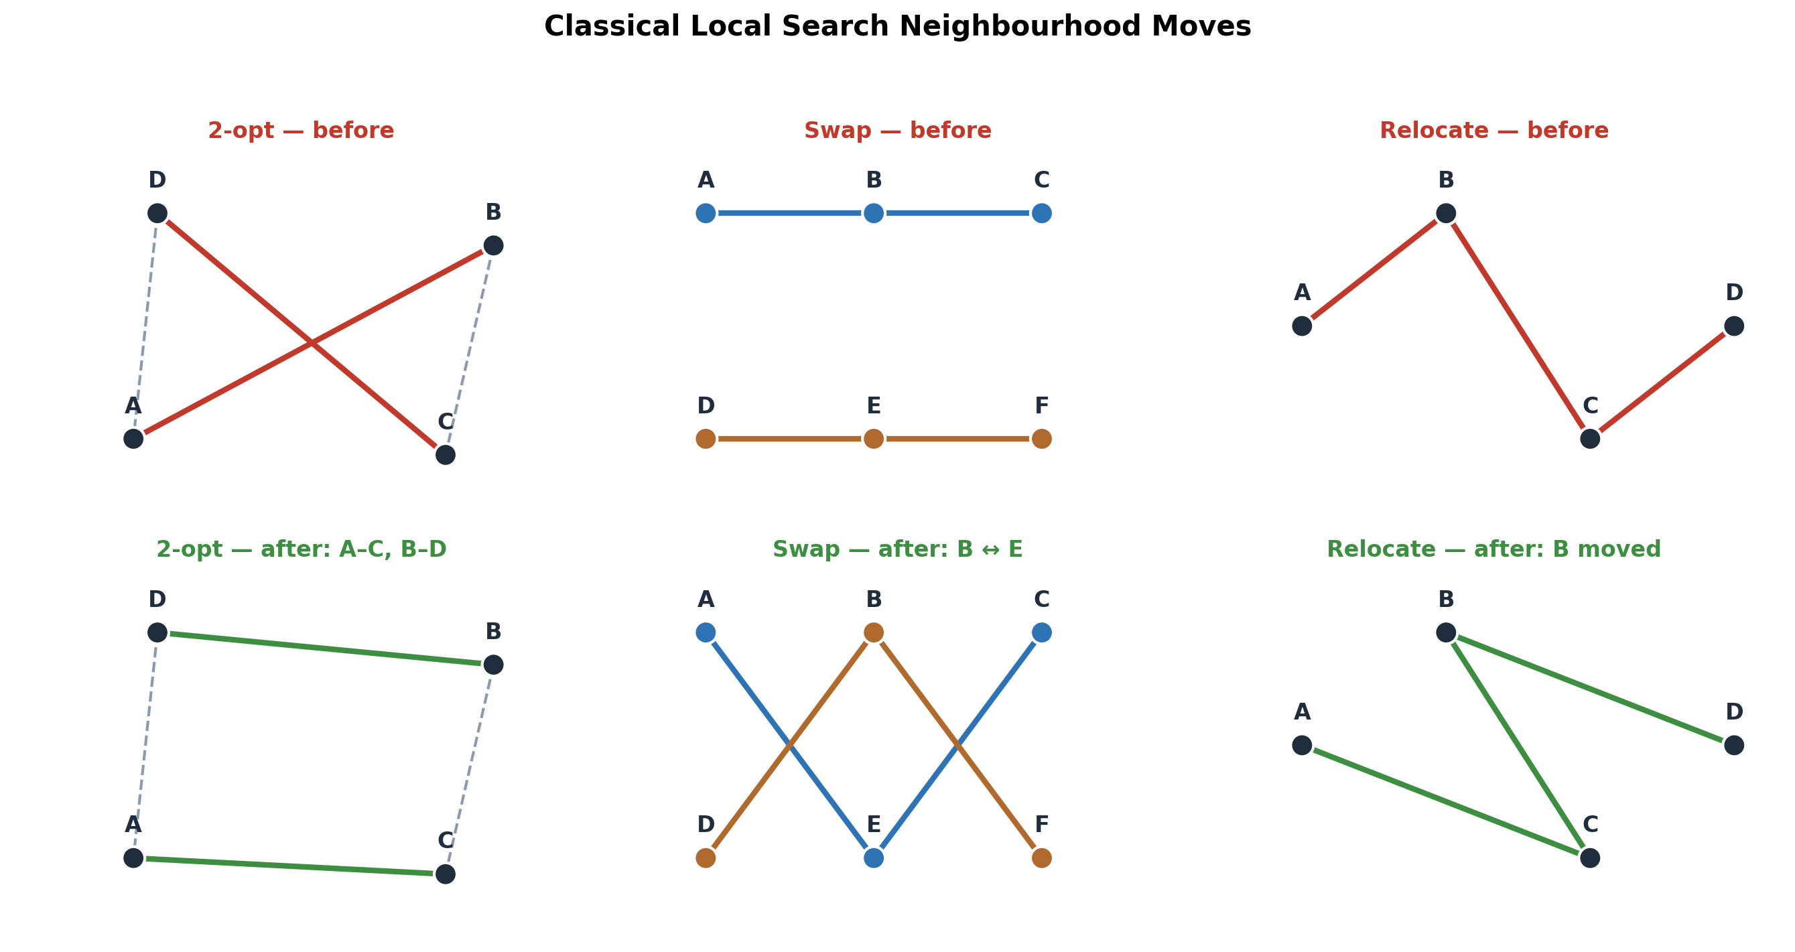
Route Improvers: Classical Local Search vs Fast-TSP
Figure 4: CLS explores several intra/inter-route neighbourhoods to a local optimum: 2-opt removes a crossing by reversing a segment, swap exchanges two nodes between routes, and relocate moves a single node to a better position. Fast-TSP applies the analogous exact/Stochastic-Local-Search reordering within each route.

Slide 11
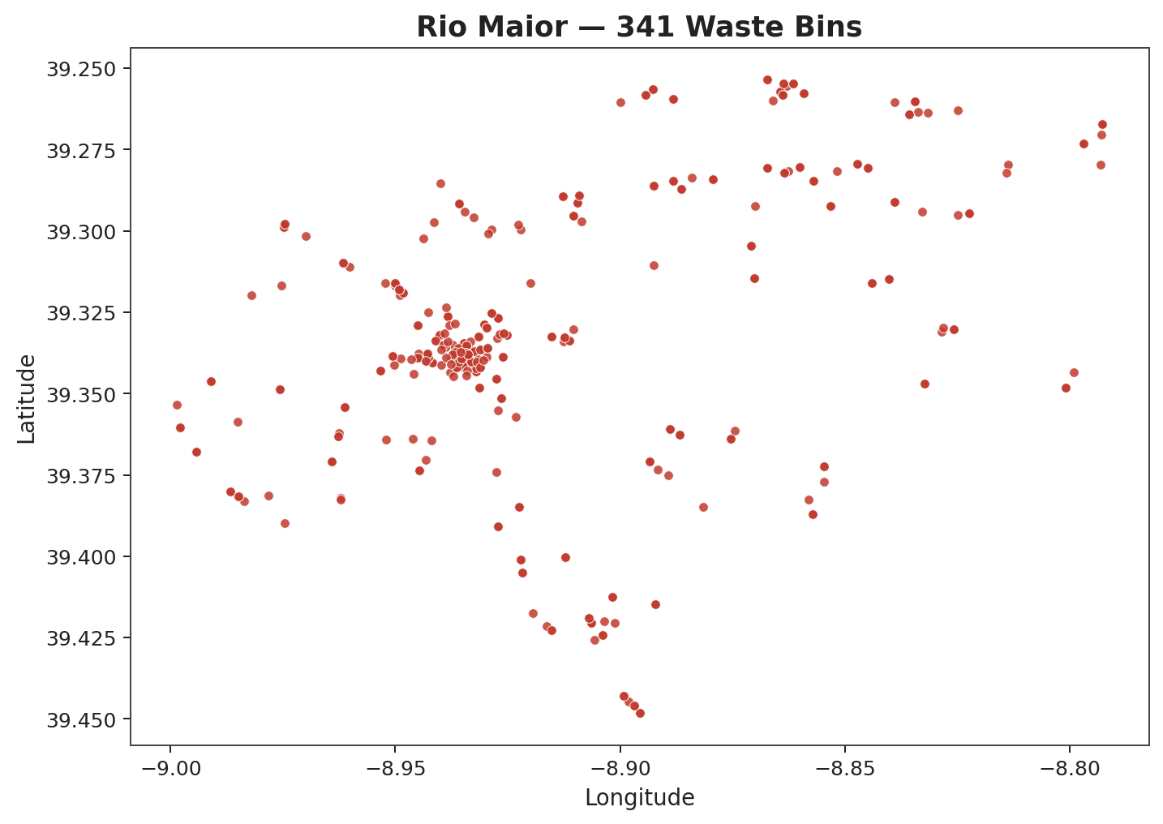
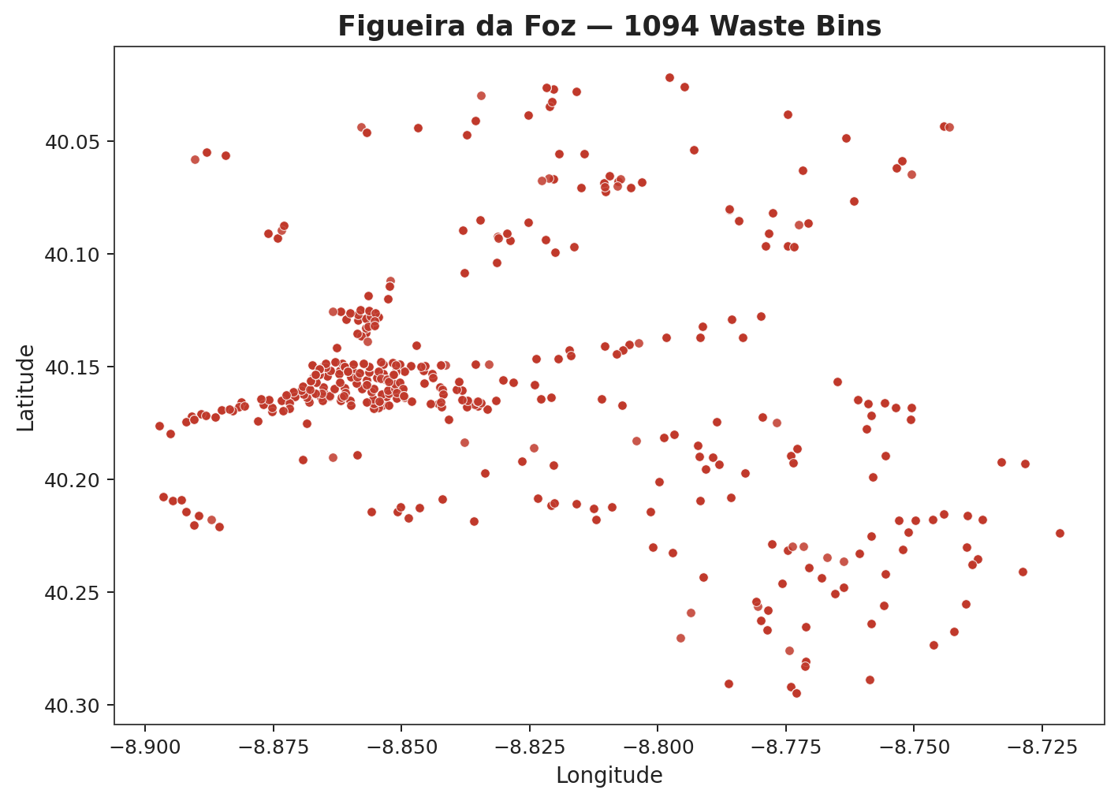
Design of Experiments
Simulation Runs
30 Days
90 Days
(Pareto-front policies only)
RM-100
RM-170
FFZ-350
RM-100
RM-170
FFZ-350
Empirical / Gamma-3
Empirical / Gamma-3
Empirical / Gamma-3
Empirical / Gamma-3
Empirical / Gamma-3
Empirical / Gamma-3
Figure 5: Every scenario (region × graph size × waste distribution) is simulated for both the 30-day and the 90-day horizon; the 90-day runs are restricted to the 30-day Pareto-front policies.
Rio Maior — every known bin location; the RM-100 / RM-170 scenarios sample this network.
Figueira da Foz — every known bin location; the FFZ-350 scenario samples this network.

Slide 12
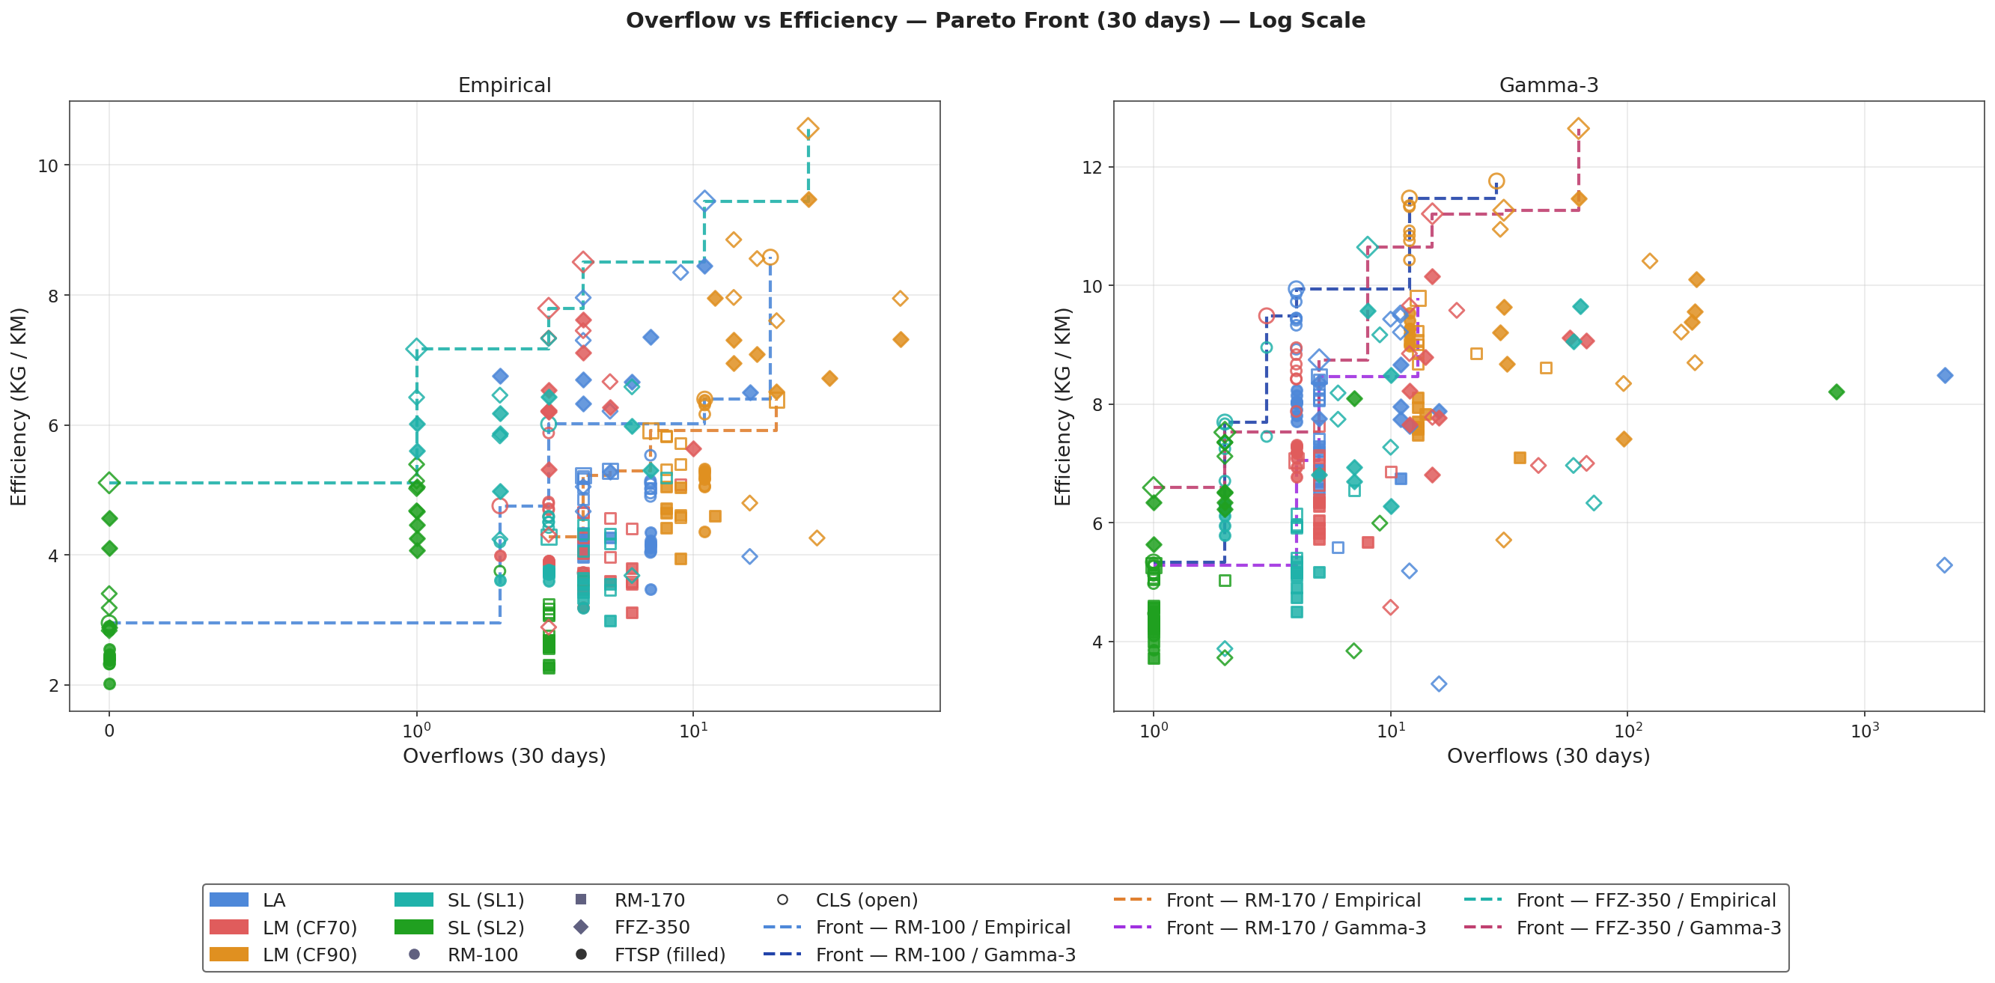
Results — Pareto Front (Overflows vs KG / KM)
Figure 6: Symlog X axis (overflows). Colour = selection variant, shape = scenario, dashed lines = Pareto fronts (one colour per scenario).

Slide 13
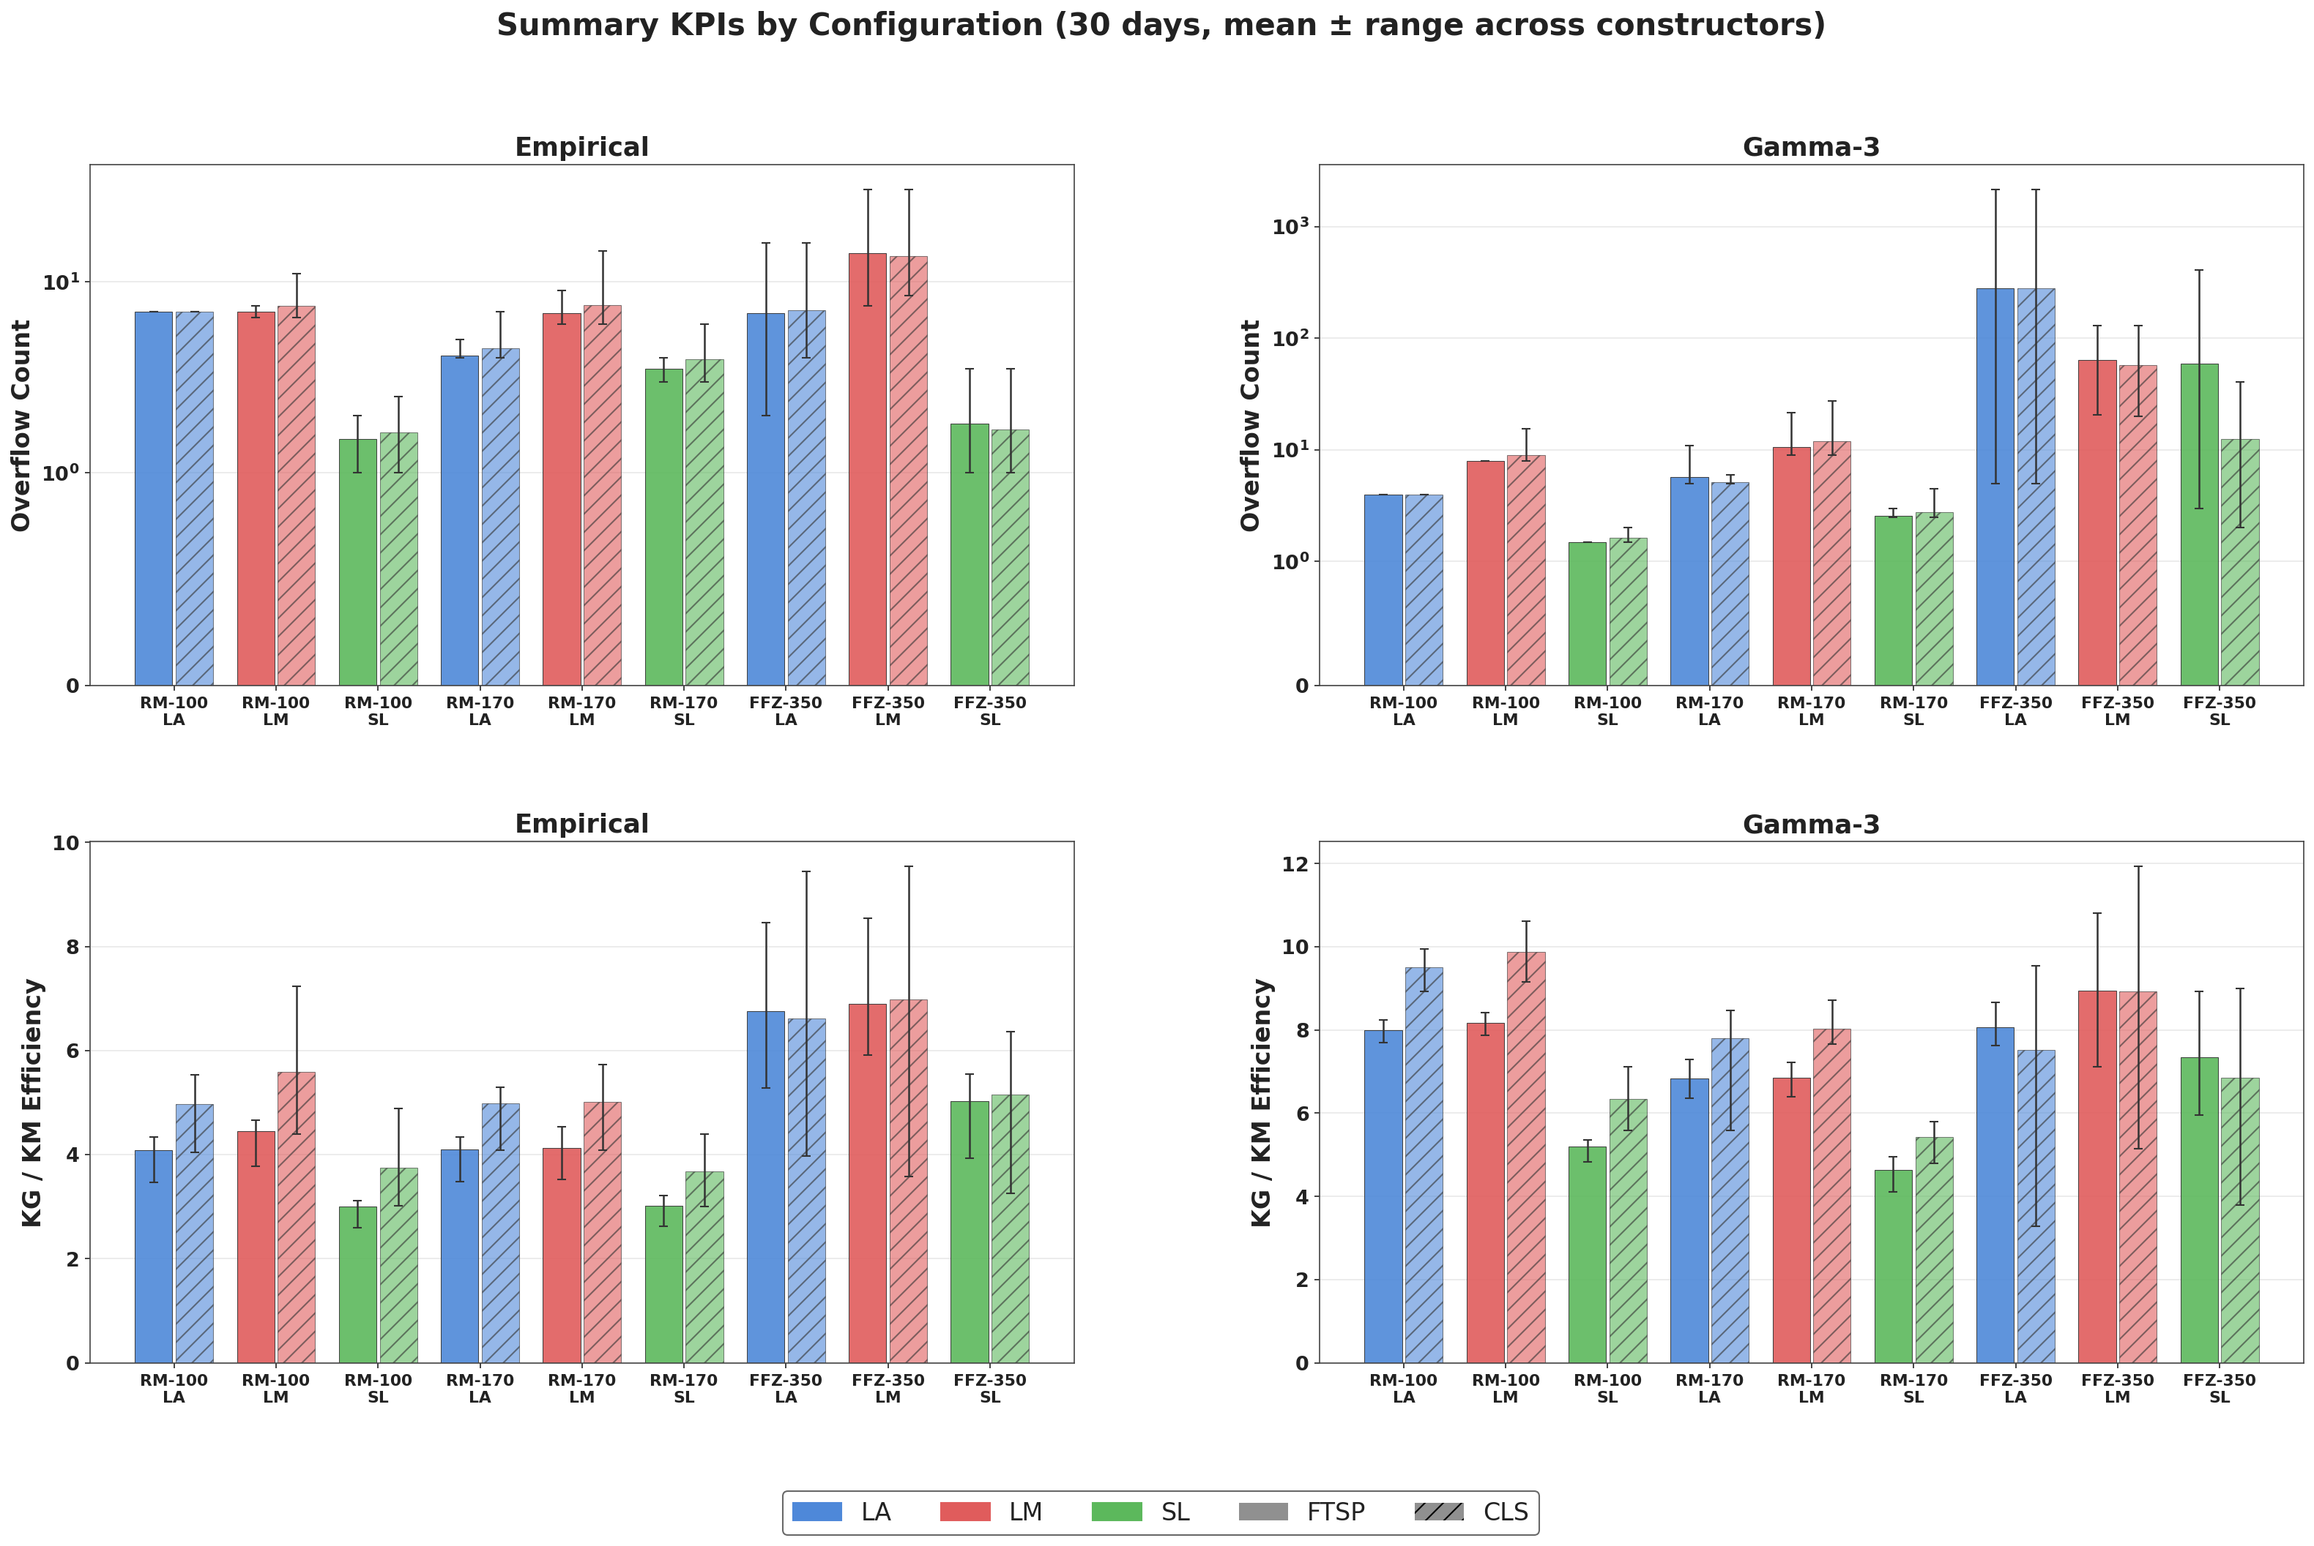
Results — Summary KPI Analysis by Selection Strategy

Slide 14
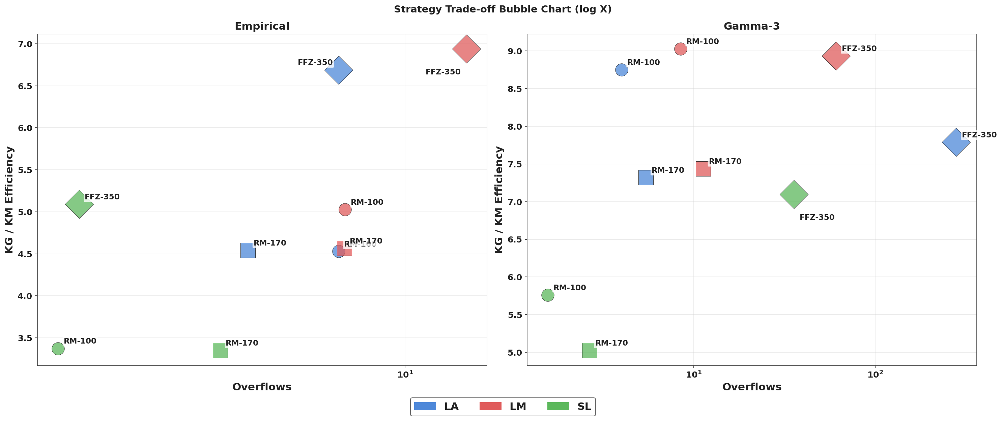
Results — Strategy Trade-off (Overflows vs KG / KM)
Figure 8: Each bubble = (selection strategy, scenario) averaged over constructors and improvers — coloured by mandatory selection strategy (LA/LM/SL).

Slide 15
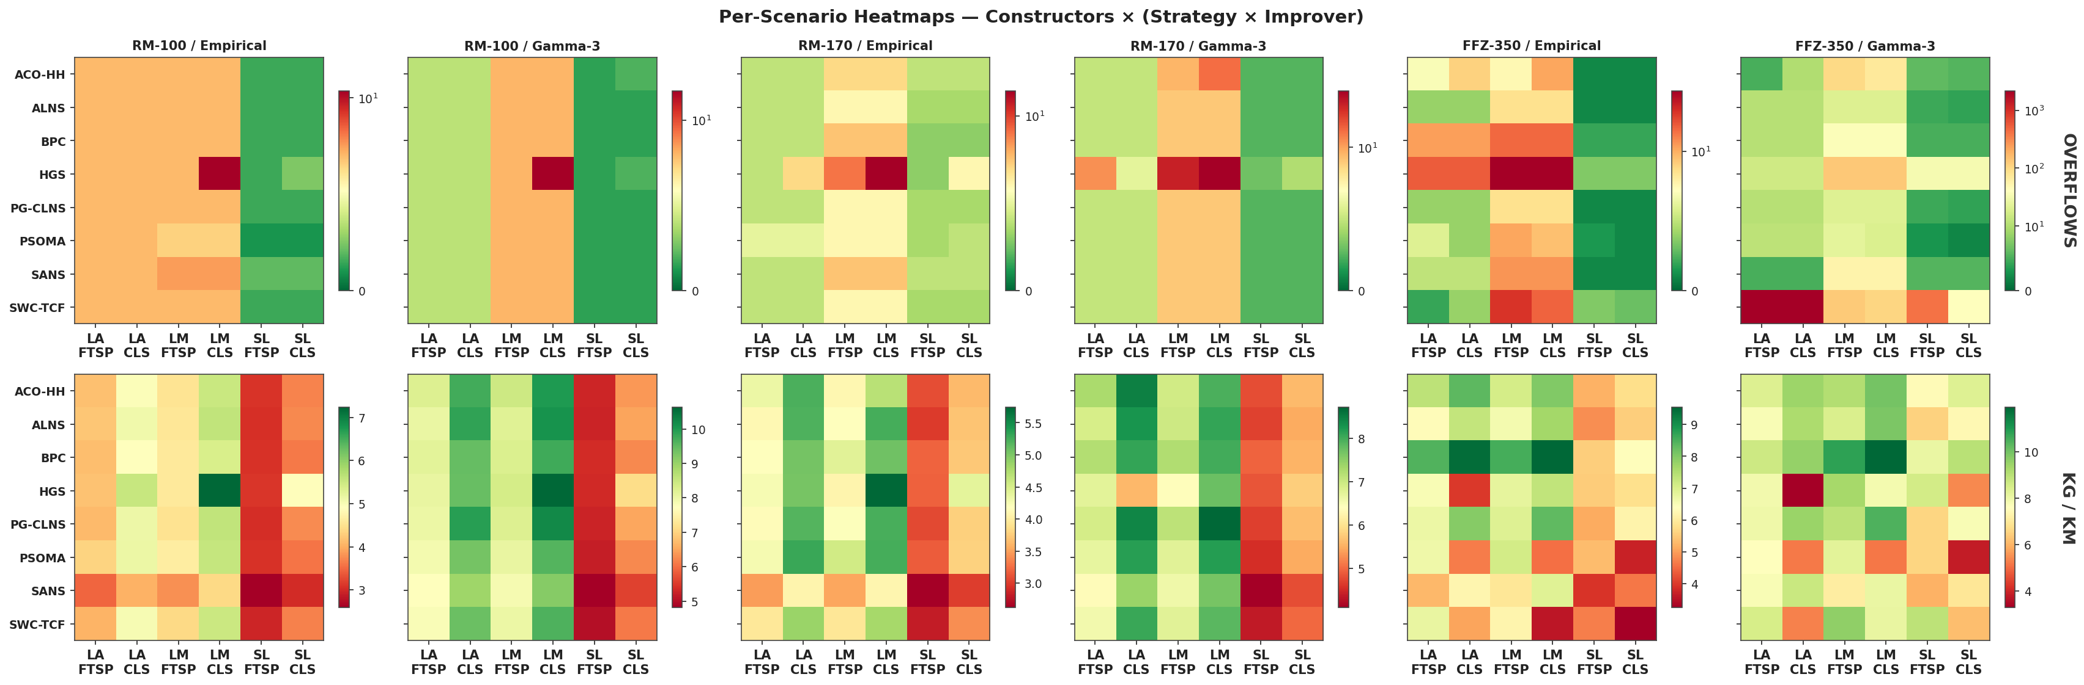
Results — Per-Scenario Heatmaps (Constructors × Strategy·Improver)
Figure 9: 30-day runs. One panel per scenario; route constructors on the rows, selection × improver combinations on the columns.

Slide 16
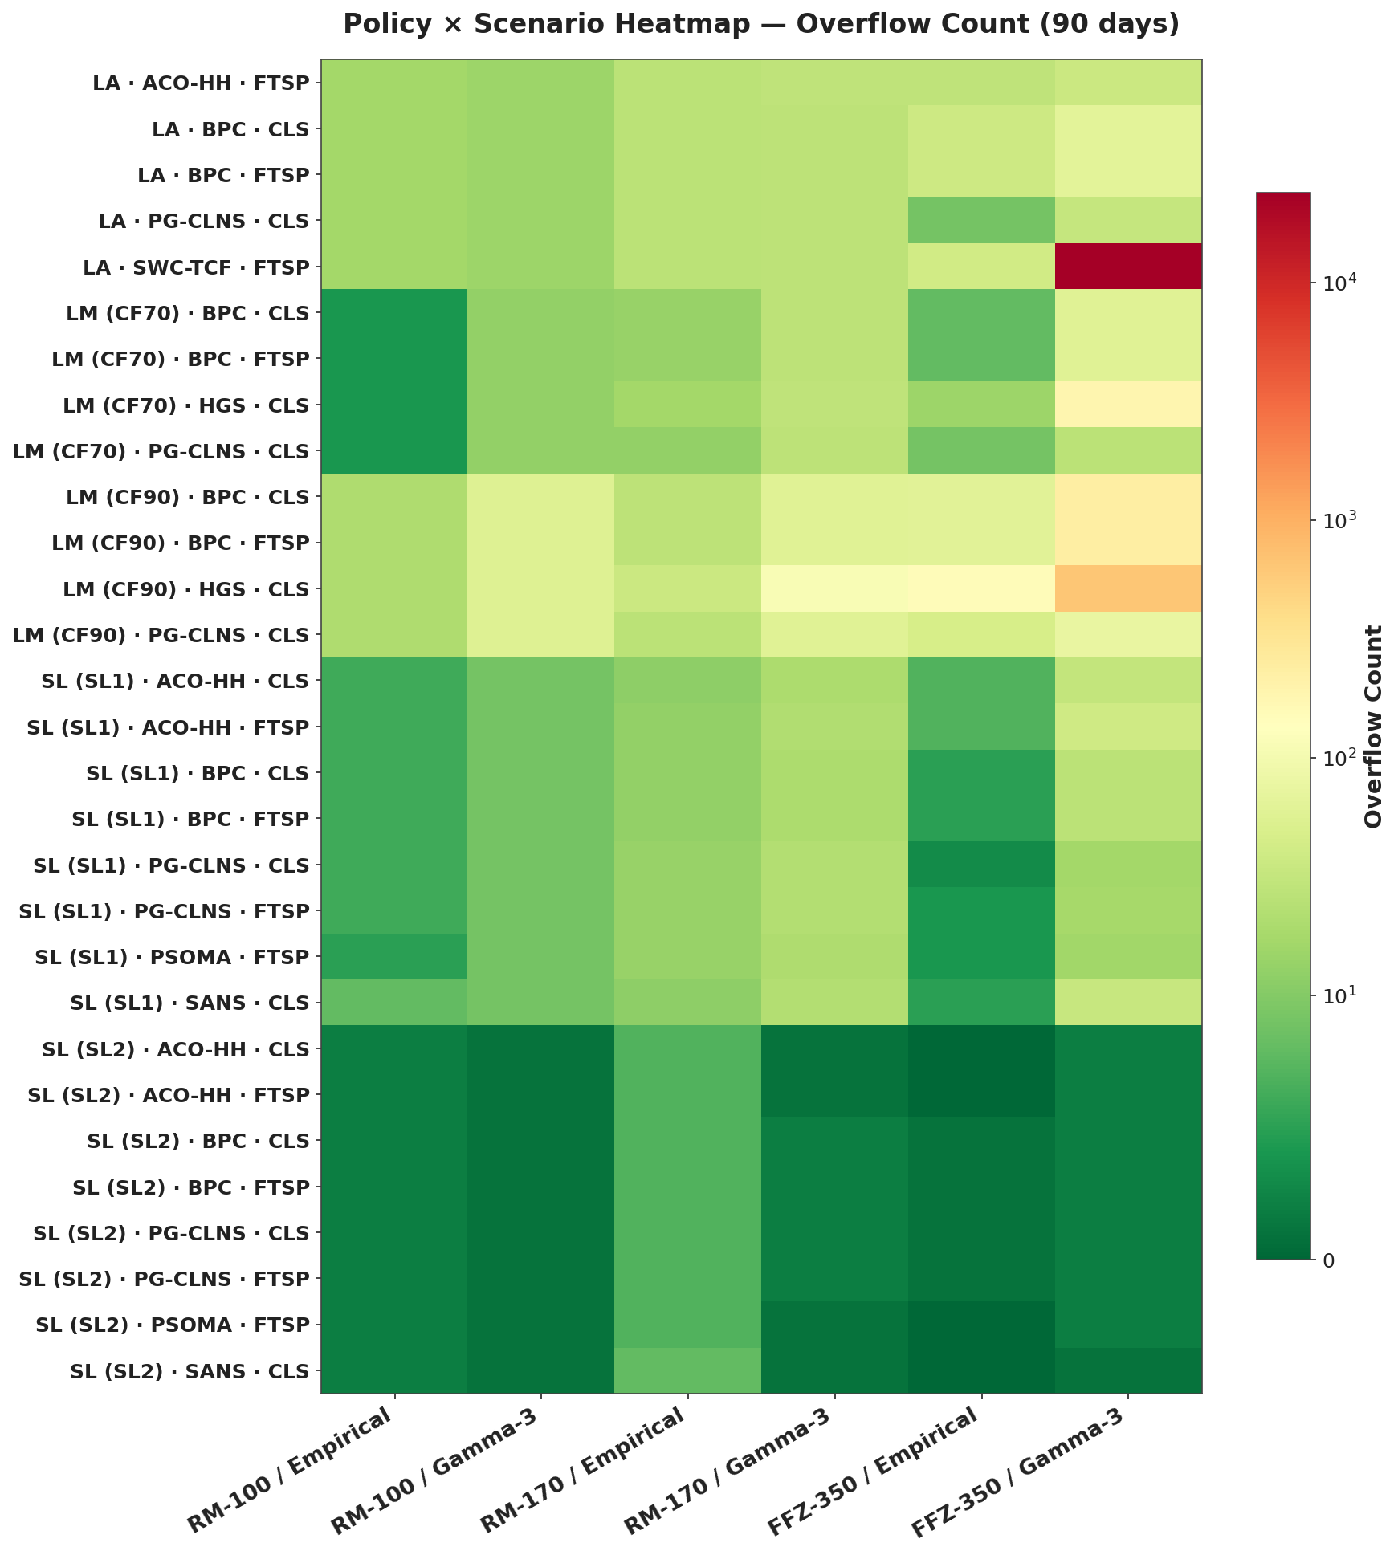
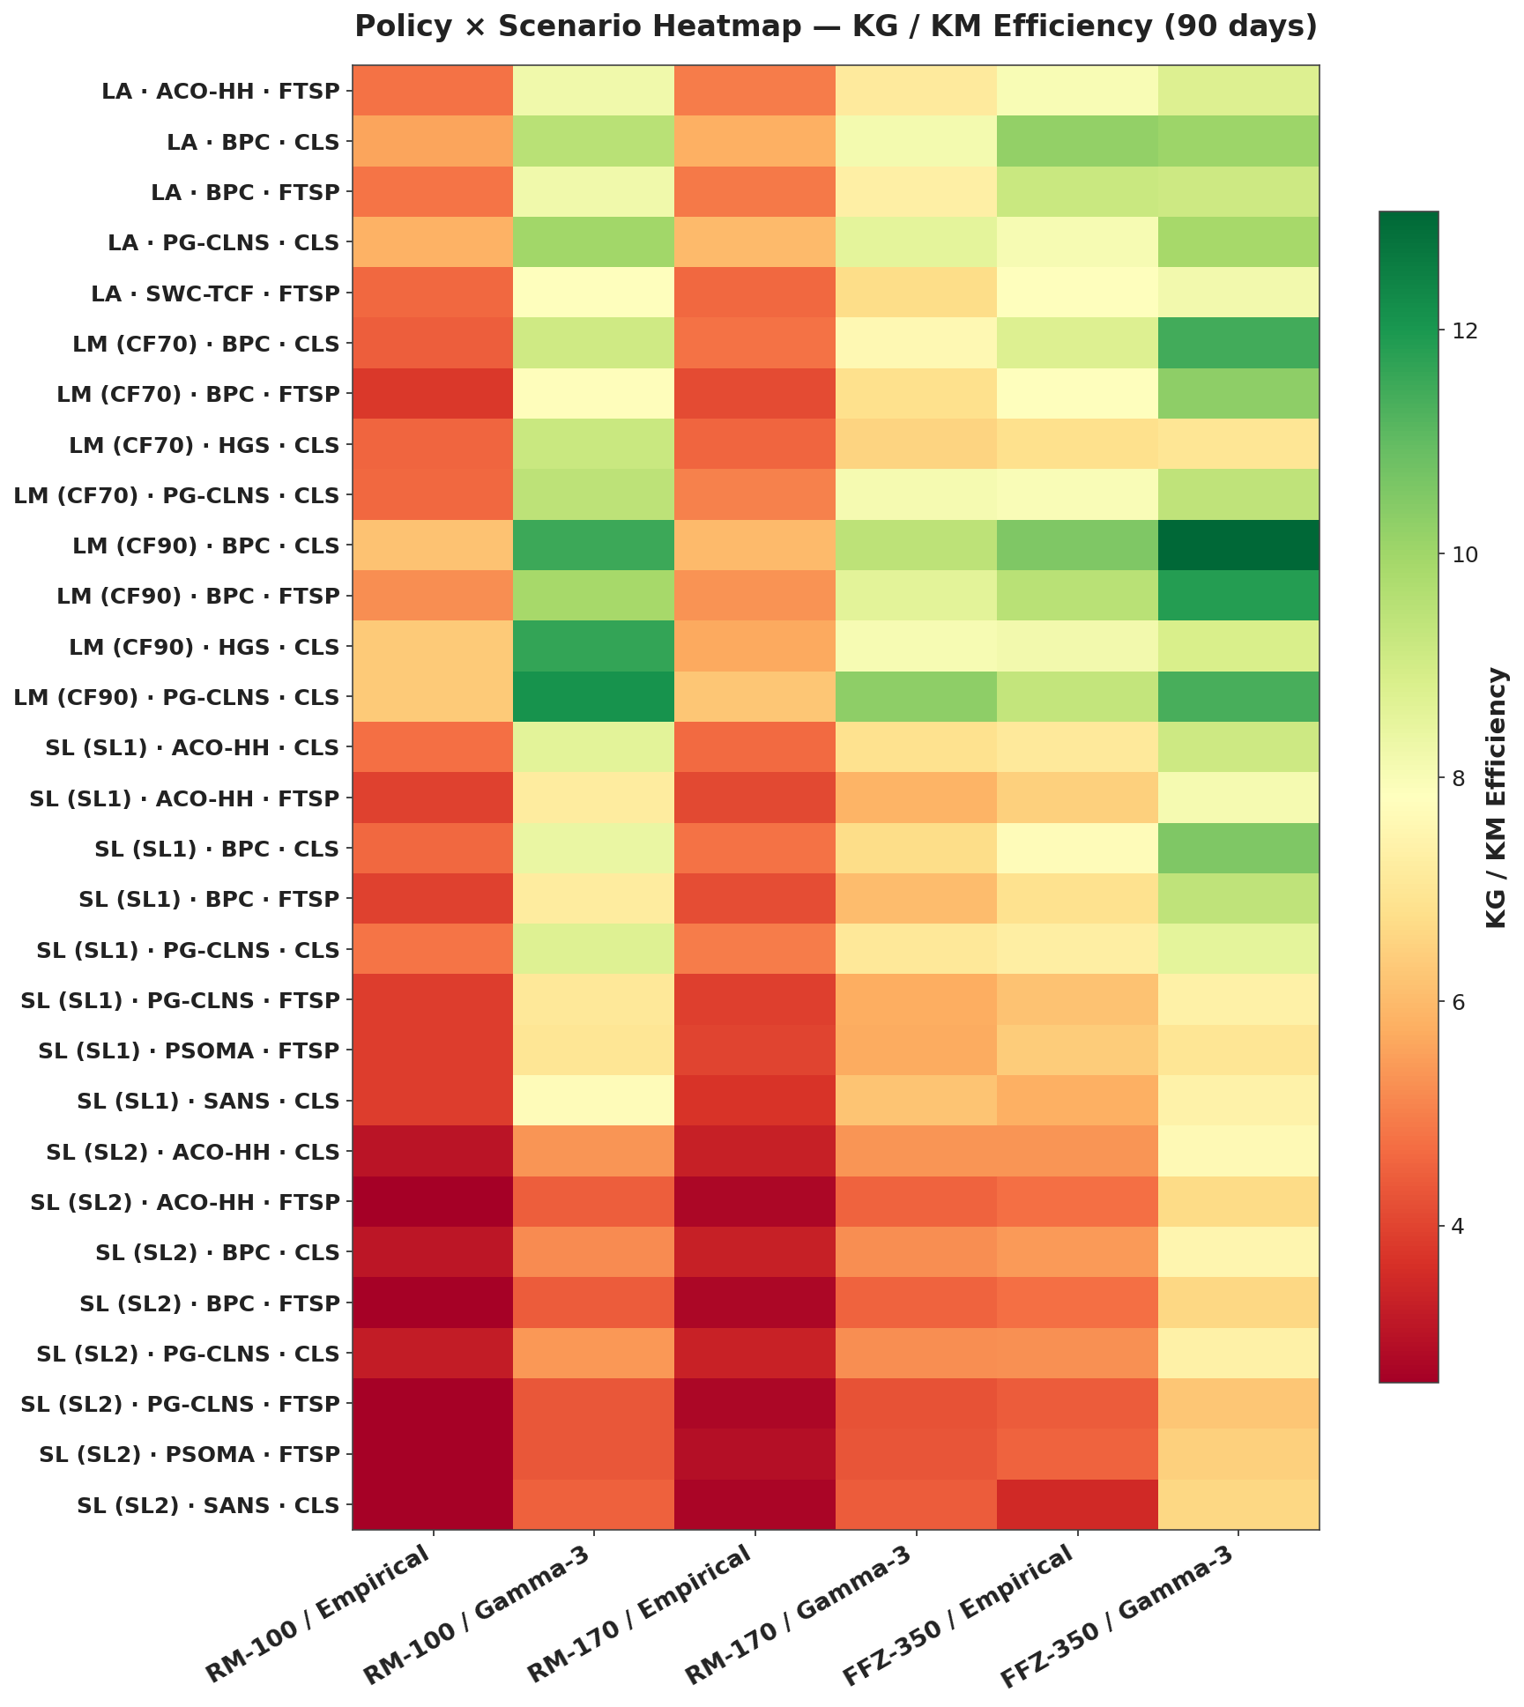
Results — Overflow & KG / KM Heatmaps, 90 Days (Policies × Scenarios)
Figure 10: 90-day runs (Pareto-front policies only — fewer rows, easier to read). Rows = policy configurations; columns = scenarios.

Slide 17
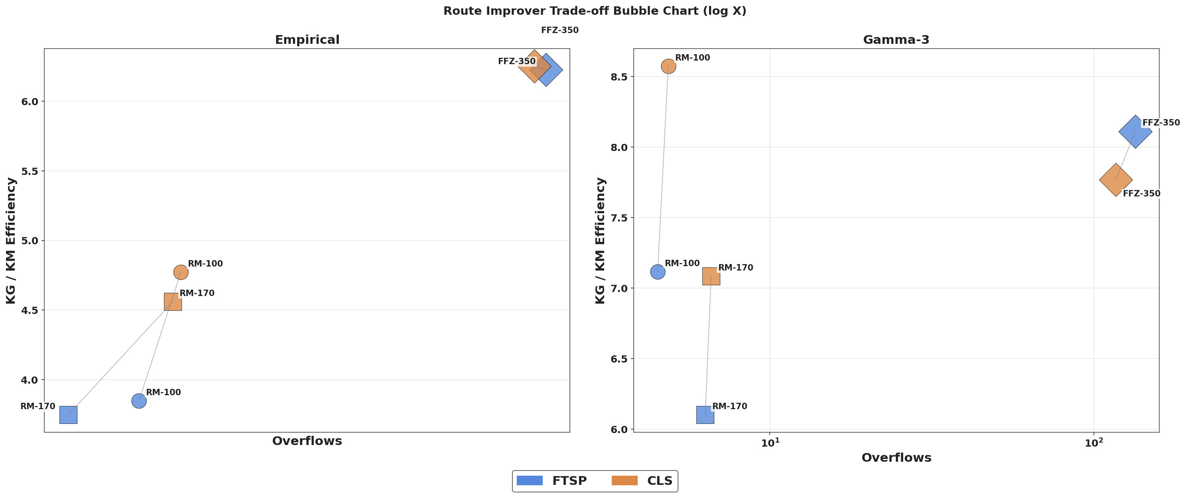
Results — Route Improver Comparison
Figure 11: Each bubble = (improver, scenario) averaged over strategies and constructors — FTSP vs CLS contrasted directly.

Slide 18
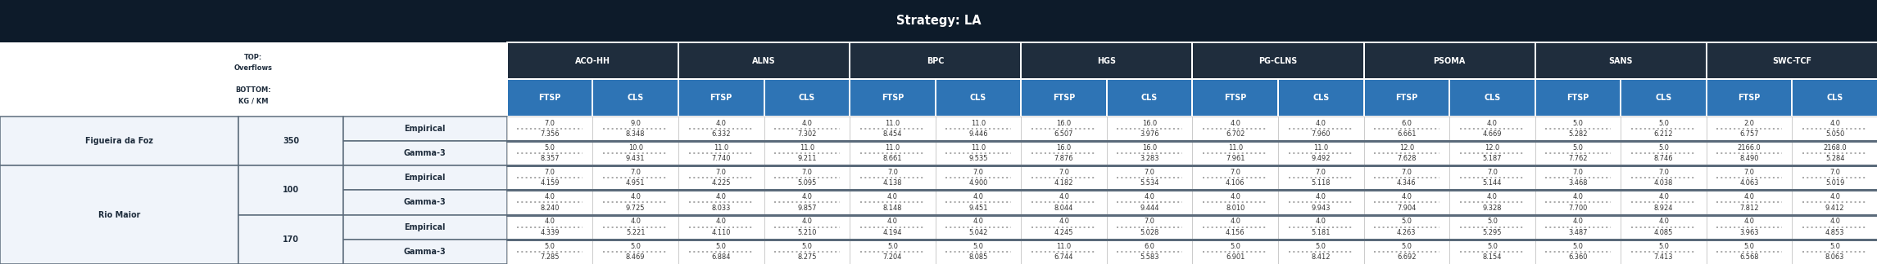


Results — Full Table (30-Day Horizon)
Table 1: Full results table — rows: region × graph size × data distribution; columns: partitioned by mandatory selection strategy (LA, LM, SL), one partial table per value; each partial table then grouped by route constructor × route improver. In every cell, the top value is mean±std overflows (lower is better) and the bottom value is mean±std KG / KM (higher is better), separated by a dotted line; the single best value per row (across every partial table) is shown in bold green.

Slide 19
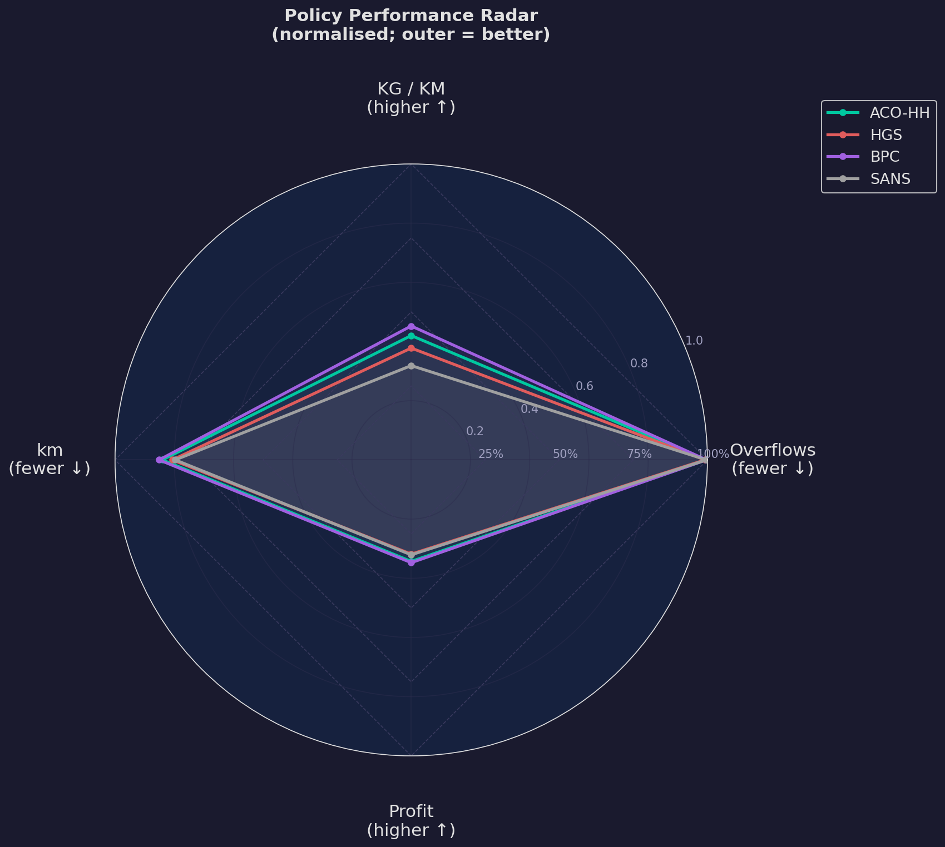
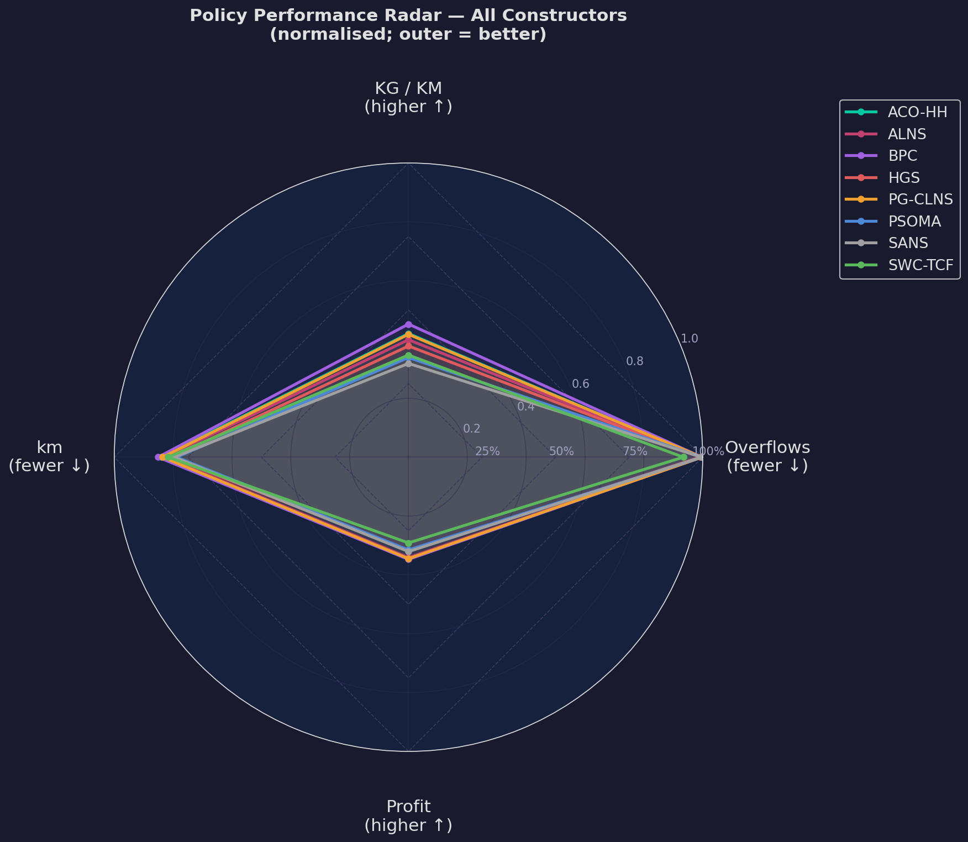
Conclusions, Limitations & Future Work
Figure 12: Overlaid radar charts comparing route constructors across overflow, efficiency, distance and profit axes (outer = better) — a curated subset (left) and every constructor (right).

Slide 20
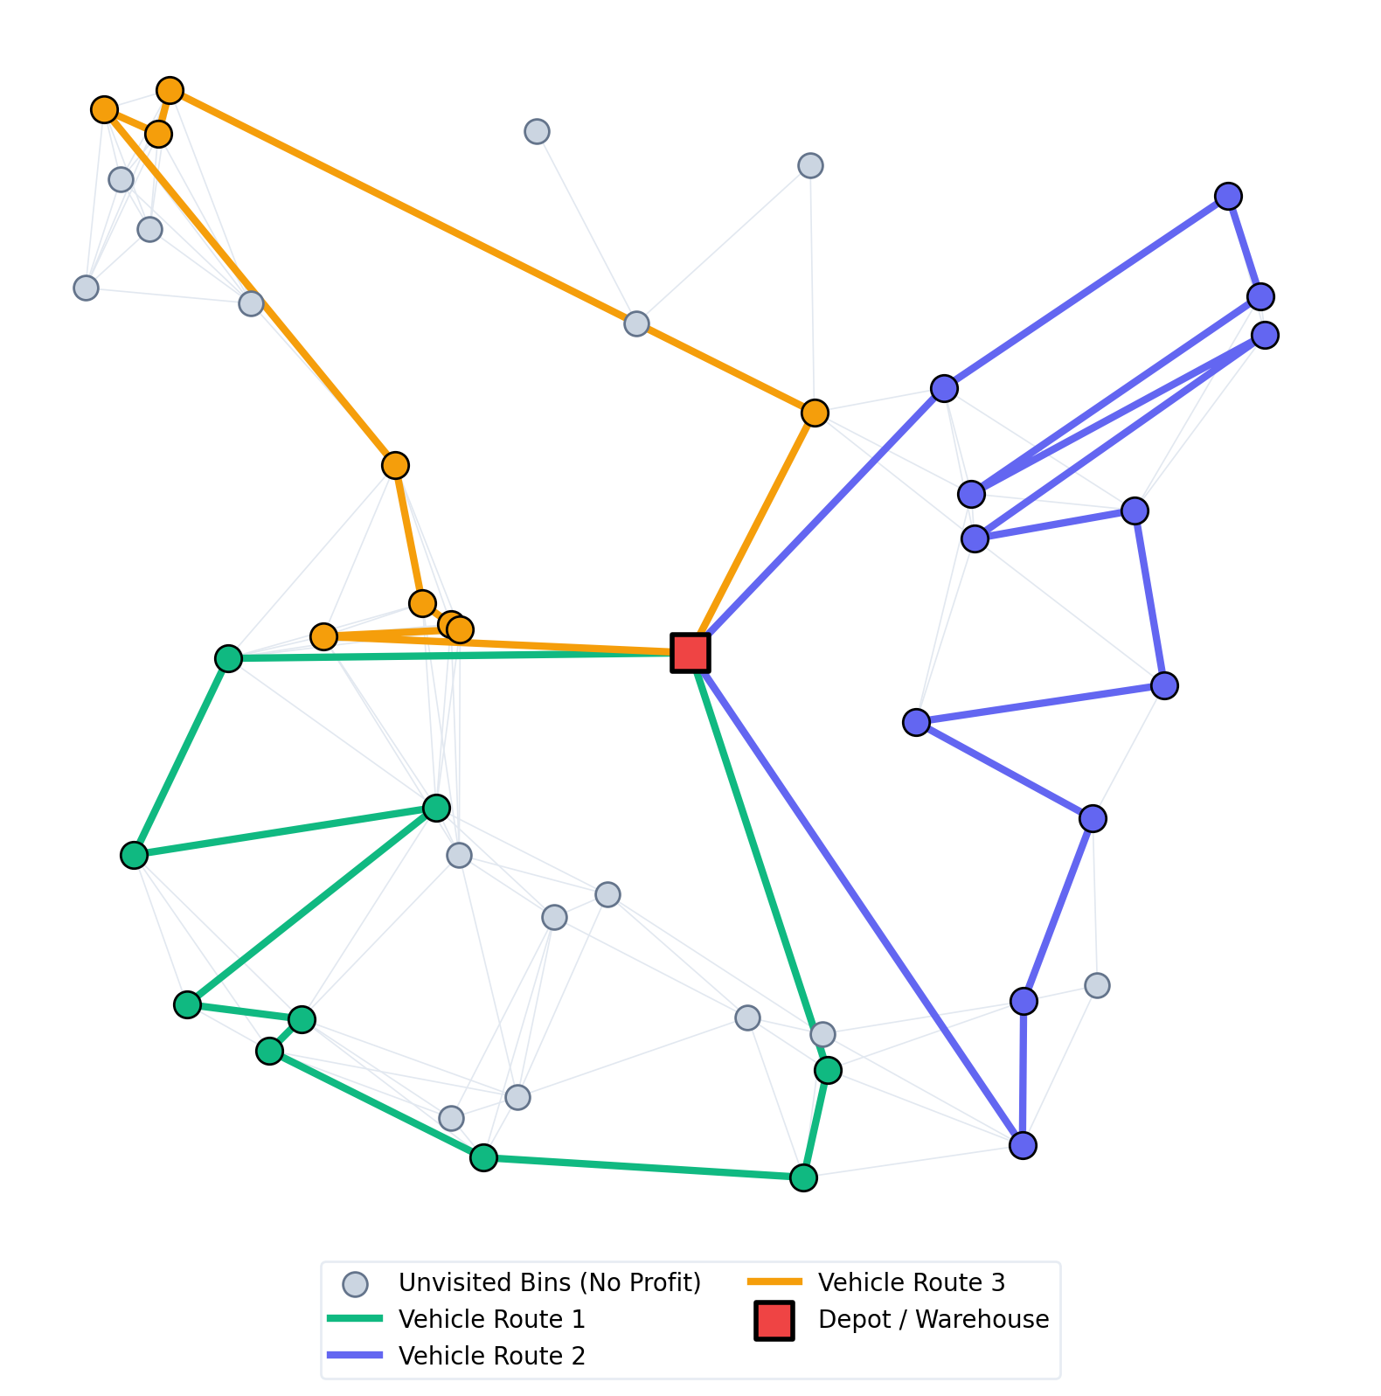
Thank You — Questions & Answers
Thank you for your attention!
Time for questions

