Slide 1




A Simulation Framework for the Multi-Period Vehicle Routing Problem with Profits in Smart Waste Collection
Afonso Cruz Fernandes¹
with Héctor Bonilla-Londoño², Diana Jorge², Manuel Lopes¹, Pedro A. Santos¹, Tânia Ramos²
¹ INESC-ID, Instituto Superior Técnico, University of Lisbon · ² CEGIST, Instituto Superior Técnico, University of Lisbon

Slide 2
Agenda
Introduction: Problem and Objective
Route Improvers
1
5
Simulator Overview
Experimental Methodology
2
6
Mandatory Node Selection Strategies
Experimental Results
3
7
Route Constructors
Conclusions & Limitations
4
8

Slide 3
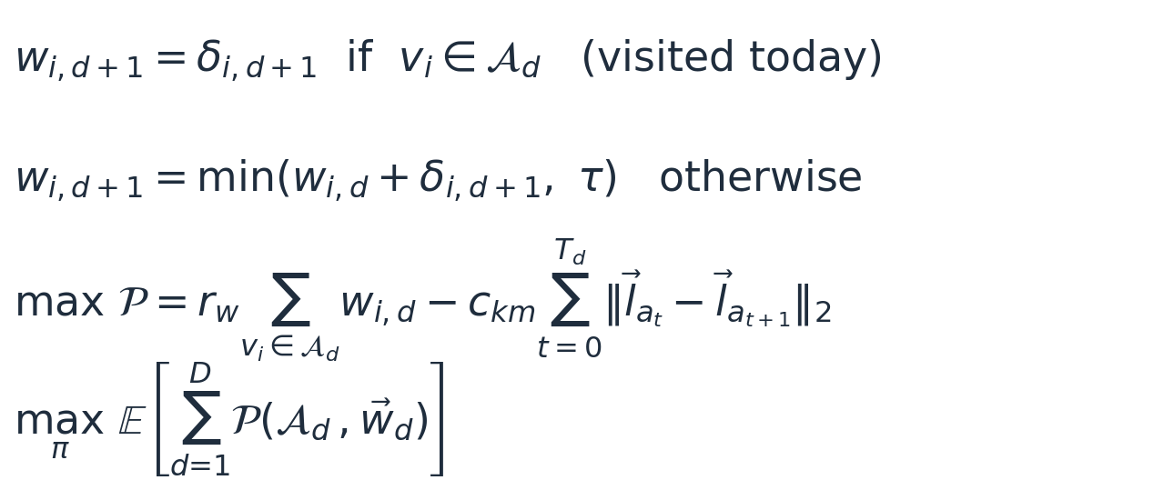
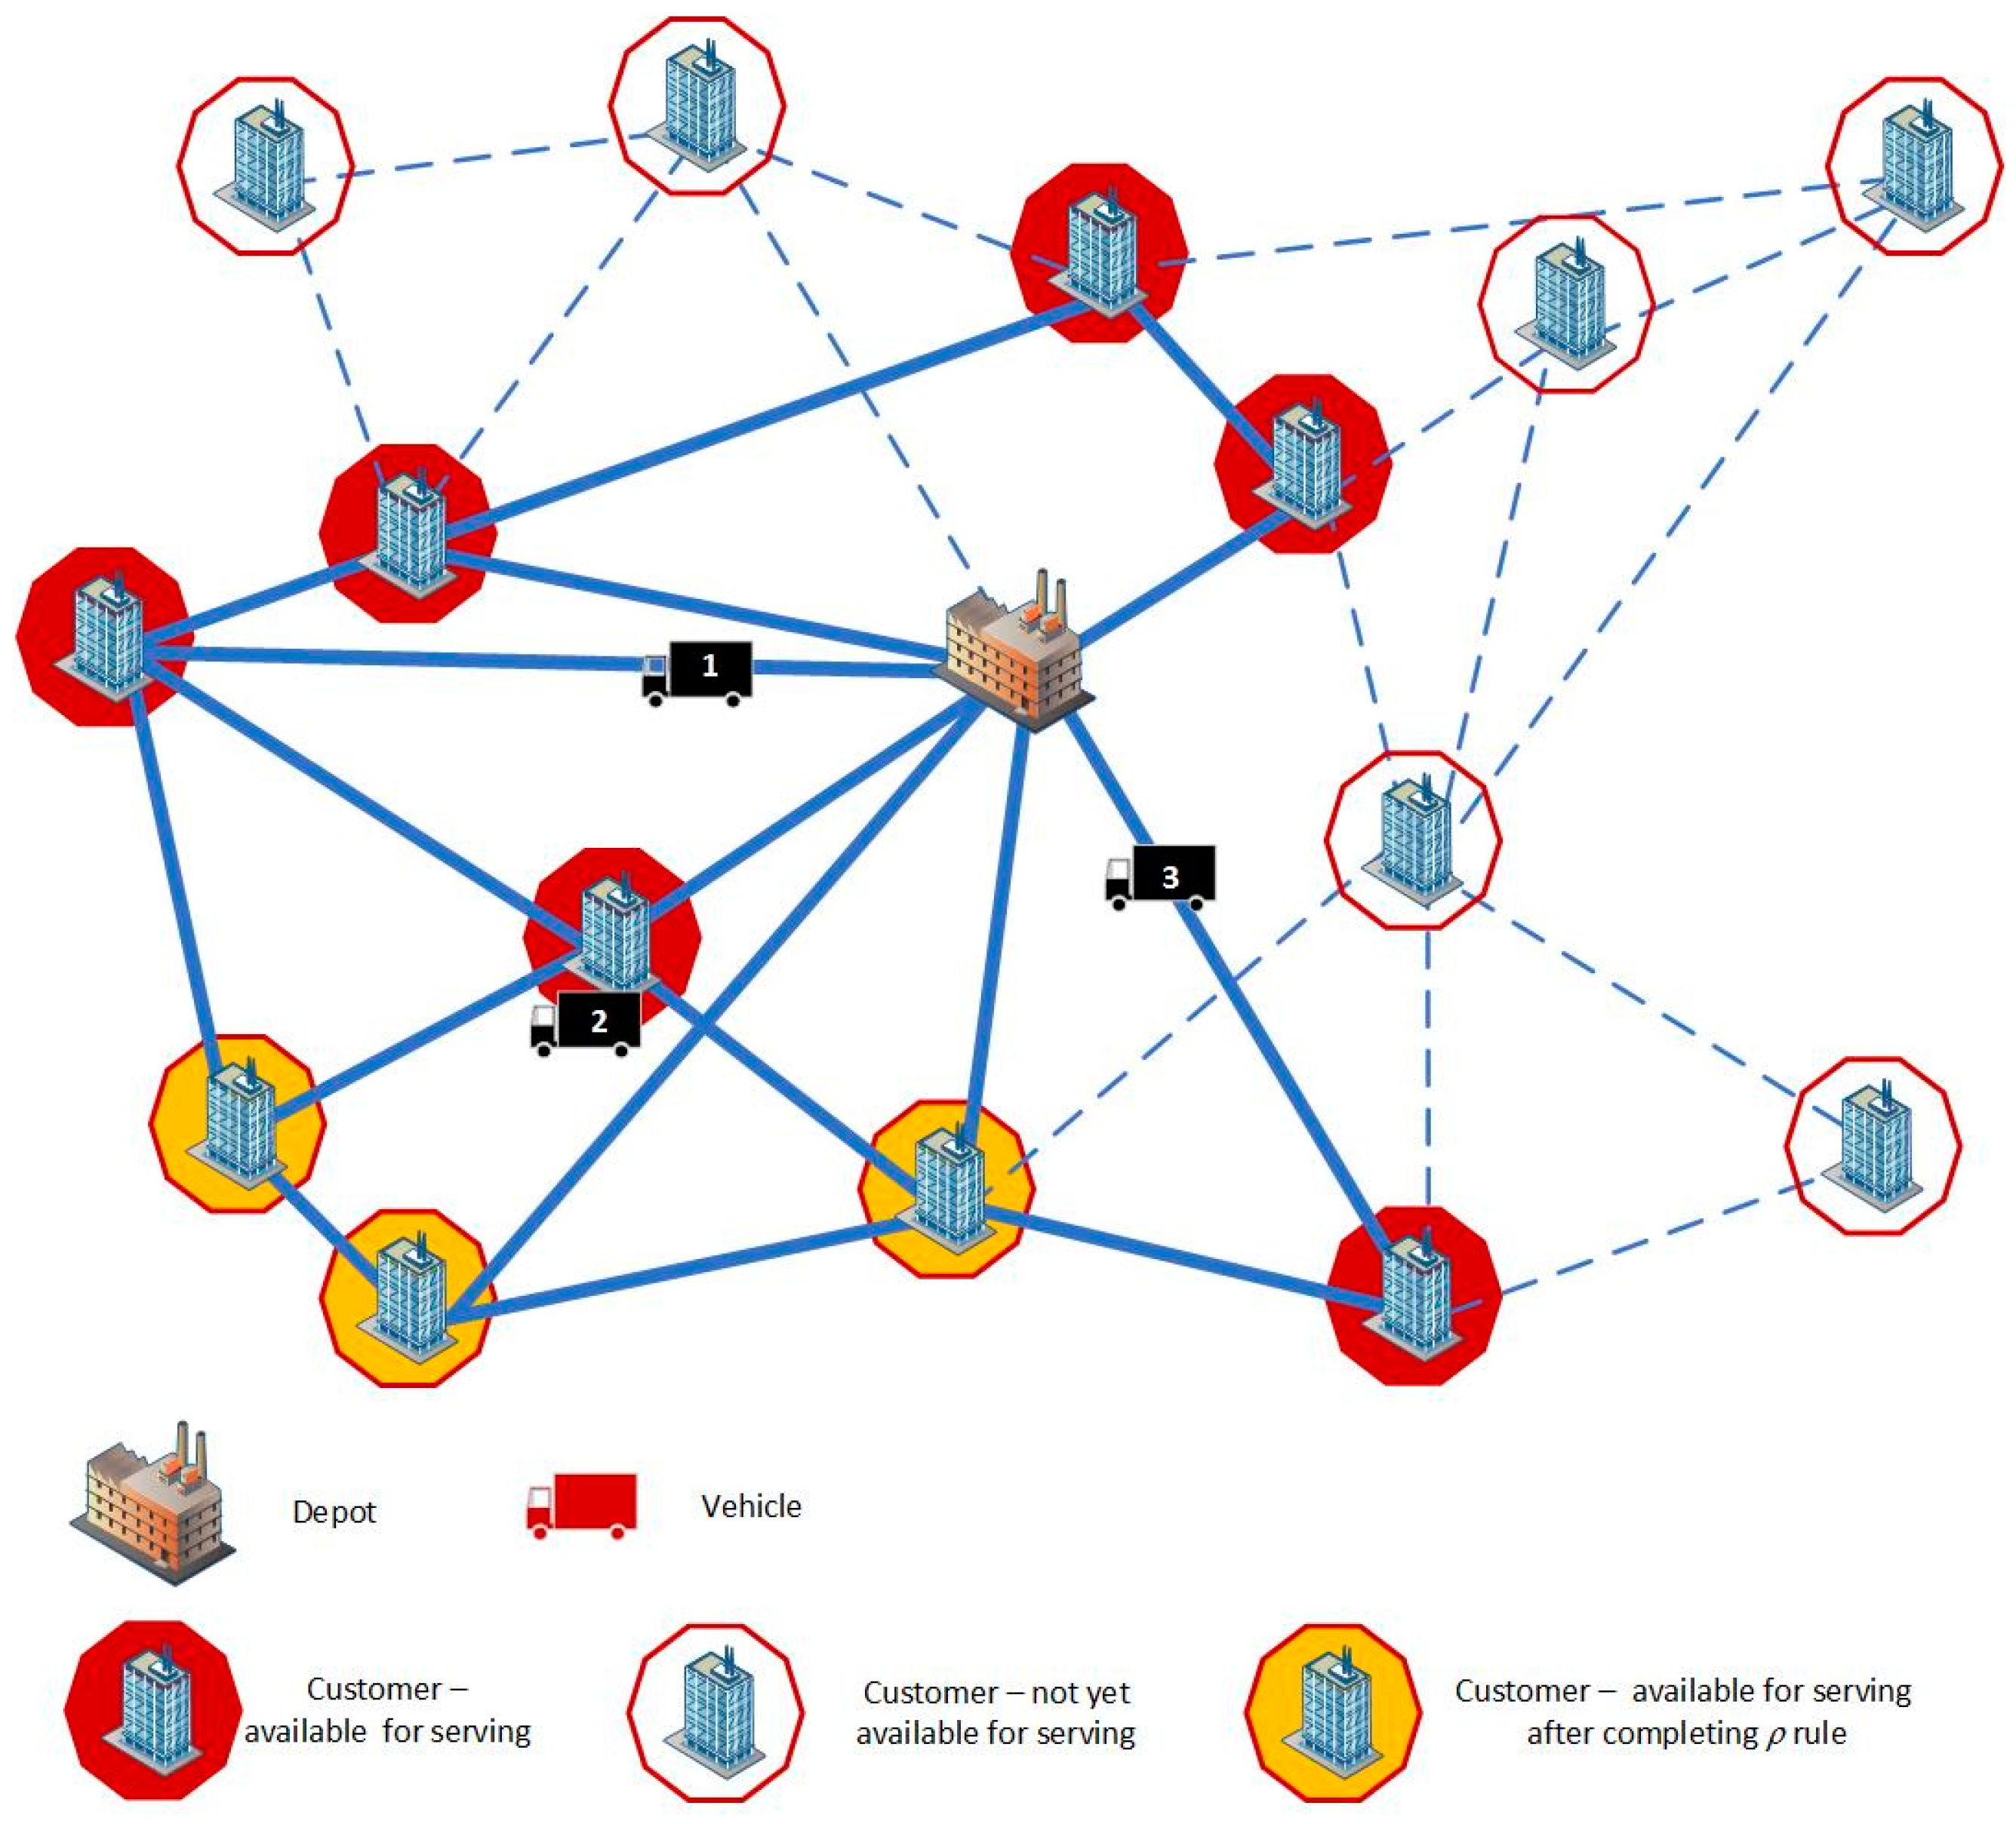
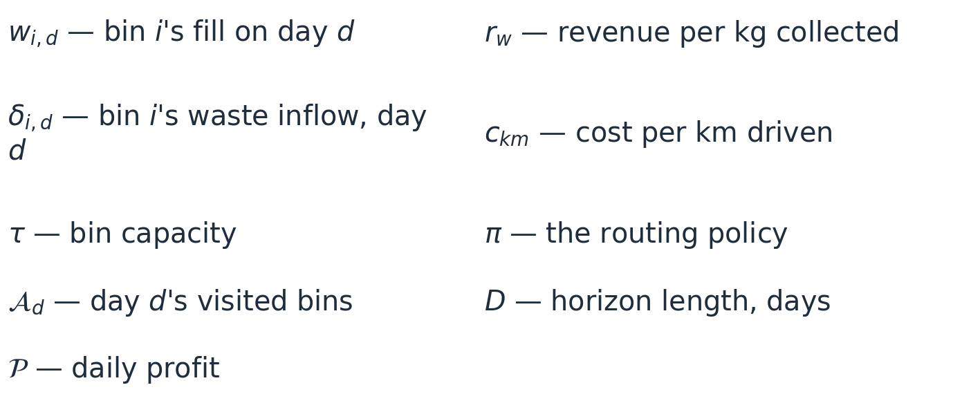
The Problem: Vehicle Routing Problem with Profits (VRPP)
Variables

Slide 4
Objective: Build a simulator to test different algorithms
One framework to compare them all
Exact Methods
One Shared Simulator
Multi-day simulator: region × graph size × demand
Fair Benchmarks (KPIs)
Meta-Heuristics
Hyper-Heuristics
Exact Methods
Meta-Heuristics
Hyper-Heuristics
Branch-and-Price-and-Cut (BPC)
Hybrid Genetic Search (HGS)
Ant Colony Optimization Hyper-Heuristic (ACO-HH)
Adaptive Large Neighborhood Search (ALNS)
Simulated Annealing Neighborhood Search (SANS)
Smart Waste Collection — Two-Commodity Flow (SWC-TCF)
Pheromone-Guided Cooperative Large Neighborhood Search (PG-CLNS)
Particle Swarm Optimization Memetic Algorithm (PSOMA)

Slide 5


Routing Simulator Philosophy — Modular Policy Pipeline
Mandatory bin
selection strategy
Route
constructor
Acceptance criterion
(optional)
Route improver
(optional)
is there a collection today?
build the routes
constructor-dependent
post-optimisation
30%
30%
87%
87%
80%
80%
60%
55%
60%
55%
50%
50%
42%
20%
42%
20%

Slide 6
Big Picture: Policy Configuration Space
Mandatory Selection
Route Constructor
Route Improver
Look-Ahead (LA)
Exact Methods
BPC · SWC-TCF
Fast-TSP
Last-Minute (LM, CF70)
Meta-Heuristics
HGS · ALNS · SANS · PG-CLNS · PSOMA
Last-Minute (LM, CF90)
Classical Local Search (CLS)
Service-Level (SL1)
Hyper-Heuristics
ACO-HH
Service-Level (SL2)

Slide 7
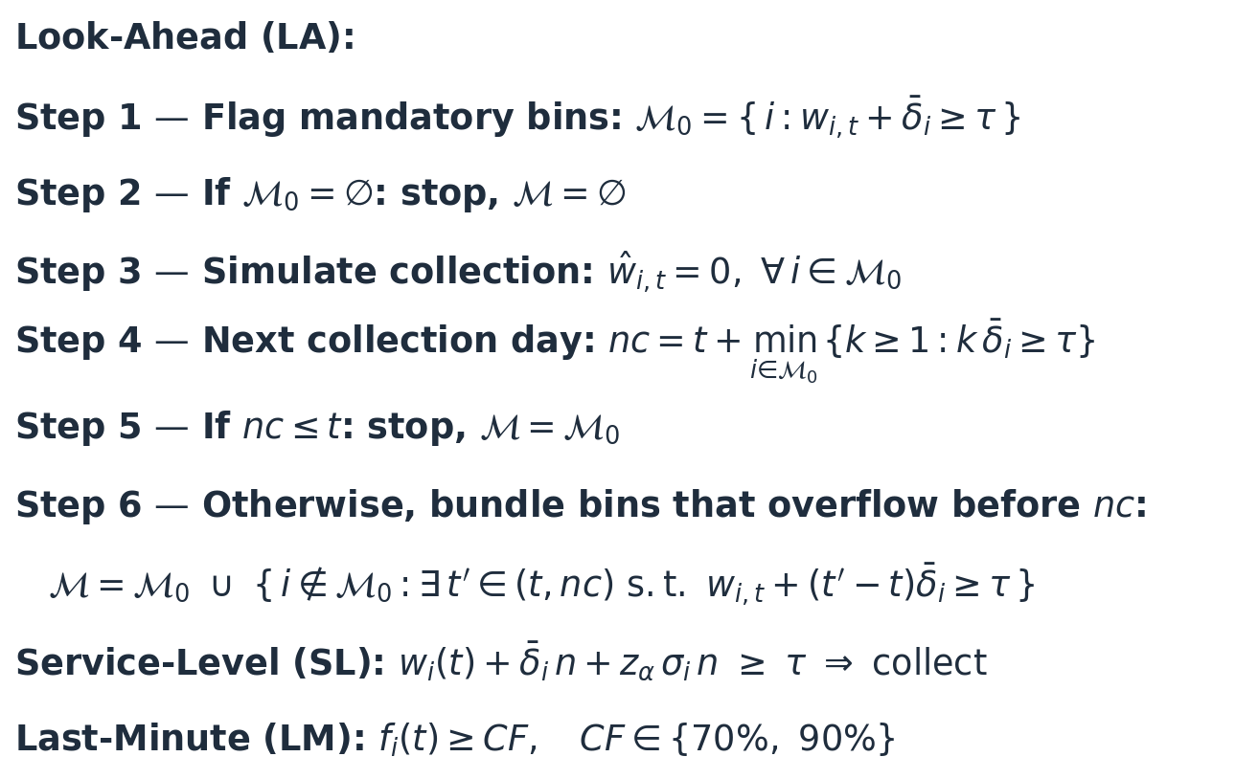
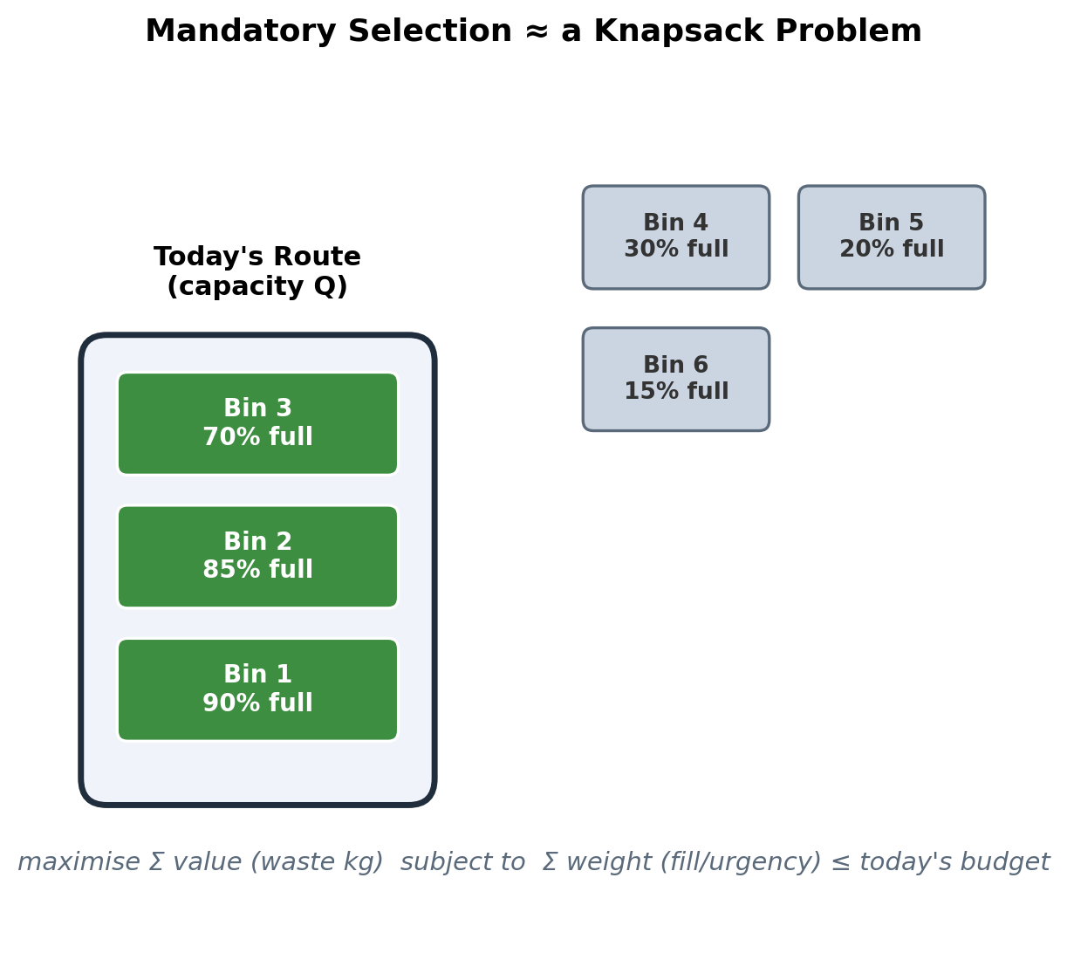
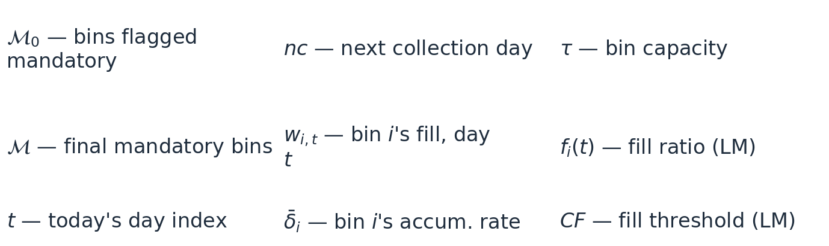
Mandatory Node Selection Strategies
Variables

Slide 8
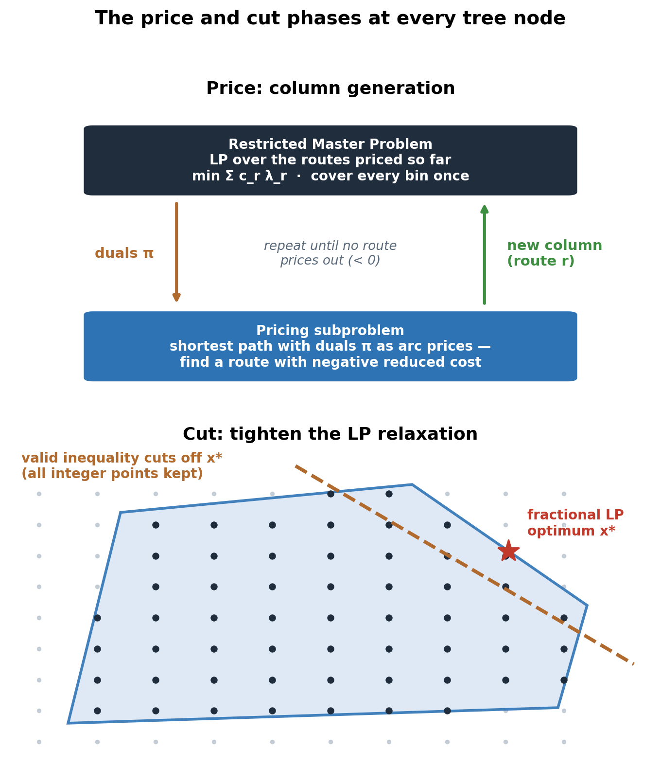
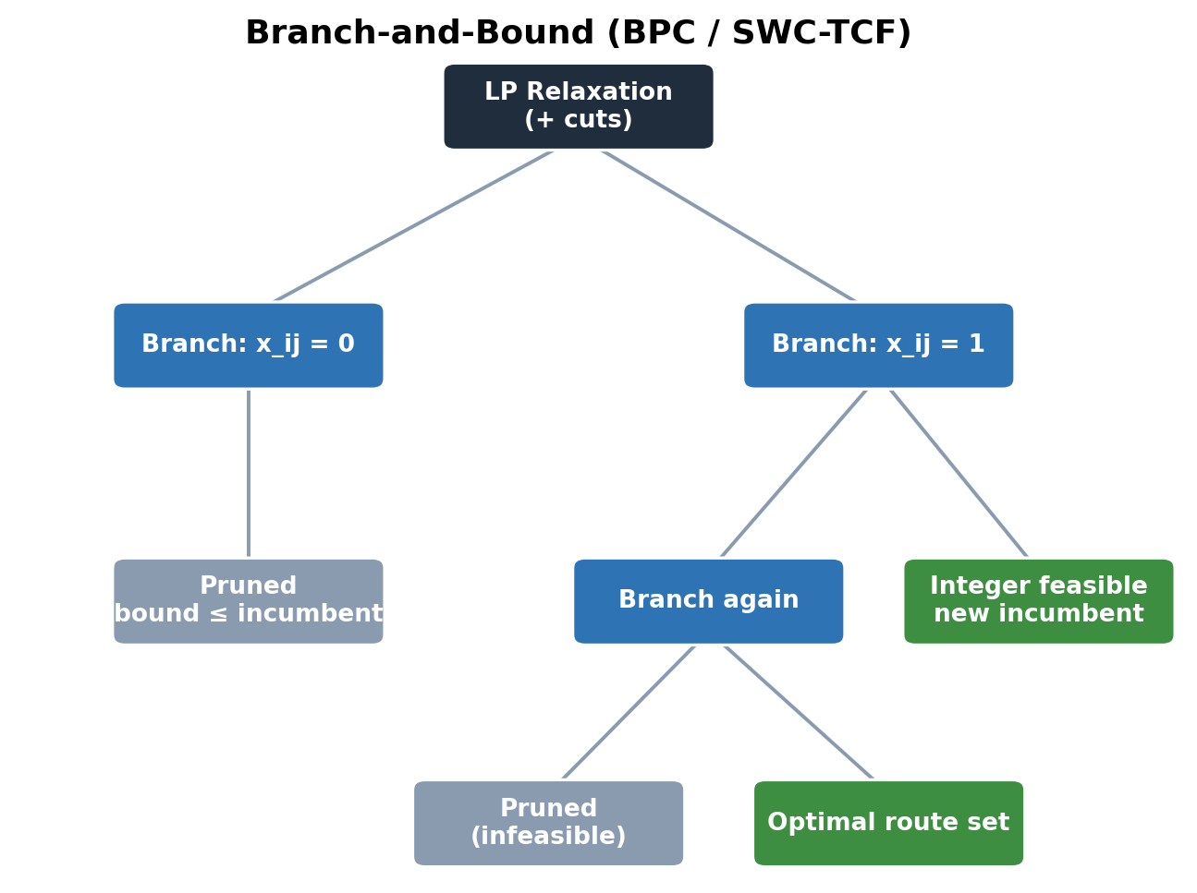
Exact Methods: BPC & SWC-TCF

Slide 9
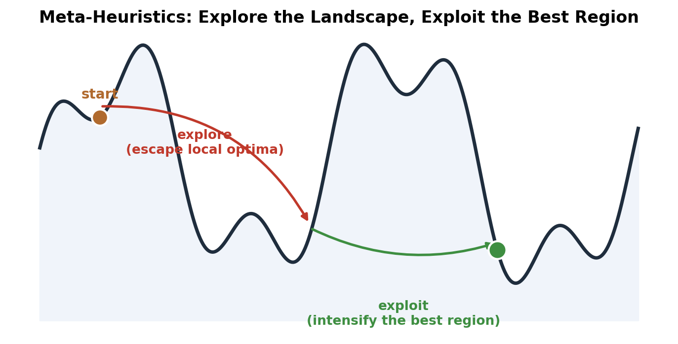
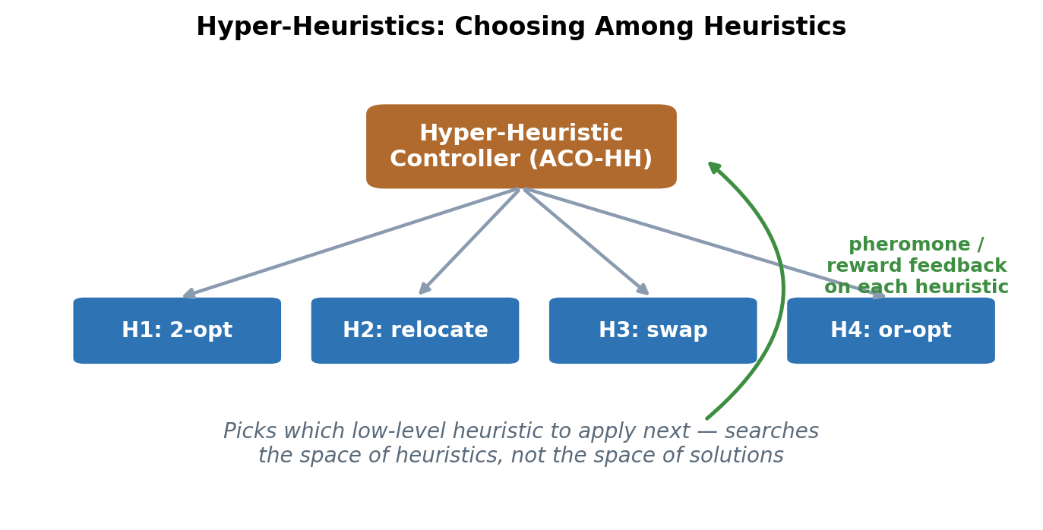
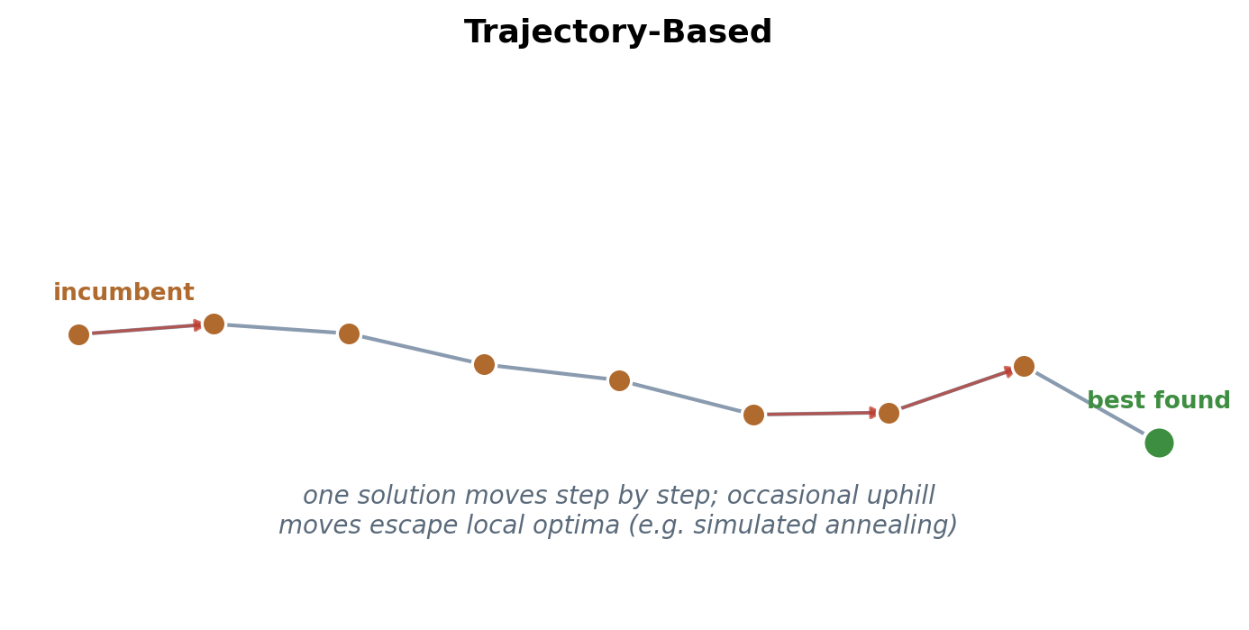
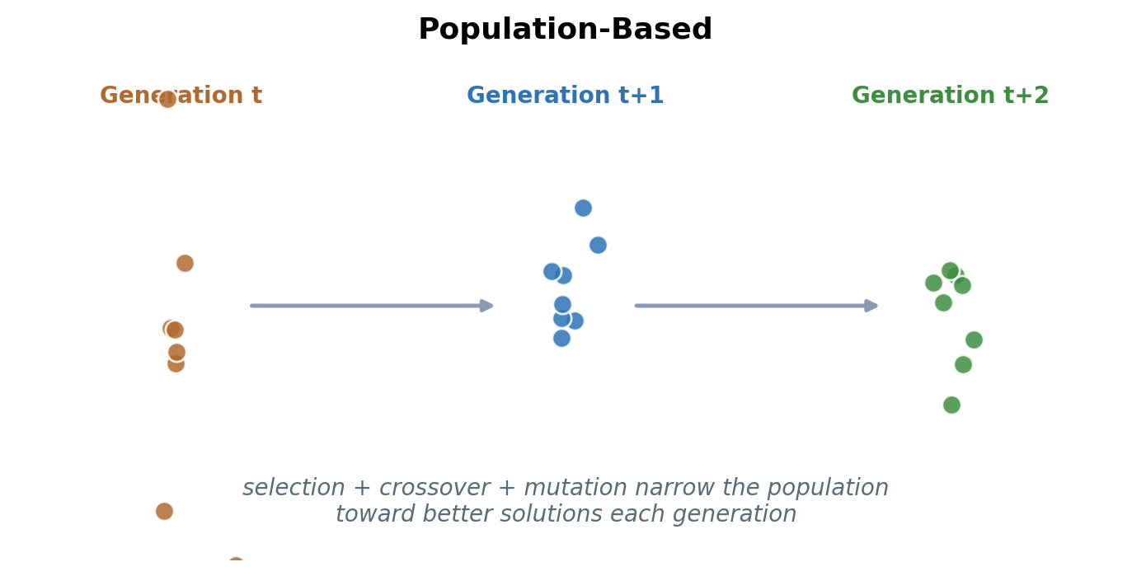
Meta-Heuristics & Hyper-Heuristics — Overarching Philosophy

Slide 10
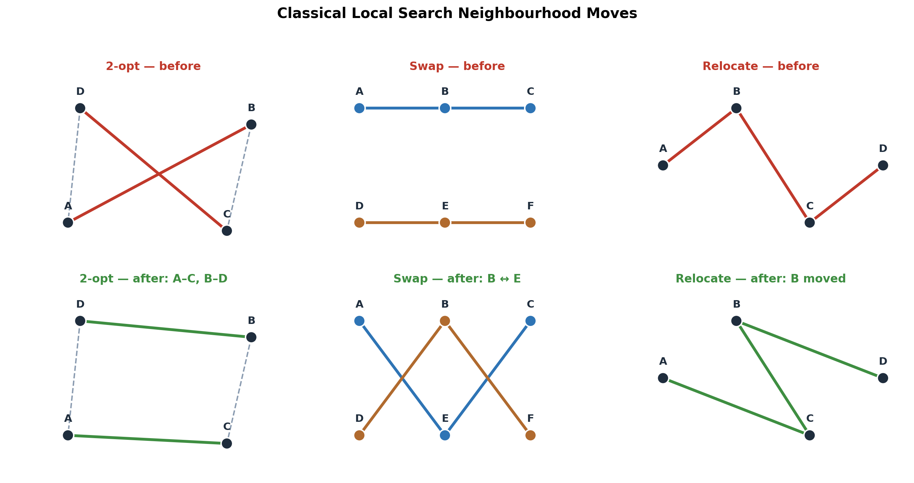
Route Improvers: Classical Local Search vs Fast-TSP

Slide 11
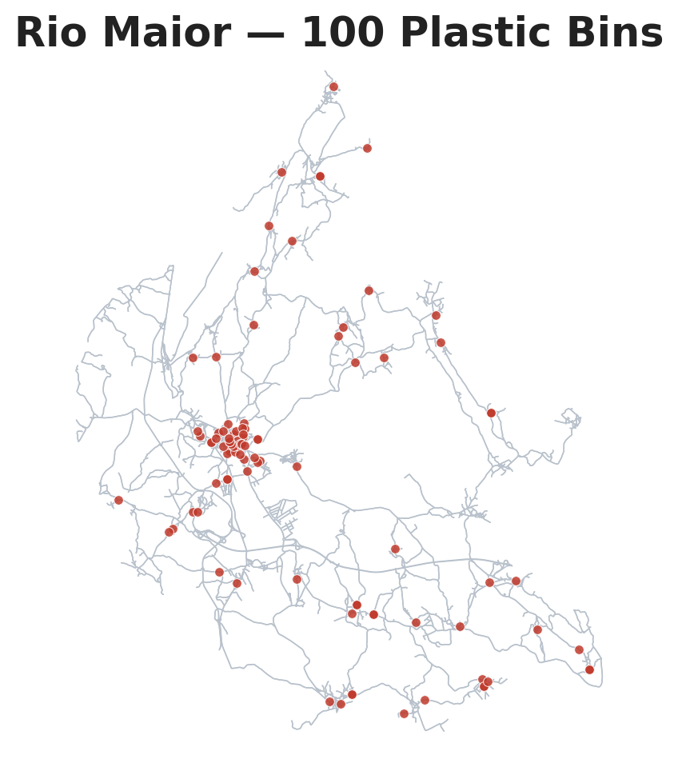
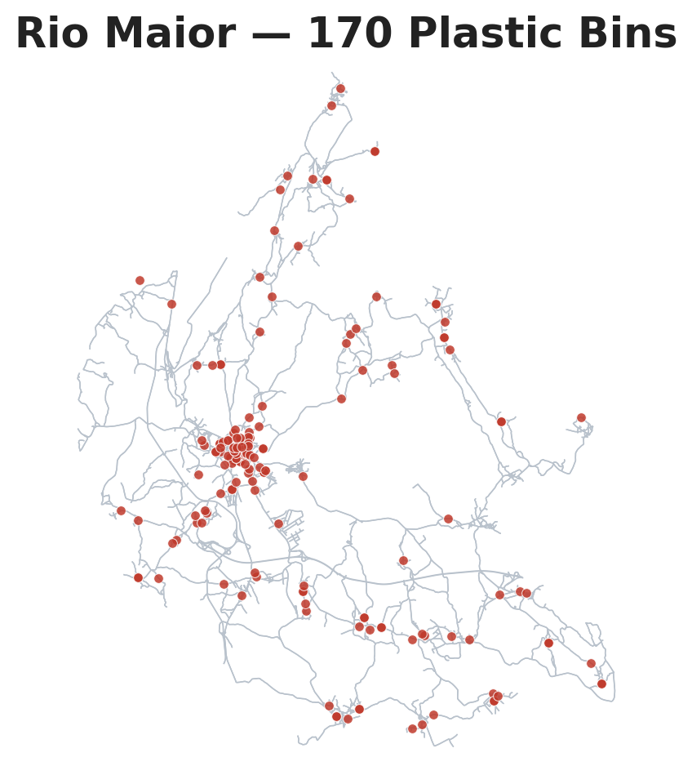
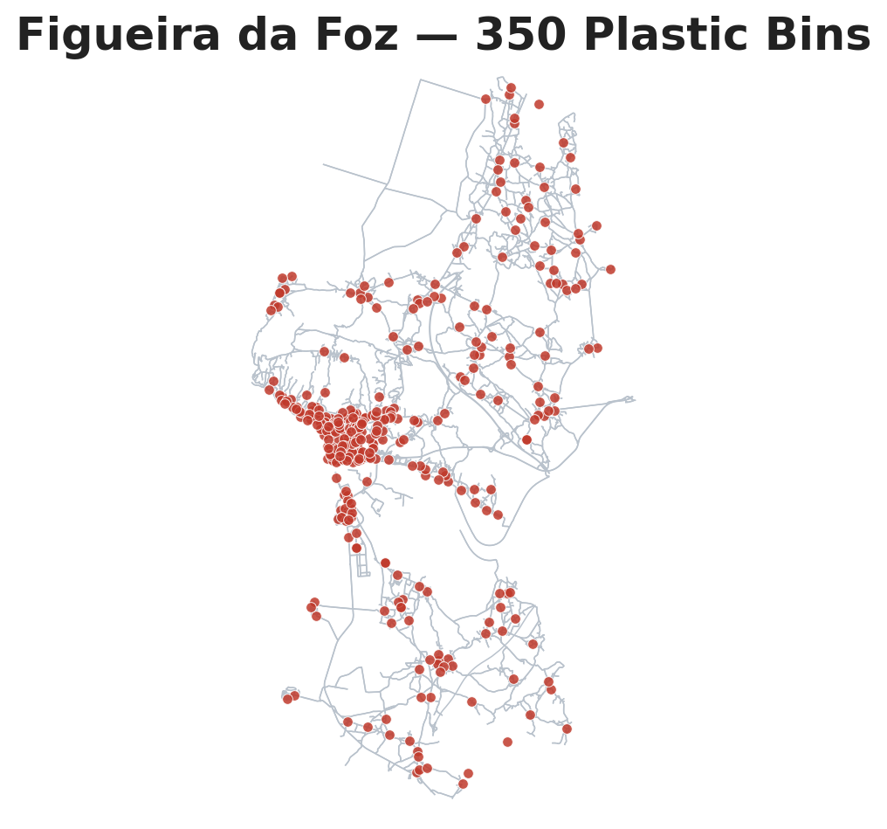
Experimental Methodology
Simulation Runs
30 Days
90 Days
(Pareto-front policies only)
RM-100
RM-170
FFZ-350
RM-100
RM-170
FFZ-350
Empirical / Gamma-3
Empirical / Gamma-3
Empirical / Gamma-3
Empirical / Gamma-3
Empirical / Gamma-3
Empirical / Gamma-3

Slide 12
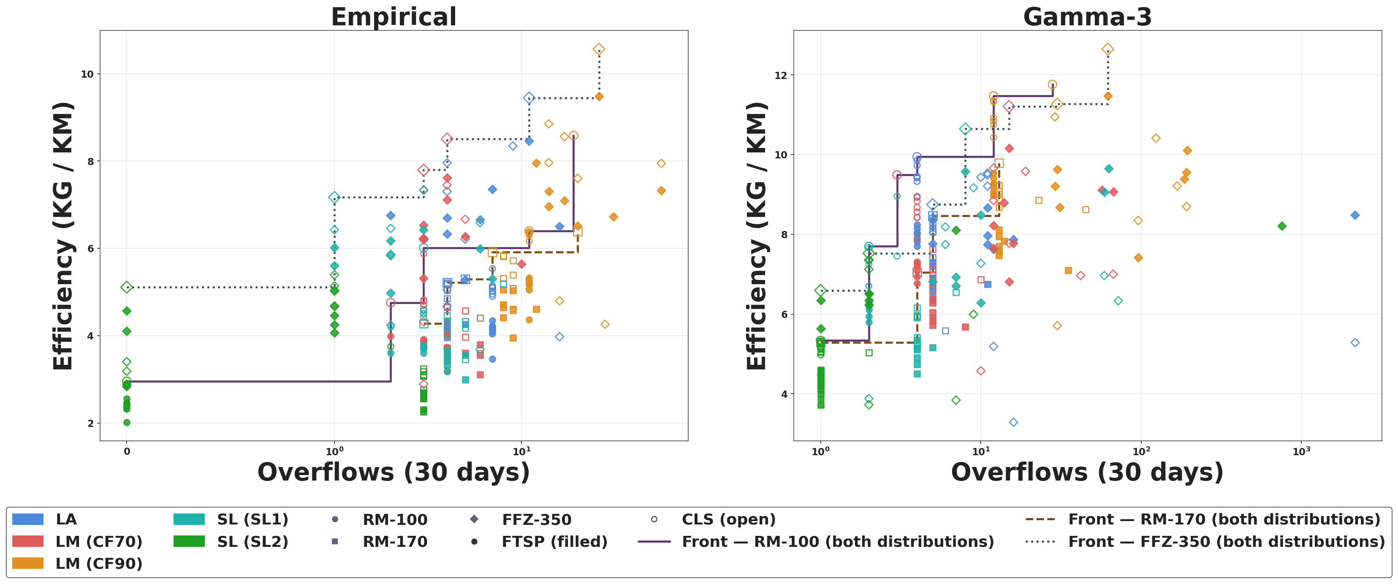
Results — Pareto Front (Overflows vs KG / KM)

Slide 13
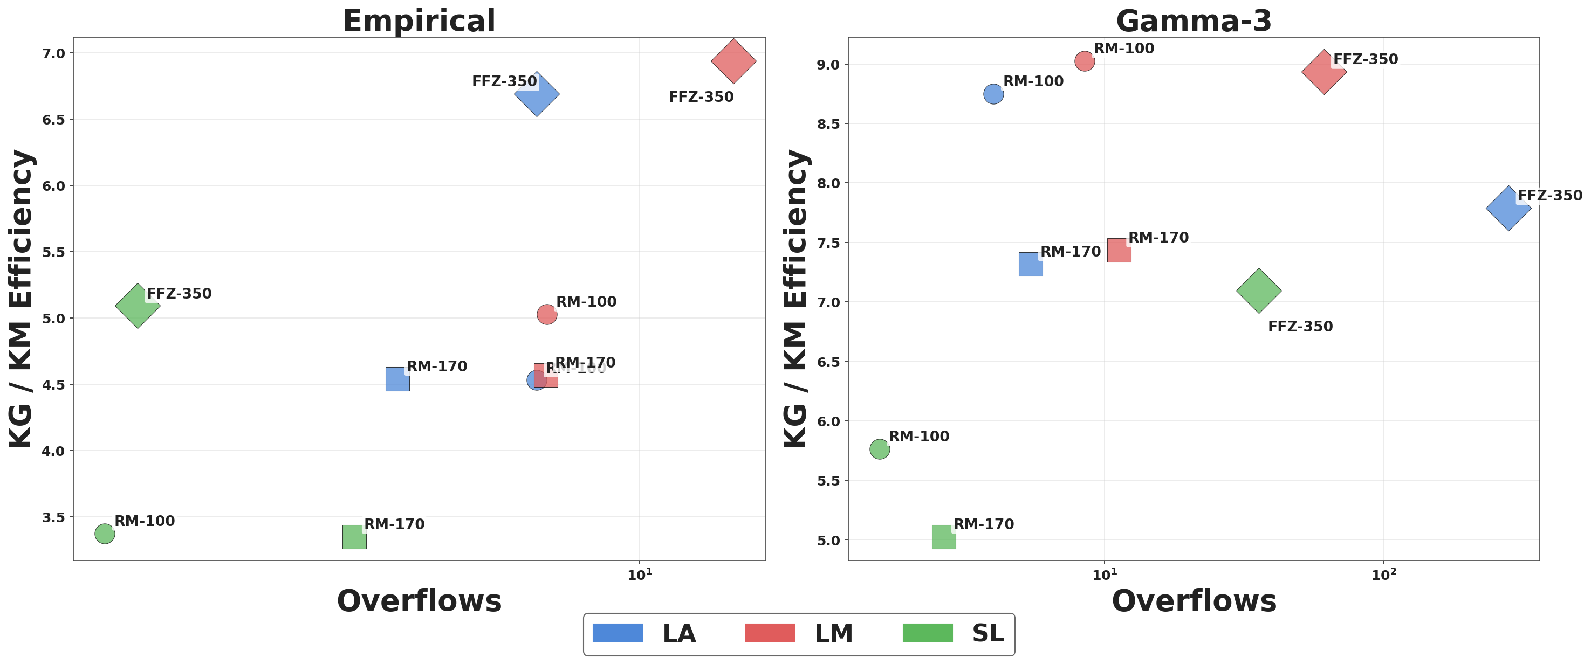
Results — Strategy Trade-off (Overflows vs KG / KM)

Slide 14
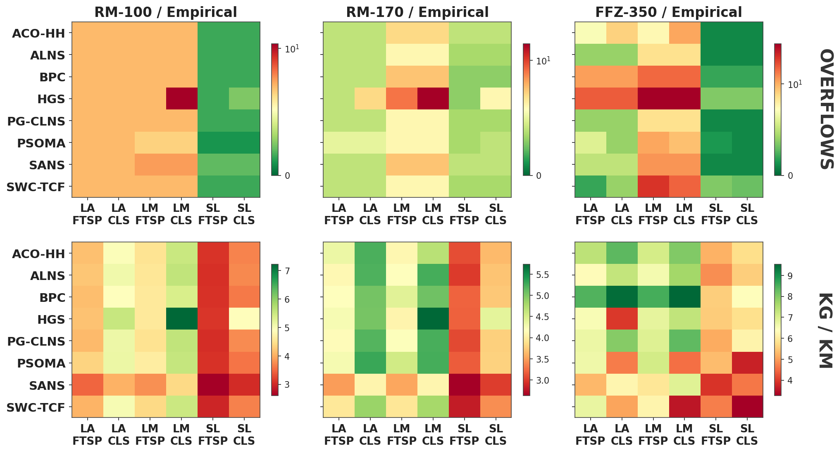
Results — Per-Scenario Heatmaps (Constructors × Strategy·Improver, Empirical Distribution)

Slide 15
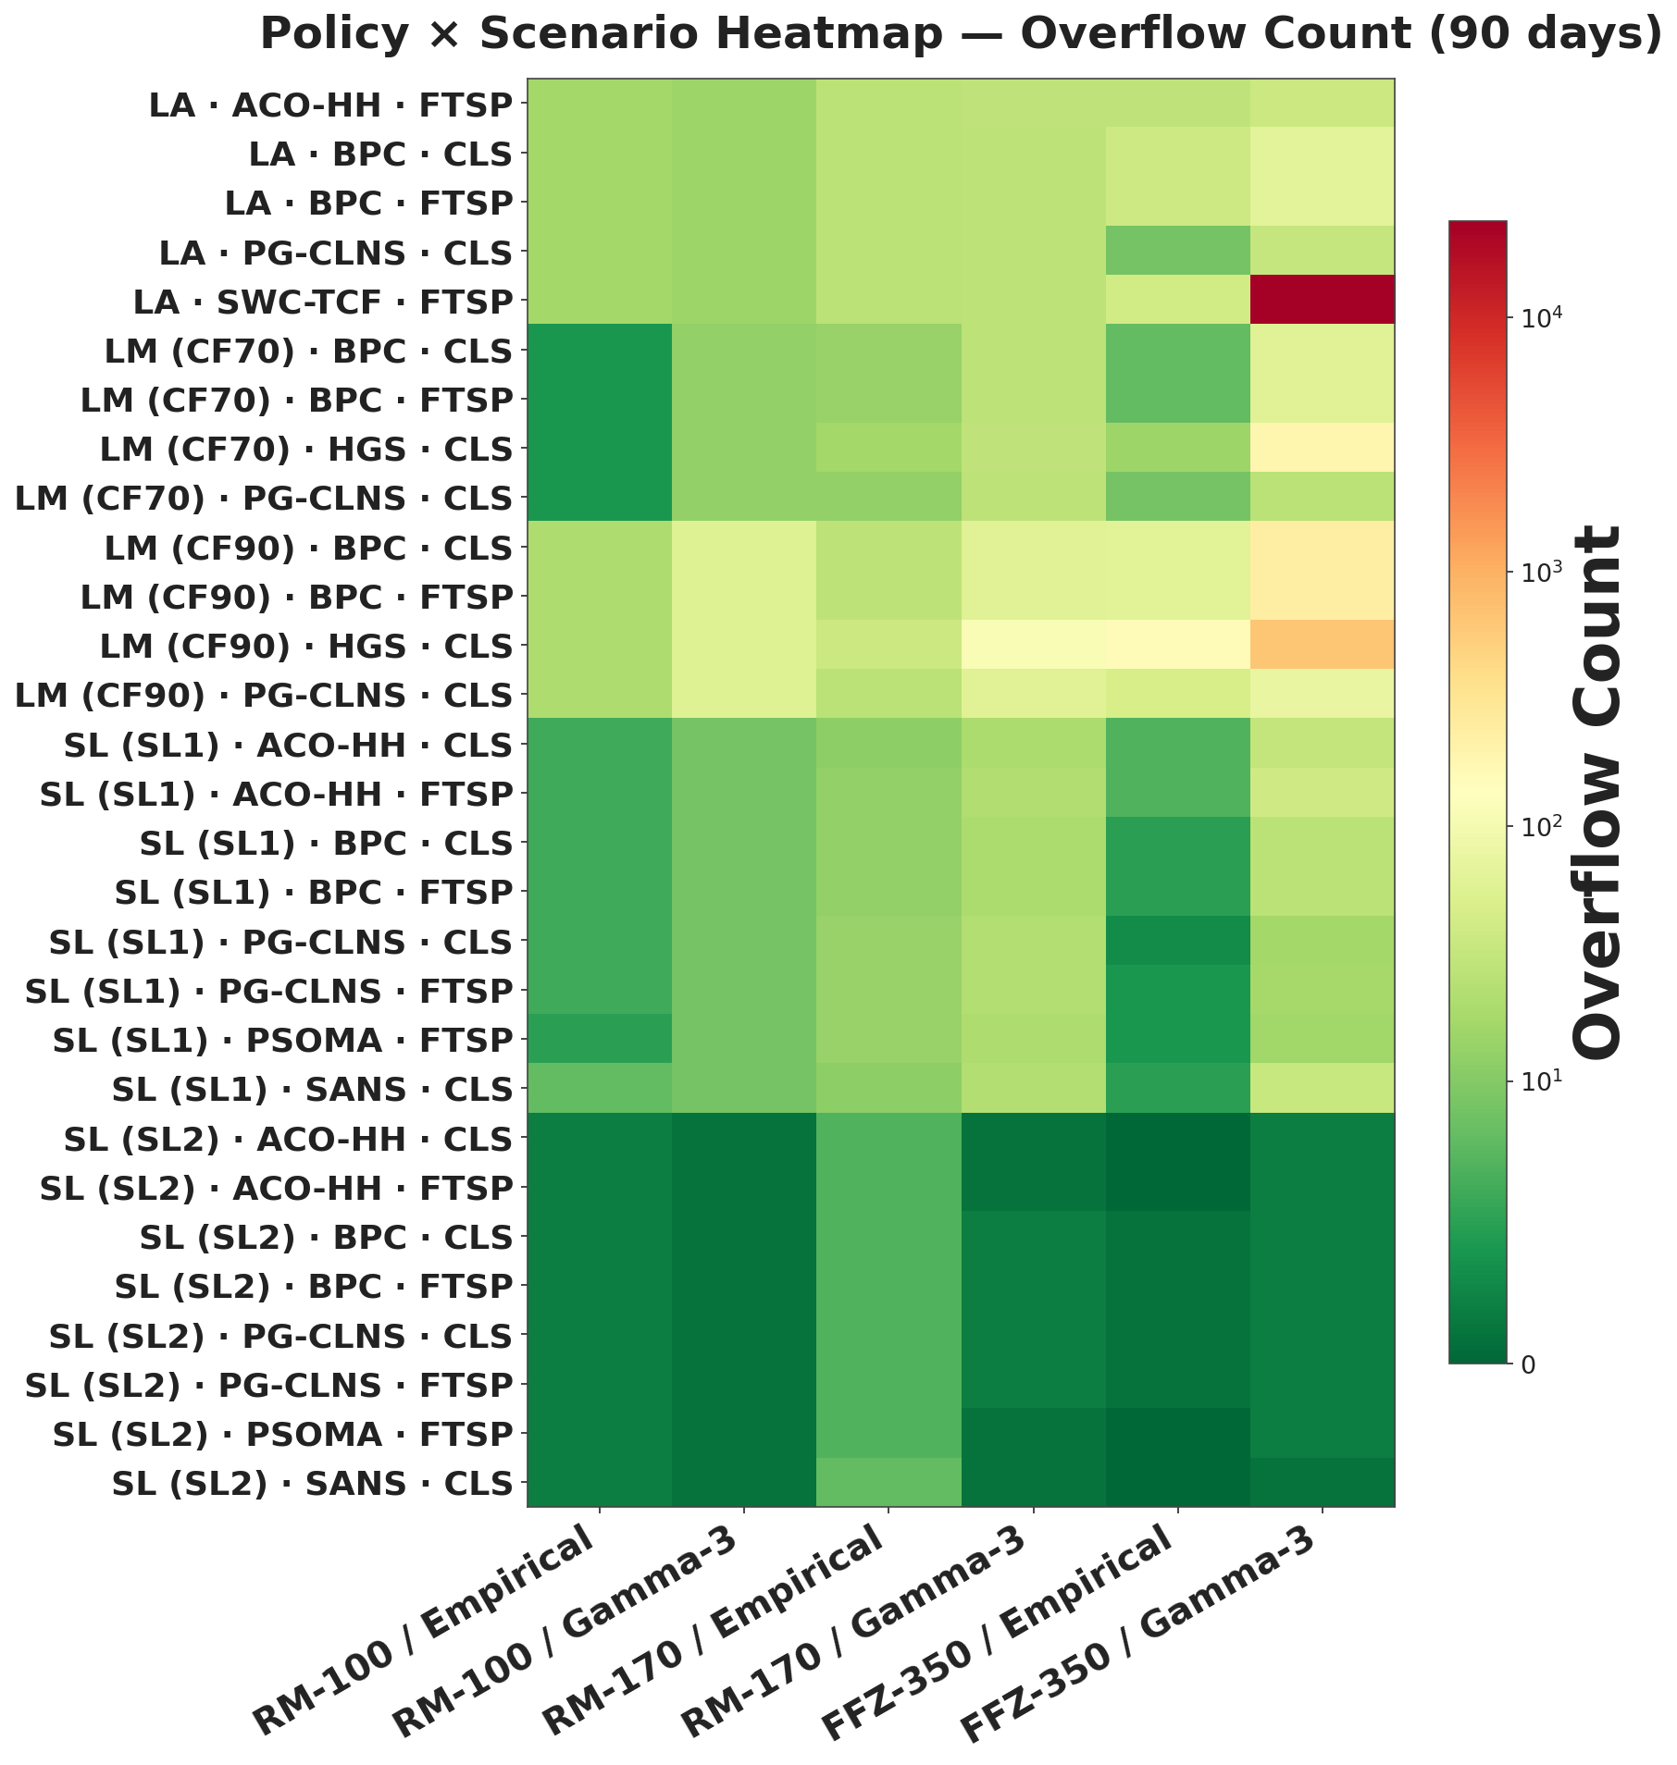
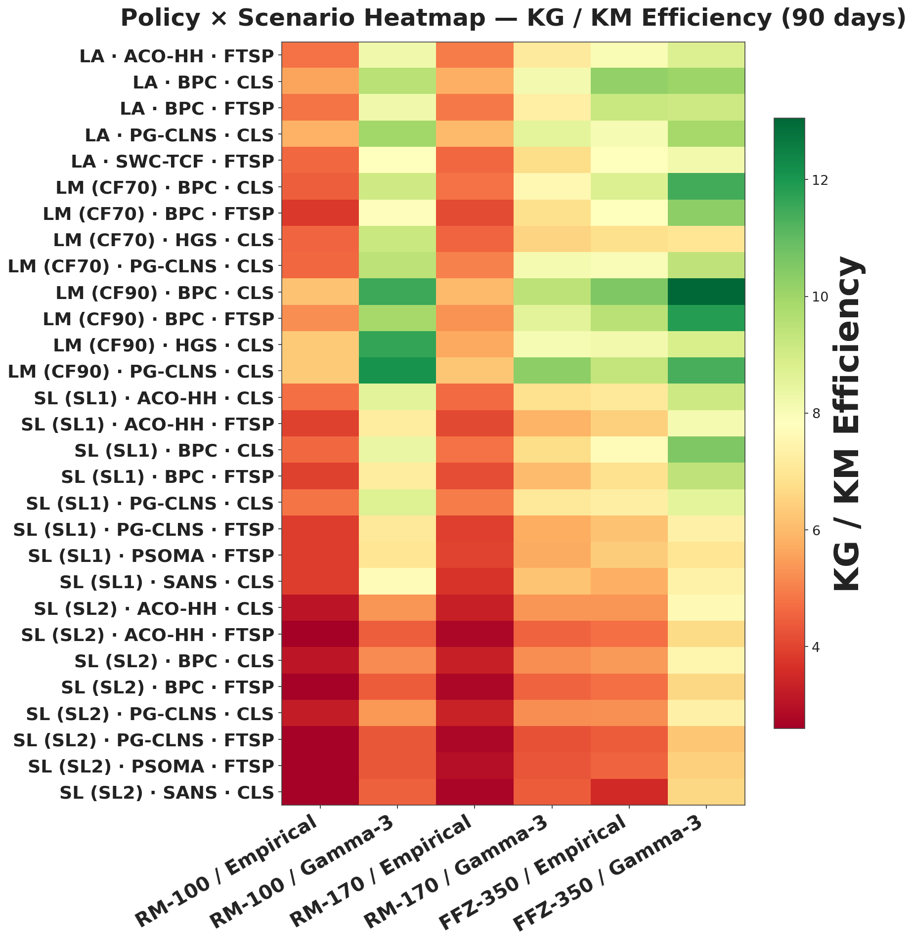
Results — Overflow & KG / KM Heatmaps, 90 Days (Policies × Scenarios)

Slide 16
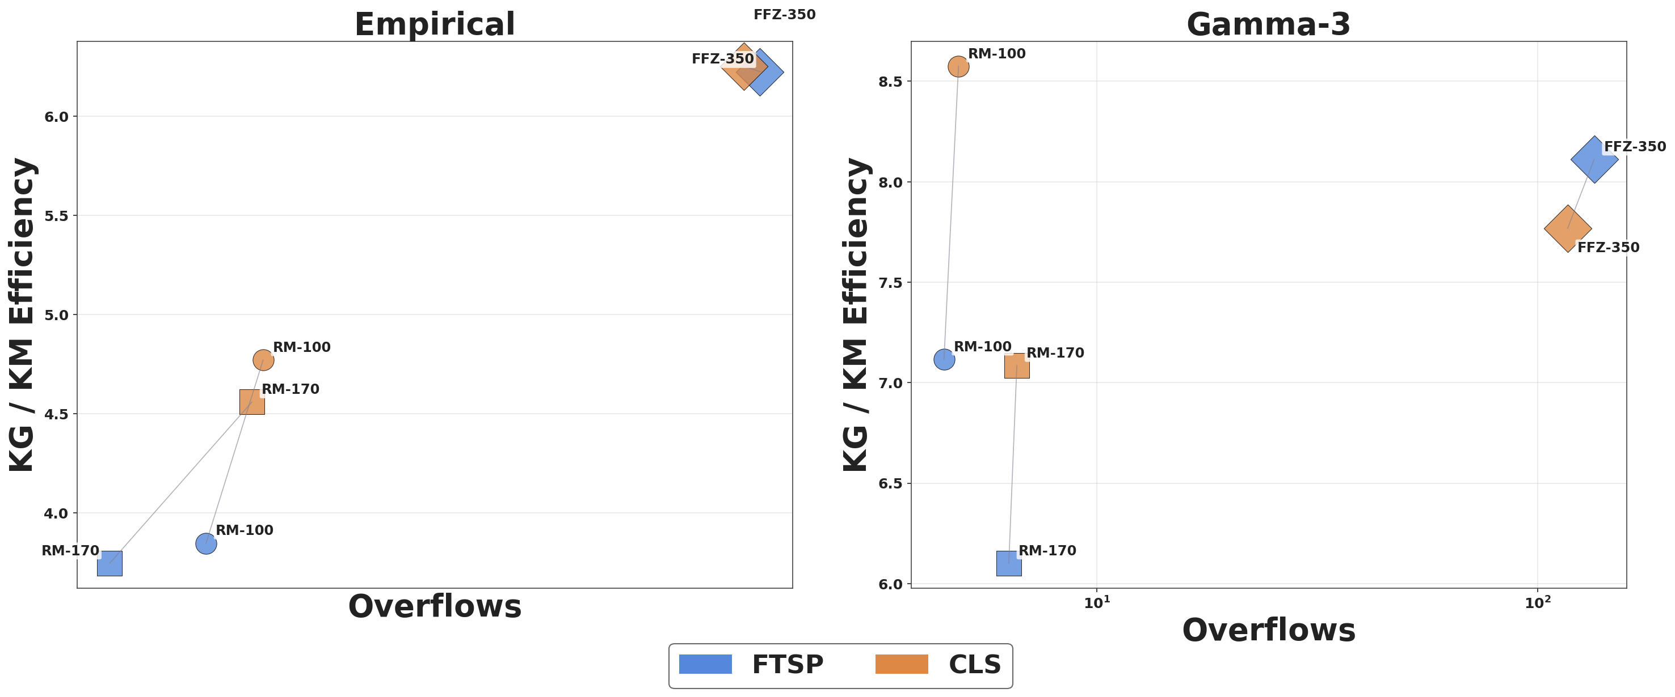
Results — Route Improver Comparison

Slide 17
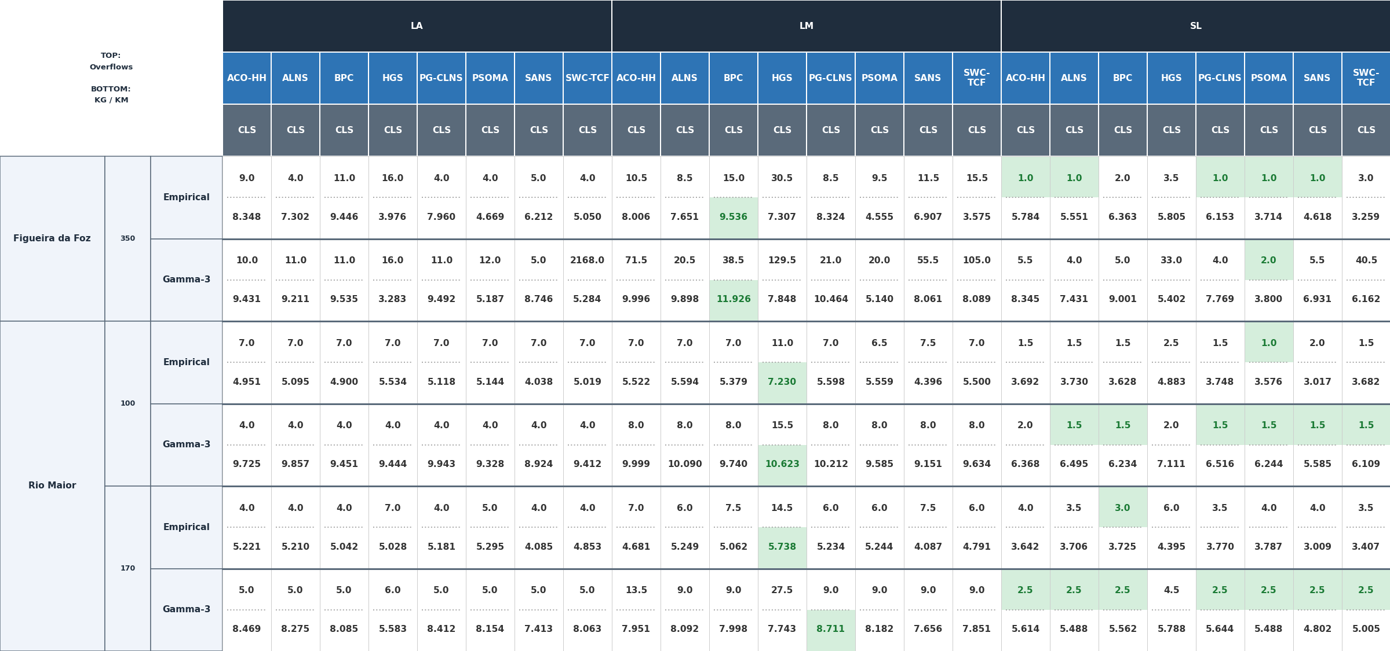
Results — CLS Improver (30-Day Horizon)

Slide 18
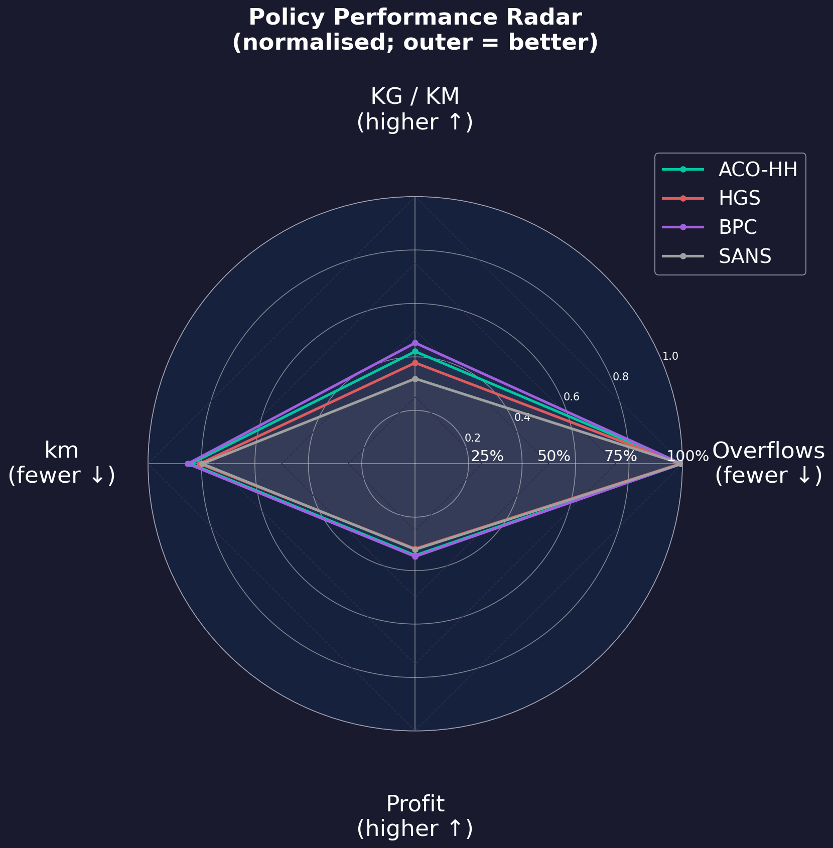
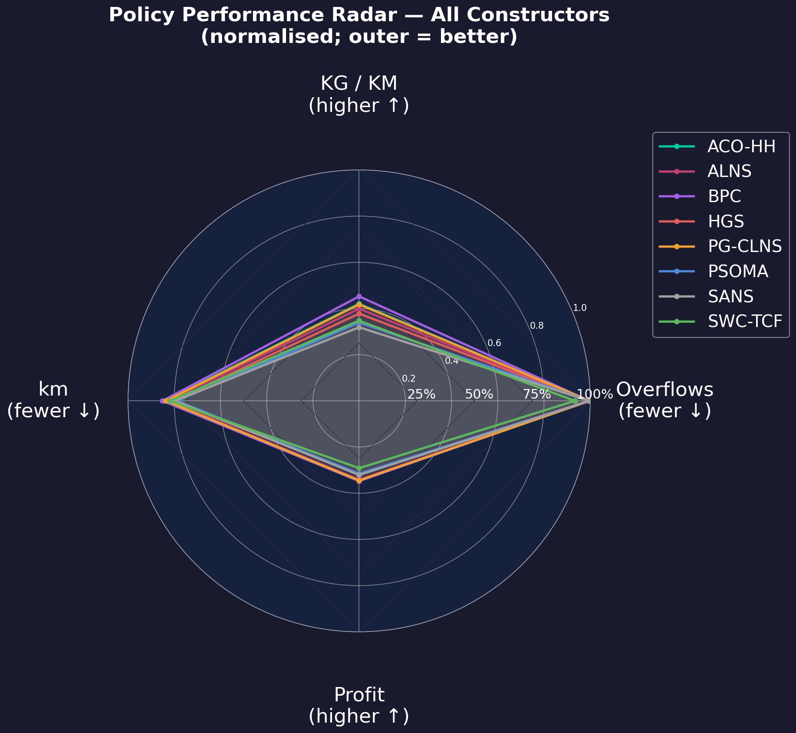
Conclusions, Limitations & Future Work

Slide 19

Acknowledgements
This work was supported by FCT – Foundation for Science and Technology, I.P., under project 2022.04180.PTDC and individual PhD research grant - 2025.06860.BDANA

Slide 20
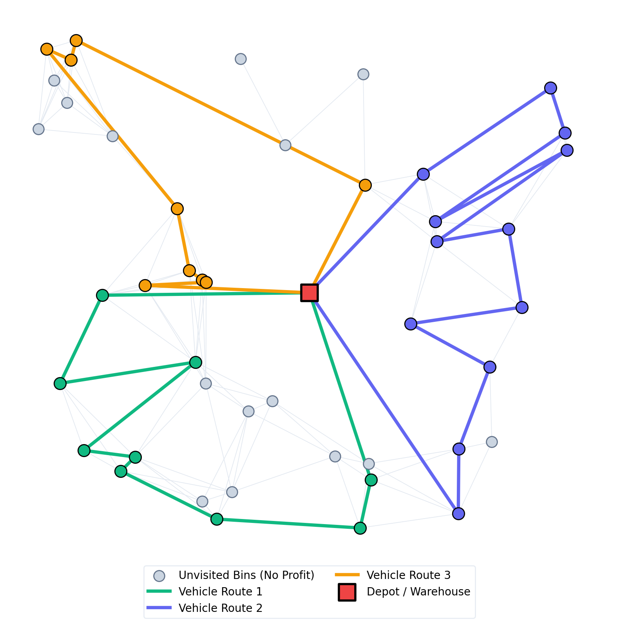
Thank You — Questions & Answers
Thank you for your attention!
Time for questions

