Slide 1


ERA: Emergency Requesting Application

Slide 2
Scope & Limitations

Slide 3
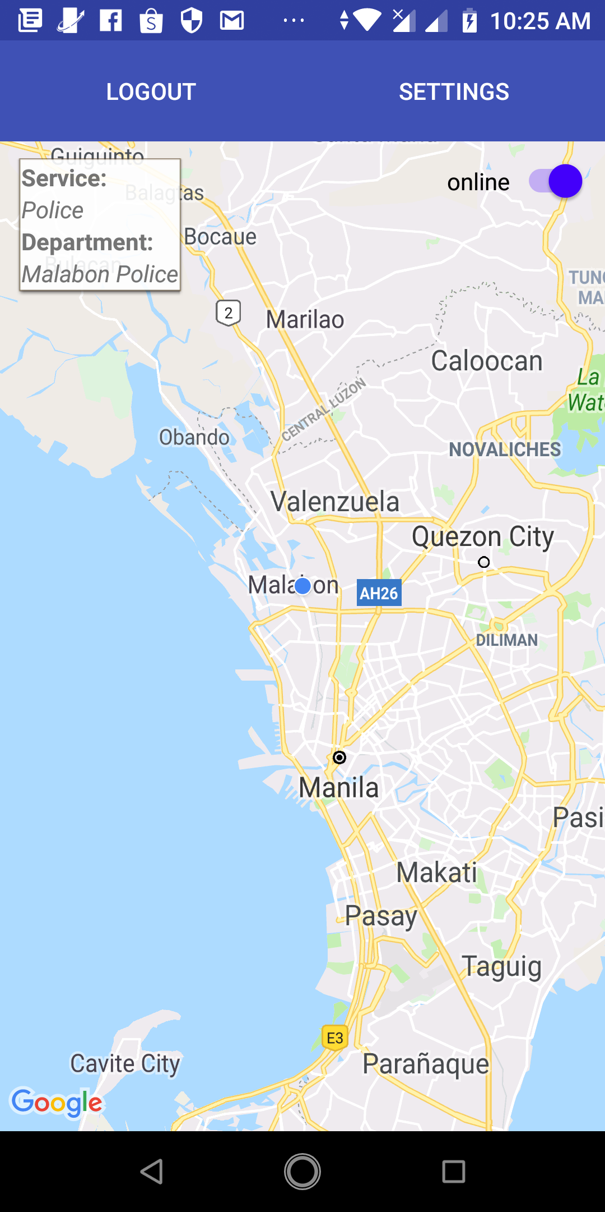
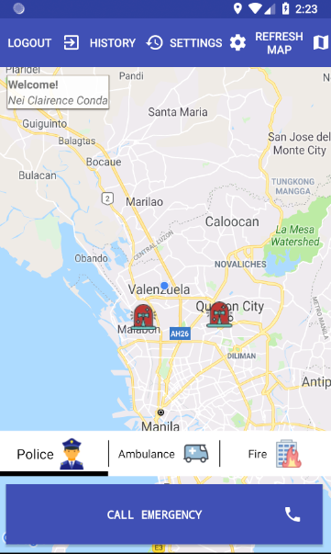
Rescuer
Student

Slide 4
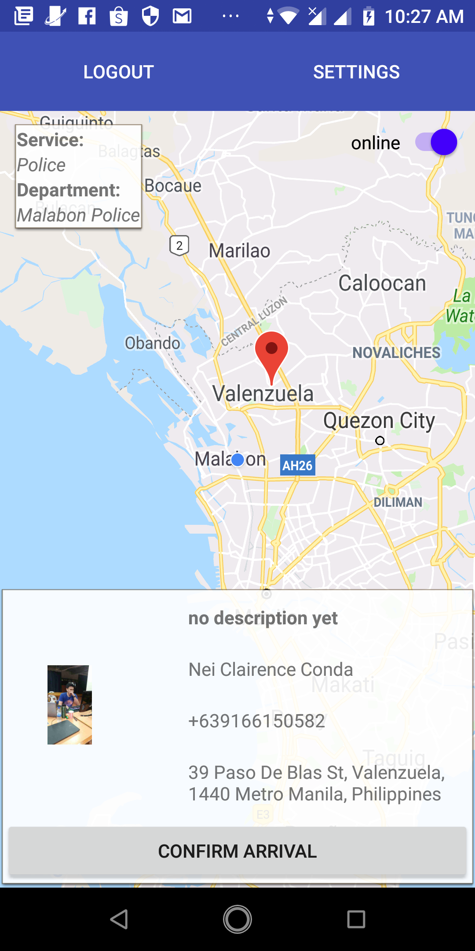
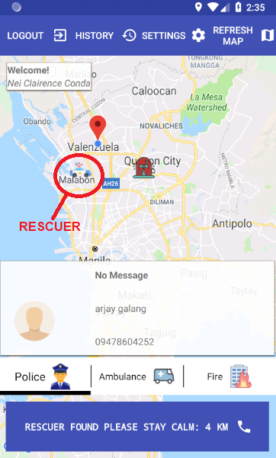
Rescuer
Student

Slide 5
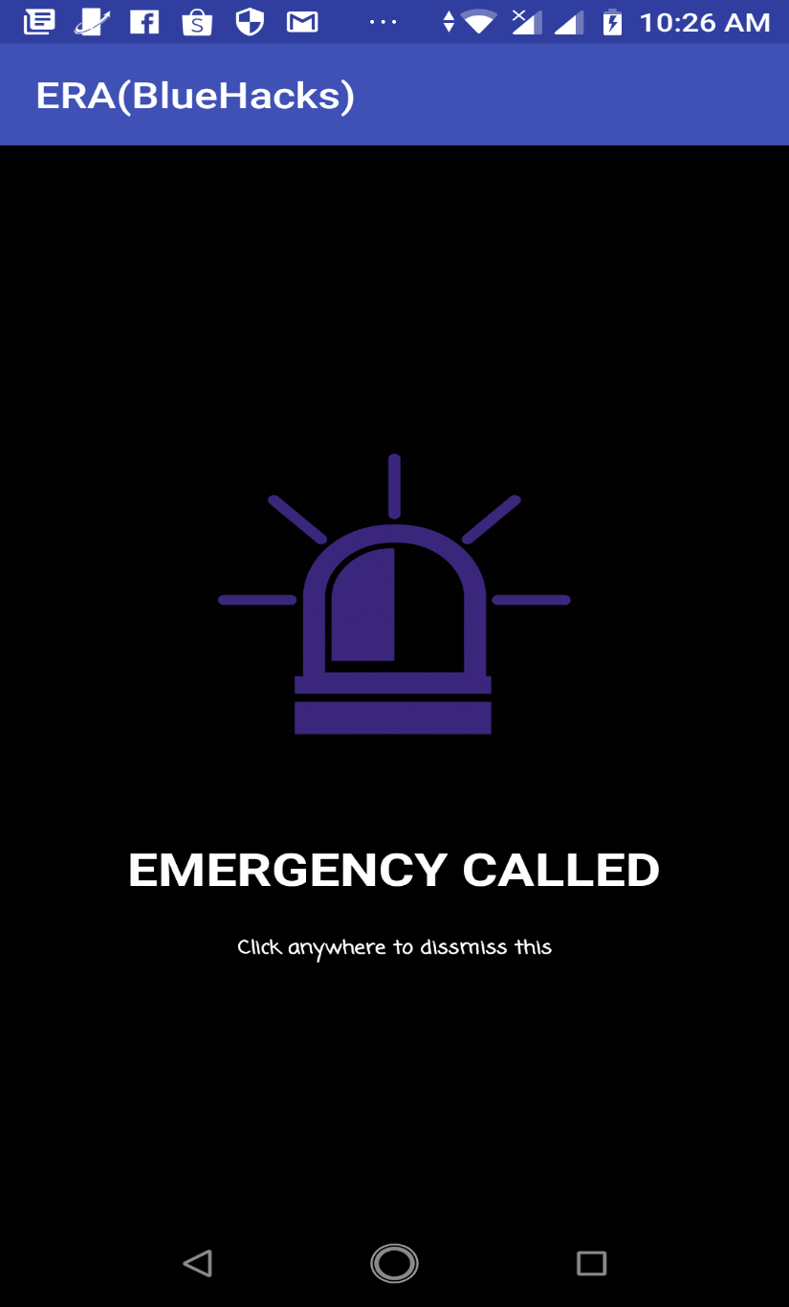
Notification

