Slide 1
Conference Scheduler
By: Ananda Guneratne, Qiao Liang, and Alex Hanson

Slide 2
Responsibilities
Responsibilities differed for different aspects
One would take charge on front end
One would take charge on back end
One would work in the middle writing needed functions and doing design
Example: Rooms for reserving
Ananda – Room backend
Alex – Room frontend
Qiao – Design of frontend page

Slide 3
Technologies Used
MySQL
Python
HTML
CSS
Javascript
MySQLWorkbench

Slide 4
Database Design
Changed as time went on
Resources implemented in a hierarchy structure
Allows for expansion in the future
Different resources

Slide 5
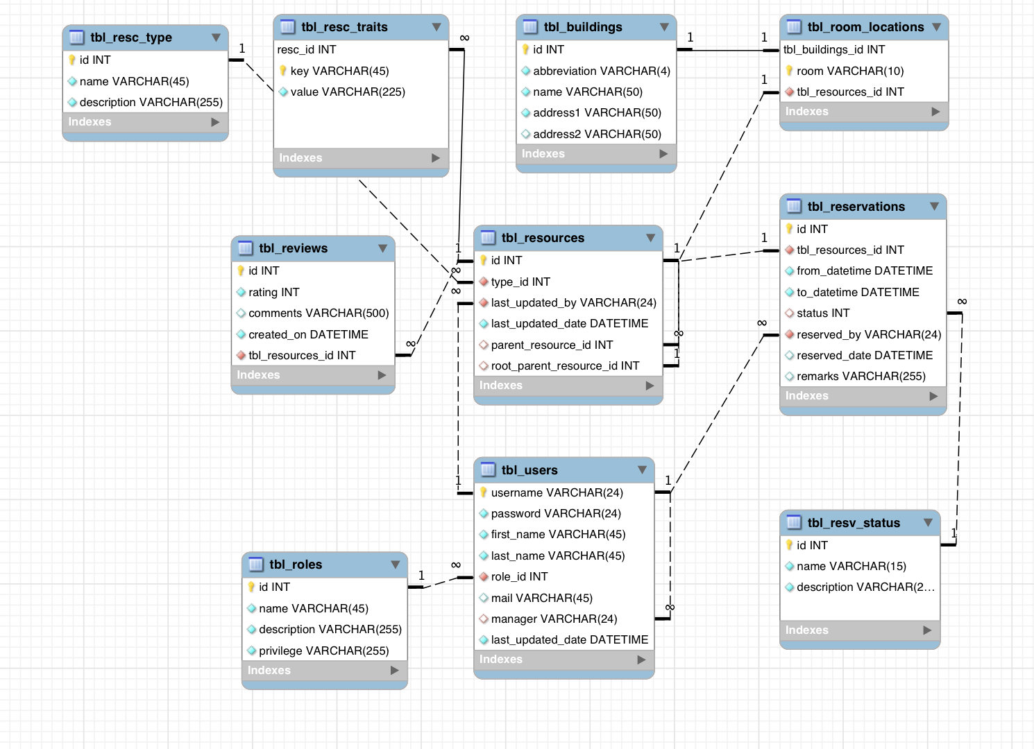

Slide 6
The End Questions?

