Slide 1
Monte Carlo Analysis and Python-based Simulations
Social Science Simulations (SVUH.00.300) · Seminar 6
Kishor Acharya · Institute of Social Studies, University of Tartu
Notes:
Welcome. Today is the first hands-on Python seminar. About 85 minutes, a five-minute break halfway, time at the end to play. Open two tabs now: the course website simulations page, and the Colab notebook. The slides tell you at each stop which animation and which notebook section to look at. No previous knowledge of probability, statistics or programming is assumed.

Slide 2
Three questions that are hard with pen and paper
A referendum
A survey
A city
Polls say 52% yes, but polls are never exact and turnout is uncertain. How likely is it to pass?
You expect a modest difference between two groups. How many people must you interview to detect it?
Each resident has only a mild preference for similar neighbours. Does the city become segregated?
Notes:
All three questions have the same shape: if the world works roughly like this, what should we expect to see? They are hard with formulas because several uncertain things interact. Monte Carlo answers them by letting a computer play the situation out thousands of times and counting. By the end of the seminar you will have answered all three.

Slide 3
Today: a ladder of six stops, and two tabs to keep open
Two dice
estimate a probability by counting
Darts and π
measure a number with randomness
1
2
Tab 1: animations
acharyakishor.com/simulations
Drag sliders, no code.
A referendum
uncertainty in, a range of outcomes out
Planning a survey
test a study design on fake data
3
4
Tab 2: notebook
Schelling's city
run an agent-based model many times
Where this leads
bootstrap, sensitivity, MCMC
5
6
Colab link on the course page.
Same experiments, with the code.
At every stop an “On your screen” slide tells you which animation and which notebook section to open, what each slider means, and what to look for.
Notes:
Each stop adds exactly one new capability. Stops 1 and 2 estimate things we could calculate, so we can check the method against the truth. From stop 3 on, Monte Carlo does things we cannot easily do any other way. Stop 5 connects everything to agent-based models. Break after stop 3.

Slide 4
Solitaire, a casino, and a secret project
Where the name comes from
Los Alamos, 1946
Notes:
Before the method, the story. It explains the odd name and it contains the whole idea.

Slide 5
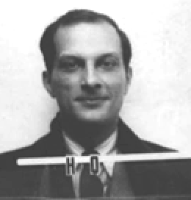
1946: a sickbed and a deck of cards
Stanisław Ulam
Stanisław Ulam, recovering from a serious illness, plays Canfield solitaire to pass the time.
He wonders: what is the chance that a randomly dealt layout can be won?
He tries to calculate it by pure combinatorics. Hopeless.
Then a simpler idea: lay the cards out a hundred times, count how many games come out, and take the proportion as the answer.
Los Alamos National Laboratory, 1940s · public domain
Metropolis, N. (1987). The beginning of the Monte Carlo method. Los Alamos Science, 15, 125–130.
Notes:
Ulam's insight is the entire method in one sentence: when you cannot calculate the answer, play the game many times and count. The more games, the better the estimate. Everything else today is this idea applied to bigger games.

Slide 6
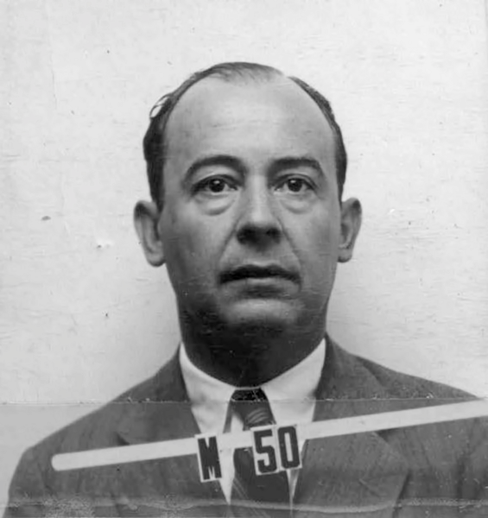
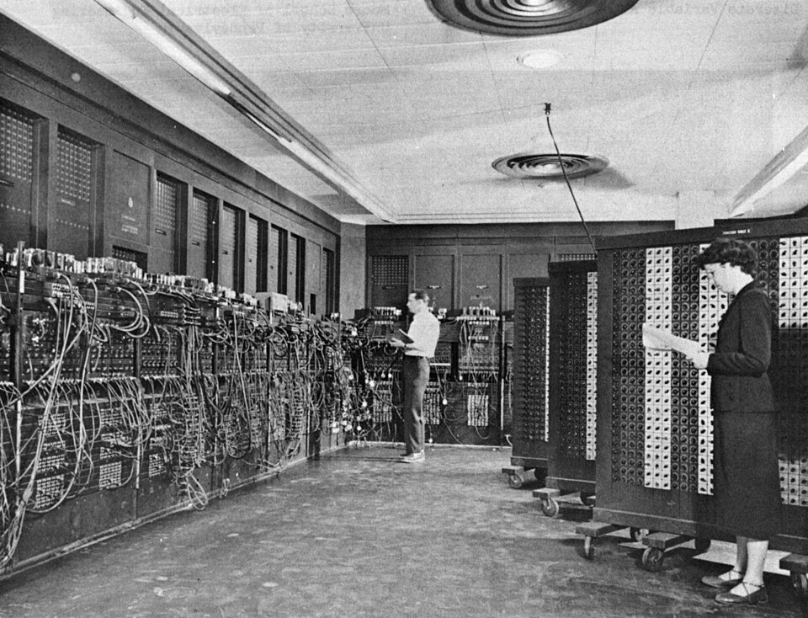
The same trick for a much harder problem
John von Neumann
ENIAC (1947)
At Los Alamos, physicists could not solve the equations for how neutrons travel through material.
But following one neutron on its random path is easy: how far it goes, whether it is absorbed or scattered.
Follow thousands of neutrons and count: the answer the equations could not give.
John von Neumann worked out how to run it on ENIAC, the first electronic computer, in 1947.
Los Alamos National Laboratory · public domain
U.S. Army photo · public domain
Trade thinking for computing
Notes:
The neutron problem is the solitaire problem again: an exact formula is out of reach, but one random instance of the process is easy to simulate. A computer can simulate thousands. What took ENIAC days takes your laptop a fraction of a second.

Slide 7
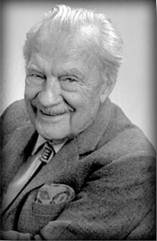
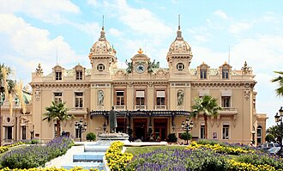
Why it is called Monte Carlo
Nicholas Metropolis
Casino de Monte-Carlo
The work was secret and needed a code name.
Nicholas Metropolis proposed “Monte Carlo”: the casino in Monaco where Ulam's uncle used to borrow money from relatives to gamble.
First public description: Metropolis & Ulam (1949).
Metropolis, N., & Ulam, S. (1949). The Monte Carlo method. Journal of the American Statistical Association, 44(247), 335–341.
Notes:
Metropolis tells this story himself in 1987. Some books say von Neumann chose the name; Metropolis's own account is the first-hand source. The gambling connection is not a coincidence: cards and dice are the simplest random processes, which is why we start with dice.

Slide 8
Three things to keep from the story
Born from gambling
Thinking for computing
Impossible before computers
Cards and dice are the simplest random processes. That is why we start with them, and why the vocabulary (odds, draws, runs) comes from the casino.
When the formula is out of reach, simulate the process and let the machine count. Patience is something a computer has in unlimited supply.
Buffon dropped needles by hand in 1777 to estimate π. What was new in 1946 was scale, and the realisation that almost any problem with randomness in it can be attacked this way.
Notes:
We meet Buffon's needle again at stop 2.

Slide 9
Probability, random numbers, distributions, and the law of large numbers
Part A · Four ideas the method rests on
Notebook Part A follows the same four headings.
Notes:
Four ideas, each with a picture. Notebook sections A.1 to A.4 are the same four, with sliders.

Slide 10
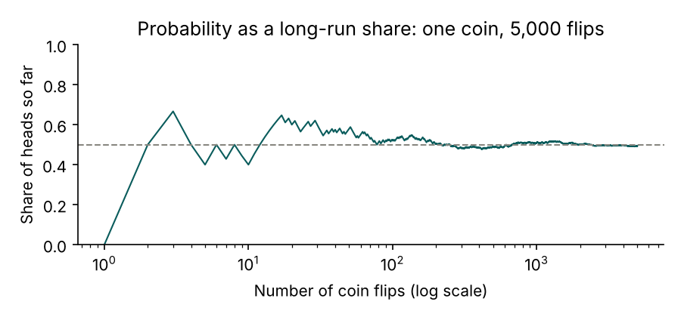
Probability is a long-run share
“Probability of heads is ½” means: in an enormous number of flips, about half are heads.
After 10 flips the share might be 0.3 or 0.7. After 5,000 it is very close to 0.5.
Probability is where the line settles.
So a probability can be measured by repeating the experiment and taking the share. No formula, only patience.
Notebook A.1: drag “Flips” from 10 to 5,000 and watch the swings narrow.
Notes:
One simulated coin flipped 5,000 times. This way of thinking is the secret of Monte Carlo: if probability is a long-run share, we can measure a probability by running the experiment many times.

Slide 11
Random numbers from a computer
What you want | Excel | Python (notebook)
a number between 0 and 1, all equally likely | =RAND() | rng.random()
a whole number from 1 to 6 (a die) | =RANDBETWEEN(1,6) | rng.integers(1, 7)
a bell-curve number, mean 100, SD 10 | =NORMINV(RAND(),100,10) | rng.normal(100, 10)
A computer cannot produce truly random numbers. It runs a formula whose output passes every test of randomness: pseudo-random. Good enough for us.
The sequence starts from a seed. Same seed, same “random” numbers, every time.
That is a feature: your colleague can reproduce your simulation exactly. Every notebook section begins by fixing a seed.
Notes:
This is the only slide with code on it, because the correspondence with Excel is worth seeing. Notebook A.2 runs these lines and shows that seed 7 gives the same numbers twice.

Slide 12
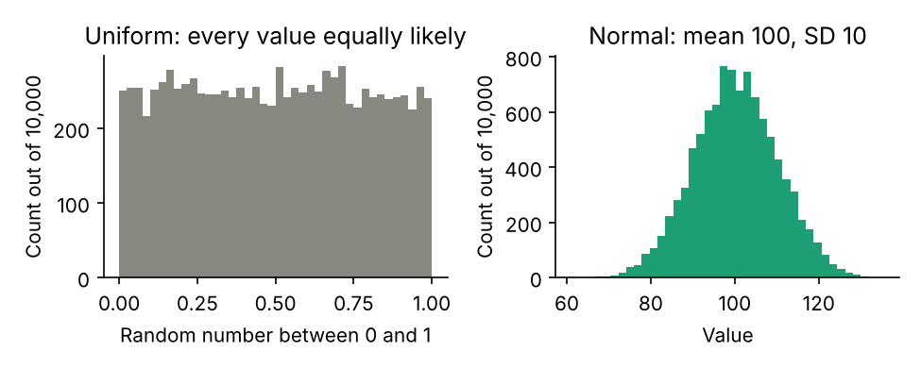
Distributions: the shape of uncertainty
A distribution says which values a random quantity takes, and how often. Draw many values, make a histogram, and you can see it.
Uniform: every value in a range equally likely. The computer's default.
Normal (bell curve): values cluster around a mean; the standard deviation (SD) sets the spread. 68% within 1 SD, 95% within 2, 99.7% within 3.
Notebook A.3: move the mean and SD sliders; the shaded band always holds about 95% of the draws.
Notes:
Two distributions do almost all the work today. Uniform is right for a dart thrown at random; normal is right for the error of an opinion poll. Converting one to the other is one line in Python or Excel, as in Verschuuren's book shared earlier in the course.

Slide 13
The law of large numbers, and the 1/√N rule
1713
1/√N
100× → 10×
Jacob Bernoulli proves it: the average of many random trials settles on the true value
the typical error of a Monte Carlo estimate shrinks with the square root of the number of runs
a hundred times more runs buys ten times less error
This is the guarantee that Monte Carlo works at all.
It also tells us the price: diminishing returns. Ten thousand runs give roughly two decimal places; a million give three.
Consequence: always report a Monte Carlo result together with its spread, and run at least a thousand times.
Bernoulli, J. (1713). Ars Conjectandi.
Notes:
The law of large numbers is why the coin's running share settles. The square-root rule is how fast. We see it as a straight line at stop 1.

Slide 14
Part B · The recipe
Monte Carlo answers a question by generating many random versions of the situation and counting what happens.
Three ingredients
Four steps
A model with something uncertain in it
A random number generator to draw one version
Repetition and aggregation: thousands of draws, then count or average
Define the output you care about
Describe each uncertain input by a distribution
Draw, run the model once, record. Repeat N times
Summarise the N outputs, with their uncertainty
Notes:
That is the whole method. Every Monte Carlo simulation has these three ingredients and follows these four steps. What differs is what sits inside the model and which summary you take. The rest of the seminar climbs through five uses of this recipe.

Slide 15
Two dice, and the first Monte Carlo
Stop 1
Estimate a probability by counting. Watch the error shrink.
Notes:
A question we can answer exactly, so we can check the simulation against the truth.

Slide 16
Roll two dice and add them. How often is the sum 7?
The exact answer
The Monte Carlo answer
6 × 6 = 36 equally likely pairs of faces.
Six of them add to 7: 1+6, 2+5, 3+4, 4+3, 5+2, 6+1.
Probability = 6/36 = 1/6 ≈ 16.7%.
Roll two dice 10,000 times. Add. Count how many sums are 7. Divide by 10,000.
Result: about 0.167, give or take a few thousandths.
It does not know any of the left box. It rolls, adds, and counts. (Notebook 1.1: four lines of code.)
STOP 1 · DICE
Notes:
Left: the pen-and-paper answer. Right: what the simulation does. Run notebook 1.1 twice: the estimate changes slightly each time. The estimate is itself random, which is why we will always report a spread.

Slide 17
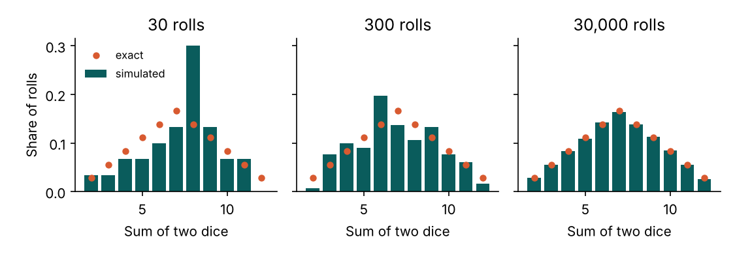
More rolls, better picture
Bars: simulated share of each sum. Dots: the exact probabilities. With 30 rolls the shape is barely there; with 30,000 the bars sit on the dots.
STOP 1 · DICE
Notes:
Open the dice animation now and drag the slider: at 10 rolls the histogram is noise, at 100 recognisable, at 10,000 nearly perfect. You are watching the law of large numbers before anyone names it.

Slide 18
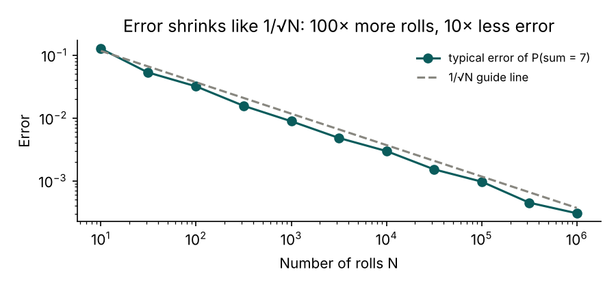
The error shrinks like 1/√N
Each point: the typical error of the estimate of P(sum = 7), averaged over 20 repetitions.
On log-log axes the points fall on a straight line with slope −½.
Every hundredfold increase in rolls buys a tenfold reduction in error.
STOP 1 · DICE
Notes:
The square-root rule made visible. It holds for every example today, including the agent-based model.

Slide 19
Stop 1 · On your screen
Website animation “Two dice”: drag Rolls, press Roll again several times at each setting.
Notebook sections 1.1 to 1.3: run each cell; the ▶ Try it cell has the slider.
Parameter | What it means | What to watch
Rolls (N) | How many times the two dice are thrown | Bars approach the dots as N grows; the error on P(7) shrinks roughly as 1/√N
Roll again | A fresh set of random rolls at the same N | At small N each press gives a visibly different picture: the estimate is itself random
✎ Exercise, for later (notebook): estimate the probability of a double (both dice equal); exact answer 1/6.
Notes:
Give three minutes. Ask them to find the smallest N at which P(7) is reliably within one percentage point of 16.7%.

Slide 20
What we learned at stop 1
A probability can be measured by counting, without any formula.
The estimate is itself random: run it twice and you get two slightly different numbers.
More runs give a better estimate, with diminishing returns (1/√N).
Notes:
Three points that carry through everything else.

Slide 21
Darts, π, and measuring with randomness
Stop 2
Now the output is a number, not a probability.
Notes:
Same trick, different kind of question: a number that has nothing to do with chance.

Slide 22
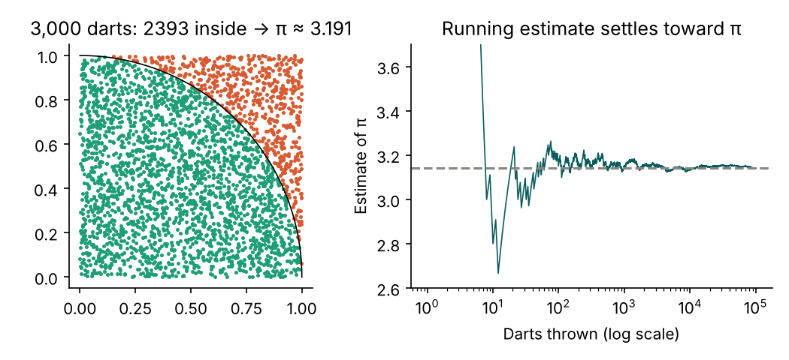
Throw darts; count the ones inside the circle
Square of side 1: area 1. Quarter circle inside it: area π/4 ≈ 0.785.
Throw darts completely at random. The share landing inside equals the share of the area.
π ≈ 4 × (inside ÷ thrown)
Nobody is gambling here. Randomness is a ruler.
STOP 2 · DARTS
Notes:
Dart-throwing samples the board evenly, and the count turns a geometric question into a counting question. Right panel: the estimate is wildly wrong for the first few dozen darts, swings less and less, and after 100,000 darts is within a few thousandths of π. It never becomes exact. Quote it with a margin: 3.14 plus or minus 0.01.

Slide 23
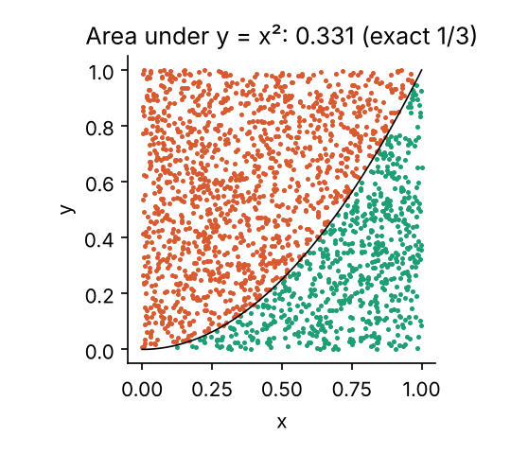
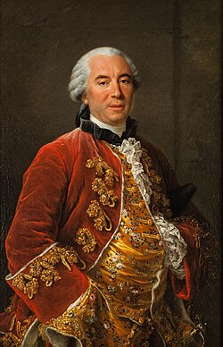
Any area, in any number of dimensions
Comte de Buffon
Replace the circle by the region under any curve: the count gives its area, the integral. Here y = x², exact area 1/3.
For one curve a calculator does better. In ten or a hundred dimensions ordinary methods become impossibly slow; random sampling costs the same regardless of dimension.
Buffon's needle (1777): drop needles on a boarded floor; the share crossing a crack depends on π. The first Monte Carlo, done by hand.
Buffon, G.-L. L. (1777). Essai d'arithmétique morale. · Verschuuren (2017), simulation 89, builds the same example in Excel.
STOP 2 · DARTS
Notes:
Monte Carlo integration is standard in physics, Bayesian statistics and economics, because it does not care how many dimensions the problem has.

Slide 24
Stop 2 · On your screen
Website animation “Darts and π”: drag Darts, press Throw again.
Notebook sections 2.1 to 2.3, plus the Buffon's needle cell.
Parameter | What it means | What to watch
Darts (N) | How many random points are thrown at the square | The running estimate wanders, then settles near 3.14 but never becomes exact
Throw again | A fresh set of darts at the same N | Two runs at the same N give two different paths and two different final estimates
f(x) (notebook 2.3) | The curve whose area is measured | Change x**2 to any curve and the same count gives its area
✎ Exercise, for later (notebook): how many darts are needed before the estimate is reliably within 0.01 of π? Does 1/√N predict it?
Notes:
Three minutes. Point out the convergence plot: the lesson is the margin, not the digits.

Slide 25
What we learned at stop 2
Monte Carlo can estimate numbers, not just probabilities, by turning a measurement into a count.
The running estimate converges but never becomes exact: always report a margin.
The method does not care how many dimensions the problem has. That is its great advantage.
Notes:
From here on, Monte Carlo starts doing things we could not do any other way.

Slide 26
A referendum, and taming the future
Stop 3
Feed distributions in. Read a distribution out.
Notes:
Stops 1 and 2 estimated things we could have calculated. This is the first thing we cannot easily do by hand: combine several uncertainties and see the whole range of outcomes.

Slide 27
Polls say 52% yes. Will it pass?
52%
± 3 points
−1 ± 1
the polls say yes
polls have historically missed the result by about this much, either way
the yes side tends to turn out slightly less, costing about a point
A single number cannot answer this. 52 − 1 = 51, “yes, narrowly”, ignores the ±3 and the ±1.
The honest answer is a probability. Monte Carlo gets it by simulating ten thousand election nights, each with its own random poll error and turnout effect.
STOP 3 · REFERENDUM
Notes:
Every fixed input becomes a distribution: the poll error is normal with SD 3, the turnout effect is normal with mean minus one and SD one. Add them to 52 ten thousand times and you have ten thousand possible election nights. Notebook 3.1 is three lines.

Slide 28
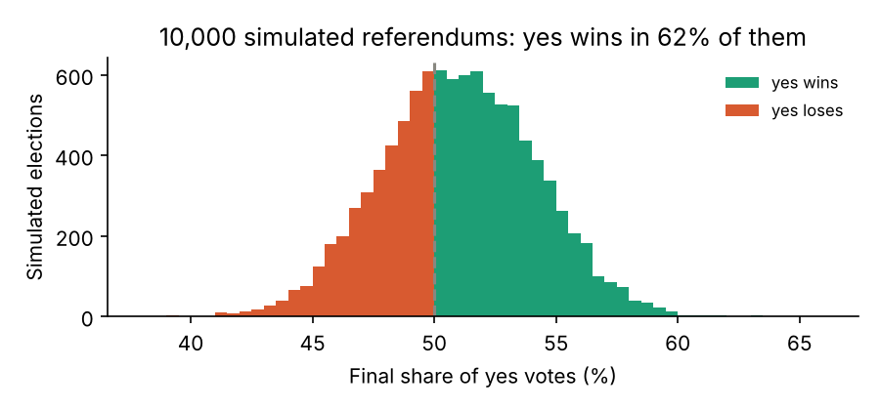
Ten thousand election nights
62%
chance the proposal passes
46% – 56%
90% of outcomes fall in this range
Three things the number 52 could not say: it will probably pass; there is a real chance (38%) it fails; almost any result between 46 and 56 would be unsurprising.
Verschuuren, G. M. (2017). 100 Excel Simulations: “taming the future” with NORMINV.
STOP 3 · REFERENDUM
Notes:
The histogram is the deliverable. This is the use of Monte Carlo you meet most often outside the classroom: project schedules, engineering risk, insurance pricing, outbreak projections. Verschuuren calls it taming the future: not predicting it, mapping how wide it is.

Slide 29
Stop 3 · On your screen
Website animation “Referendum”: three sliders for the inputs, one for the number of simulations.
Notebook sections 3.1 and 3.2, the ▶ Try it cell, and the budget exercise skeleton.
Parameter | What it means | What to watch
Polled yes % | What the last polls say | Move it toward 50: the pass probability falls fast near the line
Poll error ± | How wrong polls usually are (SD, points) | Widen it: the histogram flattens and the probability moves toward 50/50
Turnout tilt | Average points gained or lost through turnout | Shifts the whole histogram left or right
Simulations | How many election nights are played | At 100 the histogram is ragged; at 10,000 it is smooth (1/√N again)
✎ Exercise, for later (notebook): the fieldwork budget: three uncertain cost items, find the probability of exceeding €12,000, then the budget that is safe 95% of the time.
Notes:
Four minutes. Task: find the poll lead at which the pass probability reaches 90%. Then the break.

Slide 30
What we learned at stop 3
Replace every fixed input by a distribution; the output becomes a distribution too.
Summarise it as a probability, a median, and a range (for example the 5th to 95th percentile).
The histogram is more honest, and more useful, than any single number.
Notes:
Five-minute break after this slide.

Slide 31
Five-minute break
Next: testing a study design before collecting any data, then Schelling's city.
Notes:
Break.

Slide 32
Planning a survey by simulating fake data
Stop 4
Invent a world where you know the truth. Check whether your analysis finds it.
Notes:
Less obvious, but for anyone who will design a study probably the most useful capability. A short demonstration; the hands-on version is in the notebook.

Slide 33
How many people do I need?
Statistical power: the chance a study detects an effect that is really there. The usual target is 80%.
1
2
3
4
Invent a world in which the difference is real, of a given size
Simulate one fake study: a sample from each group, run your test, note whether p < 0.05
Repeat 1,000 times. The share that detected the effect is the power
Change the sample size until the power reaches 80%
This is the recipe of Part B with your own statistical test sitting inside the model. There are formulas for simple cases; the simulation works for any design, however complicated.
Effect sizes in SD units follow Cohen, J. (1988). Statistical Power Analysis for the Behavioral Sciences.
STOP 4 · POWER
Notes:
Four steps, same recipe. Notebook 4.1 is the ten-line function.

Slide 34
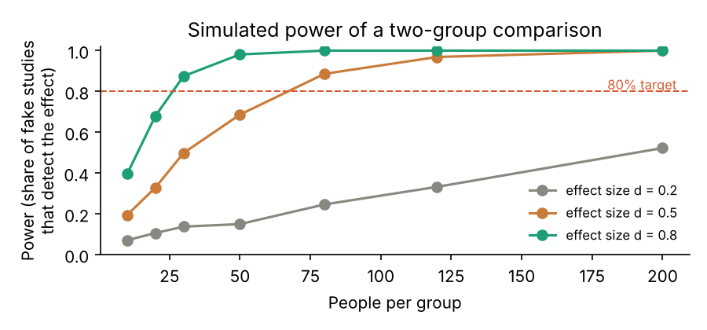
Power by simulation
Effect sizes in standard-deviation units: small 0.2, medium 0.5, large 0.8.
A medium effect needs about 64 people per group for 80% power.
A small effect needs about 400. This is why underpowered studies of small effects are so common.
The same trick checks whether any method behaves as advertised: is my estimator unbiased? Does my 95% interval really contain the truth 95% of the time? (Notebook 4.3.)
STOP 4 · POWER
Notes:
Bias and coverage are checked the same way: simulate thousands of datasets with a known truth and count.

Slide 35
Stop 4 · On your screen
Website animation “Power”: two sliders, a bar that turns green at 80%.
Notebook sections 4.1 to 4.3 (4.3 is the coverage check).
Parameter | What it means | What to watch
People per group | Sample size of each of the two groups | Power rises with n but flattens: going from 100 to 200 buys little for a medium effect
Effect size (d) | How big the real difference is, in SD units | Small effects need very large samples; at d = 0.2 the bar stays red until several hundred per group
✎ Exercise, for later (notebook): an unequal design (40 vs 20): modify power() to take two sample sizes and find how many are needed in the smaller group.
Notes:
Two minutes, demonstration only. The notebook exercise is for later.

Slide 36
What we learned at stop 4
You can test a study design by simulation before collecting any data.
Power is simply the share of simulated studies that find the real effect.
The same trick checks whether any statistical method behaves as advertised.
Notes:
Now the climax: Monte Carlo applied to an agent-based model.

Slide 37
Schelling's neighbourhood, and Monte Carlo over an agent-based model
Stop 5
One run is an anecdote. Many runs are an experiment.
Notes:
This connects Monte Carlo to the agent-based models from the previous lecture, using the most famous agent-based model in social science. It returns in our next seminar.

Slide 38
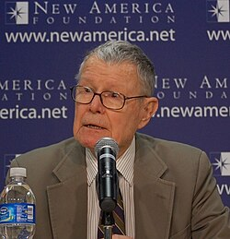
The model: a city of particular households
Thomas C. Schelling
A grid of houses. Each is empty or holds a household of one of two kinds.
Every household wants at least some share of its eight nearest neighbours to be its own kind: the tolerance threshold.
Unhappy households move to a random empty house. Happy ones stay. That is the whole model.
Schelling's question: how strong must the preference be before the city segregates? His answer: not strong at all.
Schelling, T. C. (1971). Dynamic models of segregation. Journal of Mathematical Sociology, 1(2), 143–186. · Schelling (1978). Micromotives and Macrobehavior.
STOP 5 · SCHELLING
Notes:
Thomas Schelling, economist, proposed this in 1971 and shared the 2005 Nobel prize in economics. Most people's intuition is that segregation requires strong prejudice. His result: even when every household is content with as few as a third of its neighbours being like itself, the moves of the unhappy few trigger a cascade that ends in large uniform clusters. Mild individual preferences, strongly segregated collective outcome. This gap between micro-motives and macro-behaviour is the central lesson of agent-based modelling.

Slide 39
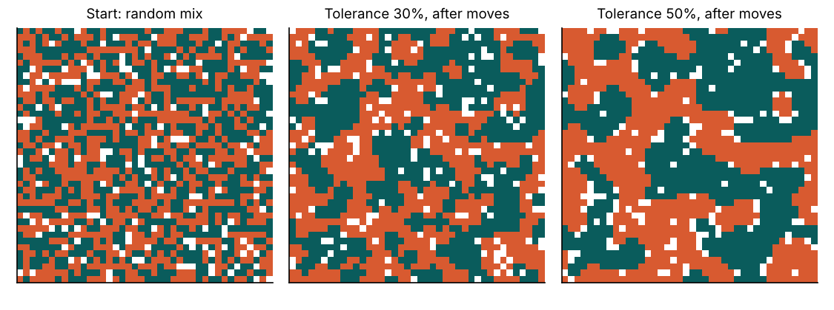
One run of the model
Left: the random starting city. Middle: after households with a 30% threshold have moved. Right: the same with a 50% threshold.
Run it again with a different seed and the clusters land elsewhere, with a somewhat different degree of segregation. Which one is “the result”? Neither.
STOP 5 · SCHELLING
Notes:
A single run of a model with randomness in it is one draw from a distribution of possible outcomes, like one roll of the dice. It is an anecdote, and an anecdote is not evidence. The remedy is the recipe: treat the whole agent-based model as the model inside the Monte Carlo loop.

Slide 40
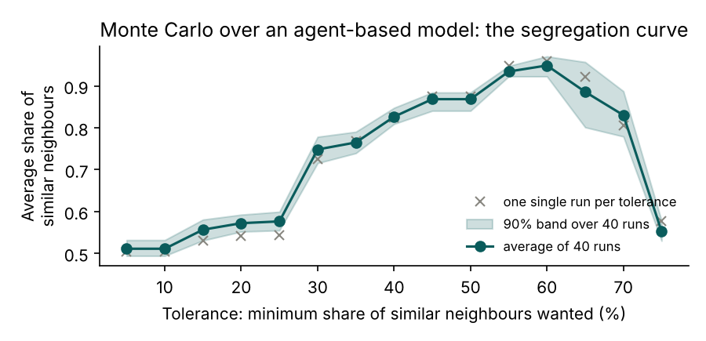
Forty runs per threshold: the segregation curve
A threshold: below 25% tolerance the city stays mixed; between 25% and 30% segregation jumps. With eight neighbours, that is the step from “two like me” to “three like me”.
A surprise at the top: above about 65% almost nobody can be satisfied, households never stop moving, and the city never settles. Segregation falls again.
A measure of confidence: the band shows the run-to-run variation to expect.
STOP 5 · SCHELLING
Notes:
This curve is something no single run could show. Circles: the average of forty runs at each threshold. Band: where 90% of individual runs fell. Grey crosses: a single run per threshold. Everything from stops 1 to 3 applies: the average is the estimate, the band its uncertainty, and four hundred runs would tighten it by about three times.

Slide 41
Stop 5 · On your screen
Website animation “Schelling”: one run with sliders, then a Sweep button that runs many and draws the curve.
Notebook 5.1 defines the model, 5.2 one run, 5.3 the sweep (about a minute), 5.4 the preview of next seminar.
Parameter | What it means | What to watch
Tolerance | Minimum share of similar neighbours a household wants | Clusters appear already at 30%; above 65% the city churns and never settles
Seed | Which random starting city and which random moves | Same tolerance, different seed: clusters elsewhere, segregation number differs
Runs per point (sweep) | How many seeds are averaged at each tolerance | More runs: smoother curve, narrower band
Empty share | Fraction of empty houses | More empties make moving easier: does the jump move?
✎ Exercise, for later (notebook): repeat the sweep with a 15×15 city (the band widens: why?) and with 30% empty houses. Then try the Granovetter playground cell.
Notes:
Five minutes. Task: find the tolerance at which the jump happens for your seed, then compare with your neighbour's seed.

Slide 42
The rule for every agent-based model
Never report a single run. Run the model many times with different seeds, report the distribution of outcomes, and sweep the parameter you care about to find where the behaviour changes.
That sweep is a Monte Carlo experiment. It is what turns a simulation from a story into evidence.
Playgrounds on the course website and in the notebook: Granovetter's threshold model of collective action (same average threshold, different spread, opposite outcome) and the forest-fire model (sweep tree density to find its threshold).
Granovetter, M. (1978). Threshold models of collective behavior. American Journal of Sociology, 83(6), 1420–1443.
Notes:
The one sentence to remember from today. Your course project will be an agent-based model; before you believe anything it says, run it this way.

Slide 43
Looking ahead: where did 30% come from?
Nowhere. It stands in for an attitude that, in a real city, you would measure with a questionnaire item: “I would feel uncomfortable if most of my neighbours were different from me.”
Turning such answers into a number a simulation can use is called pseudo-quantification.
Different people give different answers, so there is not one threshold but a distribution of thresholds. Carrying our doubt about the translation into the model is the quantification of uncertainty.
Both are the subject of the next seminar, with the same model and one line of code changed: the single tolerance value becomes an array, one per household, drawn from survey data. Notebook 5.4 is the preview.
Notes:
Everything today took its input numbers for granted and put uncertainty around them. Next time we ask where the numbers come from.

Slide 44
Where this road leads
Bootstrapping
Sensitivity analysis
Markov chain Monte Carlo
A confidence interval for a statistic with no formula: resample your own survey with replacement, recompute, repeat 10,000 times. The spread is your interval. Monte Carlo on data you already have. Notebook 6.1.
Real models have dozens of uncertain inputs. Shake them all at once, then ask which one explains most of the variation in the output. That is the one worth measuring precisely. Notebook 6.2.
Bayesian statistics needs samples from a distribution you cannot write down. MCMC takes a random walk that lingers where the data fit well. Engine of modern Bayesian software (Stan, PyMC). Notebook 6.3, twelve lines.
Efron, B. (1979). Bootstrap methods. Ann. Statist., 7(1), 1–26. · Metropolis, N., et al. (1953). Equation of state calculations by fast computing machines. J. Chem. Phys., 21(6), 1087–1092.
STOP 6 · BEYOND
Notes:
Three names to recognise later; none is examined. MCMC was invented by the same Nicholas Metropolis from our opening story.

Slide 45
Five habits that keep you honest
Garbage in, gospel out. Ten thousand runs on a wrong assumption give a beautifully smooth histogram that is precisely wrong. State your input assumptions; test what happens when you change them.
Report the spread, not just the average: a probability, a median, a 5th to 95th percentile range, a band around a curve.
Use enough runs, and say how many. A thousand is the minimum; more for the tails. If two repetitions disagree visibly, you need more.
Fix the seed and share the code, so anyone can reproduce your numbers exactly.
A model is not the world. Monte Carlo quantifies the uncertainty inside a model; it cannot tell you whether the model is right.
Notes:
Monte Carlo is easy to run and easy to misuse. The first habit is the most important: smoothness of the output says nothing about the truth of the inputs.

Slide 46
Now you: ten minutes of free play
Website animations
Colab notebook
acharyakishor.com/simulations
Dice, darts, referendum, power, Schelling, plus Granovetter and the forest fire. Each has a “Try this” box.
Link on the course page. Same numbering as these slides. Change any number, watch the figure redraw. No installation.
For later: the notebook has an ✎ Exercise at the end of every stop (doubles, darts precision, a fieldwork budget, an unequal design, a small city), and three extras that only live there: Buffon's needle, a coverage check, and a twelve-line MCMC sampler.
Notes:
Suggested first tasks: dice, N from 100 to 100,000; referendum, find the lead that gives 90%; Schelling, find the jump for your seed. The exercises are optional and not graded; they are for those who want more.

Slide 47
References
Bernoulli, J. (1713). Ars Conjectandi. Basel: Thurneysen.
Buffon, G.-L. L., Comte de (1777). Essai d'arithmétique morale. Histoire naturelle, Supplément, vol. 4.
Cohen, J. (1988). Statistical Power Analysis for the Behavioral Sciences (2nd ed.). Lawrence Erlbaum.
Efron, B. (1979). Bootstrap methods: Another look at the jackknife. The Annals of Statistics, 7(1), 1–26.
Granovetter, M. (1978). Threshold models of collective behavior. American Journal of Sociology, 83(6), 1420–1443.
Metropolis, N. (1987). The beginning of the Monte Carlo method. Los Alamos Science, 15, 125–130.
Metropolis, N., & Ulam, S. (1949). The Monte Carlo method. Journal of the American Statistical Association, 44(247), 335–341.
Metropolis, N., Rosenbluth, A. W., Rosenbluth, M. N., Teller, A. H., & Teller, E. (1953). Equation of state calculations by fast computing machines. J. Chem. Phys., 21(6), 1087–1092.
Schelling, T. C. (1971). Dynamic models of segregation. Journal of Mathematical Sociology, 1(2), 143–186.
Schelling, T. C. (1978). Micromotives and Macrobehavior. W. W. Norton.
Verschuuren, G. M. (2017). 100 Excel Simulations. Holy Macro! Books.
Notes:
Full lecture notes with these references are available from the lecturer.

Slide 48
Thank you
Generate many random versions of the situation. Count what happens. Report the spread.
Notes:
End.

