Slide 1
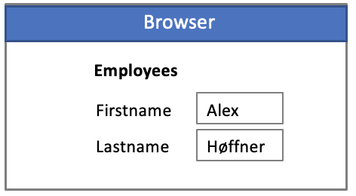
JsonWebDB
FutureForms.js
Microservice / Servlet
Leverages all database features in a secure way
Security
Scalability
Performance
Best Practices
Low/No/All code
Transactions
Concurrency
Stateless/Stateful
Virtual Private Database
Clusters ….
Application.java
Inst
Inst
Inst
Rest
Shared State
Bonus features
Caching
Compression
Upload/Download
Write
Read
Primary
Secondary

Slide 2
JsonDB Client
Client Objects:
Session
Table
Query
Insert
Update
Delete
AnySQL
Function
Procedure
Custom
Rest

