Slide 1
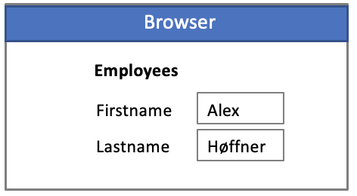
JsonWebDB
Microservice / Servlet
Security
Scalability
Performance
Low/No code
Best Practices
Leverage database
Concurrency
Stateless/Stateful
Virtual Private Database
Clusters ….
Inst
Inst
Inst
Rest
Shared State
Write
Read
Primary
Secondary

