Slide 1
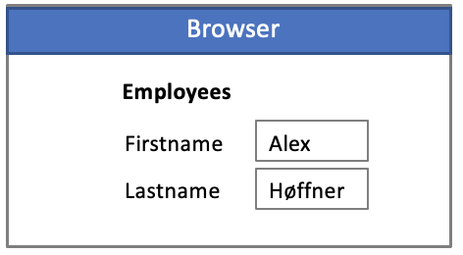
JsonWebDB
Microservice / Servlet
Security
Performance
Low/No code
Best Practices
Leverage database
Stateless/Stateful
Virtual Private Database
Rest
Inst
Inst
Inst
State
Write/Read
Primary
Secondary

