Slide 2
Introducción a los modelos de regresión mediante R y tidymodels
Speaker Name
Title
Módulo de referencia: https://aka.ms/learn-regression-with-R
Speaker Name
Title
Notes:
Link to published module on Learn: Explore and analyze data with R - Learn | Microsoft Docs

Slide 3
Objetivos de aprendizaje
¿Qué es una regresión?
Entrena y evalúa un modelo de regresión
Experimentando con el modelo

Slide 4
Introducción

Slide 5
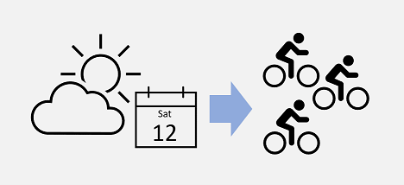
¿Qué es regresión?
La regresión establece una relación entre las variables en los datos que representan las características de lo que se observa, “la(s) característica(s)”, y la variable que estamos tratando de predecir, “la etiqueta”.
Un modelo de regresión es capaz de predecir un número.
Notes:
Regression is where models predict a number.
In machine learning, the goal of regression is to create a model that can predict a numeric, quantifiable value, such as a price, amount, size, or other scalar number.
Regression is a statistical technique of fundamental importance to science because of its ease of interpretation, robustness, and speed in calculation. Regression models provide an excellent foundation to understanding how more complex machine learning techniques work.
In real world situations, particularly when little data are available, regression models are very useful for making predictions. For example, if a company that rents bicycles wants to predict the expected number of rentals on a given day in the future, a regression model can predict this number. A model could be created using existing data such as the number of bicycles that were rented on days where the season, day of the week, and so on, were also recorded.
Regression works by establishing a relationship between variables in the data that represent characteristics of the thing being observed - known as the features, and the variable we're trying to predict - known as the label. Recall our company that rents bicycles and wants to predict the expected number of rentals in a given day. In this case, features include things like the day of the week, month, and so on, while the label is the number of bicycle rentals.

Slide 6
Entrena y evalúa un modelo de regresión

Slide 7

Entrena y evalúa un modelo de regresión
Para entrenar el modelo, comenzamos con una muestra de datos que contiene las características y los valores conocidos de la etiqueta y luego dividiremos esta muestra de datos en dos subconjuntos:
Un conjunto de datos de entrenamiento al que aplicaremos un algoritmo que determina una función f que encapsula la relación entre los valores de característica, x, y los valores de etiqueta conocidos y.
f(x) = y
Para evaluar el modelo podemos utilizar un conjunto de datos de validación o prueba, utilizándolo para generar predicciones para la etiqueta y comparándolas con los valores de etiqueta conocidos reales.
Images: allisonhorst
Notes:
To train the model, we start with a data sample containing the features, as well as known values for the label - so in this case we need historical data that includes dates, weather conditions, and the number of bicycle rentals.
We'll then split this data sample into two subsets:
A training dataset to which we'll apply an algorithm that determines a function encapsulating the relationship between the feature values and the known label values.
A validation or test dataset that we can use to evaluate the model by using it to generate predictions for the label and comparing them to the actual known label values.
The use of historic data with known label values to train a model makes regression an example of supervised machine learning.

Slide 8
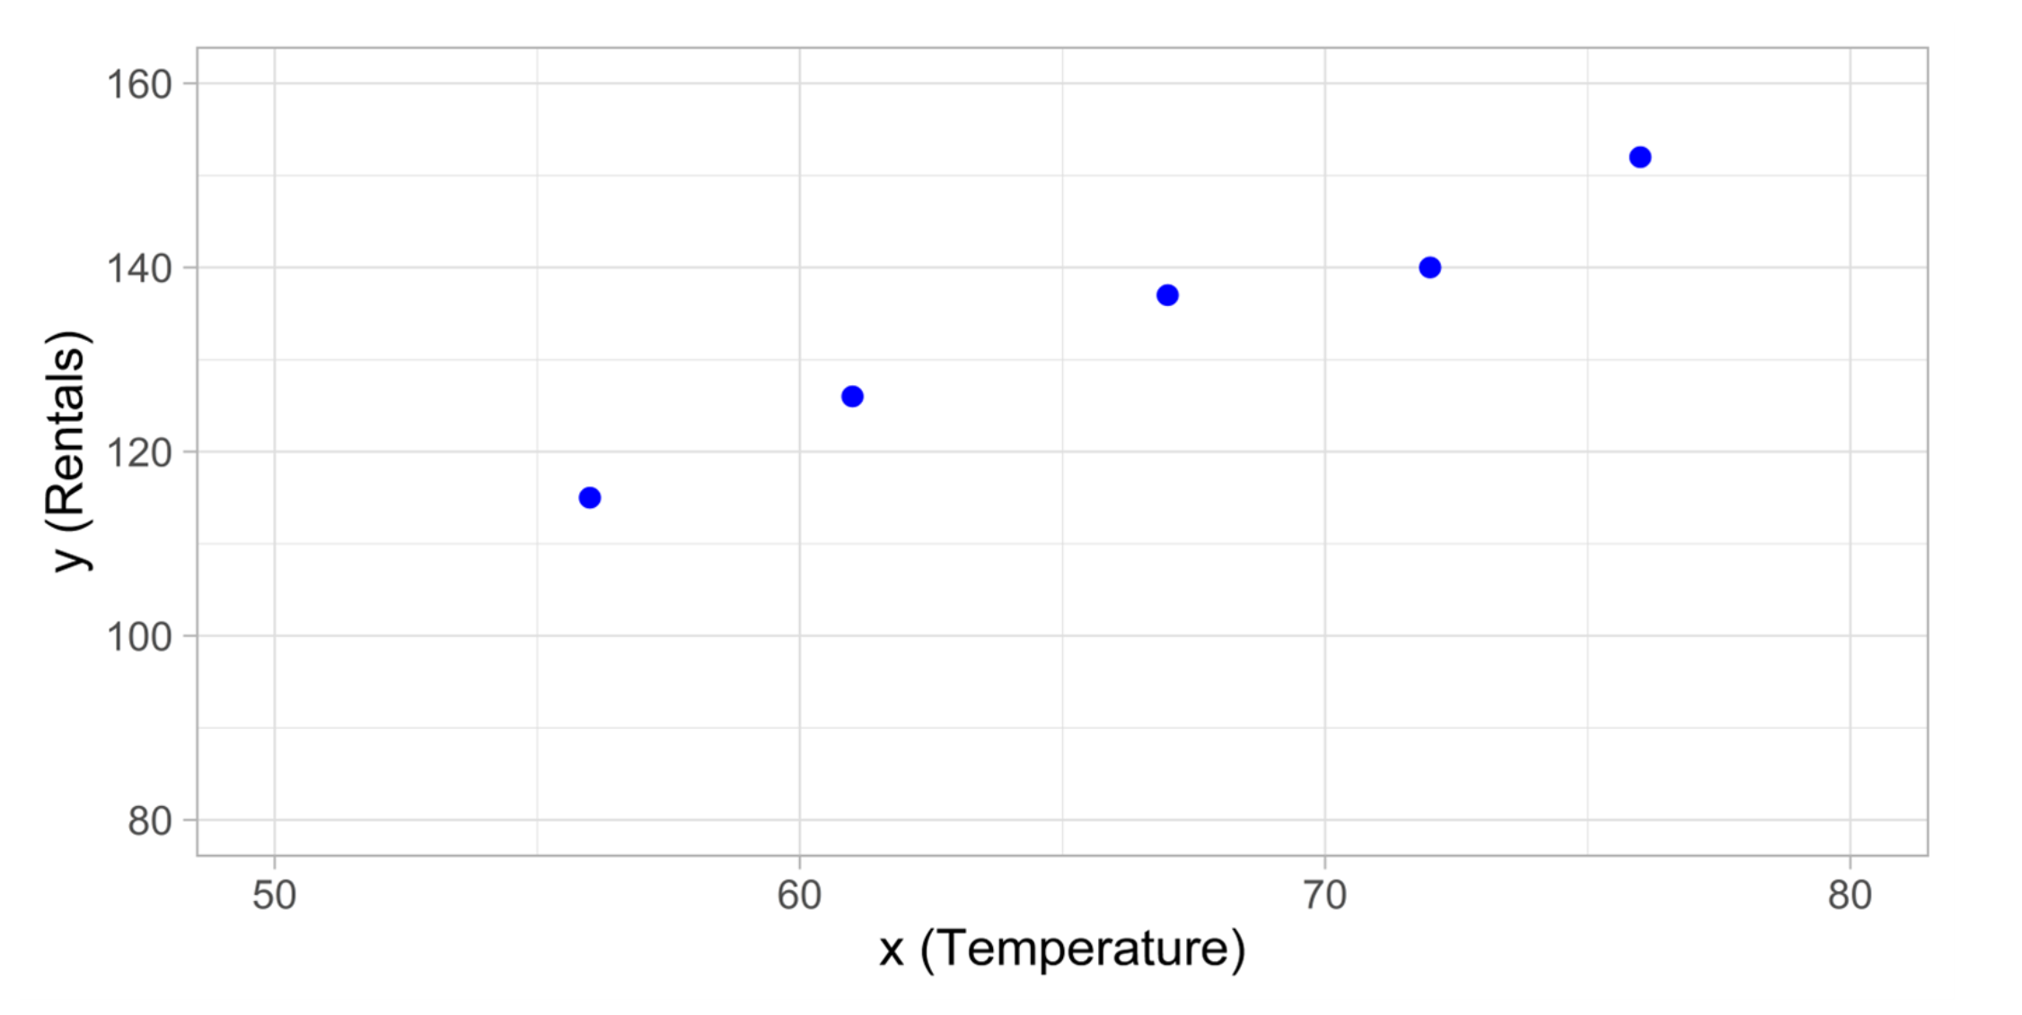
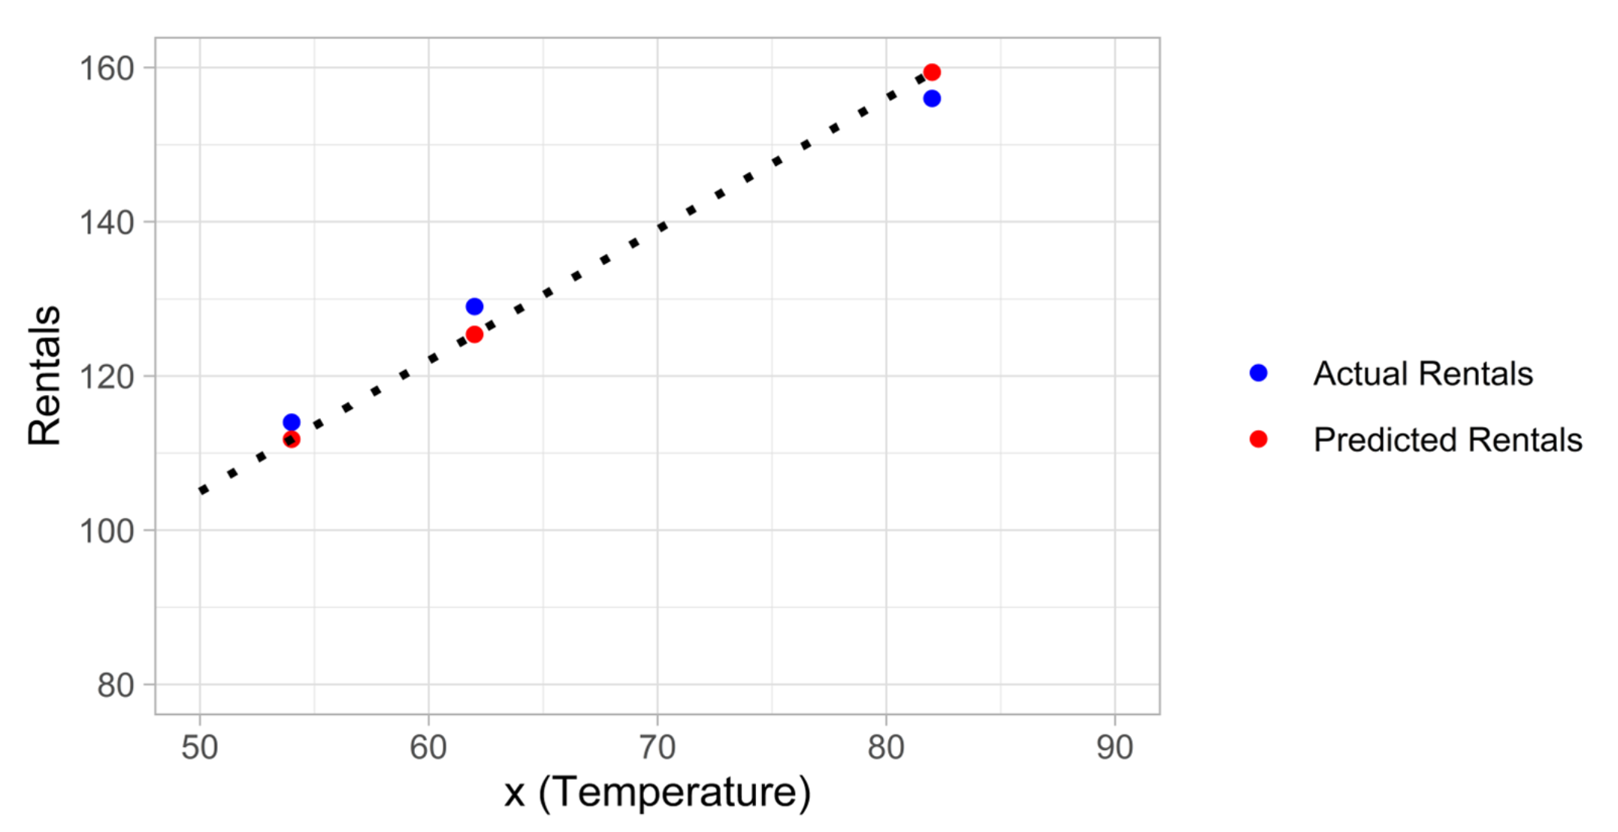
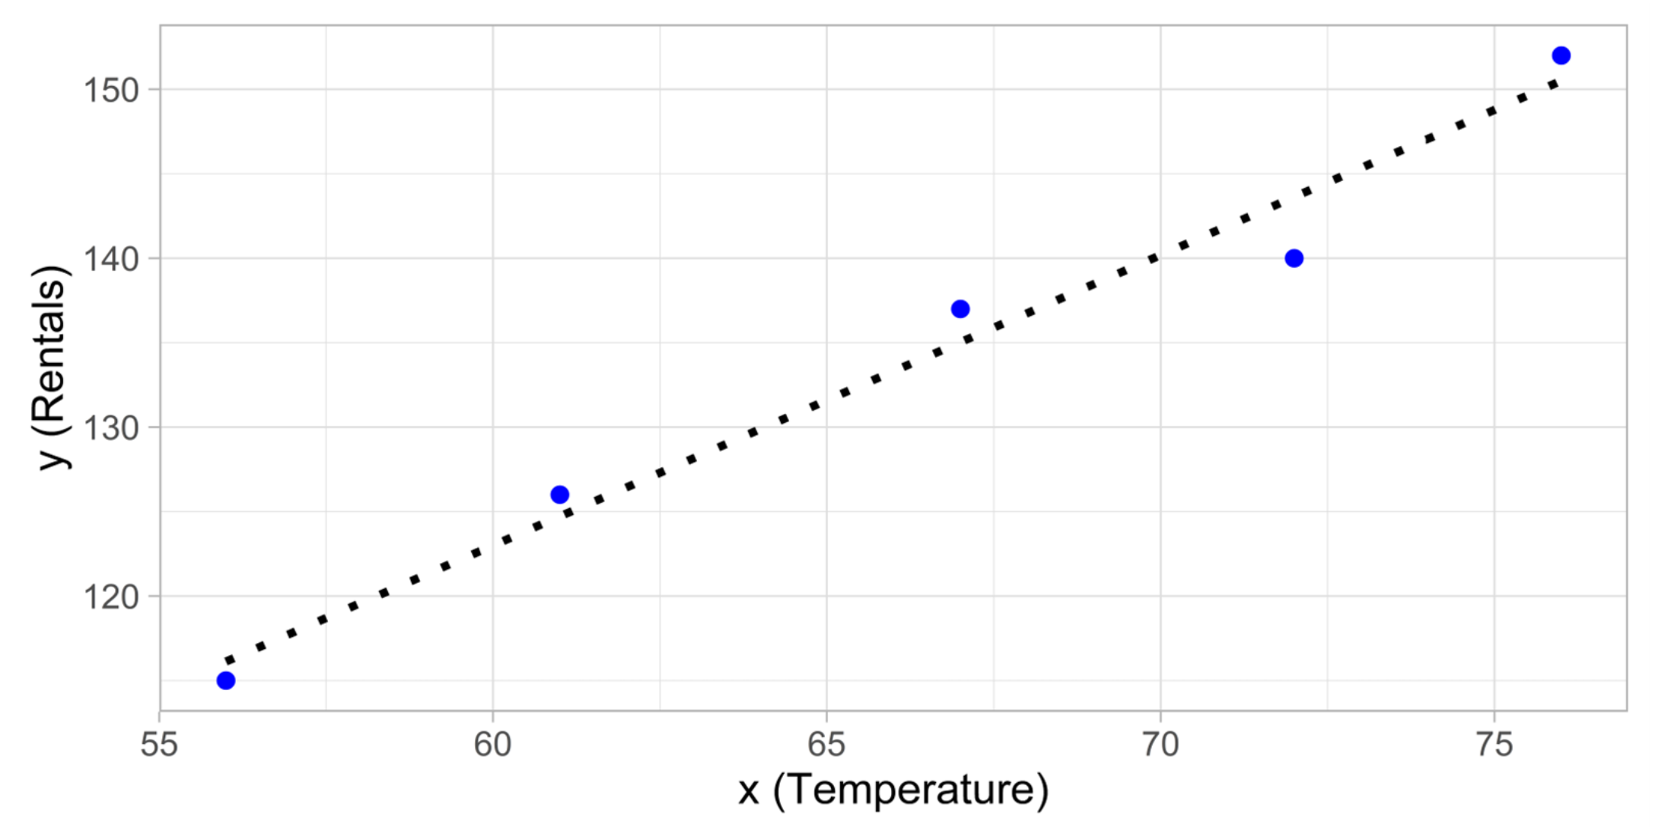
Ejemplo
La tabla contiene algunos datos de valores conocidos de característica (x) y etiqueta (y). Donde (x) es la temperatura diaria promedio y (y) el número de bicicletas alquiladas. Definamos una función capaz de predecir los #alquileres (ŷ) dada la temperatura diaria.
Temperatura (x) | Alquileres (y)
56 | 115
61 | 126
67 | 137
72 | 140
76 | 152
82 | 156
54 | 114
62 | 129
Entrenamiento
159.4
111.8
125.4
11.56
4.84
12.96
MSE 9.79
RMSE √9.79 = 3.13
Prueba
ŷ
(y-ŷ)²
Notes:
Let's take a simple example to see how the training and evaluation process works in principle. Suppose we simplify the scenario so that we use a single feature - average daily temperature - to predict the bicycle rentals label.
We start with some data that includes known values for the average daily temperature feature and the bicycle rentals label.
[Table was here]
Now we'll randomly select five of these observations and use them to train a regression model. When we're talking about 'training a model', what we mean is finding a function (a mathematical equation; let's call it f) that can use the temperature feature (which we'll call x) to calculate the number of rentals (which we'll call y). In other words, we need to define the following function: f(x) = y.
Our training dataset looks like this:
[Table was here]
Let's start by plotting the training values for x and y on a chart:
Now we need to fit these values to a function, allowing for some random variation. You can probably see that the plotted points form an almost straight diagonal line - in other words, there's an apparent linear relationship between x and y, so we need to find a linear function that's the best fit for the data sample. There are various algorithms we can use to determine this function, which will ultimately find a straight line with minimal overall variance from the plotted points; like this:
The line represents a linear function that can be used with any value of x to apply the slope of the line and its intercept (where the line crosses the y axis when x is 0) to calculate y. In this case, if we extended the line to the left, we'd find that when x is 0, y is around 20, and the slope of the line is such that for each unit of x you move along to the right, y increases by around 1.7. Our f function therefore can be calculated as 20 + 1.7 x.
Now that we've defined our predictive function, we can use it to predict labels for the validation data we held back and compare the predicted values (which we typically indicate with the symbol ŷ, or "y-hat") with the actual known y values.
[Table was here]
Let's see how the y and ŷ values compare in a plot:
The plotted points that are on the function line are the predicted ŷ values calculated by the function, and the other plotted points are the actual y values.
There are various ways we can measure the variance between the predicted and actual values, and we can use these metrics to evaluate how well the model predicts.
[!NOTE] Machine learning is based in statistics and math, and it's important to be aware of specific terms that statisticians and mathematicians (and therefore data scientists) use. You can think of the difference between a predicted label value and the actual label value as a measure of error. However, in practice, the "actual" values are based on sample observations (which themselves may be subject to some random variance). To make it clear that we're comparing a predicted value (ŷ) with an observed value (y) we refer to the difference between them as the residuals. We can summarize the residuals for all of the validation data predictions to calculate the overall loss in the model as a measure of its predictive performance.
One of the most common ways to measure the loss is to square the individual residuals, sum the squares, and calculate the mean. Squaring the residuals has the effect of basing the calculation on absolute values (ignoring whether the difference is negative or positive) and giving more weight to larger differences. This metric is called the Mean Squared Error.
For our validation data, the calculation looks like this:
[Table was here]
So the loss for our model based on the MSE metric is 9.79.
Is that any good? It's difficult to tell because MSE value isn't expressed in a meaningful unit of measurement. We do know that the lower the value is, the less loss there is in the model; and therefore, the better it is predicting. This makes it a useful metric to compare two models and find the one that performs best.
Sometimes, it's more useful to express the loss in the same unit of measurement as the predicted label value itself - in this case, the number of rentals. It's possible to do this by calculating the square root of the MSE, which produces a metric known, unsurprisingly, as the Root Mean Squared Error (RMSE).
√9.79 = 3.13
So our model's RMSE indicates that the loss is just over 3, which you can interpret loosely as meaning that on average, incorrect predictions are wrong by around 3 rentals.
There are many other metrics that can be used to measure loss in a regression. For example, R² (R-Squared) (sometimes known as coefficient of determination) is the correlation between x and y squared. This produces a value between 0 and 1 that measures the amount of variance that can be explained by the model. Generally, the closer this value is to 1, the better the model predicts.

Slide 9
Experimentando con modelos

Slide 10
Experimentando con modelos
Los modelos de regresión a menudo se utilizan porque funcionan con muestras de datos pequeñas, son robustos, fáciles de interpretar y tienen variedad.
Regresión lineal: es la forma más simple de regresión.
Árboles de decisión: algoritmos que construyen un árbol de decisión para llegar a una predicción.
Métodos de conjunto: Algoritmos que combinan los resultados de varios algoritmos básicos para mejorar la generalización.
Notes:
Regression models are often chosen because they work with small data samples, are robust, easy to interpret, and a variety exist.
Linear regression is the simplest form of regression, with no limit to the number of features used. Linear regression comes in many forms - often named by the number of features used and the shape of the curve that fits.
Decision trees take a step-by-step approach to predicting a variable. If we think of our bicycle example, the decision tree may be first split examples between ones that are during Spring/Summer and Autumn/Winter, make a prediction based on the day of the week. Spring/Summer-Monday may have a bike rental rate of 100 per day, while Autumn/Winter-Monday may have a rental rate of 20 per day.
Ensemble algorithms construct not just one decision tree, but a large number of trees - allowing better predictions on more complex data. Ensemble algorithms, such as Random Forest, are widely used in machine learning and science due to their strong prediction abilities.
Data scientists often experiment with using different models. In the following exercise, we'll experiment with different types of models to compare how they perform on the same data.

Slide 11

Mejora los modelos con hiperparámetros
Los modelos simples con bases de datos pequeñas a menudo se pueden ajustar en un solo paso, mientras que los conjuntos de datos más grandes y los modelos más complejos se deben ajustar usando repetidamente el modelo con datos de entrenamiento y comparando el resultado con la etiqueta esperada.
Los hiperparámetros son valores ajustables que permiten controlar el proceso de entrenamiento de un modelo.
Images: allisonhorst
Notes:
Simple models with small datasets can often be fit in a single step, while larger datasets and more complex models must be fit by repeatedly using the model with training data and comparing the output with the expected label. If the prediction is accurate enough, we consider the model trained. If not, we adjust the model slightly and loop again.
Hyperparameters are values that change the way that the model is fit during these loops. Learning rate, for example, is a hyperparameter that sets how much a model is adjusted during each training cycle. A high learning rate means a model can be trained faster, but if it's too high the adjustments can be so large that the model is never ‘finely tuned' and not optimal.

Slide 12

Desafío: Entrenar y evaluar modelos de regresión usando Tidymodels
Imaginemos que somos un agente de bienes raíces y nos acaban de dar un par de casas nuevas en diferentes partes de la ciudad. No sabemos el precio de venta, y queremos obtener un estimado comparándolo con otras casas en el área.
En este desafío, utilizaremos una base de datos de transacciones de ventas de bienes raíces para predecir el precio unitario de una propiedad en función de características como la antigüedad de la propiedad, la disponibilidad de servicios locales y la ubicación.
Notes:
Regression models are often chosen because they work with small data samples, are robust, easy to interpret, and a variety exist.
Linear regression is the simplest form of regression, with no limit to the number of features used. Linear regression comes in many forms - often named by the number of features used and the shape of the curve that fits.
Decision trees take a step-by-step approach to predicting a variable. If we think of our bicycle example, the decision tree may be first split examples between ones that are during Spring/Summer and Autumn/Winter, make a prediction based on the day of the week. Spring/Summer-Monday may have a bike rental rate of 100 per day, while Autumn/Winter-Monday may have a rental rate of 20 per day.
Ensemble algorithms construct not just one decision tree, but a large number of trees - allowing better predictions on more complex data. Ensemble algorithms, such as Random Forest, are widely used in machine learning and science due to their strong prediction abilities.
Data scientists often experiment with using different models. In the following exercise, we'll experiment with different types of models to compare how they perform on the same data.

Slide 13
Prerequisitos
Antes de aceptar el desafío, asegúrese de tener su máquina lista para funcionar
O
Abre el cuaderno en la nube
Docker
Instale y configure Docker para su Sistema operativo
VS Code
Instale VS Code y Remote Development extension
Agrega los archivos de configuración
Presione F1 y seleccione el comando Add Development Container Configuration Files... para Remote-Containers o Codespaces.
Seleccione la definición
Seleccione la definición. Es possible que deba seleccionar Show All Definitions... para ver la definición.
Abra la carpeta en un contenedor
Finalmente, presione F1 y ejecute Remote-Containers: Reopen Folder in Container para comenzar a utilizer la definición.
Launch in Binder

Slide 14
Prueba de conocimientos

Slide 15
Pregunta 1
Está utilizando el framework Tidymodels en R para entrenar un modelo de regresión a partir de un conjunto de datos de ventas. Desea poder evaluar el modelo para asegurarse de que funcionará adecuadamente con nuevos datos. ¿Qué debes hacer?
Divide los datos al azar en dos subconjuntos. Utilice un subconjunto para entrenar el modelo y el otro para probarlo.
Utilice todos los datos para entrenar el modelo. Luego usa todos los datos para evaluarlo.
Entrene el modelo usando solo las columnas de características y luego pruébelo usando solo la columna de etiquetas.
Notes:
Explanation: That is correct. A common way to train and evaluate models is to hold-back an evaluation dataset when training.

Slide 16
Pregunta 1
Está utilizando el framework Tidymodels en R para entrenar un modelo de regresión a partir de un conjunto de datos de ventas. Desea poder evaluar el modelo para asegurarse de que funcionará adecuadamente con nuevos datos. ¿Qué debes hacer?
Divide los datos al azar en dos subconjuntos. Utilice un subconjunto para entrenar el modelo y el otro para probarlo.
Utilice todos los datos para entrenar el modelo. Luego usa todos los datos para evaluarlo.
Entrene el modelo usando solo las columnas de características y luego pruébelo usando solo la columna de etiquetas.
Notes:
Explanation: That is correct. A common way to train and evaluate models is to hold-back an evaluation dataset when training.

Slide 17
Pregunta 2
Ha creado una especificación de modelo de regresión usando la función linear_reg() de Tidymodel. ¿Qué debes hacer para entrenar al modelo?
Llama a la función predict(), con la especificación del modelo, la fórmula y los datos.
Llama a la función de recipe(), con la especificación del modelo, la fórmula y los datos.
Llama a la función fit(), con la especificación del modelo, la fórmula y los datos.
Notes:
Explanation: That is correct. Once a model specification has been made, model training can then be done with either the fit() function or fit_xy() function.

Slide 18
Pregunta 2
Ha creado una especificación de modelo de regresión usando la función linear_reg() de Tidymodel. ¿Qué debes hacer para entrenar al modelo?
Llama a la función predict(), con la especificación del modelo, la fórmula y los datos.
Llama a la función de recipe(), con la especificación del modelo, la fórmula y los datos.
Llama a la función fit(), con la especificación del modelo, la fórmula y los datos.
Notes:
Explanation: That is correct. Once a model specification has been made, model training can then be done with either the fit() function or fit_xy() function.

Slide 19
Pregunta 3
Entrenas un modelo de regresión utilizando Tidymodels. Cuando lo evalúa con datos de prueba, descubre que el modelo logra una métrica R cuadrada de 0,95. ¿Qué te dice esta métrica sobre el modelo?
El modelo tiene una precisión del 95%.
El modelo explica la mayor parte de la variación entre los valores previstos y reales.
En promedio, las predicciones son 0,95 más altas que los valores reales.
Notes:
Explanation: That is correct. The R-squared metric is a measure of how much of the variance can be explained by the model.

Slide 20
Pregunta 3
Entrenas un modelo de regresión utilizando Tidymodels. Cuando lo evalúa con datos de prueba, descubre que el modelo logra una métrica R cuadrada de 0,95. ¿Qué te dice esta métrica sobre el modelo?
El modelo tiene una precisión del 95%.
El modelo explica la mayor parte de la variación entre los valores previstos y reales.
En promedio, las predicciones son 0,95 más altas que los valores reales.
Notes:
Explanation: That is correct. The R-squared metric is a measure of how much of the variance can be explained by the model.

Slide 21
Resumen

Slide 22
Resumen
¿Qué es regresión?
¿Cómo entrenar y evaluar un modelo de regresión?
Experimenta con el modelo

