Slide 1
DOCKERIZED CRUD 3-TIER WEB APPLICATION – DEVOPS LIFECYCLE
Deploying with Jenkins, Docker, Kubernetes, Ansible, Terraform, and AWS
‹#›

Slide 2
THE TEAM
Ahmed Elmahdy
Ibrahim Zaghloul
Michael Halem
Mohamed Emad
Ziad Abdelnabi
‹#›

Slide 3
OVERVIEW OF THE PROJECT
Objective:
Demonstrate a DevOps pipeline for deploying a containerized web application.
Focus on CI/CD, Docker for containerization, and AWS for cloud deployment.
Key Features:
Full CRUD operations.
3-tier architecture with Docker and Docker Compose.
AWS deployment for scalability.
‹#›

Slide 4
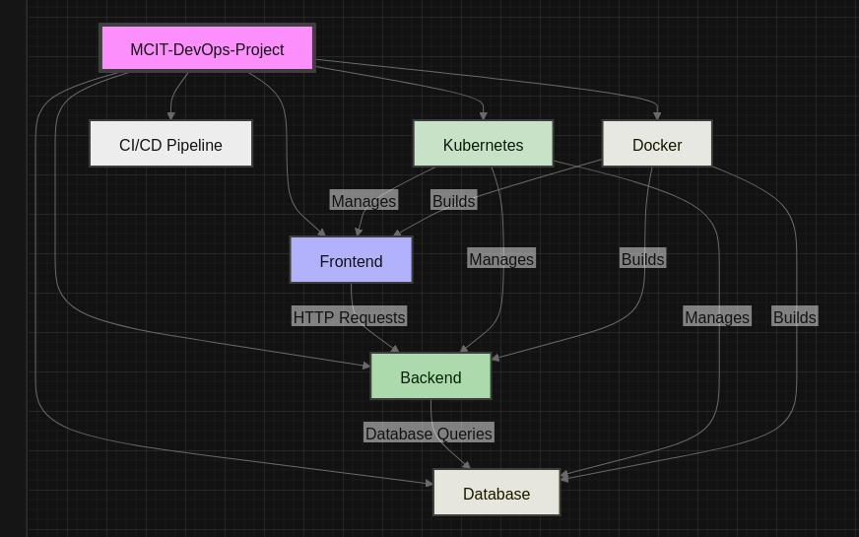
Application structure
‹#›

Slide 5
EKS Cluster Consists Of Two Nodes At Two Subnets At Different Availability Zones.
‹#›

Slide 6
DEVOPS LIFECYCLE
CONTINUOUS INTEGRATION
Automate code integration using Jenkins.
CONTINUOUS TESTING
Unit tests for server and client logic using xUnit and Jasmine.
CONTINUOUS DELIVERY
Deploy the application to AWS with Docker containers.
MONITORING & FEEDBACK
Future integration of monitoring tools to track application performance.
‹#›

Slide 7
Step 1: Code Commit
Developers push changes to GitHub.
Step 2: Jenkins Pipeline Trigger
Jenkins automatically pulls the latest code and starts the pipeline.
Step 3: Build & Test
Jenkins builds Docker images for the frontend (Angular) and backend (ASP.NET Core) and runs unit tests.
Step 4: Docker Image Push
Images are pushed to Docker Hub or a private AWS ECR registry.
Step 5: AWS Deployment
Ansible scripts deploy the Docker containers on AWS EC2 instances.
CI/CD PIPELINE
6

Slide 8
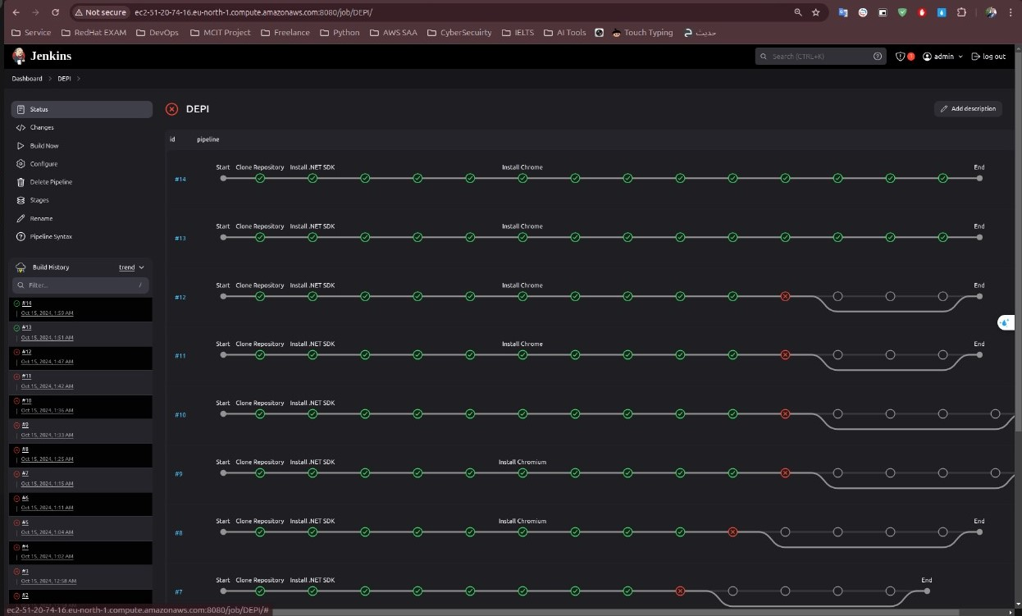
in the browser's address bar enter http:ubuntu@ec2-51-20-74-16.eu-north-1.compute.amazonaws.com:8080
‹#›

Slide 9
AWS DEPLOYMENT PROCESS WITH TERRAFORM AND KUBERNETES
Terraform:
Automates the provisioning of AWS infrastructure, such as EC2 instances, VPCs, and security groups.
Kubernetes:
Orchestrates container deployment, scaling, and management across the AWS infrastructure.
AWS EC2 Instances:
Hosting Kubernetes clusters.
Elastic Load Balancer:
Distributes traffic between Kubernetes pods.
.
‹#›

Slide 10
CI INTEGRATION WITH JENKINS
GitHub Integration: Pulls code from the repository.
Jenkins Jobs: - Build Docker images for both tiers. - Run unit tests automatically.
Automated Builds: Triggered on each commit.
‹#›

Slide 11
DOCKERIZATION
Frontend: Dockerized Angular app.
Backend: ASP.NET Core Web API in a Docker container.
Database: SQL Server running as a container
Docker Compose: Orchestrates multi-container deployment locally and in AWS.
‹#›

Slide 12
CONTAINER ORCHESTRATION WITH KUBERNETES
Kubernetes:
Manages the deployment and scaling of Docker containers.
Provides high availability through replication of application pods.
Deployment Automation:
Jenkins pipeline triggers the Kubernetes deployment after successful builds.
Automatically scales the application based on resource utilization.
‹#›

Slide 13
CHALLENGES & SOLUTIONS
Challenge: Managing multiple containers and dependencies.
Solution: Docker Compose to orchestrate containers and maintain consistency.
Challenge: Deployment complexity on AWS.
Solution: Automating with Terraform and Ansible to provision and configure the infrastructure and application.
‹#›

Slide 14
CONCLUSION & FUTURE STEPS
Conclusion: Successfully demonstrated DevOps best practices:
Continuous integration, automated testing, and deployment with AWS.
Future Enhancements:
Implement monitoring with tools like Prometheus or Grafana.
‹#›

Slide 15
THANK YOU
‹#›

