Slide 1

المشروع النهائي DevOps Engineer الدفعة الأولى
Saleh Elhalaby
Kareem Mahdi Baz
Mostafa Ali Mostafa
Ayman Ahmed Elshafie

Slide 2
Agenda
Project Overview
User Interface (UI)
Containerization with Docker
Version Control with GitHub
Orchestration with Kubernetes (K8s)
Cloud Infrastructure on AWS
Infrastructure as Code with Terraform
Continuous Integration/Continuous Deployment (CI/CD) with Jenkins

Slide 3
To-Do Project
Project name: To-Do
What’s To-Do: it’s python project that user write a to do list and store it in a database.
The goal of project: deploying a web app using DevOps tools and technologies starting from building it on Docker locally, all the way to deploying it on AWS using Terraform to create the infrastructure, Promethues and grafana for monitoring, jenkins to make the Ci/CD pipeline.

Slide 4
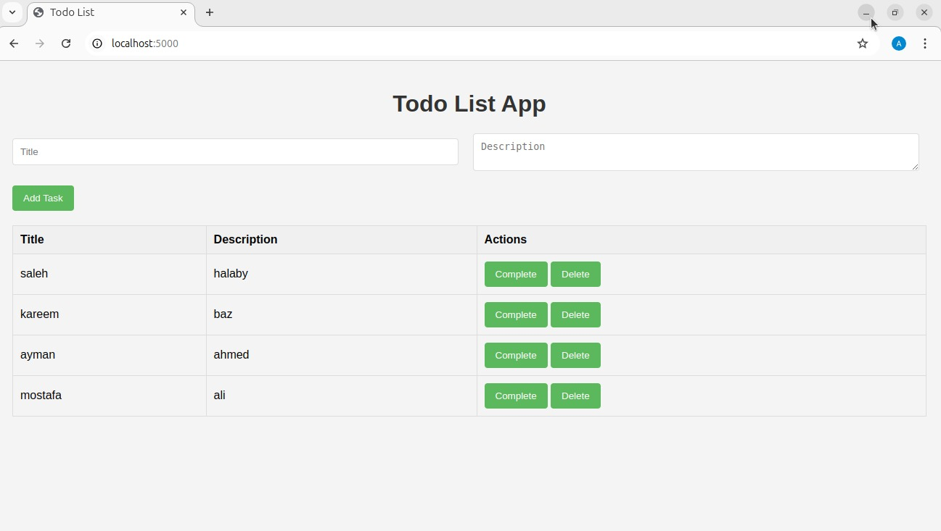
Project UI

Slide 5
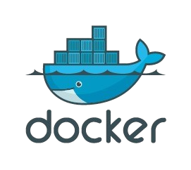
⁠Create Docker file
Build Docker image
⁠docker compose up
docker login
⁠docker push

Slide 6

Create a Repository
Clone a Repository
⁠Commit Changes
Push Changes
Pull Changes

Slide 7
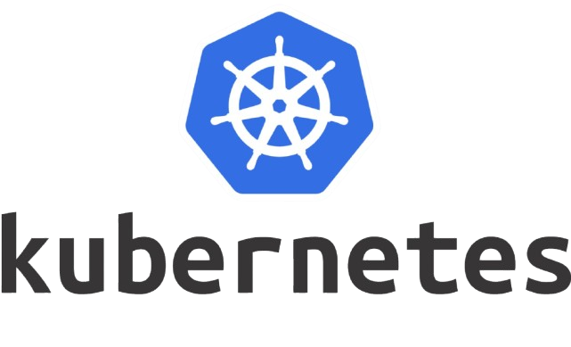
Set Up the Environment
Configure kubectl⁠
Define Application Manifests
Deploy Application
Expose Application

Slide 8
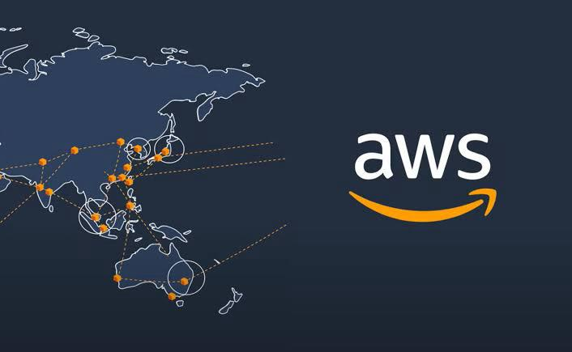
Create an AWS Account
⁠Set Up IAM Users and Roles
⁠Configure AWS on Terraform

Slide 9
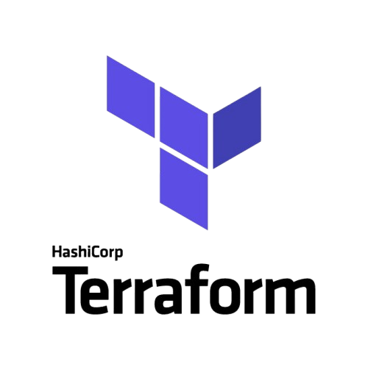
Infrastructure as Code
⁠Providers (AWS)
⁠Configuration Files
⁠Resource Blocks
⁠State Management
⁠Initialization
⁠Planning Changes
⁠Applying Changes

Slide 10

Install Jenkins
⁠Accessing Jenkins
⁠⁠Set Up AWS Credentials
⁠Install Required Plugins
⁠Create a New Pipeline Job

Slide 11
Please feel free to ask any questions you may have Thank you. Saleh Elhalaby Kareem Mahdi Baz Mostafa Ali Mostafa Ayman Ahmed Elshafie

