Slide 1

Olist E-Commerce Performance Analysis
Welcome to our comprehensive Power BI project report on Olist's e-commerce performance. This analysis delves deep into the intricate workings of Olist's online marketplace, offering valuable insights to drive strategic decision-making. Our report leverages the extensive Olist E-commerce Dataset from Kaggle, encompassing crucial information from orders, customers, sellers, products, payments, reviews, and geolocation data.
Tailored for Olist's higher management, marketing team, and logistics department, this analysis aims to uncover key trends in sales performance, customer behavior, and operational efficiency. By examining these critical aspects, we seek to provide actionable intelligence that can propel Olist's growth and enhance its competitive edge in the dynamic e-commerce landscape.

Slide 2
Project Objectives and Data Sources
Our primary objective is to deliver a comprehensive Power BI report that dissects Olist's e-commerce performance, addressing key business questions related to sales trends, customer behavior patterns, and operational efficiency metrics. This analysis aims to provide actionable insights that can drive strategic decision-making across various departments within Olist.
Data Source
Target Audience
The foundation of our analysis is the Olist E-commerce Dataset from Kaggle, a rich repository of information encompassing multiple aspects of the e-commerce ecosystem. This dataset includes detailed tables on Orders, Order Items, Customers, Sellers, Products, Payments, Reviews, and Geolocation, providing a holistic view of Olist's operations.
Our analysis caters to three primary stakeholder groups within Olist: 1. Higher Management: Providing overarching insights on business performance and strategic direction. 2. Marketing Team: Offering data-driven insights on product trends and customer behavior to inform targeted campaigns. 3. Logistics Team: Presenting metrics on order fulfillment and delivery efficiency to optimize operations.

Slide 3
Key Performance Metrics
Our analysis of Olist's e-commerce platform has revealed several crucial performance metrics that provide a comprehensive overview of the business's health and customer satisfaction levels. These key indicators offer valuable insights into the scale of operations, customer engagement, and overall platform performance.
1
Revenue and Order Volume
2
Customer Base and Average Order Value
3
Customer Satisfaction Metrics
Olist has generated an impressive overall revenue of R$15,422K, processing a total of 96.48K orders. This substantial order volume indicates a robust level of customer activity and engagement on the platform.
The platform has attracted 93.36K unique customers, demonstrating its wide reach and appeal. The average order value stands at R$159.85, providing insights into typical customer spending patterns.
With an average review score of 4.16 out of 5, Olist maintains a high level of customer satisfaction. The impressive Net Promoter Score (NPS) of 71 further underscores strong customer loyalty and a high likelihood of referrals.

Slide 4
Sales Performance Analysis
Our analysis of Olist's sales performance reveals intriguing trends across product categories, revenue growth, and geographic distribution. This multi-faceted examination provides valuable insights into the platform's strengths and areas for potential growth.
1
Top-Selling Categories
Electronics leads the pack with 19.2K orders, followed closely by Furniture (17.5K), Beauty (15.3K), Fashion (9.9K), and Home Goods (6.2K). This distribution highlights the diverse product range that drives Olist's success.
2
Revenue Trends
Olist experienced significant growth, particularly in Q4 2016 with a remarkable 104% increase. Subsequent quarters showed varying growth rates, indicating seasonal fluctuations. Average order values ranged from R$160 to R$180 across different quarters.
3
Geographic Insights
Analysis by state reveals that São Paulo, Minas Gerais, and Paraná lead in both order count and revenue generation. This geographic distribution provides crucial information for targeted marketing and logistics optimization strategies.

Slide 5
Customer Segmentation Insights
Our customer segmentation analysis has unveiled four distinct groups based on their purchasing value and frequency. This segmentation provides crucial insights for tailoring marketing strategies and improving customer engagement across different user profiles.
Low Value Infrequent (74%)
High Value Infrequent (19%)
Comprising the majority of the customer base, these users make small, infrequent purchases. While they represent a large portion of customers, their individual contribution to revenue is limited. Strategies to increase their purchase frequency or value could significantly impact overall revenue.
This segment spends significantly more per purchase but buys less frequently. They represent a prime opportunity for targeted marketing efforts aimed at increasing their purchase frequency, potentially leading to substantial revenue growth.
High Value Frequent (4%)
Frequent Low Value (3%)
Although a small segment, these customers are the most valuable, contributing significantly to revenue through frequent, high-value purchases. Retention and loyalty programs should focus on maintaining their engagement and satisfaction.
These customers make frequent purchases but at lower values. They are crucial for maintaining consistent order volume. Strategies could focus on gradually increasing their order value while maintaining their high purchase frequency.

Slide 6
Payment Preferences Analysis
Understanding customer payment preferences is crucial for optimizing the checkout process and improving overall customer satisfaction. Our analysis reveals interesting trends in payment methods and installment choices among Olist's customer base.
Preferred Payment Methods
Installment Preferences
Payment Growth Trends
The data shows a diverse range of installment preferences: - 52.5K customers prefer single installment payments - 12.4K opt for 2 installments - 10.5K choose 3 installments - 7.1K select 4 installments This variety in installment choices reflects the importance of offering flexible payment options to cater to different financial situations and purchasing habits.
The analysis reveals mixed payment growth rates across quarters, with some periods experiencing a decrease in payment volume. This fluctuation suggests the need for deeper investigation into seasonal trends and potential external factors affecting consumer spending patterns on the platform.
Credit cards emerge as the dominant payment method on the Olist platform. This preference indicates a high level of trust in the platform's security measures and a desire for convenience among customers. The prevalence of credit card usage also suggests opportunities for partnerships with card issuers or implementing a co-branded credit card program.

Slide 7



Customer Feedback and NPS Analysis
Customer feedback and the Net Promoter Score (NPS) are crucial indicators of customer satisfaction and loyalty. Our analysis of Olist's customer feedback data reveals a strong positive sentiment among users, with some areas for potential improvement.
Net Promoter Score (NPS)
Promoters vs. Detractors
Customer Reviews
The breakdown of customer scores reveals: - Promoters (Score 9-10): 84,649 customers - Detractors (Score 0-6): 14,575 customers This significant gap between promoters and detractors further reinforces the positive customer sentiment towards Olist's services.
With a total of 99K reviews and an average score of 4.16 out of 5, Olist maintains a strong reputation among its user base. This high average score aligns with the positive NPS and indicates consistent customer satisfaction across various aspects of the platform.
Olist boasts an impressive NPS of 71, indicating a high level of customer satisfaction and loyalty. This score suggests that a significant portion of customers are likely to recommend the platform to others, contributing to organic growth through word-of-mouth marketing.

Slide 8
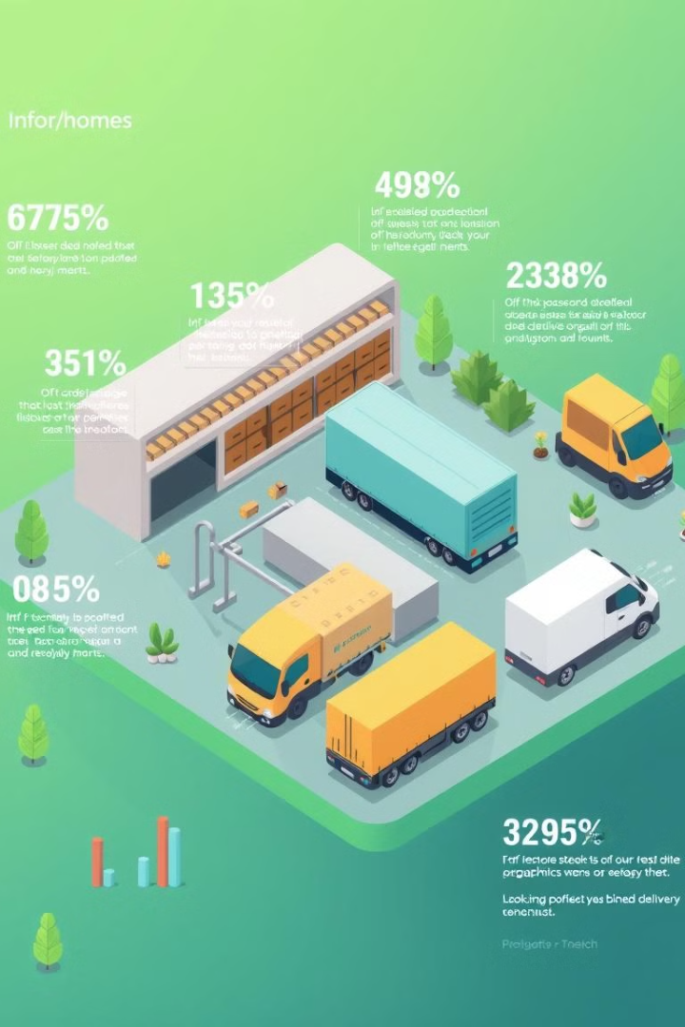
Order Fulfillment and Delivery Performance
Efficient order fulfillment and timely delivery are crucial factors in e-commerce success. Our analysis of Olist's logistics performance reveals strong overall efficiency with some areas for potential improvement.
Metric
Performance
Implications
On-Time Delivery Rate
93%
Indicates efficient logistics management
Delayed Delivery Rate
7%
Room for improvement in delivery performance
Average Order Fulfillment Time
12 days
Benchmark for order process efficiency
Cancellation Rate
0.63%
Reflects good customer and order management

Slide 9




Product Category Preferences
Understanding product category preferences is crucial for inventory management, marketing strategies, and overall business growth. Our analysis of Olist's sales data reveals clear trends in customer preferences across various product categories.
Electronics
Beauty
Furniture
Fashion
Leading the pack with 19.2K orders, electronics demonstrate strong consumer interest in technology products. This category's popularity may be driven by the constant innovation and necessity of tech in daily life.
The beauty category shows significant traction, reflecting growing consumer interest in personal care and wellness products. This trend aligns with the global rise in beauty and self-care awareness.
With 17.5K orders, furniture represents a strong category, possibly driven by home improvement trends and the growing importance of comfortable living spaces.
Fashion's popularity on Olist underscores the platform's ability to cater to style-conscious consumers. This category's success may be attributed to the convenience of online shopping for clothing and accessories.

Slide 10
Strategic Recommendations
Based on our comprehensive analysis of Olist's e-commerce performance, we propose the following strategic recommendations to drive growth, enhance customer satisfaction, and optimize operations:
1
Targeted Marketing Initiatives
2
Logistics Optimization
Develop personalized marketing campaigns for High Value Infrequent customers to increase their purchase frequency. Implement loyalty programs and targeted offers to convert Low Value Infrequent customers into more frequent buyers, potentially through cross-selling and upselling strategies.
While the current 93% on-time delivery rate is commendable, focus on further improving this metric to enhance customer satisfaction. Invest in advanced logistics technologies and optimize routing algorithms to reduce the 7% delayed delivery rate.
3
Payment Strategy Enhancement
4
Customer Satisfaction Initiatives
Continue offering diverse payment options, with a particular focus on installment plans that cater to different customer segments. Consider partnering with fintech companies to introduce innovative payment solutions that could attract new customer segments.
Leverage feedback from promoters to identify and amplify key satisfaction drivers. Conduct in-depth analysis of detractor feedback to address pain points and improve overall customer experience, aiming to convert detractors into promoters and further boost the impressive NPS of 71.

