Slide 1
E-Commerce
Website Presentations
Team
Role
Youssef Osama elsayed
Mohammed Read Mohmmed
Kareem Mohammed Awadallah
Backend
Full stack
Frontend

Slide 2
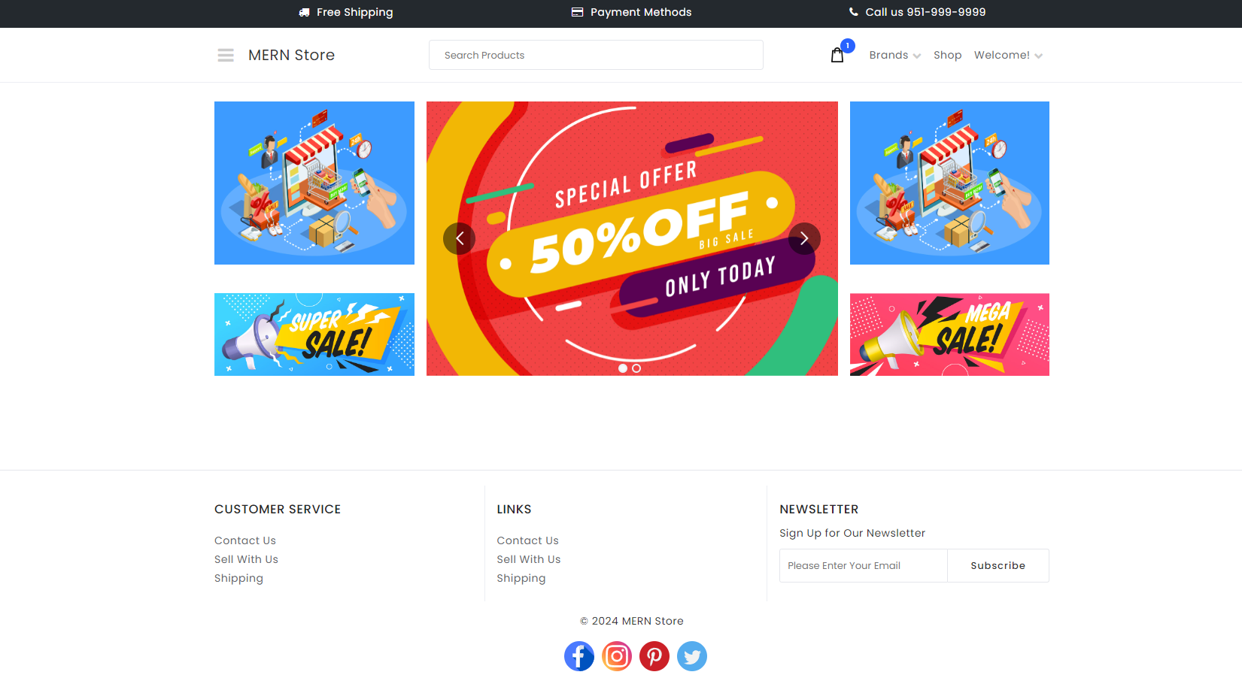
Main page
The main page showcases vibrant sale banners, a product search bar, and navigation links, with customer service and social media links below.

Slide 3
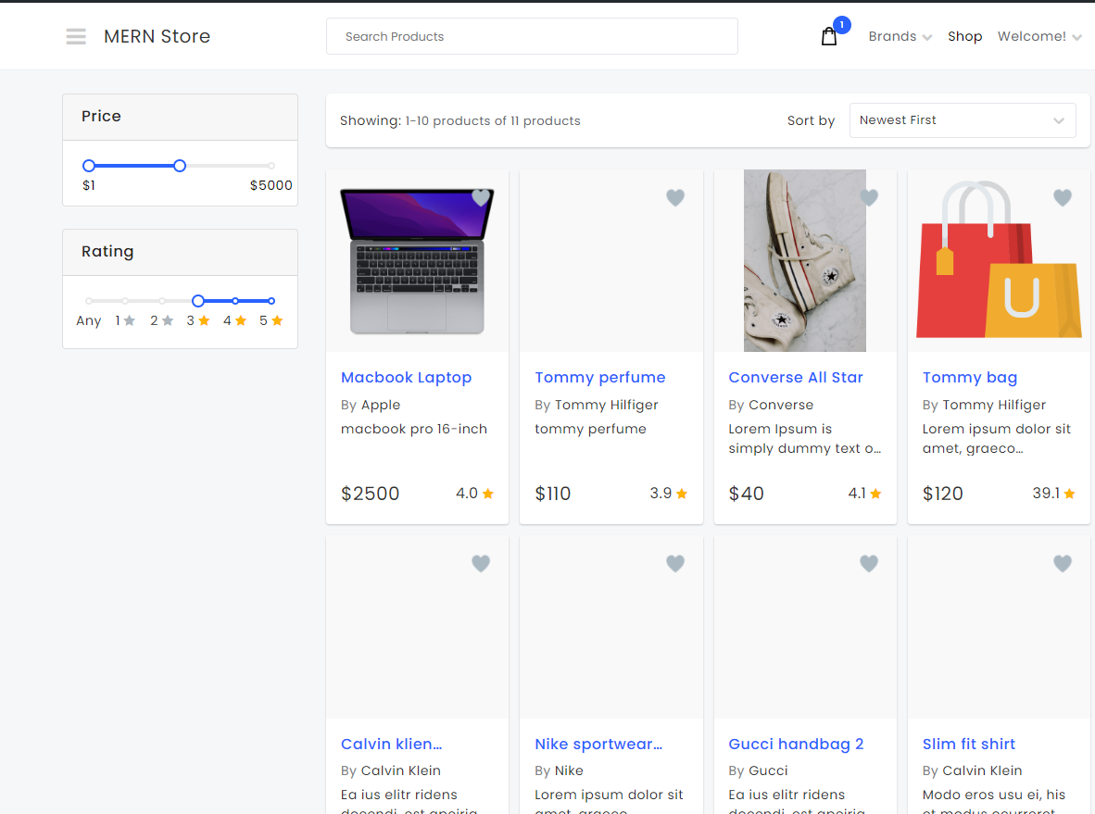
Shop page
This product listing page for "MERN Store" includes filters for price and rating, displays items with images, descriptions, prices, and ratings.

Slide 4
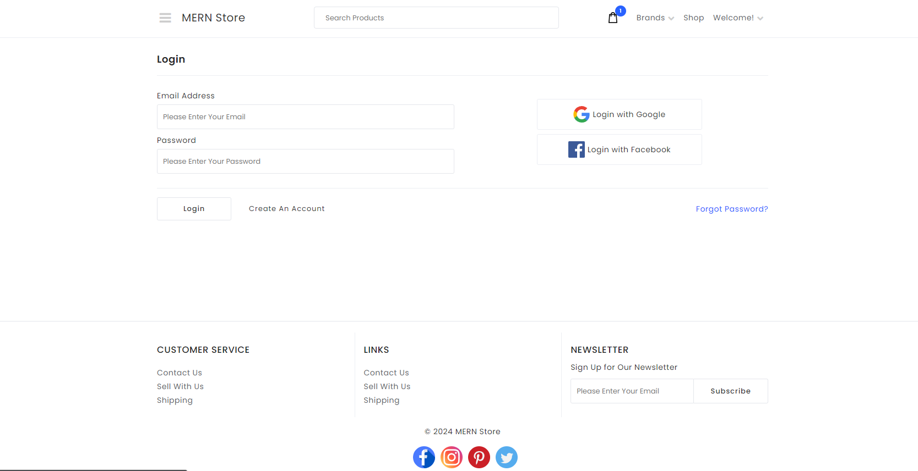
Login Page
The Login Page has fields for email and password with "Login" and "Create an account" options. The Register Page includes first name,last name, email, password fields, and a "Register" button.

Slide 5
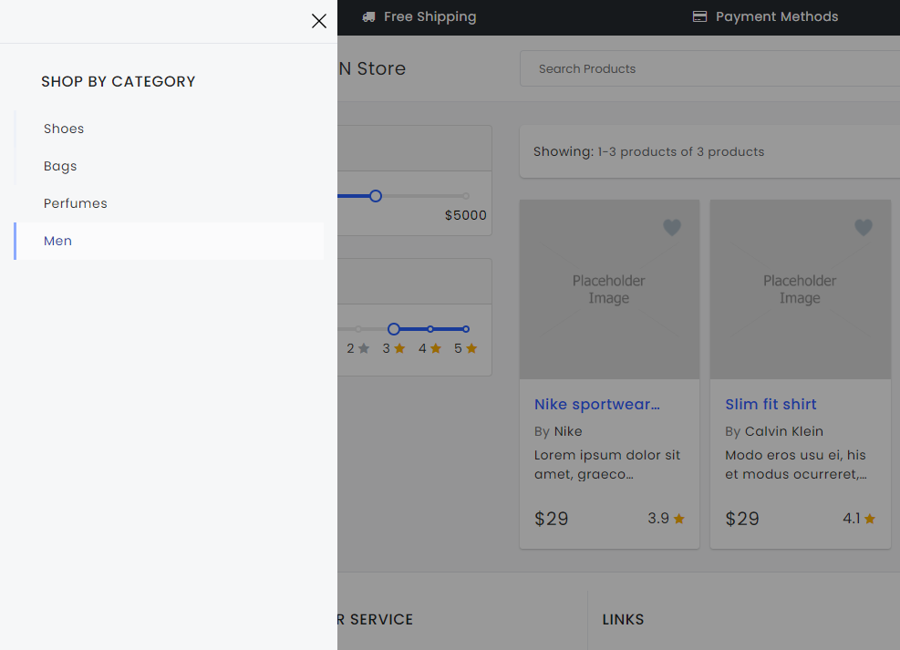
Side Bar
This side bar show the categories in the website like shoes,Bags and men etc..

Slide 6
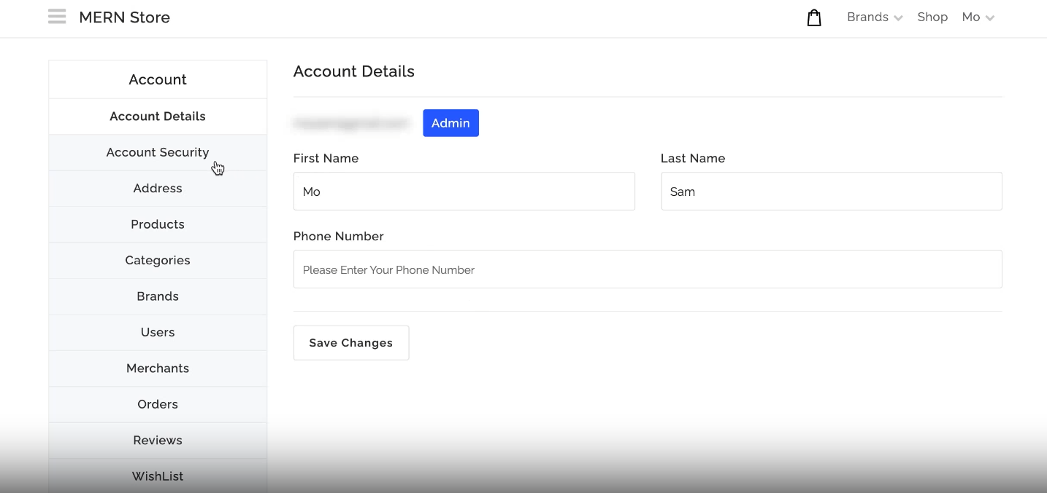
Admin dashboard
This admin dashboard for MERN Store allows administrators to manage account details, security settings, address information, and phone number. It also provides access to sections for products, categories, brands, users, merchants, orders, reviews, and wishlists.

Slide 7

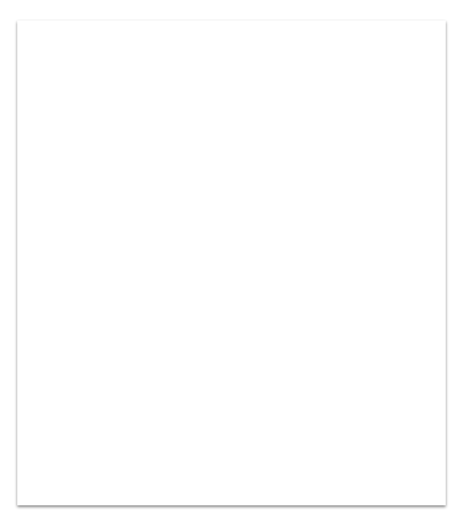
Thanks
For more information about the project
Check the documentation file

