Slide 1



Project Management System
You can Now handle your team projects more easily
The implementing company: AST

Slide 2
TEAM:
Moustafa Mohammed Nasr
Full Stack Developer
Abdulrahman Mohamed Saber
Full Stack Developer
Mohammed Abdelzaher
Front-End Developer
Mostafa ElSha7at
Front-end Developer
Ahmed Naser
Back-end Developer

Slide 3
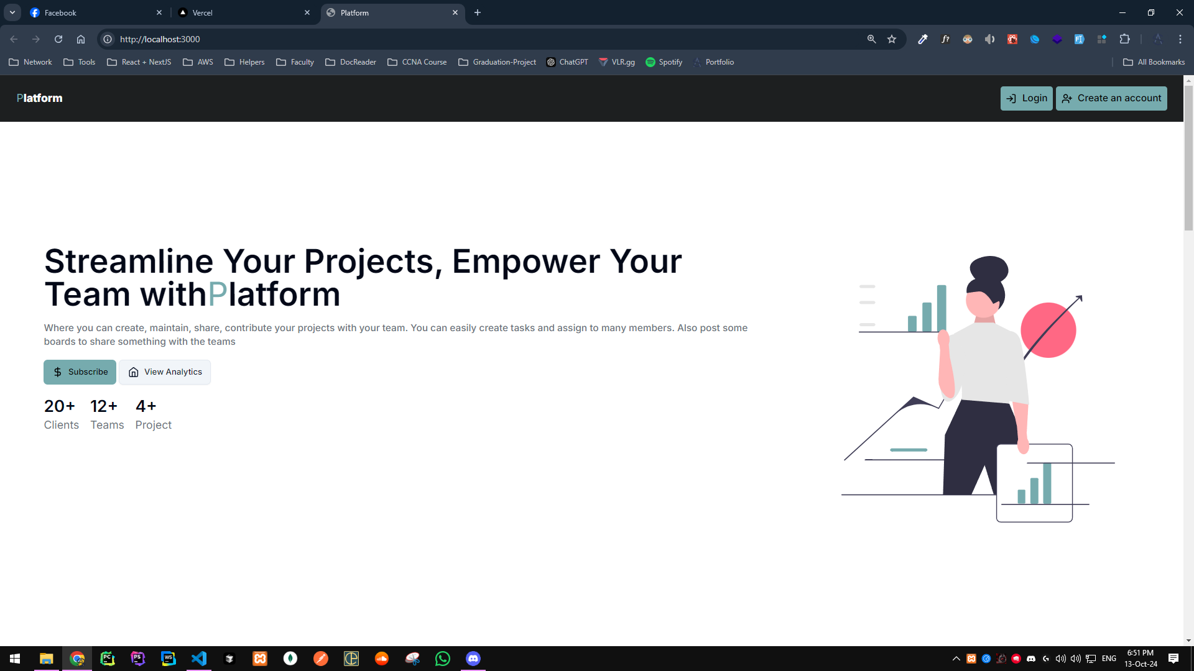
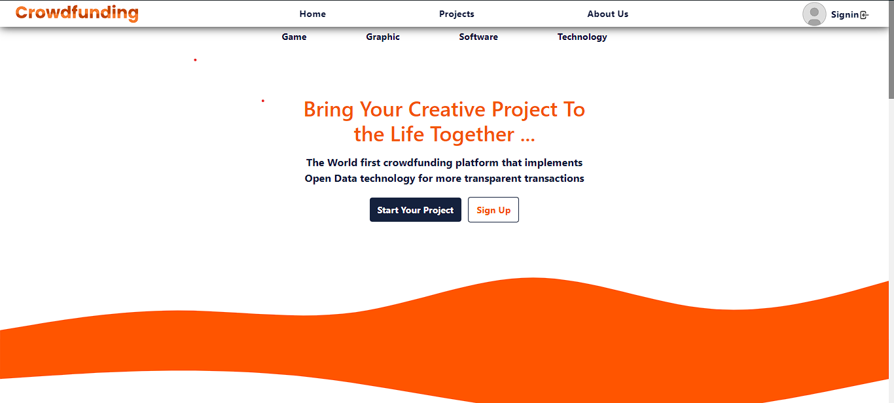
The Product
Main Page
We we enter into the website we will get a heading displaying what’s the main idea of this product.

Slide 4
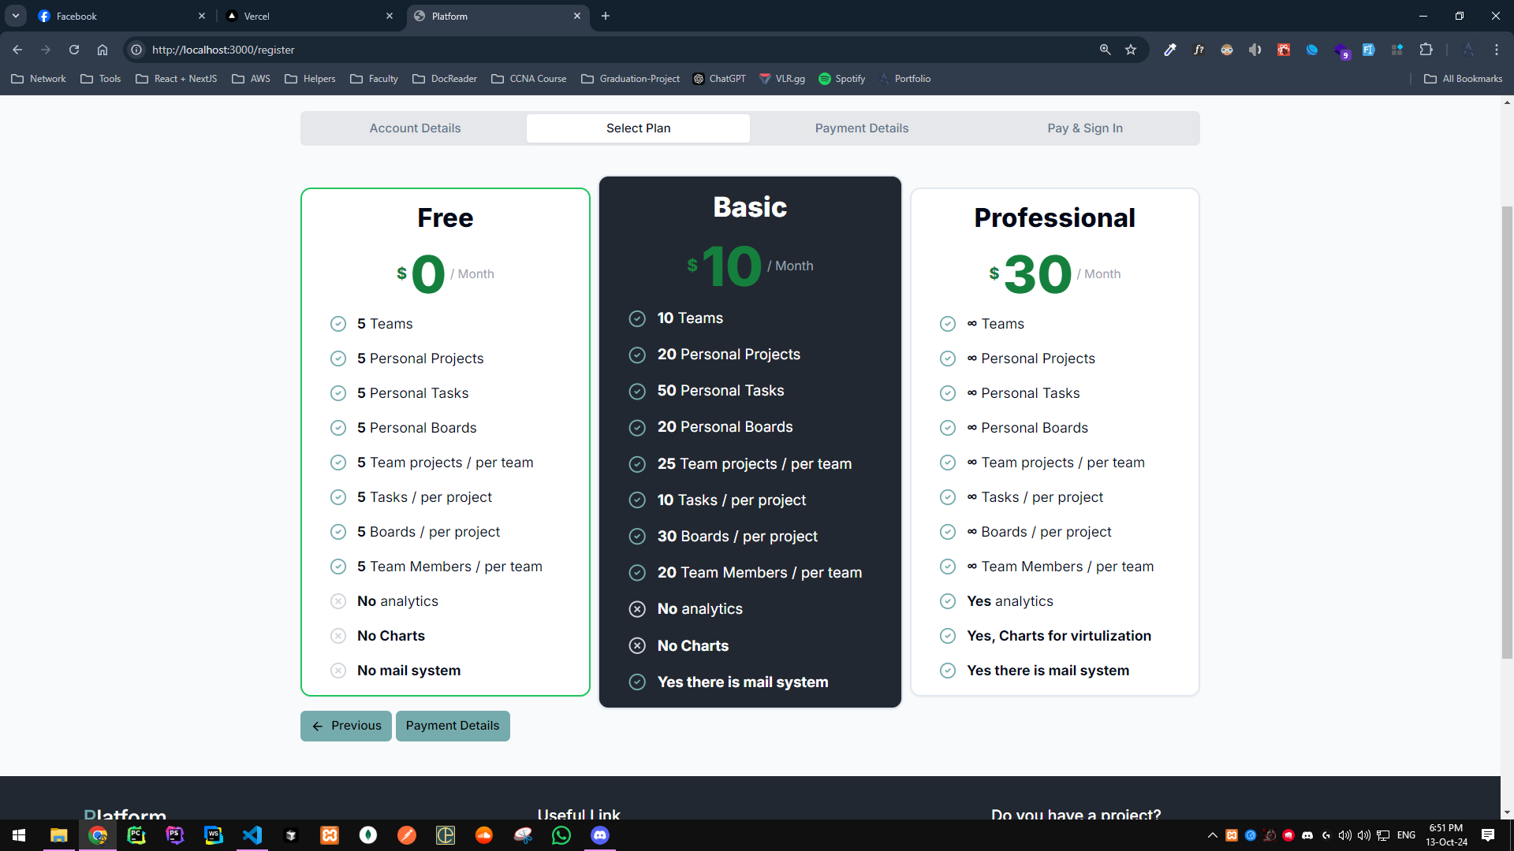
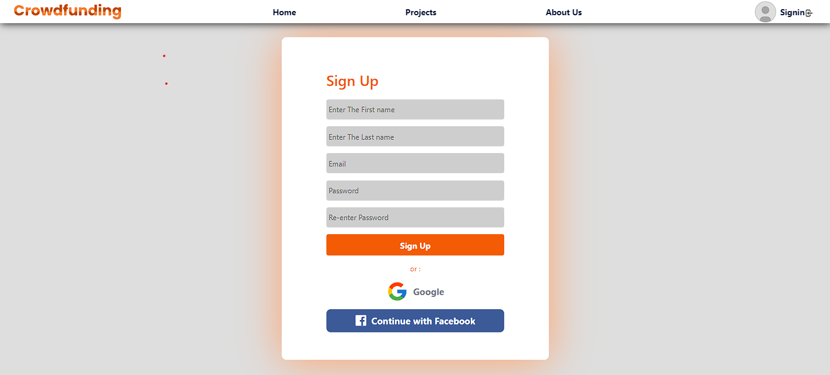
The Product
Plans Page
Here’s our plans of users teams

Slide 5
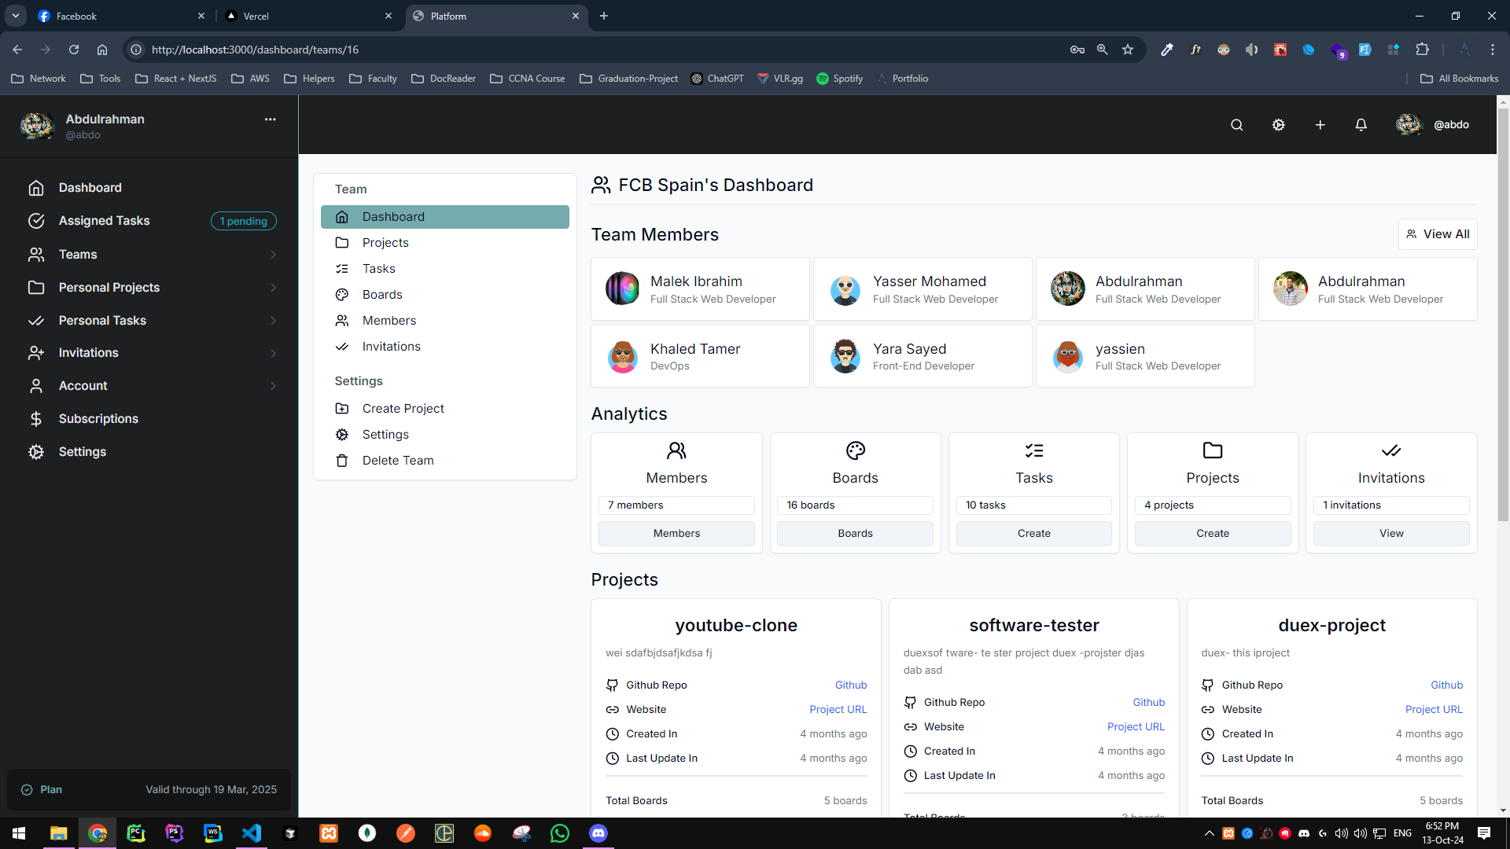
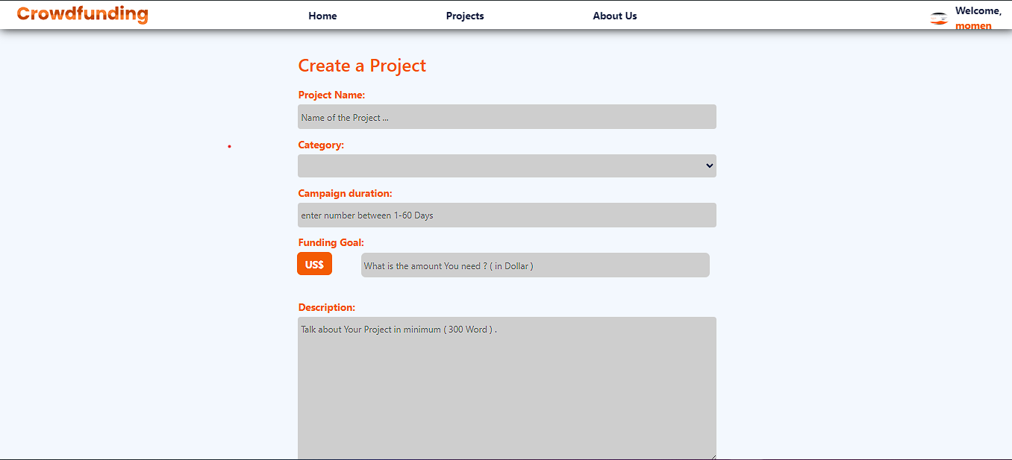
The Product
User dashboard
Dashboard displaying selected team details

Slide 6
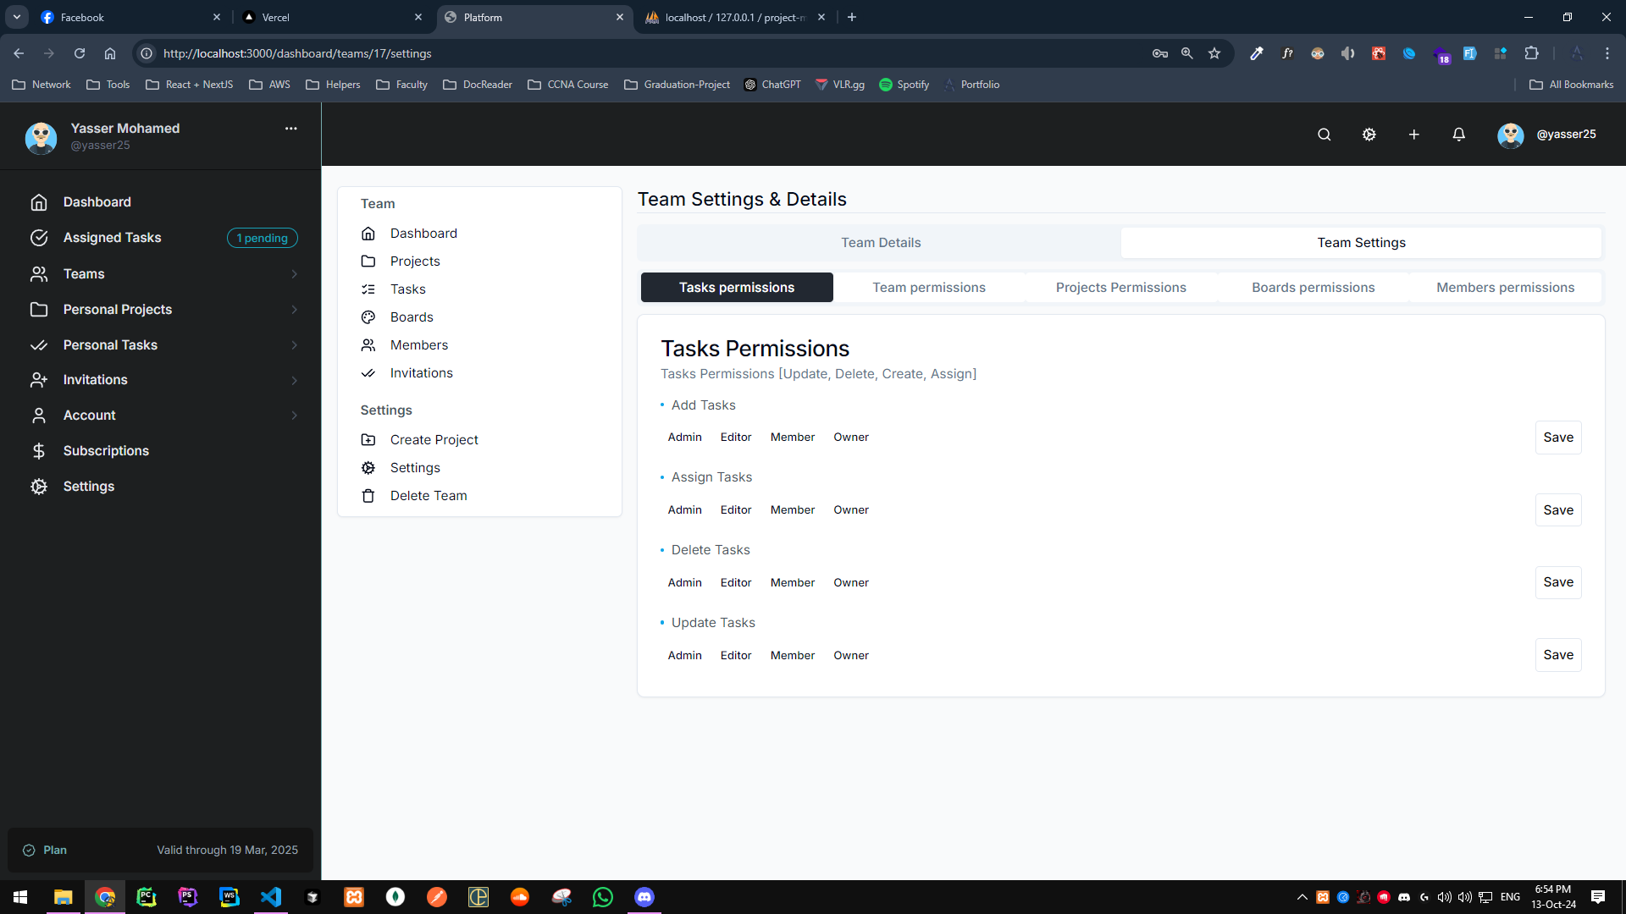
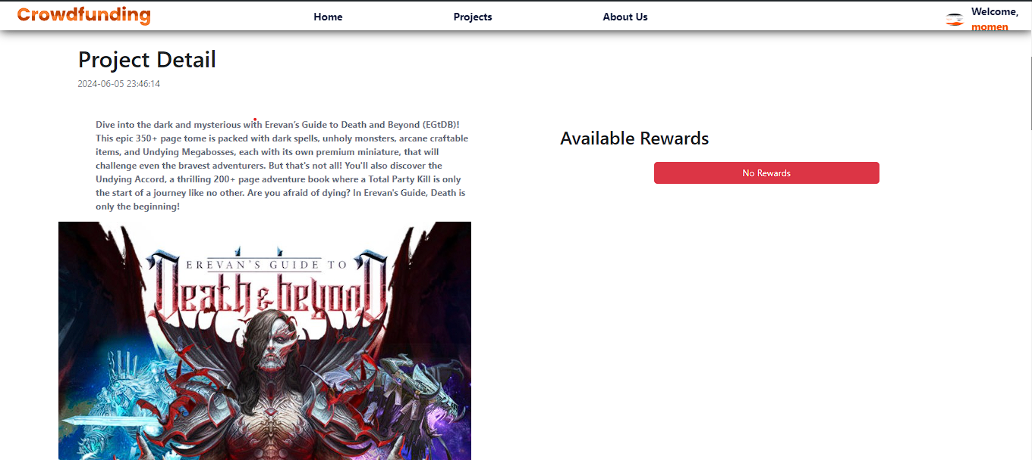
The Product
Team settings
Here can user selected and assign permission to different roles

Slide 7
Thank You

