Slide 1
TunePlay
“Where music and memory collide”
Casey Flynn
Kristof Fogarasi
Austin Lent
Connor Sheehan

Slide 2
Main Layouts
Home Screen
Directions Screen
Practice Screen
Play Screen

Slide 3
Layout Organization
HOME SCREEN
DIRECTION SCREEN
PRACTICE SCREEN
PLAY SCREEN
DIRECTION 1
GAME OVER
NEXT LEVEL
YOU WIN!
DIRECTION 2
DIRECTION 3
DIRECTION 4
Direction 7 leads to Play Screen
Game Over leads to Play Screen or Home Screen
Next Level leads to Play Screen
You Win! Leads to Home Screen
Practice Screen leads to Play Screen
DIRECTION 5
DIRECTION 6
DIRECTION 7

Slide 4
Home Screen

Slide 5
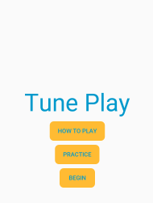
Three Buttons
Press “How To Play” Button → Directions Screen Layout
Press “Practice” Button → Practice Screen Layout
Press “Begin” Button → Play Screen Layout

Slide 6
Directions Screen

Slide 7
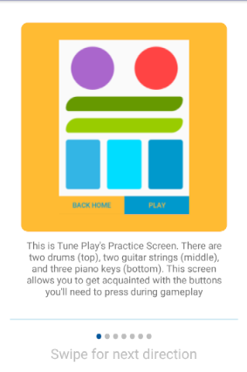
Home Screen → Direction Screen
TunePlay screen view
Direction Explanation
Direction Page Indicator

Slide 8
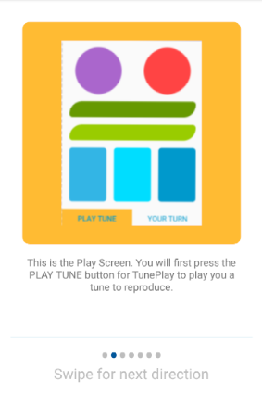
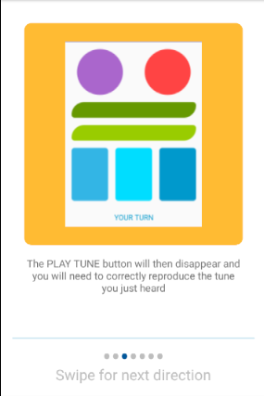
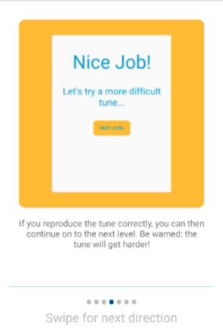
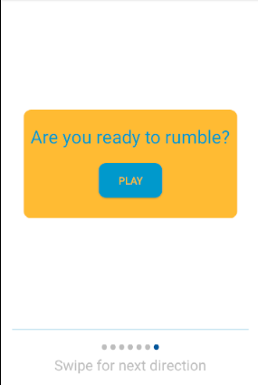
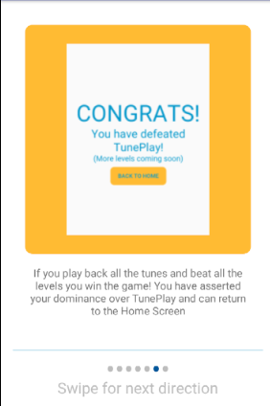
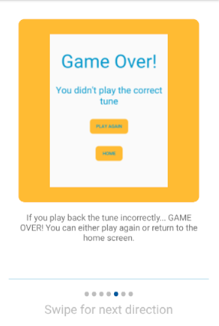
Directions Screen Content Flow
PLAY SCREEN

Slide 9
Direction 1
First direction slide
Explains TunePlay’s Practice Screen

Slide 10
Direction 2
Explains how to use the Play Screen
Press “Play Tune” to hear tune user will need to reproduce

Slide 11
Direction 3
Explains feature of Play Screen
Tells user what to do once PLAY TUNE button is clicked

Slide 12
Direction 4
Explains what happens when level is passed (user plays back tune correctly)

Slide 13
Direction 5
Explains what happens when the user fails to play back the tune correctly

Slide 14
Direction 6
Explains what happens when the user successfully completes all the levels (beats TunePlay)

Slide 15
Direction 7
Last direction slide
Contains button that leads to Play Screen

Slide 16
Practice Screen

Slide 17
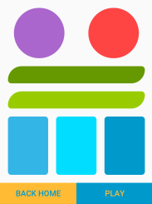
Practice Screen
Chance to become familiar with Play Screen before playing the game
7 instrumental buttons (3 piano keys, 2 guitar strings, and two drums)
Music plays when instrument buttons pressed
2 Navigational Buttons
Press “BACK HOME” → Home Screen Layout
Press “PLAY” → Play Screen Layout

Slide 18
Play Instrumental Buttons as much as you’d like to prepare for the game!

Slide 19
When “BACK HOME” button pressed, user is navigated to Home Screen

Slide 20
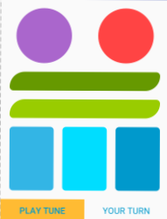
When “PLAY” button pressed, user is navigated to Play Screen

Slide 21
Play screen

Slide 22
Play Screen
Time to play!
7 Instrumental Buttons (3 piano keys, 2 guitar strings, and two drums)
Music plays when instrument buttons pressed
PLAY TUNE Button
Plays user the tune that they will need to reproduce
After being clicked once → disappears
YOUR TURN TextView
Covers bottom of screen (takes up space PLAY TUNE button was occupying as well)

Slide 23

When “PLAY TUNE” button pressed, TunePlay plays you a tune! Make sure to listen closely!

Slide 24
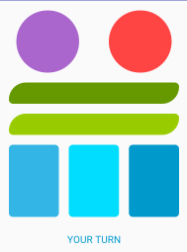
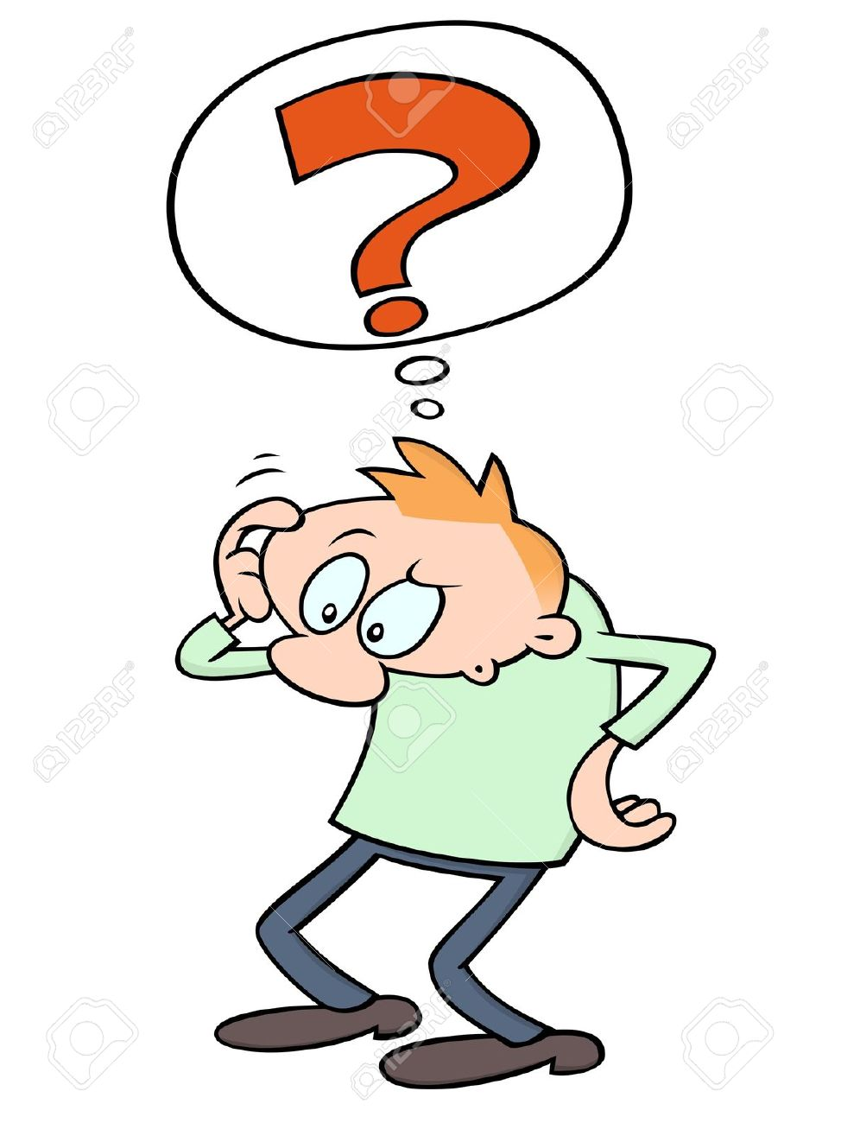
We told you to listen closely! Once TunePlay plays you the tune you need to reproduce, the PLAY TUNE button disappears. We hope you have a good memory!

Slide 25
Three cases after Level Completion

Slide 26
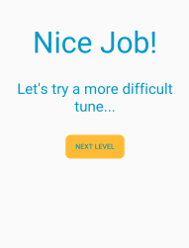
NEXT LEVEL!
If you play back the tune correctly, this screen pops up.
Click the “NEXT LEVEL” button to proceed to the next level!

Slide 27
Time for the next level! Are you ready?

Slide 28
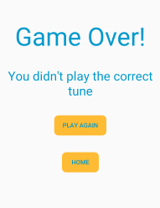
GAME OVER!
If you don’t play the tune back correctly… GAME OVER!
… You gotta work on that memory
But don’t fret, you have the chance to redeem yourself, by pressing “PLAY AGAIN” button and starting over
Or… You can wallow in defeat and return to the Home Screen by pressing the “Home” button

Slide 29
Get back on that horse!
If at first you don’t succeed, quit

Slide 30
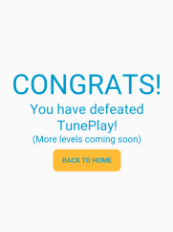
CONGRATULATIONS!
You are the champion!
If you see this screen, it’s because you have defeated all ten rounds of TunePlay
You showed TunePlay who’s boss and can heroically return to the Home Screen by pressing the “BACK TO HOME” button

Slide 31
We applaud you, you have defeated TunePlay – A feat that puts you among the greats like Hercules, Babe Ruth, and Bugs Bunny

Slide 32
Technical Challenges

Slide 33
Challenges we faced (in brief)
Wanted instrument buttons to highlight when played, but buttons only highlighted after tune was played → we had to omit this feature, maybe revisit it in future development
Wanted tune to play as soon as Play Screen was loaded, but tune played before Play Screen was launched → we had to create a “PLAY TUNE” button on Play Screen
Ran into issue that media player could only be created so many times → we created all necessary media players in level one and referenced them in proceeding levels rather than creating a new one each level.

Slide 34
Why tunePlay is ~Special~

Slide 35
Marketability
It appeals to musicians!
It appeals to people who enjoy memory games!
It appeals to game players because it’s fun!
It’s challenging! Keeps the user coming back for more
Color scheme is simple and clean! Appealing to the eye!

Slide 36
Thank you!

