Slide 2

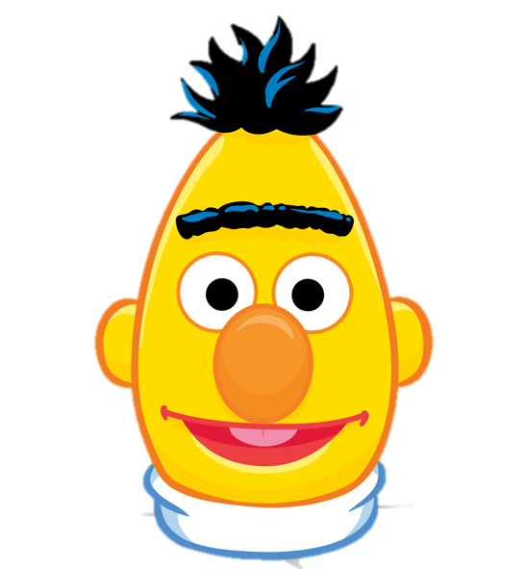

Risky Posts
Screening
Depression
Prediction
It's my first time on antidepressants …
0.43
Direct Expression
Feel Depressed
Treatment
Indirect Symptom
Guilty Feelings
Pessimism
Crying
…
I'm a shitty person for doing it …
0.27
Depression
0.25
im trying but that happened, its very frustrating
0.05
… crying at the end of Breakfast at Tiffanys...
Finally taking the plunge on a new Pokemon game

Slide 3
…
0
1
0
1
2
3
4
5
6
7
8
9
10
11
12
13
0
1
2
4
6
11
2
3
4
5
6
7
8
9
10
11
12
13
History
3
5
7
8
9
10
12
13
Risk: 0.3
Risk: 0.9
Risk: 0.4
Risk: 0.9
Screening
Min Risk: 0.6
4: 0.8
Min Risk: 0.3
7: 0.9
Min Risk: 0.6
7: 0.9
Min Risk: 0.6
Risky
Post
Queue
3: 0.5
5: 0.9
5: 0.9
1: 0.3
4: 0.8
4: 0.8
0: 0.6
0: 0.6
0: 0.6
0: 0.6
No Inference
Hierarchical Attentional Network (w BERT)
Prediction
Score

