Slide 1







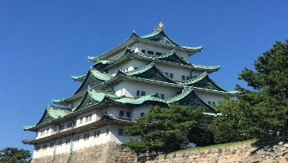

#Nanjing says no to Nagoya# This small Japan, is really irritating. What is this? We Chinese people are tolerant of good and evil, and you? People do things, and the gods are watching. Japanese, be careful, and beware of thunder chop! (via Bing Translation)

