Slide 1


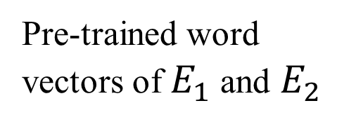
Output confidence
σ
LSTM
Dense Layer
Vector Representation
Token
Position
DT
lead#s
lead
DT
$$E_{1}$$
into
PR
JJ
$$E_{2}$$
Token
Normalized Sequence
Pre-trained word vectors of $E_{1}$ and $E_{2}$
-4
-3
-2
-1
0
1
2
3
4
Position
-8
-7
-6
-5
-4
-3
-2
-1
0
Original Sentence
The king led the dog into his nice garden .
dog
garden

