Slide 1
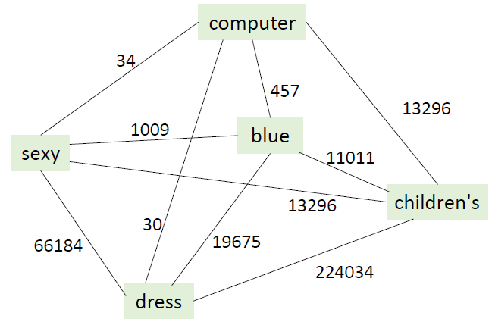


Rank using graph (score low-high)
children’s sexy dress
children’s blue dress
children’s cute dress
Annotation by crowd sourcing
children’s sexy dress
children’s blue dress
children’s cute dress
Automatic generation
children’s sexy children’s cute
dress dress
Preprocessing
children’s blue dress
……
children’s sexy dress
……
children’s cute dress
Raw Query Data
Adidas gym shoes (Adidas球鞋)
children’s blue dress (儿童蓝色连衣裙)
……
children’s sexy dress (儿童性感连衣裙)
3D printer (3维打印机)
……
children’s cute dress (儿童可爱连衣裙)
Quality Control
by crowdsourcing
(children’s sexy dress ,
children’s cute dress)
store in CoCon

