Slide 1
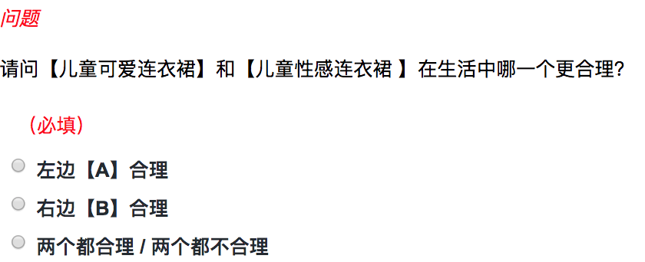
Question
Which one between【children’s cute dress】and【children’s sexy dress】is more plausible in our life ?
Left one 【A】
Right one 【B】
Both are plausible / implausible

