Slide 1
Automatically Paraphrasing via Sentence Reconstruction and Round-trip Translation
Speaker: Zilu Guo

Slide 2
Introduction
Paraphrase:
Same meaning
Different wording
Paraphrase Generation:
Given a sentence, generate its paraphrase
Sentence 1 | Sentence 2
A man is sitting on a bench next to a bike | Young man sitting on a bench behind a personal bicycle
How can I be a good geologist ? | What should I do to be a great geologist ?
How an unverified dossier became a crisis for @realdonaldtrump ? | How an unverified but explosive dossier became a crisis for Donald Trump ?
Notes:
Paraphrase -> a sentence with same meaning but different wording compared with original sentence

Slide 3
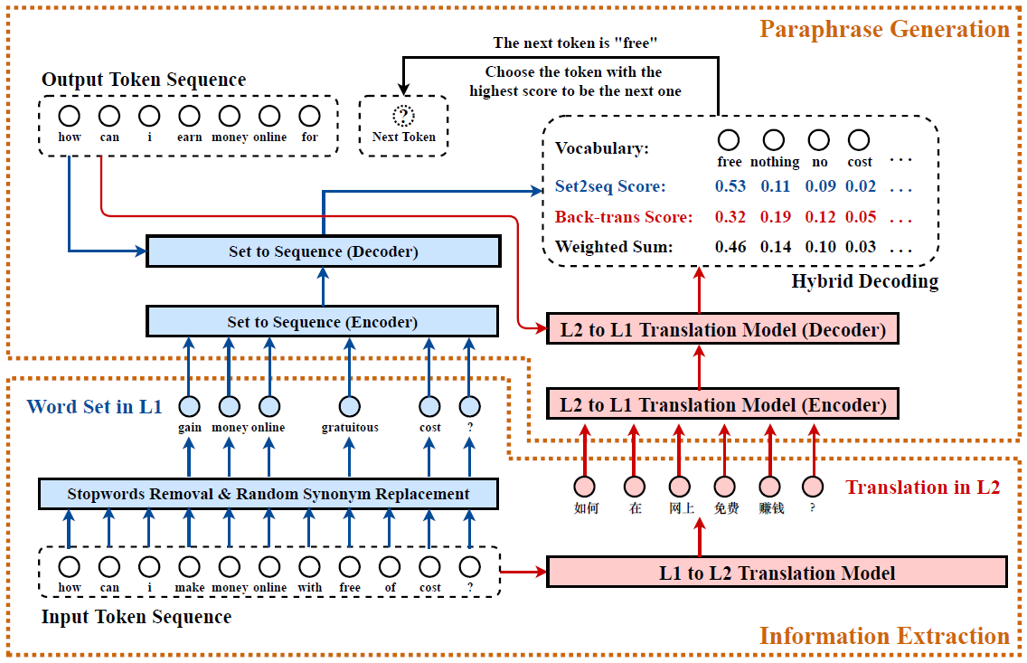
Figure 1. Our Paraphrasing Framework

Slide 4
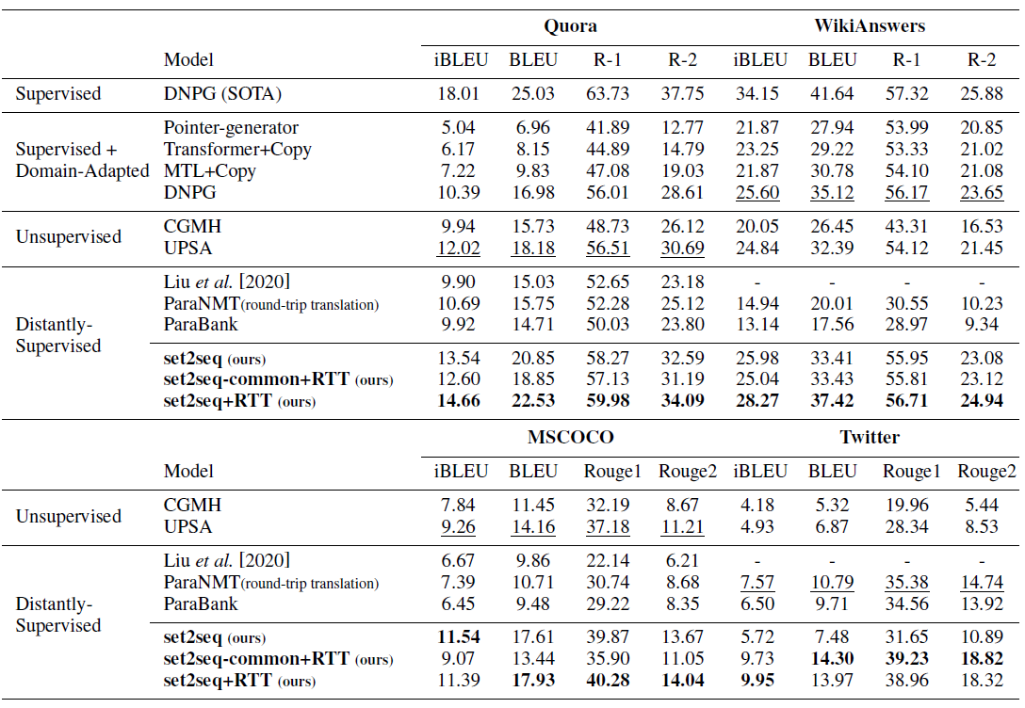
Table 2. Compared with baseline methods

Slide 5
Thank You

