Slide 1

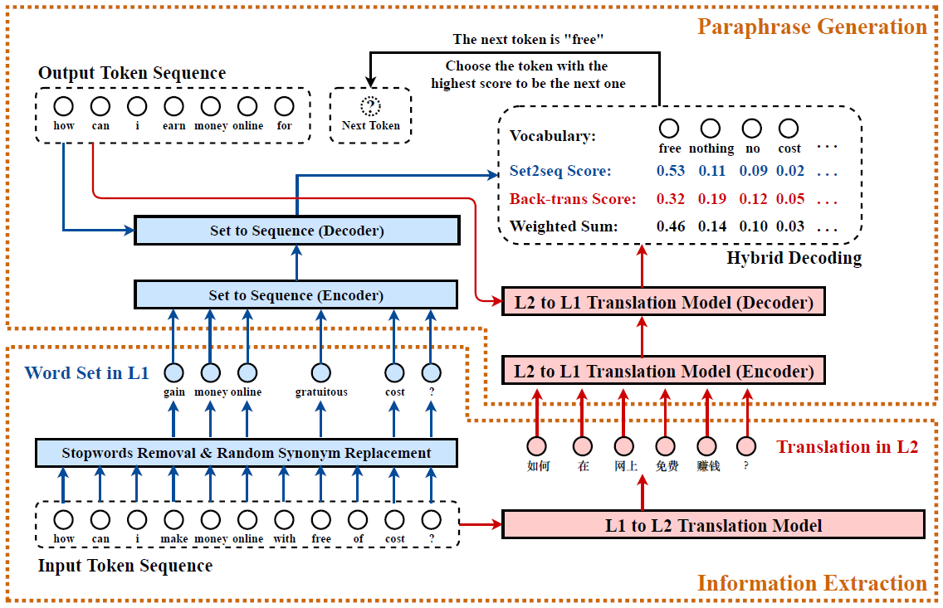
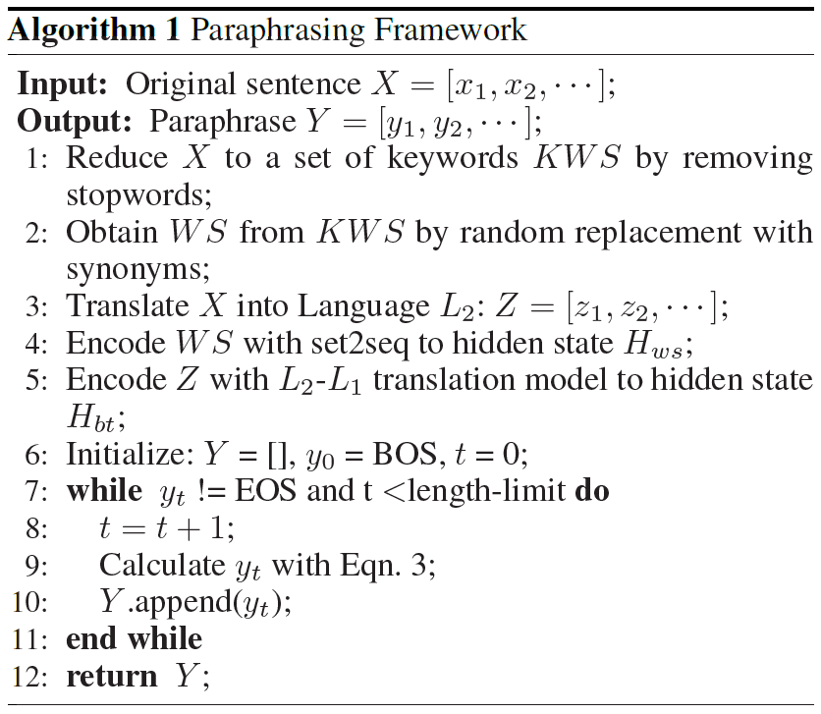
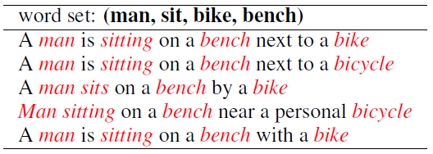
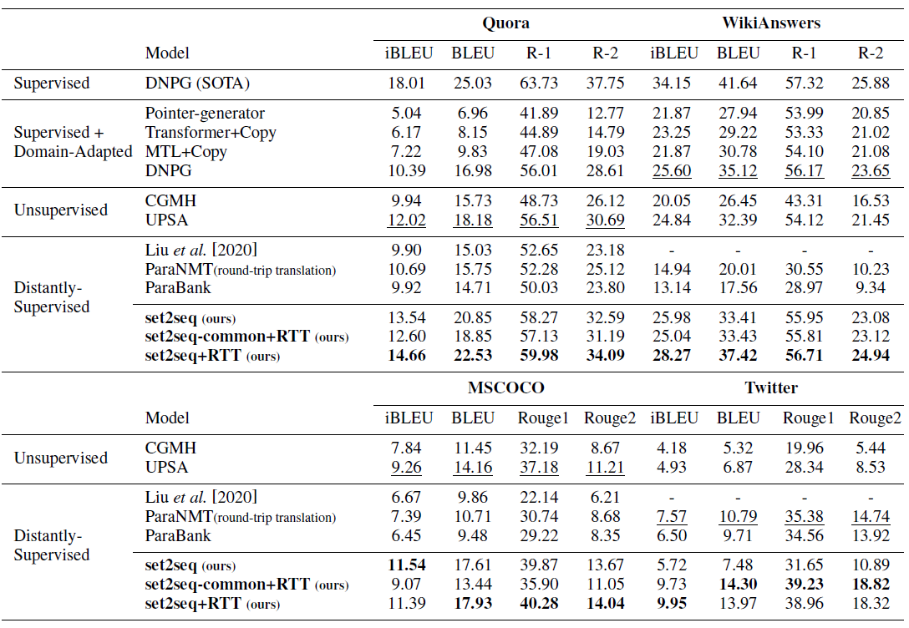
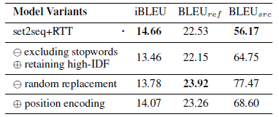
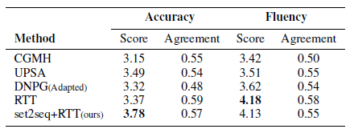
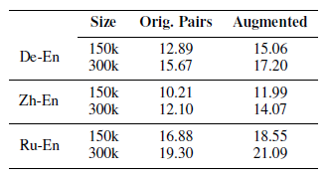
Automatically Paraphrasing via Sentence Reconstruction and Round-trip Translation
Zilu Guo¹, Zhongqiang Huang², Kenny Q. Zhu¹, Guandan Chen², Kaibo Zhang², Boxing Chen² and Fei Huang²
¹ Shanghai Jiao Tong University
² Alibaba Damo Academy
Abstract
Paraphrase generation plays key roles in NLP tasks such as question answering, machine translation, and information retrieval. In this paper, we propose a novel framework for paraphrase generation. It simultaneously decodes the output sentence using a pretrained wordset-to-sequence model and a round-trip translation model. We evaluate this framework on Quora, WikiAnswers, MSCOCO and Twitter, and show its advantage over previous state-of-the-art unsupervised methods and distantly-supervised methods by significant margins on all datasets. For Quora and WikiAnswers, our framework even performs better than some strongly supervised methods with domain adaptation. Further, we show that the generated paraphrases can be used to augment the training data for machine translation to achieve substantial improvements.
Approach
Introduction
Paraphrase: a pair of sentences with similar meaning, but different wording.
Two kinds of underlying semantics:
1. Word set
2. The translation in another language
How to generate parpahrase:
Step 1. Generate a word set from the input
Step 2. Translate the input into another language
Step 3. Generate paraphrase through the word set and the translation with a hybrid decoder
Data Augmentation For NMT (English -- X)
Step 1. Extract English sentences from the training pairs
Step 2. Generate paraphrase For English sentences
Step 3. Combine the paraphrase and the X language from the original training pair to get new training pairs
Figure 1. Our Paraphrasing Framework
Figure 2. Detail For our framework
Results
Set2seq model:
Trained with in-domain & non-parallel data
Trained on a single GTX-2080 GPU for 3 hours
Table 1. Paraphrases formed from a word set.
Round-trip Translation model:
Trained with WMT17 parallel zh-en dataset
Trained on two GTX-2080 GPUs for 3 days
Table 3. Ablation Study
Table 4. Human evaluation
Set2seq-common model:
Trained with WMT17 English monolingual data
Trained on a single GTX-2080 GPU for 1.5 days
Table 2. Compared with baseline methods
Table 5. Results For NMT data augmentation

