Slide 1
Automatically Paraphrasing via Sentence Reconstruction and Round-trip Translation
Speaker: Zilu Guo

Slide 2
Content
Introduction
Approach
Results
Application
Conclusion

Slide 3
Introduction
Paraphrase:
Same meaning
Different wording
Paraphrase Generation:
Given a sentence, generate its paraphrase
Sentence 1 | Sentence 2
A man is sitting on a bench next to a bike | Young man sitting on a bench behind a personal bicycle
How can I be a good geologist ? | What should I do to be a great geologist ?
How an unverified dossier became a crisis for @realdonaldtrump ? | How an unverified but explosive dossier became a crisis for Donald Trump ?
Notes:
Paraphrase -> a sentence with same meaning but different wording compared with original sentence

Slide 4
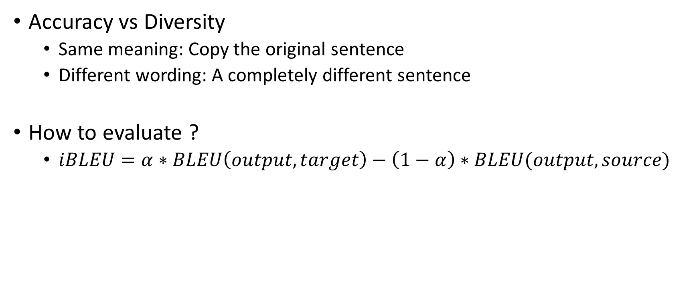
Natural Contradiction
Accuracy vs Diversity
Same meaning: Copy the original sentence
Different wording: A completely different sentence
How to evaluate ?
$iBLEU=α∗BLEU\left(output, target\right)−\left(1−α\right)∗BLEU(output, source)$
Notes:
Natural Contradiction for paraphrase generation: Accuracy & Diversity
2 key words in definition: same meaning, different wording
Same meaning -> copy the original sentence
Different wording -> generate a completely different sentence
Seek for balance

Slide 5
Datasets
 | Quora | WikiAnswers | Twitter | MSCOCO
Source | Quora | WikiAnswers | Twitter | Image Caption
Type | Questions | Questions | Sentences | Captions
Structure | Pair | Cluster | Cluster | Cluster(len-5)
Manual annotation | ✔ | ✖ | ✔ | ✔
Size(parallel) | 150K | 18M | 60K | 480K
Size(total) | 400K | 18M | 110K | 480K
Quality | 😀 | ☹ | ☹ | 😐
Problem: Domain-specific
Solution: Training without parallel in-domain data
Notes:
The first three crawler sentences from their sources and get similar sentences automatically, Quora and Twitter will ask people whether the sentences in the pair are duplication of each other to mark them as parallel or non-parallel.
If you want to train on a high quality dataset with manual annotation, you will get a small dataset. If you want to train on a large dataset, you will get a low-quality dataset with lots of spelling errors but without manual annotation. Even if you don’t care any of the quality and quantity, you can still only get a dataset full of questions unless you can accept a dataset full of Twitter-style expressions.
We only need a small but high-quality dataset for testing.

Slide 6

Try to describe the picture ?
A man is sitting on a bench next to a bike
How do you come up with this description ?

Slide 7
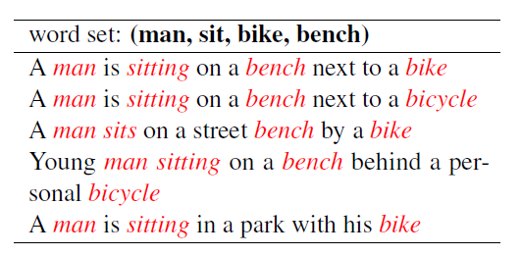
Word Set
Man | Bike | Bench | Sit

Slide 8
Extraction & Extension
Young man sitting on a bench behind a personal bicycle
Young man sitting on a bench behind a personal bicycle
Word Set Construtor
(Man | Bicycle | Bench | Sit)
Set2seq Model
A man is sitting on a bench next to a bike
A man is sitting on a bench next to a bike

Slide 9
Word Set Constructor
Two steps
Remove stopwords
Randomly replace words with their synonyms

Slide 10
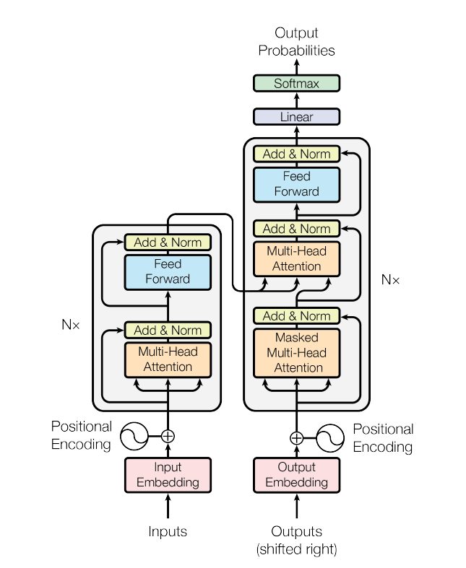
Set2seq Model

Slide 11
An Issue
Russia is bigger than Vatican
Stopwords: is, than
Synonym: big -> large
(Russia | Large | Vatican)
Which country is larger? Russia or Vatican
Information loss without sequential expression

Slide 12
Hybrid Decoding
Russia is bigger than Vatican
Word Set Constructor
En-Zh translator
(Russia | Large | Vatican)
俄罗斯比梵蒂冈大
Set2seq Model
Zh-En translator
Russia is larger than Vatican

Slide 13
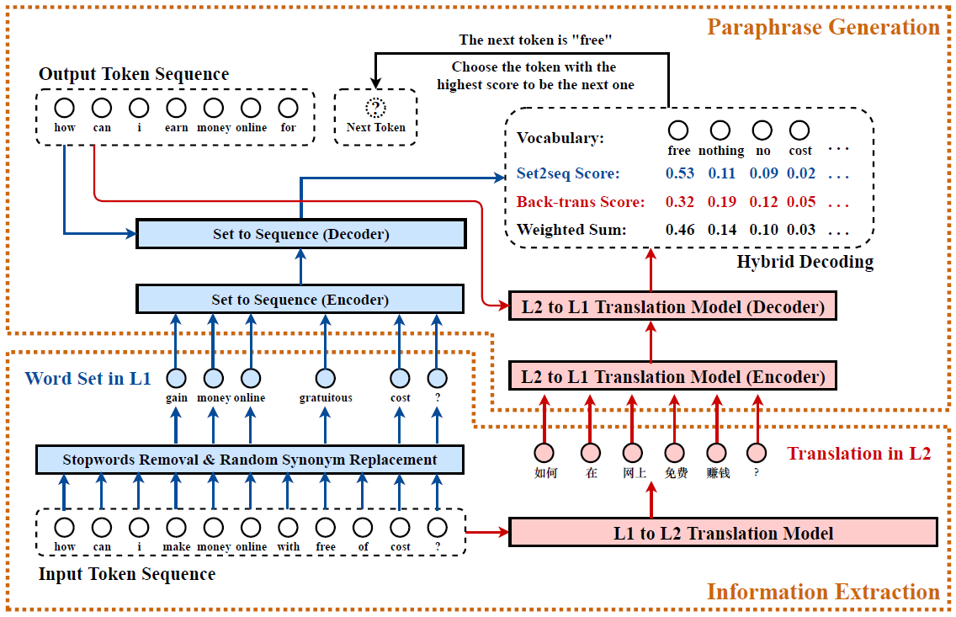
Figure 1. Our Paraphrasing Framework

Slide 14
Experiments & Results
Set2seq model:
Trained with in-domain & non-parallel data
Trained on a single GTX-2080 GPU for 3 hours
Round-trip Translation model:
Trained with WMT17 parallel zh-en dataset
Trained on two GTX-2080 GPUs for 3 days
Set2seq-common model:
Trained with WMT17 English monolingual data
Trained on a single GTX-2080 GPU for 1.5 days

Slide 15
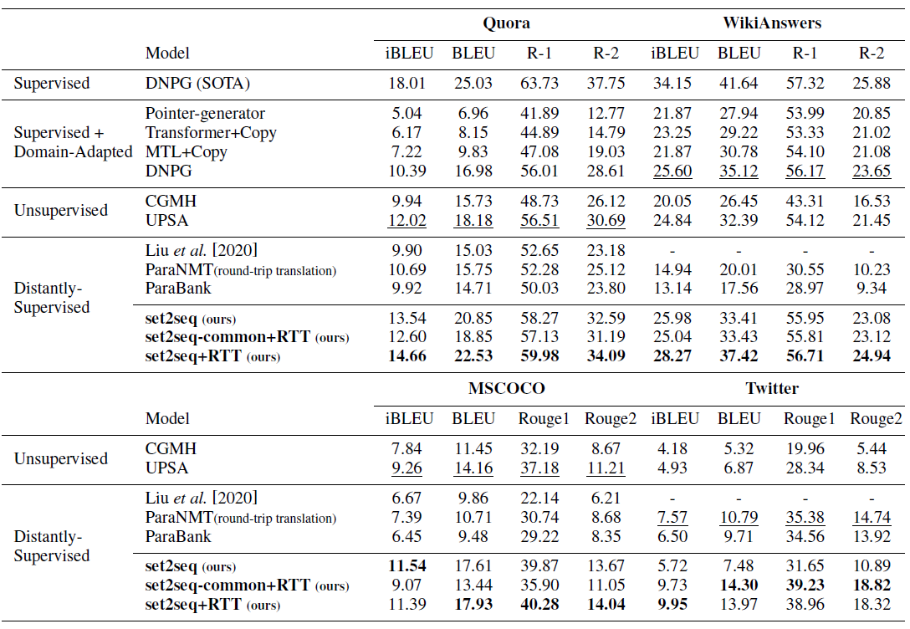
Table 2. Compared with baseline methods

Slide 16
Application: Data Argumentation on NMT
Training Pair:
What did you have for lunch?
你中午吃了什么？
What did you eat for lunch?
你中午吃了什么？
Augmented
Data
What did you eat this noon?
你中午吃了什么？
What did you have at lunch time?
你中午吃了什么？

Slide 17
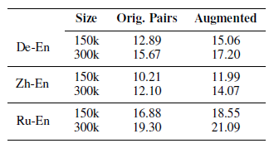
Application: Data Argumentation on NMT
Training Pair:
What did you have for lunch?
你中午吃了什么？
What did you eat for lunch?
你中午吃了什么？
Augmented
Data
What did you eat this noon?
你中午吃了什么？
Table 5. Results For NMT data augmentation
What did you have at lunch time?
你中午吃了什么？

Slide 18
Conclusion
We are the first to apply the set2seq model to the task of paraphrase generation by combining it with a round-trip translation model through a hybrid decoder.
The framework proposed by us achieve state-of-the-art accuracies on four benchmark datasets compared with existing methods.
We apply our method to augment the training data of low-resource translation tasks and obtain significant improvement in translation quality.

Slide 19
Thank You

