Slide 2

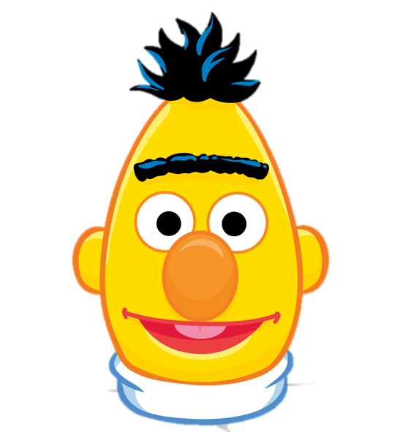

Risky Posts
Screening
Depression
Prediction
It's my first time on antidepressants …
0.43
Direct Expression
Feel Depressed
Treatment
Indirect Symptom
Guilty Feelings
Pessimism
Crying
…
I'm a shitty person for doing it …
0.27
Depression
0.25
im trying but that happened, its very frustrating
0.05
… crying at the end of Breakfast at Tiffanys...
Finally taking the plunge on a new Pokemon game

Slide 3







$$u$$
Attention
$$p_{1}^{′}$$
$$p_{2}^{′} p_{3}^{′} … p_{K−2}^{′} p_{K−1}^{′}$$
$$p_{K}^{′}$$
User Encoder (Transformer)
$$p_{1}$$
$$p_{2} p_{3} … p_{K−2} p_{K−1}$$
$$p_{K}$$
Post Encoder (BERT)
……………….
Post Encoder (BERT)
$$x_{1}, x_{2}, …, x_{L}$$
……………….
$$x_{1}, x_{2}, …, x_{L}$$

Slide 4
…
0
1
0
1
2
3
4
5
6
7
8
9
10
11
12
13
0
1
2
4
6
11
2
3
4
5
6
7
8
9
10
11
12
13
History
3
5
7
8
9
10
12
13
Risk: 0.3
Risk: 0.9
Risk: 0.4
Risk: 0.9
Screening
Min Risk: 0.6
4: 0.8
Min Risk: 0.3
7: 0.9
Min Risk: 0.6
7: 0.9
Min Risk: 0.6
Risky
Post
Queue
3: 0.5
5: 0.9
5: 0.9
1: 0.3
4: 0.8
4: 0.8
0: 0.6
0: 0.6
0: 0.6
0: 0.6
No Inference
Hierarchical Attentional Network (w BERT)
Prediction
Score

Slide 6
ID | Post
A | When I’m struggling with my shyness and force myself to be confident, I feel a sense of fear. And it f**king hurts if I feel I’m rejected.
B | I have many singers/bands that I’ll never tire of.
C | I feel like my depression comes in waves, when I go through good periods and other times I think life is completely pointless.

