Slide 1
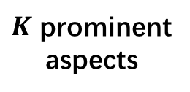
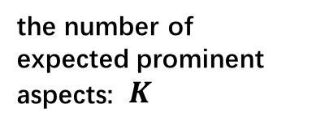
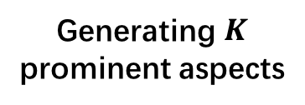
Knowledge
Aggregating
aspect synsets
Constructing
aspect graph
Grouping
aspect clusters
Generating $K$
prominent aspects
input
output
the number of expected prominent aspects: $K$
Relation
weighting
$K$ prominent
aspects
customer
reviews

