Slide 1
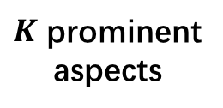
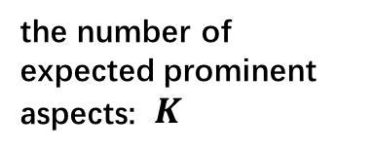
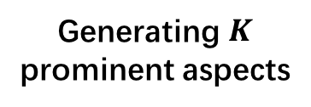
Knowledge
(WordNet, Probase, Glove)
aspect space construction
aspect space segmentation
Aspect Candidates
Extraction
Aggregating
aspect synsets
Constructing
aspect graph
Grouping
aspect clusters
Generating $K$
prominent aspects
output
input
Relation
weighting
$K$ prominent
aspects
the number of expected prominent aspects: $K$
customer
reviews
aspect aggregation

