Slide 1
Leaner and Faster: Two-Stage Model Compression for Lightweight Text-Image Retrieval
Siyu Ren and Kenny Q. Zhu
Shanghai Jiao Tong University
Shanghai, China
roy0702@sjtu.edu.cn
Notes:
Hello everyone, My name is Siyu Ren, and I am a Phd student at Shanghai Jiao Tong university, China.I am glad to share our work “leaner and faster: two-stage model compression for lightweight text-image retrieval”. This work is done under the supervision of my advisor Kenny Zhu.

Slide 2
Outline
1
Text-Image Retrieval
2
A Two-Stage Compression Framework
3
Evaluation & Application
4
Summary
Notes:
My presentation will be divided into 4 parts, starting with the background of text-image retrieval task itself as well as its practical application. And then I will elaborate on our proposed two-stage compression framework for enabling faster and more lightweight text-image retrieval. Next I will introduce the experiment section, where we benchmark our framework in terms of retrieval accuracy and efficiency.

Slide 3
Outline
1
Text-Image Retrieval
2
A Two-Stage Compression Framework
3
Evaluation & Application
4
Summary
Notes:
First, I will briefly introduce what is the task of text-image retrieval and what kind of challenge it faces currently.

Slide 4




Text-Image Retrieval
Text-image retrieval is the technique of retrieving a set of relevant images from a large candidate pool given a textual query specified by users.
It has broad application scenarios on different platform, including image search on web and mobile devices.
Cats napping
Notes:
Text-image retrieval is the technique of retrieving a set of relevant images from a potentially very large candidate image pool, given a textual query specified by the users. It has broad application scenarios on different platforms, including image search engine on the Internet and mobile devices. Here is an example illustrating the scenario where the user searches for images describing “cats napping”. The candidate pool may contain images of both dogs and cats napping, a good text-image retrieval system should correctly
return the two images of cats napping.

Slide 5
Text-Image Retrieval
State-of-the-art retrieval systems rely on dense representation of both texts and images. They can be categorized into two lines:
Cross-encoder: Based on early-interaction, the huge response time latency hinders its deployment. ❌
Dual-encoder: Based on late-interaction, allowing pre-indexing and sub-linear time search. ✅
Encoder
Text Encoder
Image Encoder
Text
Image
Text
Image
Cross-encoder
Dual-encoder
Notes:
Current state-of-the-art text-image retrieval systems largely rely on dense representations of both texts and images.These systems can be categorized into two lines:
The first type is based on cross-encoder architecture. Cross-encoder takes as input text query and image simultaneously and produce the real-valued matching score. It is also known as early-interaction model, since the inter-modality interaction happens early in the first few layers.The major drawback that hinders cross-encoder’s wide deployment is that it requires looping over the entire image pool whenever a new text query comes in.
The second type is based on dual-encoder architecture. Dual-encoder encodes texts and images separately with the respective encoders. In practice, dual-encoder allows pre-computation of image representations and can be further accelerated by techniques such as maximum inner-product search.

Slide 6
Text-Image Retrieval
State-of-the-art retrieval systems rely on dense representation of both texts and images. They can be categorized into two lines:
Cross-encoder: Based on early-interaction, the huge response time latency hinders its deployment. ❌
Dual-encoder: Based on late-interaction, allowing pre-indexing and sub-linear time search. ✅
Large memory footprint and computation cost
Encoder
Text Encoder
Image Encoder
Text
Image
Text
Image
Cross-encoder
Dual-encoder
Notes:
However, even for the more efficient dual-encoder architecture, the memory footprint or disk space is still prohibitive for resource-constrained edge devices, such as smart phones. To address this problem, we aim to compress the large
Dual-encoder model into smaller and faster ones without significant performance degradation.

Slide 7
Outline
1
Text-Image Retrieval
2
A Two-Stage Compression Framework
3
Evaluation & Application
4
Summary
Notes:
Now I will formally present our proposed twp-stage framework for text-image retrieval compression.

Slide 8
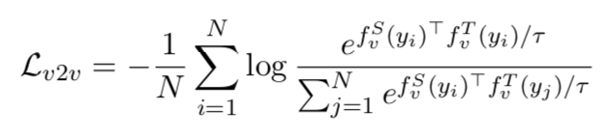
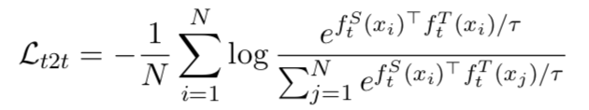
Two-Stage Model Compression
Two-stage pipeline:
Directly optimizing smaller image/text encoders via inter-modal InfoNCE will lead to sub-optimal generalization due to the lower model capacity. To address this issue, we propose to leverage massively available unpaired images/texts via intra-modal contrastive distillation.
Aligning image encoder
Aligning text encoder
Notes:
We denote the student encoder as f with superscript S and teacher encoder with superscript T. We first note that directly optimizing student image and text encoders via the commonly adopted inter-modal InfoNCE loss will lead to sub-optimal generalization due to the lower model capacity. To overcome this issue, we propose to leverage massively available unpaired images/texts via intra-modal contrastive distillation. The intra-modal contrastive loss has similar form compared with InfoNCE loss, except that the pair of positive sample is defined as the representations produced by the teacher and student encoder w.r.t the same input sample.
Essentially, the student encoder is trained to recover the representation ability of the teacher encoder.

Slide 9
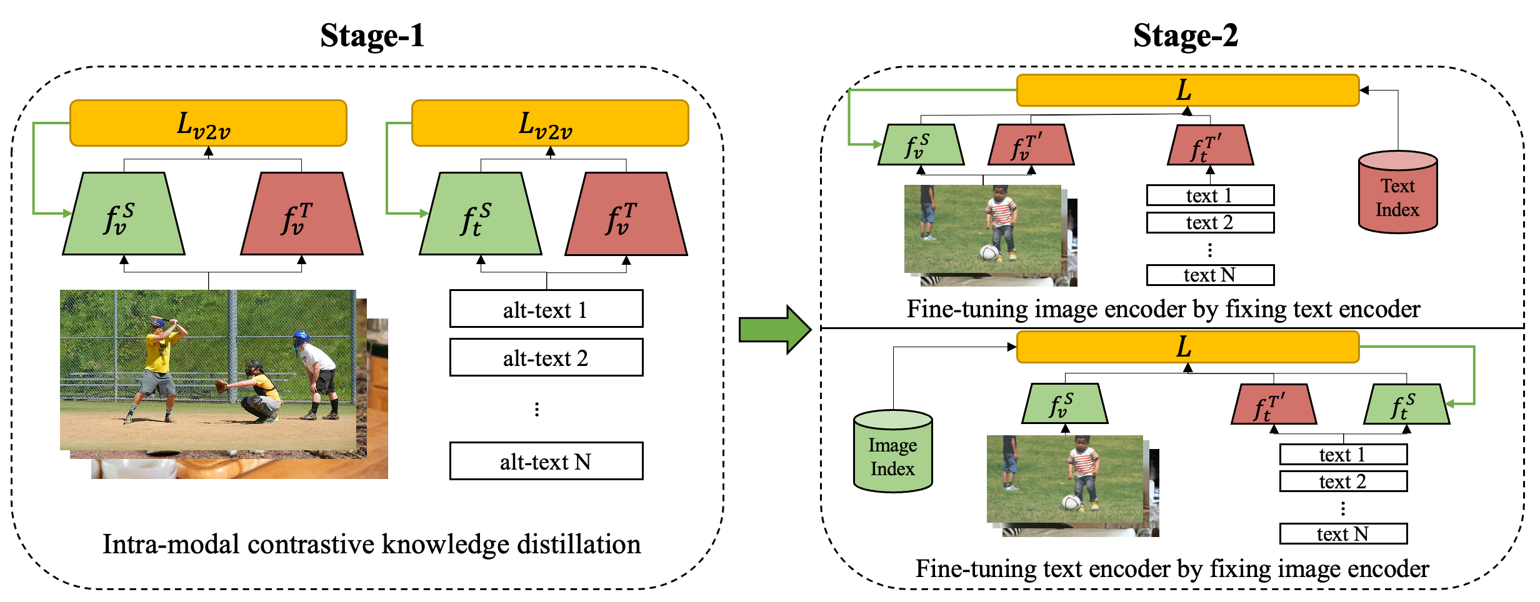
Two-Stage Model Compression
Two-stage pipeline:
Directly optimizing smaller image/text encoders via inter-modal alignment will lead to sub-optimal generalization due to the lower model capacity. To address this issue, we propose to leverage massively available unpaired images/texts via intra-modal contrastive distillation.
After intra-modal distillation, we then sequentially fine-tune the image and text encoder with a comprehensive objectives:
Teacher-student contrastive objective
InfoNCE loss with in-batch negatives
InfoNCE loss with corpus-level hard negatives
Notes:
After the stag—1 distillation, the student encoders are now ready to be transferred to task-specific in-domain data. At stage-2, we perform sequential fine-tuning on the image and text encoder with comprehensive training objectives:
The first objective is the teacher-student intra-modal contrastive loss as in stage-1.
The second objective is the standard InfoNCE loss with in-batch negatives
The third objective is the InfoNCE loss using corpus-level hard negatives. To mine such corpus-level hard negatives, we pre-compute the representations of all images and texts in the training set using the teacher encoders, and index them using Faiss to support fast run-time retrieval. These hard negatives can enhance model’s ability to distinguish samples with nuanced difference.

Slide 10
Outline
1
Text-Image Retrieval
2
A Two-Stage Compression Framework
3
Evaluation & Application
4
Summary
Notes:
Now let’s come to the experiment part.

Slide 11
Experiments
Dataset
Stage-1: Google Conceptual Caption(CC) is adopted as the mono-modal corpus for stage-1 intra-modal distillation. It consists of 3M image-text pairs.
Stage-2: MSCOCO and Flickr30K are used as standard image-text retrieval benchmark. There are 113,287/5000/5000 image-text pairs for training, validation, and testing in MSCOCO, and 28,783/1000/1000 image-text pairs for training, validation, and testing in Flickr30K.
Evaluation Metrics:
Recall@K, K=1,5,10.
Query Per Second(QPS).
Notes:
We perform stage-1 distillation on the Google Conceptual Caption dataset. It consists of 3 million image-text pairs, however, we only treat it as a reservoir of image and text without using the alignment information. For evaluate the compressed model on MSCOCO and Flickr 30K datasets, which are commonly selected testbeds for cross-modal retrieval.
Rcall@K is adopted as the evaluation metrics for retrieval accuracy, and we also report Query Per Second to reflect the model efficiency and throughput.

Slide 12
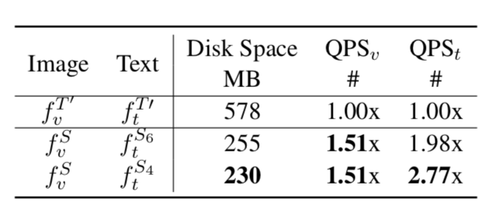
Experiments
Compression setting
Teacher: ViT-B/32 CLIP with 12-layer Vision Transformer for image encoder and 12-layer Transformer for text encoder.
Student: ViT-S/16 as image encoder and 6/4-layer Transformer as text encoder.
Notes:
The teacher model we aim to compress is the largest open-sourced ViT-B/32 CLIP model with 12-layer Vision Transformer for image encoder and 12-layer Transformer for text encoder.
The student model has a ViT-S/16 as image encoder and 6 or 4 layer Transformer as text encoder.
The table below shows the disk space and QPS for the original CLIP and our compressed one.

Slide 13
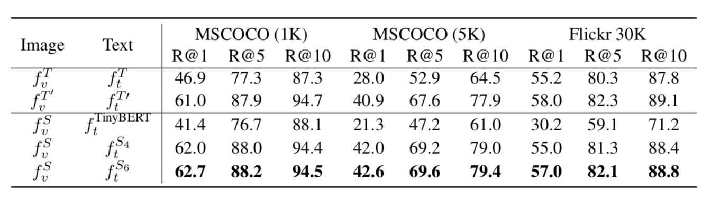
Experiments
Experimental results
On most evaluation metrics, models compressed by our proposed two-stage pipeline perform on par with or better than the fine-tuned target model.
We also found that the capacity of text encoder has limited affect on the performance.
Notes:
From the table we can see that, on most evaluation metrics, models compressed by our proposed two-stage framework perform on par with or better than the fine-tuned teacher model.
We also found that the capacity of text encoder has limited effect on the retrieval accuracy.

Slide 14
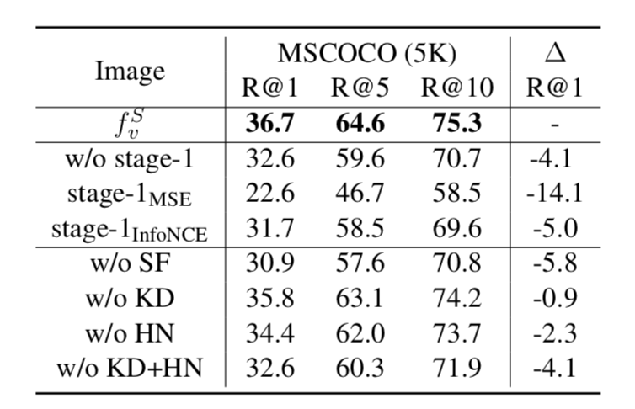
Experiments
Ablation study
Sequential fine-tuning makes fine-tuning stable and is essential for convergence.
Both knowledge distillation(KD) and hard negative mining(HN) improve retrieval accuracy and are complementary to each other.
Intra-modal contrastive distillation helps when image-text pairs are noisy, yielding significant advantage over inter-modal infoNCE loss.
Notes:
We also conducted extensive ablation study to examine the impact of each element in our proposed framework.
We make the following observations:
The sequential fine-tuning strategy makes fine-tuning stable and is essential for convergence.
Both knowledge distillation and hard negative mining improve retrieval accuracy and are complementary to each other.
Intra-modal contrastive distillation helps when image-text pairs are noisy, showing the advantage over inter-modal InfoNCE loss.

Slide 15
Conclusion
We propose a two-stage compression framework for lightweight text-to-image retrieval.
The compressed model achieves comparable retrieval accuracy while being 2.6x smaller and ~3.0x faster.
We open-source two mobile photo search applications on both Android and iOS platform at https://github.com/DRSY/MoTIS.
Notes:
In conclusion, We propose a two-stage compression framework for lightweight text-to-image retrieval. The compressed model achieves comparable retrieval accuracy while being 2.6x smaller and ~3.0x faster. We open-source two mobile photo search applications on both Android and iOS platform at https://github.com/DRSY/MoTIS.

Slide 16
Thanks for watching!
Notes:
And that’s all for my presentation, thanks for watching!

