Slide 1

A Unified Model for User Preference Analysis in Geo-tagged Reviews
ZHAO Kaiqi
School of Computer Engineering
Supervisor: Assist/P CONG Gao
15 September 2014

Slide 2
Outline
Aims & Objectives
Literature Review
Model Description
Applications
Experimental Results
Conclusion & Future Plan

Slide 3





Aims & Objectives
Location Based Services
Twitter:
500 million Tweets/day
78% users on mobile
Foursquare:
Over 6 billion check-ins
Yelp:
138 million monthly visit users
Over 61 million reviews

Slide 4
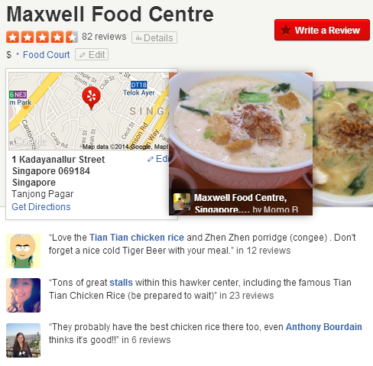

Aims & Objectives
Geo-tagged reviews in Yelp
category
coordinates
user
rating
review
Aspect | Sentiment
Cleanness | Positive
Price | Positive (Cheap)
Food | Positive
Drink | Positive

Slide 5
Aims & Objectives
Build a unified model for modeling user preference on categories, aspects and regions.
Apply this model to several applications.
?
User
Aspect
Sentiment
Category
Location
Point-of-interest (POI) recommendation
User recommendation
Aspect satisfaction analysis in geographical regions
Explanation of recommendation on both aspects and regions

Slide 6
Literature Review
Geographical Topic modeling (Quan et al. 2013, etc.)
On user check-ins
Explored latent regions for POIs
Sentiment Analysis (Jo and Oh 2011,etc.)
On product reviews
Explored aspects and sentiments for products
POI recommendation (Zhang et al. 2014, etc.)
Most of the proposals do not consider aspect and sentiment
Zhang et al. used explicit extracted aspects and sentiments but no geographical information is considered.
None of these proposals consider region, aspect, sentiment and category in a unified model.

Slide 7
Model Description
Intuitions
A user chooses to visit a region because 1) it is close to her activity area; 2) its function satisfies her interests (e.g., shopping street).
A user concerns about some aspects of POIs in some specific category.
Given a region and a category, users choose to visit POIs that not far from the region and belong to the given category.
In a review, users write words about aspects and sentiments, as well as words about the geographical location (e.g., Sentosa, Changi, etc.).

Slide 8
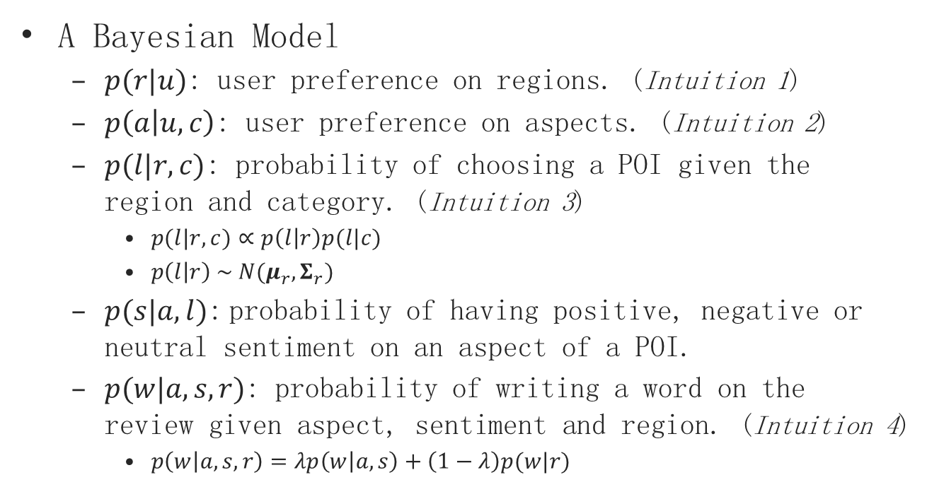
Model Description
A Bayesian Model
$p(r|u)$: user preference on regions. (Intuition 1)
$p\left(a | u,c\right)$: user preference on aspects. (Intuition 2)
$p(l|r,c)$: probability of choosing a POI given the region and category. (Intuition 3)
$p(l|r,c)∝p\left(l | r\right)p(l|c)$
$p\left(l | r\right) \sim N(μ_{r}, Σ_{r})$
$p(s|a,l)$: probability of having positive, negative or neutral sentiment on an aspect of a POI.
$p(w|a,s,r)$: probability of writing a word on the review given aspect, sentiment and region. (Intuition 4)
$p\left(w | a,s,r\right)=λp\left(w | a,s\right)+\left(1−λ\right)p(w|r)$

Slide 9
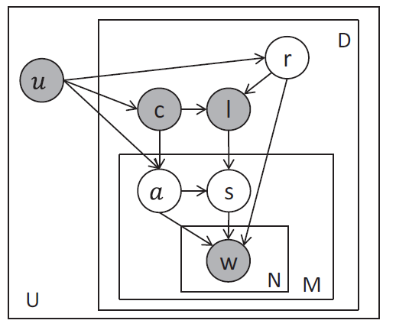
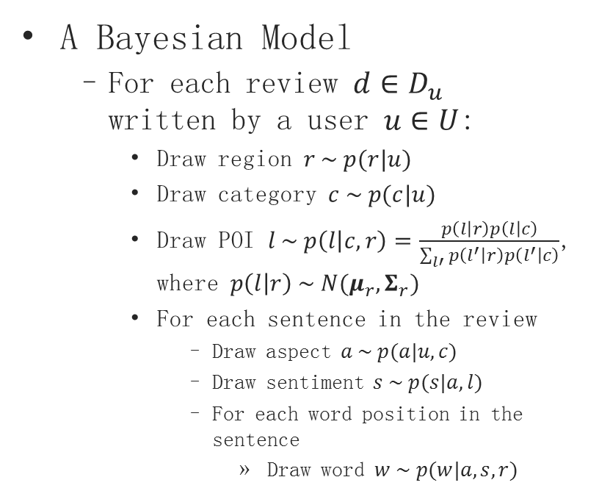
Model Description
A Bayesian Model
For each review $d∈D_{u}$ written by a user $u∈U$:
Draw region $r \sim p(r|u)$
Draw category $c \sim p(c|u)$
Draw POI $l \sim p\left(l | c,r\right)=\frac{p\left(l | r\right)p\left(l | c\right)}{\sum_{l′}{p\left(l^{′} | r\right)p\left(l^{′} | c\right)}}$, where $p\left(l | r\right) \sim N(μ_{r},Σ_{r})$
For each sentence in the review
Draw aspect $a \sim p(a|u,c)$
Draw sentiment $s \sim p(s|a,l)$
For each word position in the sentence
Draw word $w \sim p(w|a,s,r)$

Slide 10
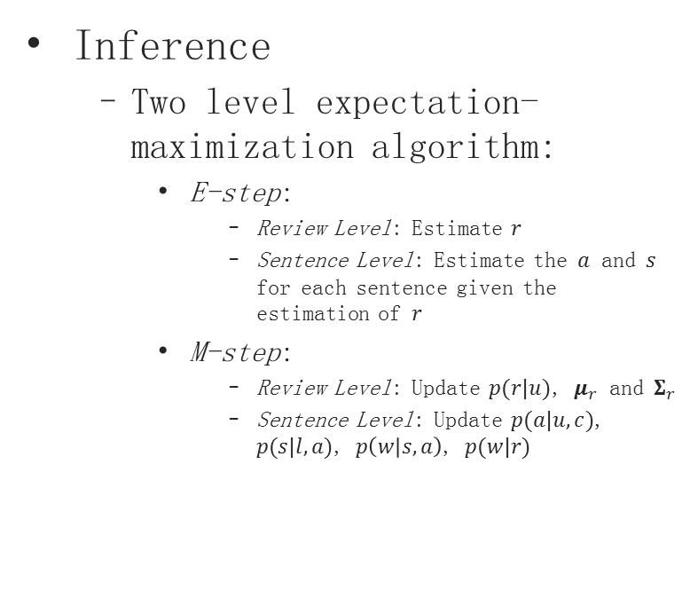
Model Description
Inference
Two level expectation-maximization algorithm:
E-step:
Review Level: Estimate $r$
Sentence Level: Estimate the $a$ and $s$ for each sentence given the estimation of $r$
M-step:
Review Level: Update $p(r|u)$, $μ_{r}$ and $Σ_{r}$
Sentence Level: Update $p(a|u,c)$, $p(s|l,a)$, $p\left(w | s,a\right)$, $p(w|r)$

Slide 11
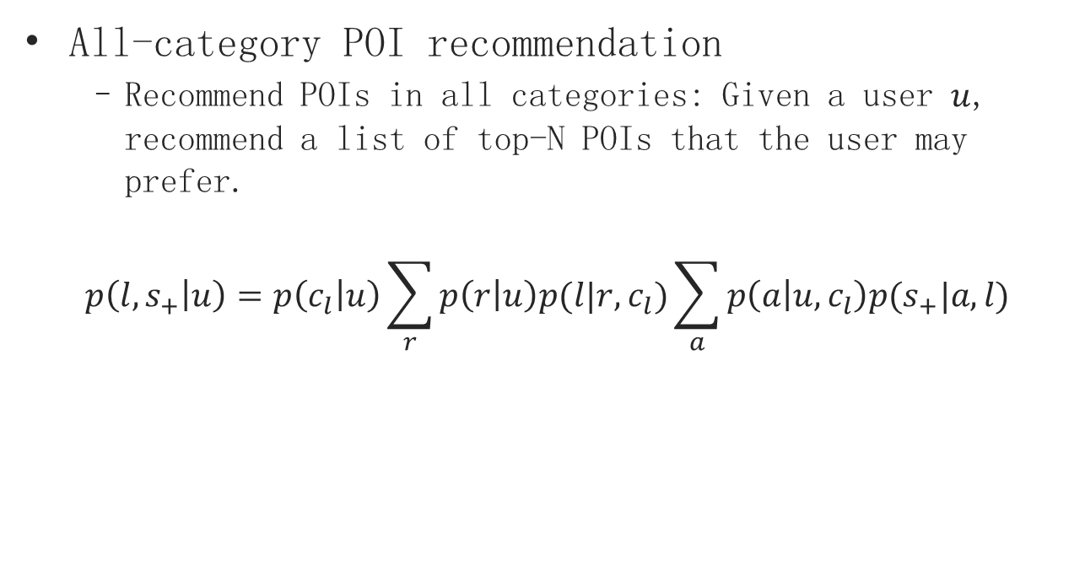
Applications
All-category POI recommendation
Recommend POIs in all categories: Given a user $u$, recommend a list of top-N POIs that the user may prefer.
$$p\left(l,s_{+} | u\right)=p\left(c_{l} | u\right)\sum_{r}{p\left(r | u\right)p(l|r,c_{l})}\sum_{a}{p\left(a | u,c_{l}\right)p(s_{+}|a,l)}$$
region & category preference
aspect preference

Slide 12
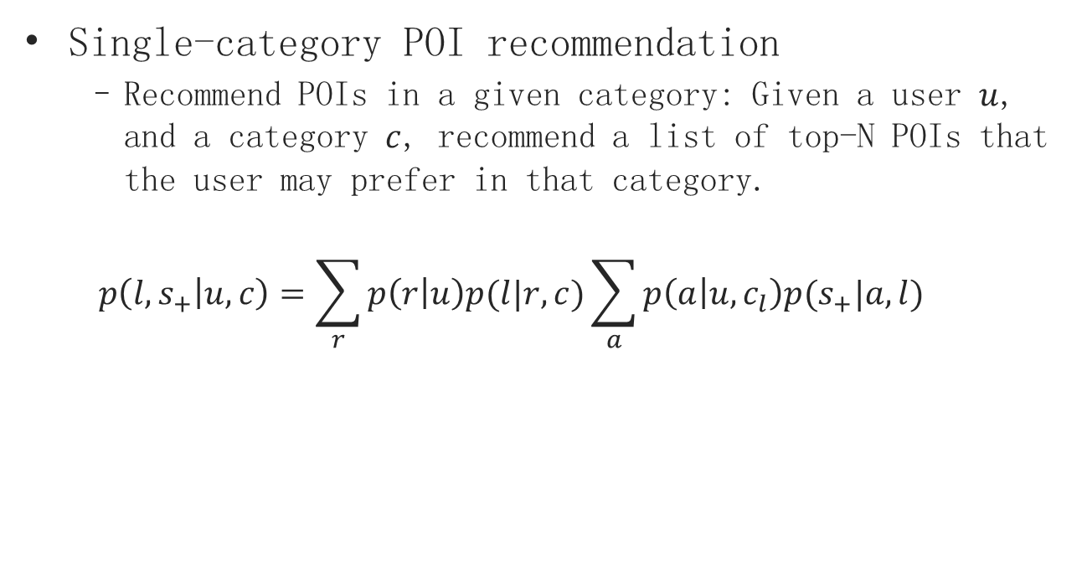
Applications
Single-category POI recommendation
Recommend POIs in a given category: Given a user $u$, and a category $c$, recommend a list of top-N POIs that the user may prefer in that category.
$$p\left(l,s_{+} | u,c\right)=\sum_{r}{p\left(r | u\right)p(l|r,c)}\sum_{a}{p\left(a | u,c_{l}\right)p(s_{+}|a,l)}$$
region preference
aspect preference

Slide 13



Applications
Efficient algorithm for Top-N POI recommendation:
$$p\left(l,s_{+} | u\right)=p\left(c_{l} | u\right)\sum_{r}{p\left(r | u\right)p(l|r,c_{l})}\sum_{a}{p\left(a | u,c_{l}\right)p(s_{+}|a,l)}$$
Not all the regions need to be considered
r2
r1
$$l$$
r3 does not contribute much to $p(l|r,c_{l})$ , and thus can be eliminated when computing top-N items
r3

Slide 14
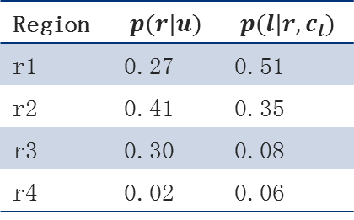

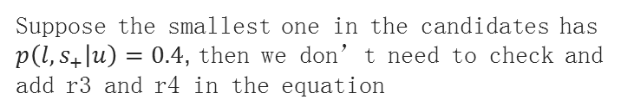
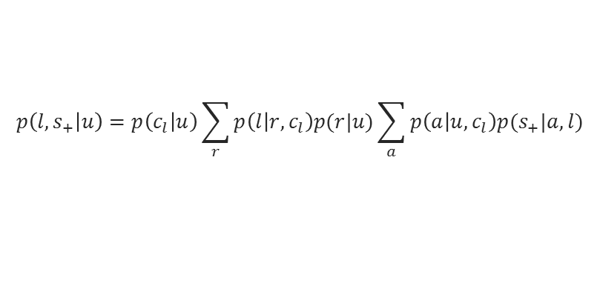
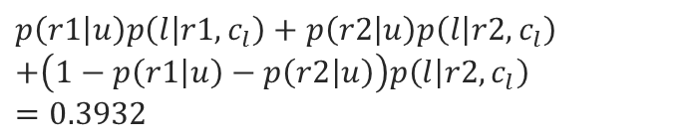
Applications
Efficient algorithm for Top-N POI recommendation:
Suppose we have N initial candidate POIs (Greedy selected)
Check regions in the descending order of $p(l|r,c_{l})$
Each time we check a region, see if the maximum score of the current POI can be larger than the smallest one in the candidates
$$p\left(l,s_{+} | u\right)=p\left(c_{l} | u\right)\sum_{r}{p\left(l | r,c_{l}\right)p(r|u)}\sum_{a}{p\left(a | u,c_{l}\right)p(s_{+}|a,l)}$$
Region | $$p(r|u)$$ | $$p(l|r,c_{l})$$
r1 | 0.27 | 0.51
r2 | 0.41 | 0.35
r3 | 0.30 | 0.08
r4 | 0.02 | 0.06
Upper bound
$$p\left(r1 | u\right)p\left(l | r1, c_{l}\right)+p\left(r2 | u\right)p\left(l | r2,c_{l}\right)$$
$$+\left(1−p\left(r1 | u\right)−p\left(r2 | u\right)\right)p\left(l | r2,c_{l}\right)$$
$$=0.3932$$
Suppose the smallest one in the candidates has
$p\left(l,s_{+} | u\right)=0.4$, then we don’t need to check and
add r3 and r4 in the equation

Slide 15
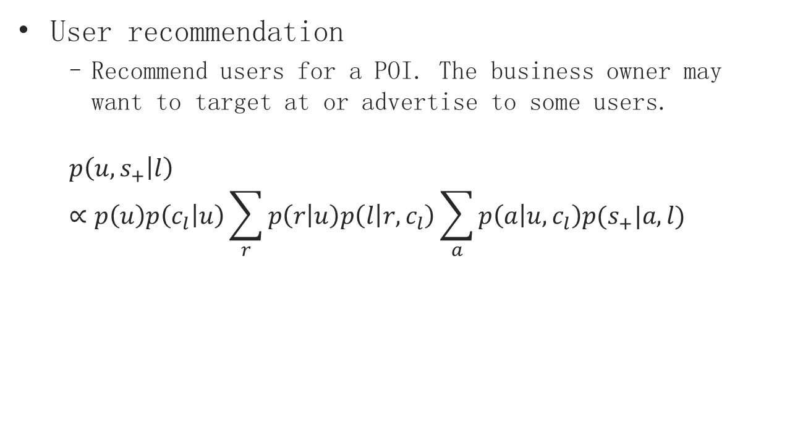
Applications
User recommendation
Recommend users for a POI. The business owner may want to target at or advertise to some users.
$$p\left(u,s_{+} | l\right)∝p\left(u\right)p\left(c_{l} | u\right)\sum_{r}{p\left(r | u\right)p\left(l | r,c_{l}\right)}\sum_{a}{p\left(a | u,c_{l}\right)p(s_{+}|a,l)}$$
user popularity
aspect preference
region and category preference

Slide 16
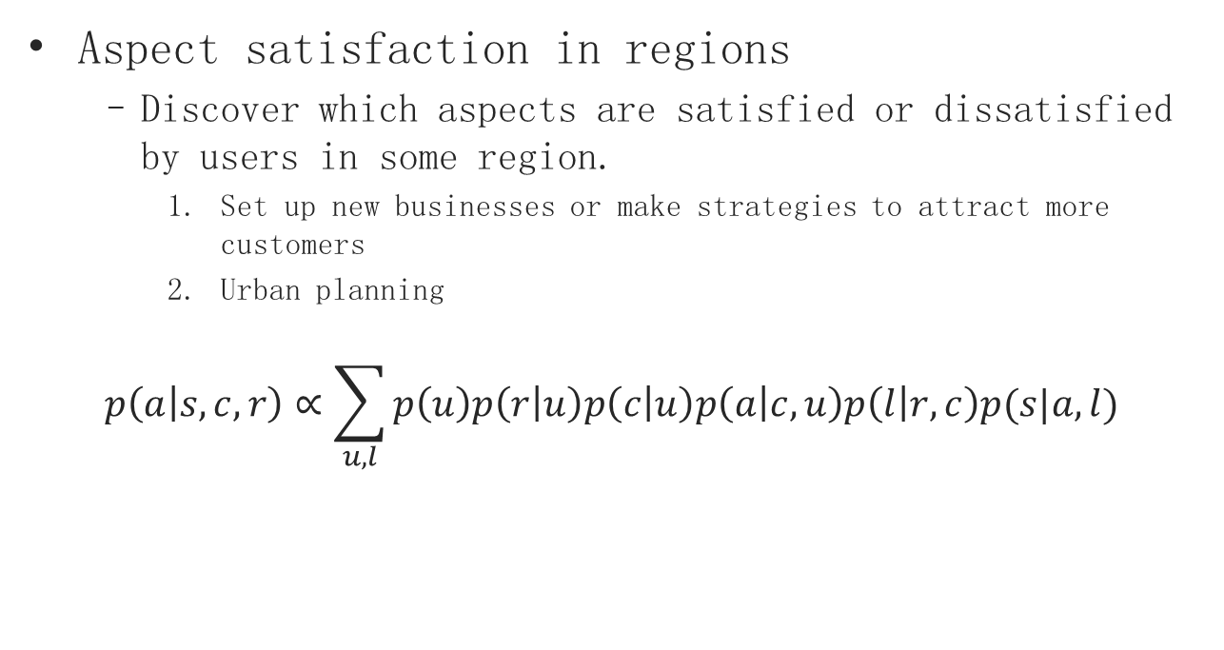
Applications
Aspect satisfaction in regions
Discover which aspects are satisfied or dissatisfied by users in some region.
Set up new businesses or make strategies to attract more customers
Urban planning
$$p\left(a | s,c,r\right)∝\sum_{u,l}{p\left(u\right)p\left(r | u\right)p\left(c | u\right)p\left(a | c,u\right)p\left(l | r,c\right)p(s|a,l)}$$

Slide 17
Experimental Results
Dataset – Yelp
 | Phoenix | Singapore
# POIs | 11,359 | 8,846
# Users | 21,908 | 1,654
# Reviews | 215,837 | 20,248
# Reviews per user | 4.92 | 12.40
# Reviews per POI | 18.71 | 2.36

Slide 18
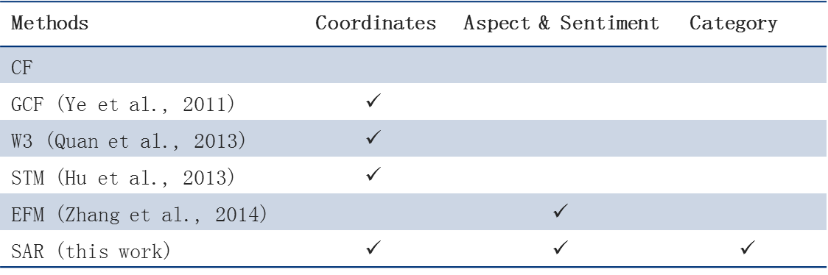
Experimental Results
All-category POI recommendation
Recommendation methods:
Metrics:
Top N quality: Precision@N and Recall@N
Rank list quality: Mean Average Precision (MAP)
Methods | Coordinates | Aspect & Sentiment | Category
CF
GCF (Ye et al., 2011) | $$✓$$
W3 (Quan et al., 2013) | $$✓$$
STM (Hu et al., 2013) | $$✓$$
EFM (Zhang et al., 2014) |  | $$✓$$
SAR (this work) | $$✓$$ | $$✓$$ | $$✓$$

Slide 19
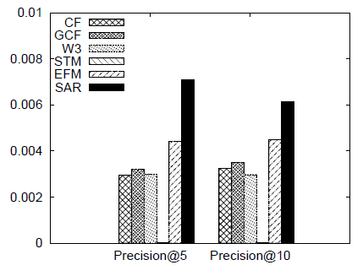
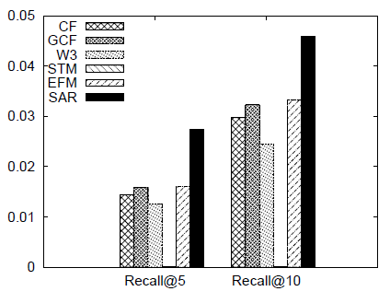
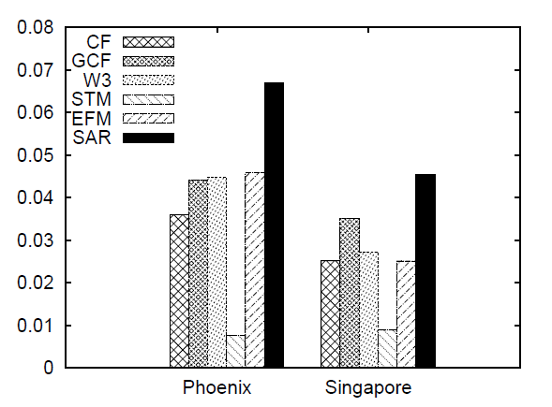
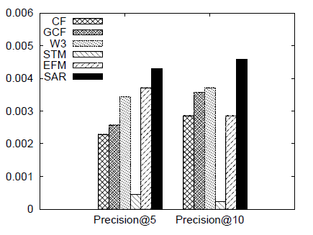
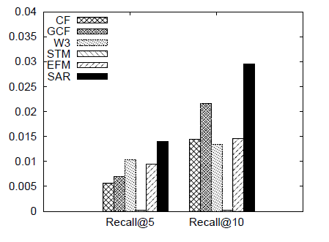
Experimental Results
All-category POI recommendation
Phoenix
MAP on both datasets
Singapore

Slide 20
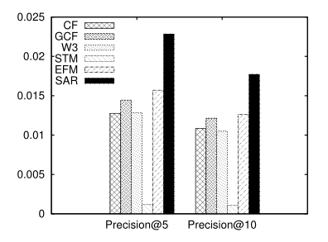
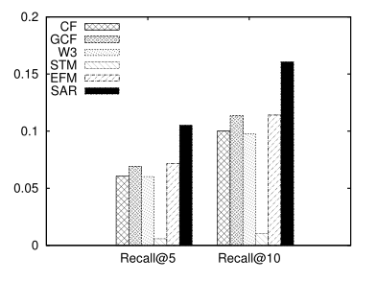
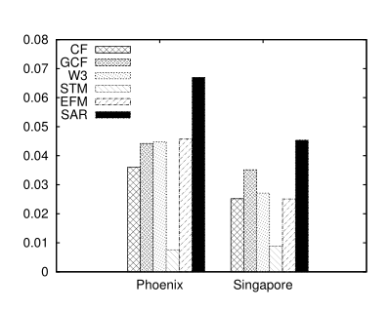
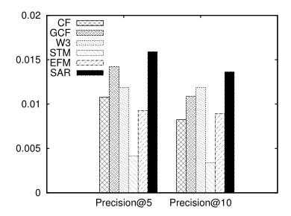
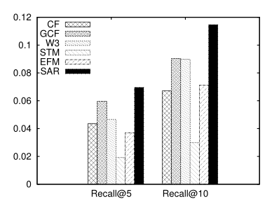
Experimental Results
Single-category POI recommendation
Phoenix
MAP on both datasets
Singapore

Slide 21
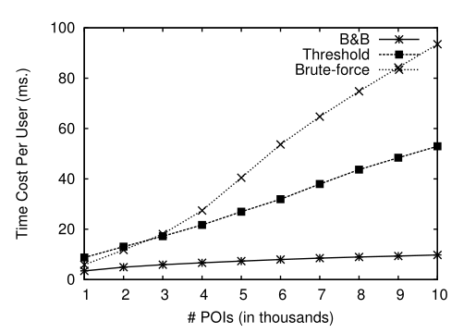
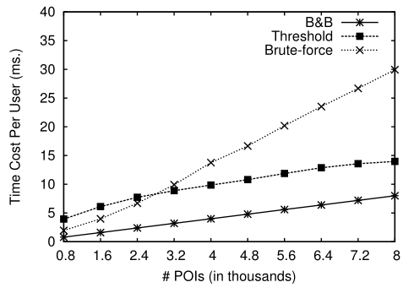
Experimental Results
Efficiency of POI recommendation
Methods:
Brute-force
Threshold algorithm
Branch & Bound proposed in this work
Phoenix
Singapore

Slide 22
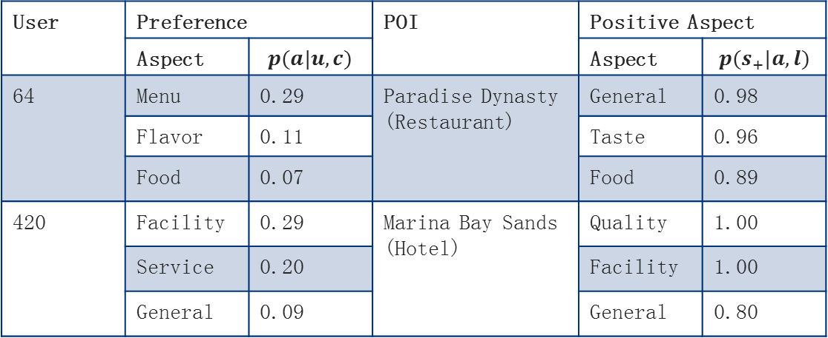
Experimental Results
The reason of recommendation
Aspect
User | Preference |  | POI | Positive Aspect
 | Aspect | $$p(a|u,c)$$ |  | Aspect | $$p(s_{+}|a,l)$$
64 | Menu | 0.29 | Paradise Dynasty (Restaurant) | General | 0.98
 | Flavor | 0.11 |  | Taste | 0.96
 | Food | 0.07 |  | Food | 0.89
420 | Facility | 0.29 | Marina Bay Sands (Hotel) | Quality | 1.00
 | Service | 0.20 |  | Facility | 1.00
 | General | 0.09 |  | General | 0.80

Slide 23
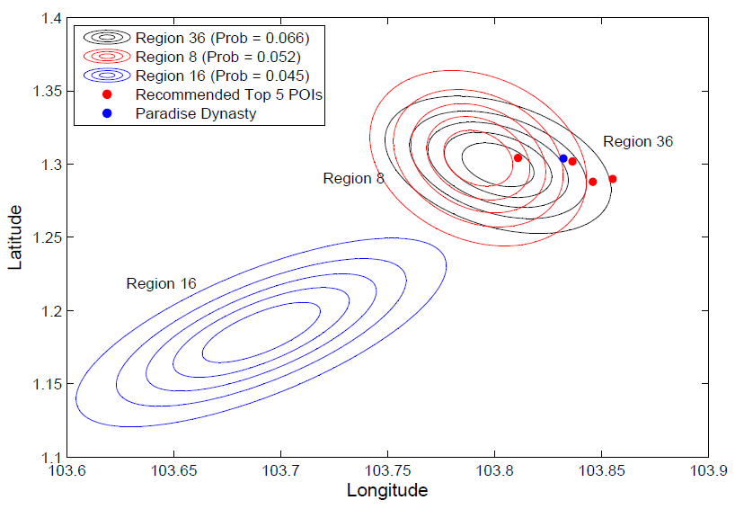
Experimental Results
The reason of recommendation
Region
Region Preference of User 64

Slide 24
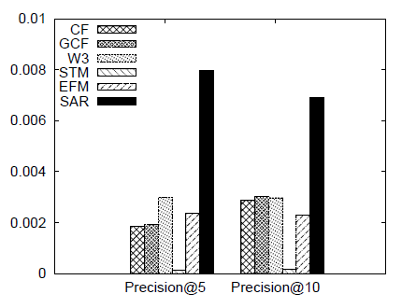
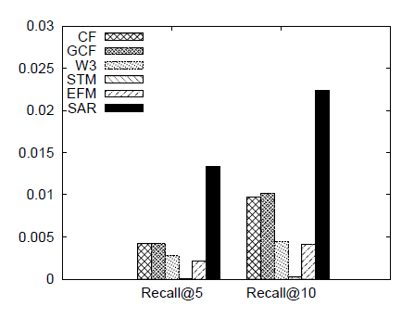
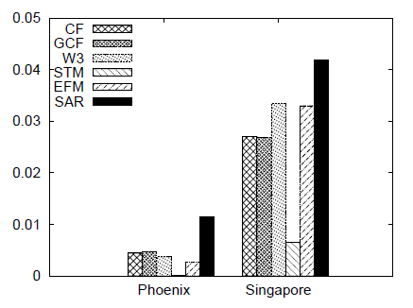
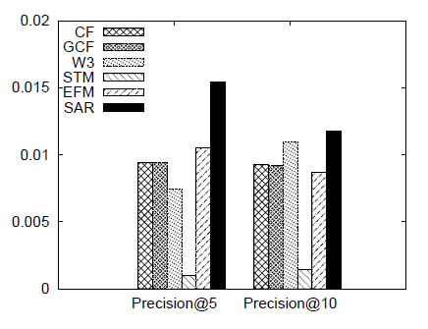
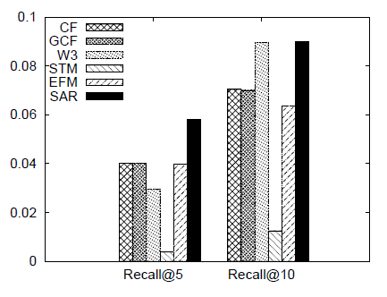
Experimental Results
User recommendation
Phoenix
MAP on both datasets
Singapore

Slide 25
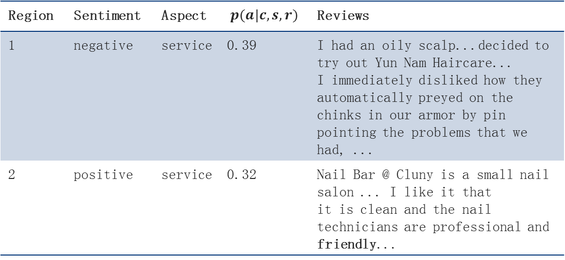
Experimental Results
Aspect satisfaction in regions
Category: Beauty & Spas
Region | Sentiment | Aspect | $$p(a|c,s,r)$$ | Reviews
1 | negative | service | 0.39 | I had an oily scalp...decided to try out Yun Nam Haircare... I immediately disliked how they automatically preyed on the chinks in our armor by pin pointing the problems that we had, ...
2 | positive | service | 0.32 | Nail Bar @ Cluny is a small nail salon ... I like it that it is clean and the nail technicians are professional and friendly...

Slide 26
Conclusion & Future Plan
In this work
We proposed a unified generative model for modeling user preferences on category, aspect and region
We showed the effectiveness of the proposed model in several applications
A possible future direction of the project is to incorporate time factor to the model.

Slide 27
Thank you!

