Slide 1
Dead Code Detection For Scala Applications
ADAPT-Lab
Dept. of Computer Science & Engineering
Shanghai Jiao Tong University

Slide 2
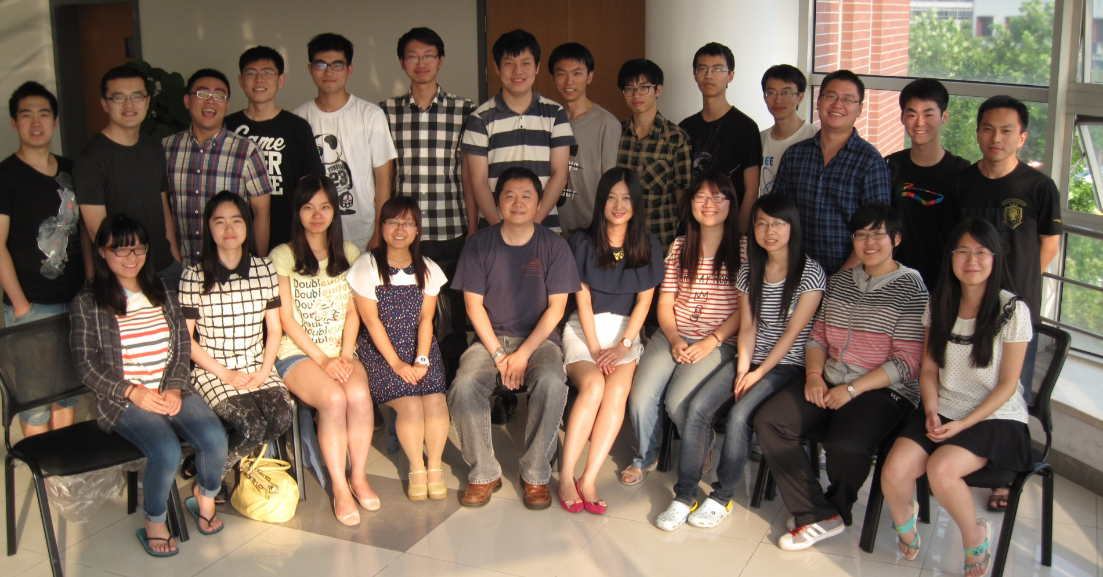
ADAPT-Lab

Slide 3





Introduction
Director: Kenny Q. Zhu （朱其立）
National University of Singapore: B.Eng, PhD.
Microsoft: Software Design Engineer
Princeton University: Postdoc & Lecturer
Microsoft Research Asia: Visiting professor
Shanghai Jiao Tong University: Distinguished Research Professor
Current members:
3 PhD Students
8 Masters Students
Many outstanding undergraduate students

Slide 4
Dead Code Detection Goals
1. Code which is unreachable and never executed.
2. Dead code which has no external impact
3. Dead code which may have external impact (ex. a division where the result is not used but would throw an exception on division by zero.)

Slide 5
Main Proposal
Two possible plans to achieve the goal.
A. By building a scala compiler plugin based on linter and the API of scala compiler
B. By translating Scala code to Java and adapting java tools.

Slide 6
Plan A: Compiler Plugins
Scala’s compiler can do part of dead code detection too by add options “-Ywarn-dead-code”.
Linter is a Scala static analysis compiler plugin which adds compile-time checks for various possible bugs, inefficiencies, and style problems.

Slide 7
What can Scala compiler do?
Mark and Sweep algorithm to detect and remove part of dead code.
For each of the instruction we add the reference count information to it.
We use workList to store useful instruction.

Slide 8
What can Scala compiler do?
In this way, it should detect some unreachable code and dead code.
For example, it can detect dead code after return statement.

Slide 9
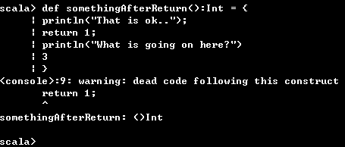
Unreachable Code
def somethingAfterReturn(): Int = {
println("That is ok..");
return 1;
println("What is going on here?");
3
}

Slide 10
What can Scala compiler do?
But unfortunately, it doesn’t even warn the unused assignment as dead code which results from the special feature of scala.
We aim to improve this part to find more dead code.

Slide 11
What can linter do?
It can detect some unreachable code and part of special case, which is powerful than scala compiler.

Slide 12
Unreachable Code
def somethingUnreachable1(): Int = {
println("That is ok..");
val x = 1
if (x > 0){
println("That is ok..");
if (x < -1){
println("This is dead code!");
}
}
return 2;
}

Slide 13
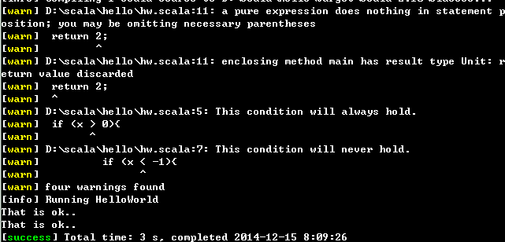
Linter

Slide 14
def somethingUnreachable2(): Int = {
var x =1
var y = 0
if (y== 0){
println(“This is y==0!")
if (y == -1)
println("This is y!=0!")
}
if (x!=1)
y = x/x
}

Slide 15
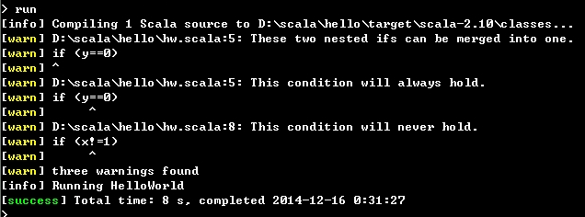
Linter

Slide 16
What can linter do?
It will test each known boolean expression and warn you which part is unreachable.
It can do more, such as unused method parameters, identical branch and etc.

Slide 17
Major Steps of Plan A
Compile into bytecode; instructions annotated with source code locations.
For the first case, we use execution flow (control flow) analysis combined with linter compiler plugins to find unreachable code.
For the second case, we use the mark and sweep algorithm, the same as used in scala compiler to accurately find dead code.

Slide 18
Major Steps of Plan A
For the third case, instructions identified by step 3 which have side effects (IO or exceptions) are marked as type 3 dead code.
For some special case, deal with them individually.
Return source code locations of all identified instructions.

Slide 19
Plan B:Conversion
Compile scala program by “scalac” into a java .class file (bytecode), with annotation of source locations.
Use a decompiler (Javap or JDEclipse) to decompile .class file back into Java.
Establish mapping between scala source and Java source.
Use a dead code detector (UCDetector) to detect dead code (classified into 1 of the 3 types)
Map back to scala source code.

Slide 20
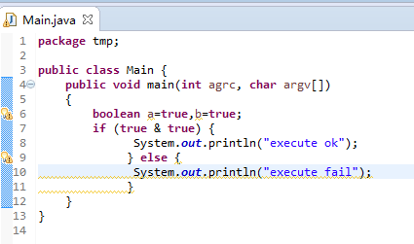
What UCDetector can do
For the first type, it can be detected by compilers.

Slide 21
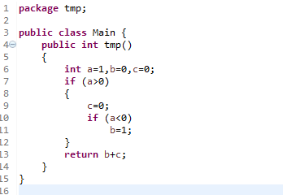
What UCDetector can do
Any thing in the “if” block is exempted from dead code detection.

Slide 22
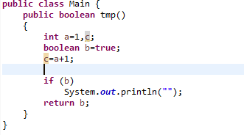
What UCDetector can do
For the second type, it can also be detected.

Slide 23
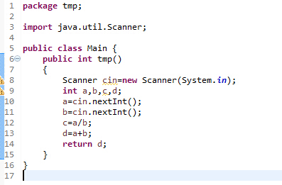
What UCDetector can do
For the third type, it can’t be detected at all.

Slide 24
Decompiling in java
There are many tools in Java to do the work of decompile such as javap.
After decompiling , we get a list of declarations in Java formats and some functions in byte codes.
We can change the byte codes into source codes by referencing the language specification.
But it may be much harder than the first one.

Slide 25
Example of byte codes
public void init();
Code:
0: aload_0
1: sipush 500
4: bipush 100
6: invokevirtual #2 // Method resize:(II)V
9: aload_0
10: aload_0
11: ldc #3 // String LAST_UPDATED
13: invokevirtual #4 // Method getParameter:(Ljava/lang/String;)Ljava/lang/String;
16: putfield #5 // Field date:Ljava/lang/String;
19: aload_0
20: aload_0
21: ldc #6 // String EMAIL
23: invokevirtual #4 // Method getParameter :(Ljava/lang/String;)Ljava/lang/String;
26: putfield #7 // Field email:Ljava/lang/String;
29: return

Slide 26
Example
Source code in scala:
object Main {
def main(args: Array[String]) = {
println("Hello, " + args(0))
}
}

Slide 27
Example
Javap output in Main$.class:
public final class Main$ extends java.lang.Object implements scala.ScalaObject{
public static final Main$ MODULE$;
public static {};
public void main(java.lang.String[]);
}

Slide 28
Example
Javap output in Main.class:
public final class Main extends java.lang.Object{
public static final void main(java.lang.String[]);
}
As we can see it’s the same as we can get when compiling a java file.

Slide 29
Challenge 1
Decompilation tools for Java can be incomplete and unreliable.

Slide 30
Challenge 2
After compiling and decompiling , we can get source codes in java but not in scala.
Possible solution: mapping source codes from java to scala or from byte codes to scala with the help of compiler by changing the compiler.
Also, the decompiling is not explicit.

