Slide 1
Dead Code Detection By Dynamic Tools

Slide 2
Why Scala compilation is slow?
Greater startup overhead, includes more than 20 phases
Slow compilation speed, due to type inference, type checking , transformations on AST.

Slide 3
Why Scala compilation is slow?
Most time-consuming classes(visualVM)
Class Name | Time(%)
scala.tools.nsc.transform.Transform | 36%
scala.tools.nsc.symtab.classfile.Pickler | 1.1%
scala.tools.nsc.transform.TailCalls | 0.8%
scala.tools.nsc.typechecker.Analyzer | 31.4%
scala.tools.nsc.backend.jvm.GenASM | 22.4%
scala.tools.nsc.backend.icode.GenICode | 6.9%
Total | 98.6%

Slide 4
Why Scala compilation is slow?
The central data structure of the compiler is class scala.tools.nsc.ast.Tree. Trees are immutable structures , however they are decorated with symbol and type information in a mutable way.
We wish to find dead code in these related class for better performance.

Slide 5
Static Detection Tools
We first use existing static analysis tool Linter to detect some of the redundant code.
We add the extra scala compiler plugin to the compilation process of the scala compiler to test.

Slide 6

Static Detection Tools
We have found 16 such type 1 dead code fragments.
Useless assignment.
Identical Condition

Slide 7


Static Detection Tools
Identical cases
Useless condition

Slide 8
Static Detection Tools
Most of the detected errors have little impact on the compilation speed since it doesn’t show up in the most frequently used classes.
It’s hard to detect type 2 and 3 dead code from static analysis after trying. Dynamic method is a better way for doing so.

Slide 9
Dynamic Detection Tool
We run the whole program step by step and output the path and name of every step.
Implemented by editing the Scala IDE tools.

Slide 10
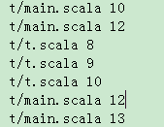
Type One Dead Code
Output format: path and line number
This file is generated by the modified Scala IDE, demonstrating executed traces.

Slide 11
Type One Dead Code
Then for each input, we will get a sequence of statements executed.
We compute the difference set between this and the whole source and we will get the type one dead code for this input.
Then we try many times and get the intersection which is the unexecuted codes.

Slide 12
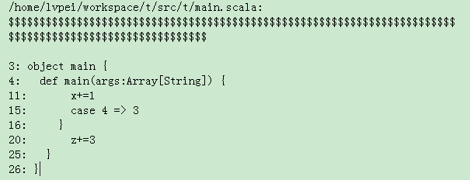
Type One Dead Code
Output format (deadcode.txt):

Slide 13
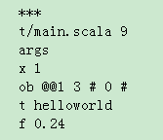

Type Two Dead Code
We change the output format and add the variables’ information.
line 9
arguments
X = 1
ob = some state
t = helloworld
f = 0.24

Slide 14
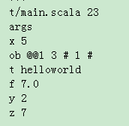
Type Two Dead Code
For a class, see the value changed of variables ob. It means that we have changed some contents of classes.

Slide 15
Type Two Dead Code
Then by comparing the values of variables between each steps, and combining with the AST tree, we keep a set for each variable in which instructions it was read and written.
Treat “if”, “where”as useful statement specifically, since “if” and “where” control the executed traces.

Slide 16
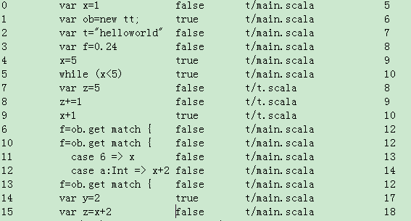
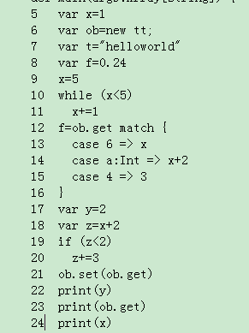
Type Two Dead Code
Output whether an executed line is useful or useless.(false: useless; true: useful)

Slide 17
Future Work
Use more information in AST tree to increase the accuracy.
The present running time is about 1 hour and costs a lot of memory for each program. We are working to speed it up.

