Slide 1
  Text Similarity in NLP and its Applications

Slide 2
Why text similarity?
Used everywhere in NLP
Information retrieval (Query vs Document)‏
Text classification (Document vs Category)‏
Word-sense disambiguation (Context vs Context)‏
Automatic evaluation
  Machine translation (Gold Standard vs Generated)‏
  Text summarization (Summary vs Original)‏

Slide 3
  Word Similarity

Slide 4
Word Similarity
Finding similarity between words is a fundamental part of text similarity.
Words can be similar if:
  They mean the same thing (synonyms)‏
  They mean the opposite (antonyms)‏
  They are used in the same way (red, green)‏
  They are used in the same context (doctor, hospital, scalpel)‏
  One is a type of another (poodle, dog, mammal)‏
Lexical hierarchies like WordNet can be useful.

Slide 5
WordNet-like Hierarchy
animal
fish
mammal
reptile
amphibian
wolf
horse
dog
cat
mare
stallion
hunting dog
dachshund
terrier

Slide 6
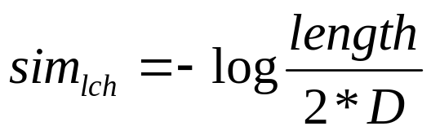
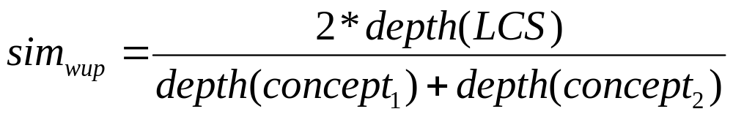
Knowledge-based word semantic similarity
(Leacock & Chodorow, 1998)‏
(Wu & Palmer, 1994)‏
(Lesk, 1986)‏
      Finds the overlap between the dictionary entries of two words

Slide 7

Corpus-based + knowledge-based
Based on information content
  P(C) = probability of seeing a concept of type C in a large corpus = probability of seeing instances ofthat concept
    Determine the contribution of a word sense based on the assumption of equal sense distributions:
      e.g. “plant” → 50% occurrences are sense 1, 50% are sense 2

Slide 8
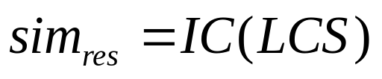
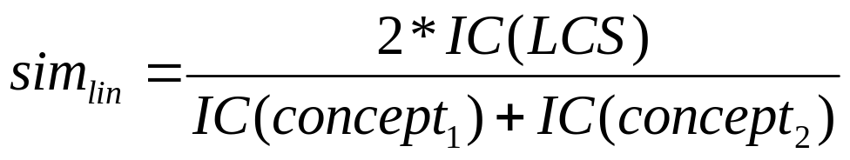
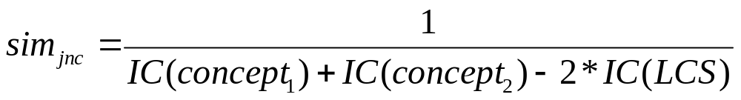
Corpus-based + knowledge-based
(Resnik, 1995)‏
(Lin, 1998)‏
(Jiang & Conrath, 1997)‏

Slide 9
  The Vectorial Model and Cosine Similarity

Slide 10
Vectorial Similarity Model
Imagine an N-dimensional space where N is the number of unique words in a pair of texts.
Each of the two texts can be treated like a vector in this N-dimensional space.
The distance between the two vectors is an indication of the similarity of the two texts.
The cosine of the angle between the two vectors is the most common distance measure.

Slide 11
Vector space model
Example:
T₁ = 2W₁ + 3W₂ + 5W₃
T₂ = 3W₁ + 7W₂ + W₃
cos Ɵ = T₁·T₂ / (|T₁|*|T₂|
= 0.6758
W₃
T₁ = 2W₁ + 3W₂ + 5W₃
W₁
  T₂ = 3W₁ + 7W₂ + W₃
W₂

Slide 12
Document similarity
Hurricane Gilbert swept toward the Dominican Republic Sunday , and the Civil Defense alerted its heavily populated south coast to prepare for high winds, heavy rains and high seas.
The storm was approaching from the southeast with sustained winds of 75 mph gusting to 92 mph .
“There is no need for alarm," Civil Defense Director Eugenio Cabral said in a television alert shortly before midnight Saturday .
Cabral said residents of the province of Barahona should closely follow Gilbert 's movement .
An estimated 100,000 people live in the province, including 70,000 in the city of Barahona , about 125 miles west of Santo Domingo .
Tropical Storm Gilbert formed in the eastern Caribbean and strengthened into a hurricane Saturday night
The National Hurricane Center in Miami reported its position at 2a.m. Sunday at latitude 16.1 north , longitude 67.5 west, about 140 miles south of Ponce, Puerto Rico, and 200 miles southeast of Santo Domingo.
The National Weather Service in San Juan , Puerto Rico , said Gilbert was moving westward at 15 mph with a "broad area of cloudiness and heavy weather" rotating around the center of the storm.
The weather service issued a flash flood watch for Puerto Rico and the Virgin Islands until at least 6p.m. Sunday.
Strong winds associated with the Gilbert brought coastal flooding , strong southeast winds and up to 12 feet to Puerto Rico 's south coast.

Slide 13
Document Vectors for selected terms
Document1
  Gilbert: 3
  Hurricane: 2
  Rains: 1
  Storm: 2
  Winds: 2
Document2
  Gilbert: 2
  Hurricane: 1
  Rains: 0
  Storm: 1
  Winds: 2
Cosine Similarity: 0.9439

Slide 14
Problems with the simple model
Common words improve the similarity too much
  The king is here vs The salad is cold
  Solution: Multiply raw counts by Inverse Document Frequency (idf)‏
Ignores semantic similarities
  I own a dog vs. I have a pet
  Solution: Supplement with Word Similarity

Slide 15
Problems with the simple model (cont)‏
Ignores syntactic relationships
  Mary loves John vs. John loves Mary
  Solution: Perform shallow SOV parsing
Ignores semantic frames/roles
  Yahoo bought Flickr vs. Flickr was sold to Yahoo
  Solution: Analyze verb classes

Slide 16
Walk-through example
T1: When the defendant and his lawyer walked into the court, some of the victim supporters turned their backs to him.
T2: When the defendant walked into the courthouse with his attorney, the crowd turned their backs on him.
Paraphrase or not?
- Compare similarity with threshold of 0.5

Slide 17
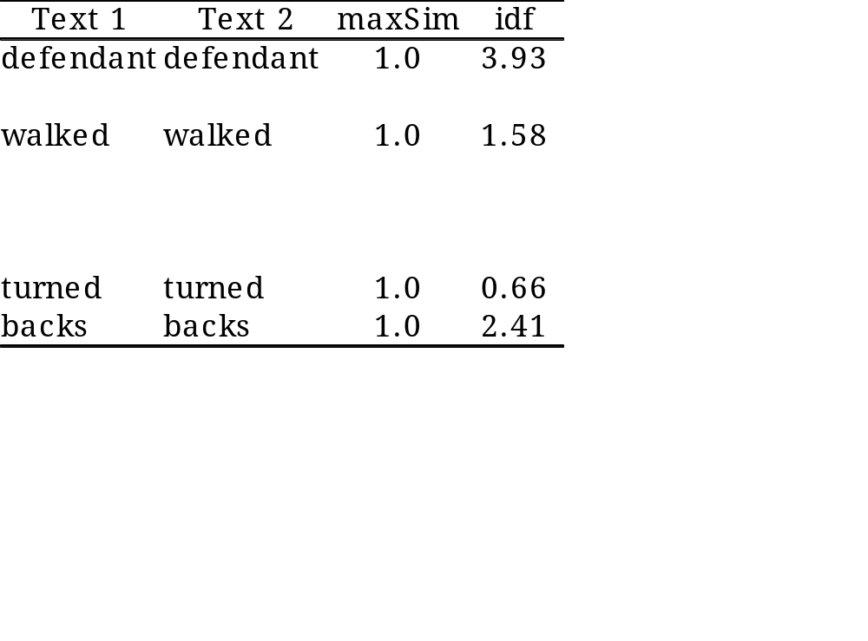
Walk-through example
T1: When the defendant and his lawyer walked into the court, some of the victim supporters turned their backs to him.
T2: When the defendant walked into the courthouse with his attorney, the crowd turned their backs on him.
Vector space model
  Cosine similarity = 0.45 ⇒ not paraphrase

Slide 18
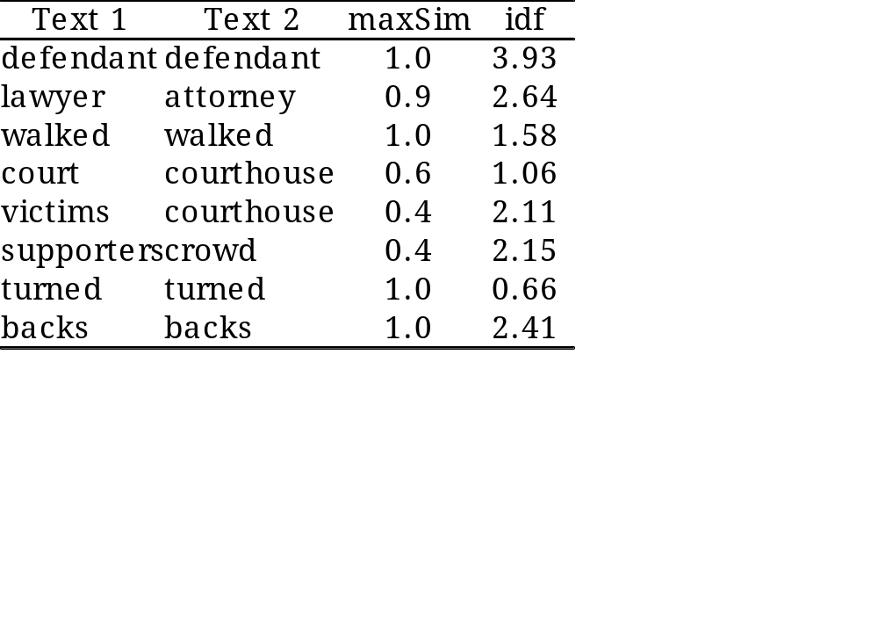
Walk-through example
T1: When the defendant and his lawyer walked into the court, some of the victim supporters turned their backs to him.
T2: When the defendant walked into the courthouse with his attorney, the crowd turned their backs on him.
Semantic similarity measure
  Similarity = 0.80 ⇒ paraphrase

Slide 19
  Pure Corpus-Based Approaches

Slide 20
Corpus-based word semantic similarity
Information exclusively derived from large corpora
(Landauer 1998) Latent semantic analysis
  dimensionality reduction through SVD
(Gabrilovich¸ Markovich 2007) Explicit semantic analysis
  uses Wikipedia concepts to define vector space

Slide 21
Latent Semantic Analysis
Finds words that co-occur within a window of a few words and forms an NxN matrix.
Mapped into k rows (k-dimensional space) using the SVD matrix operation.
This technique learns related words due to their occurrence together in a context.
Problem: Dimensions are not well defined.

Slide 22
Explicit Semantic Analysis
Determine the extent to which each word is associated with every concept of Wikipedia via term frequency or some other method.
For a text, sum up the associated concept vectors for a composite text concept vector.
Compare the texts using a standard cosine similarity or other vector similarity measure.
Advantage: The vectors can be analyzed and tweaked because they are closely tied to Wikipedia concepts.

Slide 23
ESA Example
Text1: The dog caught the red ball.
Text2: A labrador played in the park.
Similarity Score: 14.38%
 | Glossary of cue sports terms | American Football Strategy | Baseball | Boston Red Sox
T1: | 2711 | 402 | 487 | 528
T2: | 108 | 171 | 107 | 74

Slide 24
Why?
http://en.wikipedia.org/wiki/Glossary_of_cue_sports_terms

Slide 25
  Automatic Student Answer Grading

Slide 26
Class Grading Example
Question: what is a variable?
Answer: a location in memory that can store a value
Grader
 | 5
 | 3.5
 | 5
 | 5
 | 5
a variable is a location in memory where a value can be stored
a named object that can hold a numerical or letter value
it is a location in the computer 's memory where it can be stored for use by a program
a variable is the memory address for a specific type of stored data or from a mathematical perspective a symbol representing a fixed definition with changing values
a location in memory where data can be stored and retrieved

Slide 27
Class Grading Example
Question: what is a variable?
Answer: a location in memory that can store a value
Cosine Grader
a variable is a location in memory where a value can be stored
a named object that can hold a numerical or letter value
it is a location in the computer 's memory where it can be stored for use by a program
a variable is the memory address for a specific type of stored data or from a mathematical perspective a symbol representing a fixed definition with changing values
a location in memory where data can be stored and retrieved
0.724 | 5
0.040 | 3.5
0.316 | 5
0.106 | 5
0.304 | 5

Slide 28
Class Grading Example
Question: what is a variable?
Answer: a location in memory that can store a value
LSA-Wiki Grader
a variable is a location in memory where a value can be stored
a named object that can hold a numerical or letter value
it is a location in the computer 's memory where it can be stored for use by a program
a variable is the memory address for a specific type of stored data or from a mathematical perspective a symbol representing a fixed definition with changing values
a location in memory where data can be stored and retrieved
0.901 | 5
0.212 | 3.5
0.869 | 5
0.536 | 5
0.839 | 5

Slide 29
Class Grading Example
Question: what is a variable?
Answer: a location in memory that can store a value
ESA Grader
a variable is a location in memory where a value can be stored
a named object that can hold a numerical or letter value
it is a location in the computer 's memory where it can be stored for use by a program
a variable is the memory address for a specific type of stored data or from a mathematical perspective a symbol representing a fixed definition with changing values
a location in memory where data can be stored and retrieved
0.938 | 5
0.428 | 3.5
0.780 | 5
0.656 | 5
0.664 | 5

Slide 30
Class Grading Example
Question: what is a variable?
Answer: a location in memory that can store a value
JCN Grader
a variable is a location in memory where a value can be stored
a named object that can hold a numerical or letter value
it is a location in the computer 's memory where it can be stored for use by a program
a variable is the memory address for a specific type of stored data or from a mathematical perspective a symbol representing a fixed definition with changing values
a location in memory where data can be stored and retrieved
0.768 | 5
0.413 | 3.5
0.778 | 5
0.550 | 5
0.661 | 5

Slide 31
Some Problems
Negation and Antonymy
  I like pizza vs I don't like pizza
  I ran the marathon very quickly vs I ran the marathon slowly
Semantic Role Reversal
  Dog bites man vs Man bites dog
Logical Inconsistency/Too Much Information
  It's raining today vs It's raining today because the sun is out

