Slide 1
Detecting Text Similarity over Short Passages: Exploring Linguistic Feature Combinations via Machine Learning EMNLP 1999

Slide 2
Highlights
Composite similarity metric between short textual units based on multiple linguistic features
A more restricted definition of text similarity than conventional document similarity
Results show effectiveness in identifying closeness between short texts

Slide 3
Definition of Similarity
A form of semantic similarity
Two short texts are similar if:
They share common concepts/actor/object/action
Common actor/object must perform/be subjected to the same action
Note “action” is quite important here
This is a more restrictive way of defining similarity

Slide 4
Methodology
Compute feature vector over a pair of texts
Features are either:
Primitive Features
Composite Features

Slide 5
Primitive Features
Word co-occurrence
Matching noun phrase
Wordnet Synonyms
Common verb classes
Common proper nouns
Normalization:
Feature_value/sqrt(len(A) * len(B))
Feature_value/log(# of texts/# texts containing the feature) → similar to IDF in TF*IDF

Slide 6
Composite Features
Ordering
Two pairs of primitive features preserves ordering
Distance
Two pairs of primitive features occur within distance in text
Primitive
Only certain specific primitive feature is used

Slide 7
Evaluation
Learn classifier using RIPPER
Tune the loss ratio
Achieves 36.6% recall + 60.5% precision
Effective individual features:
Any word
Simplex NP
Noun
Effective composite feature
Verb distance <= 5 (however recall is low)

Slide 8
Improving Short-Text Classification Using Unlabeled Background Knowledge to Assess Document Similarity ICML 2000

Slide 9
Highlights
Main idea: use a larger, unlabeled texts as background knowledge to bridge smaller training set and test text
Significantly decreases error rate

Slide 10
Approach
Use WHIRL, a conventional DB system augmented with text comparison abilities, e.g.
SELECT Test.instance, Train.label
FROM Train AND Test
WHERE Train.instance SIM Test.instance
WHIRL with background knowledge
SELECT Test.instance, Train.label
FROM Train AND Test AND Background
WHERE Train.instance SIM Background.value
AND Test.instance SIM Background.value

Slide 11
Evaluation
Data sets:
Tech papers
News
Web page titles
Company names
Compared WHIRL-nn (baseline) with RIPPER
Do better in tech papers and news but not so good in web page titles and company names
Compare WHIRL-bg with WHIRL-nn
WHIRL-bg is less sensitive to training data size, in other words, it requires little training data to achieve rather good performance

Slide 12
An Empirical Evaluation of Models of Text Document Similarity CogSci 2005

Slide 13
Goal
This paper compares various computation models with human minds in short text similarity (correlation)
Argues that similarity is ultimately a psychological problem
Best computation model should model human performance well

Slide 14
Evaluation
Dataset
50 short news doc (51-126 words)
126 similar docs as backgrounding corpus
Human judgement
Inter-rater correlation: 0.605
Binary Models
x_{ik} = # of times i^{th} word (n-gram) occurs in k^{th} document
t_{ik} = 1 if x_{ik} > 0 and t_{ik} = 0 if x_{ik} = 0
Four different counts based on t_{ik}:
a_{ij}: number of words occurred in both doc i and j
b_{ij} and c_{ij}: number of words occurred in one but not the other doc
d_{ij}: number of words occurred in neither doc

Slide 15
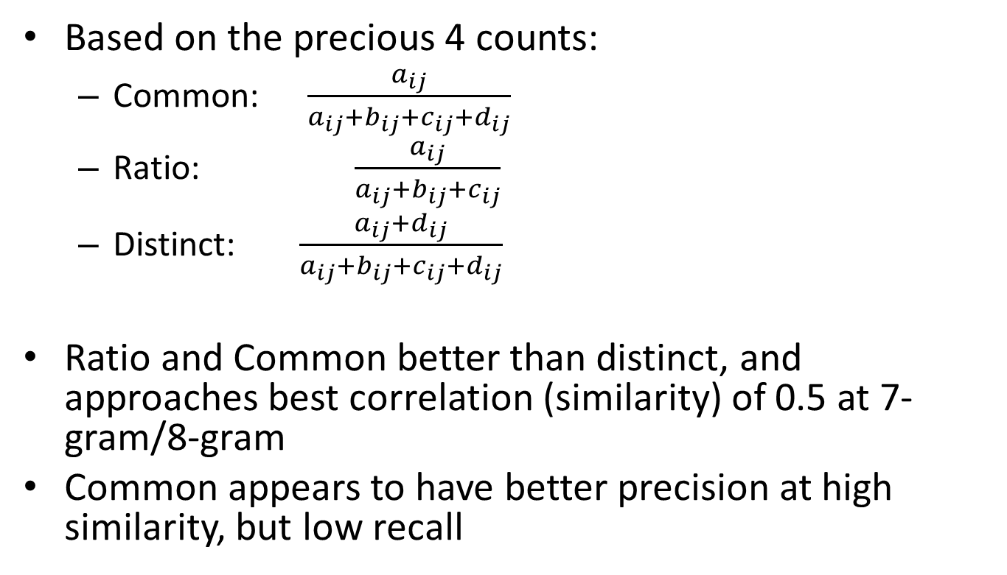
Binary Similarity Models
Based on the precious 4 counts:
Common:
Ratio:
Distinct:
Ratio and Common better than distinct, and approaches best correlation (similarity) of 0.5 at 7-gram/8-gram
Common appears to have better precision at high similarity, but low recall

Slide 16
Count Based Similarity Models
Four models:
Correlation
Jaccard
Cosine
Overlap
Performs about the same: approaches max similar at 4-gram and above
But in general not as good as the binary models!

Slide 17
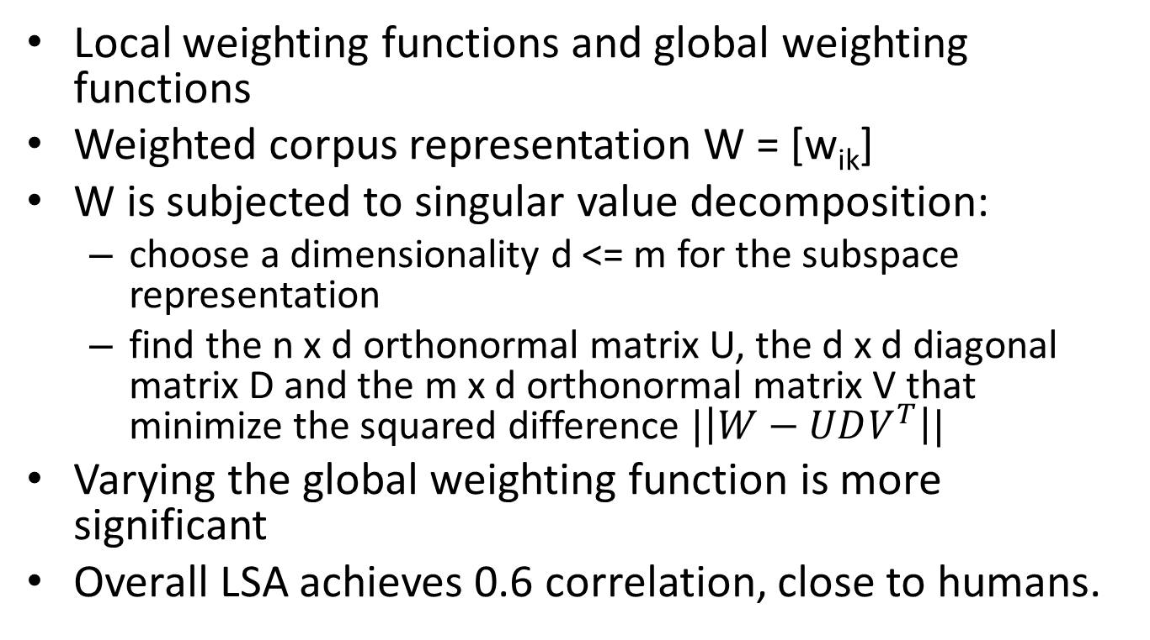
LSA Similarity Model
Local weighting functions and global weighting functions
Weighted corpus representation W = [w_{ik}]
W is subjected to singular value decomposition:
choose a dimensionality d <= m for the subspace representation
find the n x d orthonormal matrix U, the d x d diagonal matrix D and the m x d orthonormal matrix V that minimize the squared difference $|\left|W−UDV^{T}\right||$
Varying the global weighting function is more significant
Overall LSA achieves 0.6 correlation, close to humans.

Slide 18
Similarity Measures for Short Segments of Text ECIR 2007

Slide 19
Highlights
This paper examines a number of similarity measures for short texts
Pure lexical
Stemming
Language modeling based
Evaluate these measures on query-to-query similarities from search log (360k queries)

Slide 20
Deficiencies of Standard Similarity Measures
Term based: if terms are missing or mismatched, then zero similarity
E.g. UAE vs. United Arab Emirates
Context are missing in short text
E.g. Apple pie vs. Apple computers

Slide 21
Text Representation
Surface form
Original text without any changes
Stemmed form
Introduces noises
But overall still beneficial
Use Porter stemmer
Expanded form
Web query results
Top 200 titles and snippets for each short text query

Slide 22
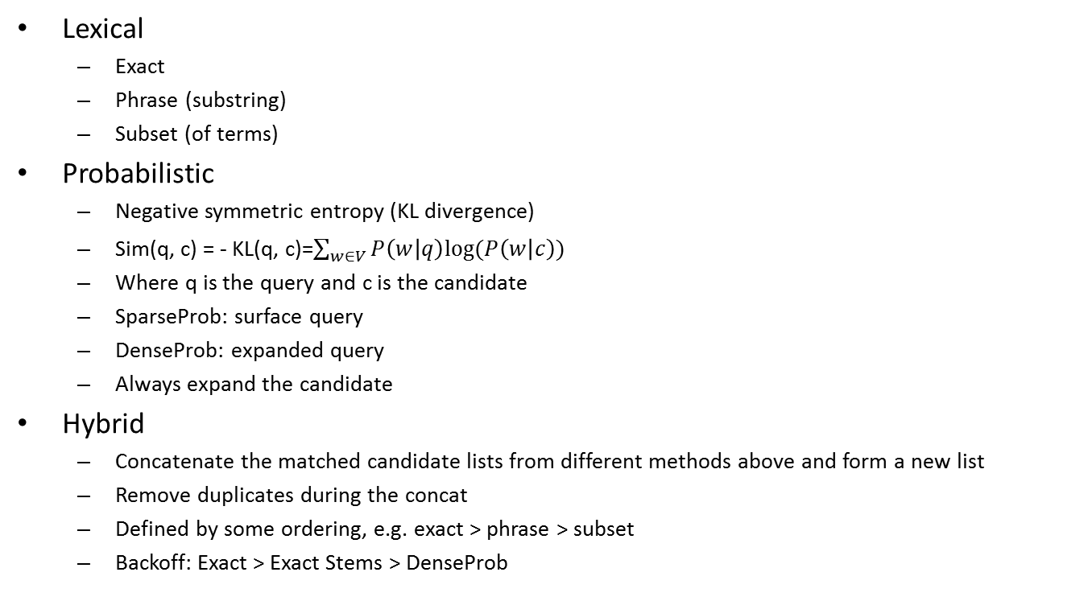
Similarity Measures
Lexical
Exact
Phrase (substring)
Subset (of terms)
Probabilistic
Negative symmetric entropy (KL divergence)
Sim(q, c) = - KL(q, c)=$\sum_{w∈V}{P\left(w | q\right)log⁡(P\left(w | c\right))}$
Where q is the query and c is the candidate
SparseProb: surface query
DenseProb: expanded query
Always expand the candidate
Hybrid
Concatenate the matched candidate lists from different methods above and form a new list
Remove duplicates during the concat
Defined by some ordering, e.g. exact > phrase > subset
Backoff: Exact > Exact Stems > DenseProb

Slide 23
Evaluation
Judge rate with 4-point scale: excellent, good, fair and bad
Treat excellent/good as relevant, the performance:
Backoff > Prob methods > lexical methods
Backoff is good because it includes exact matches missed by prob methods
Efficiency
Lexical methods are fast
Prob methods are slower, denseProb is slower (3 sec) than sparseProb (0.15 sec)
SparseProb is the best overall performer

Slide 24
A Comparative Study of Two Short Text Semantic Similarity Measures KES-AMSTA 2008

Slide 25
Goal
Conversational Agent
Automated answering machine
Customer service
The proposed approach:
A number of rules containing a few prototype sentences
Compare the similarity between a user utterance with the prototype sentences, and generate firing strength for each rule
STASIS
LSA
Semantic matching instead of lexical

Slide 26
Similarity Models and Measures
Relatedness vs. similarity
Car is related to gasoline but car is similar to bicycle [Resnik’99]
Four forms of similarity [Klein and Murphy’02]:
Taxonomic: Wordnet, noun similarity, synonyms
Thematic: co-occurrence, e.g. car and gasoline
Goal derived: similar if items achieve common goal
Radial: similar if linked by a chain of similar items, probably thru evolutionary process
Similarity is assymmetric sometimes
Typically similarity is measured on a scale from 0 to 4
Can’t represent oppositeness, which may have high co-occurrence similarity
Items with complex features are more likely to be assimilated by humans

Slide 27
Models
STASIS
s(w1, w2) based on path length and depth of the two words in a lexical database (something like WordNet)
S(T1, T2) combines word position info and word frequency info from a large corpus
LSA
SVD into 3 matrices

Slide 28
Results
Correlation with mean human ratings:
STASIS: 0.816
LSA: 0.838
Average Human: 0.825
Worse Human: 0.594
Best Human: 0.921

Slide 29
Semantic Text Similarity Using Corpus-Based Word Similarity and String Similarity ACM Trans on KDD 2008

Slide 30
Highlights
Proposed a method which combines:
String similarity
Corpus-based word semantic similarity
(optionally) common word order similarity

Slide 31
Survey
Word co-occurrence/vector based model
Meadow et al. 2000, Salton 7 Lesk 1971, Corley & Mihalcea2005
Corpus based
LSA
Hyperspace Analogues to Language (HAL )(Burgess et al. 1998)
Lexical co-occurrence to construct a semantic space
Words are points in this space
Distance between two sentences are the distance between two rep vectors
Hybrid: corpus + knowledge base
Li et al. 2006
Description feature based
Represent a sentence using a set of features
Similarity obtained from a trained classifier

Slide 32
String Similarity
Longest Common Subsequence (LCS)
Take the weighted sum of three modified/normalized LCS
v₁ = len(LCS(s1, s2))²/(len(s1) x len(s2))
v₂ = len(MCLCS₁(s1, s2))²/(len(s1) x len(s2))
v₃ = len(MCLCS_{n}(s1, s2))²/(len(s1) x len(s2))
MCLCS₁ starts matching from 1st char
MCLCS_{n} starts matching from any char

Slide 33
Semantic Similarity between Words
Second Order Co-occurrence PMI (SOC-PMI)
Measure the similarity of two words by the PMI of their neighboring words in large corpus
The neighboring words are like bridges
m is the number of tokens in corpus
X_{i} is the set of neighboring words

Slide 34
Common Word Order Similarity
For two texts P and R: put the d common words into two lists, X and Y, preserving their order in the texts.
Common word order sim is:
x_{i} and y_{i} are index number (position) in the X

Slide 35
Overall Precedure
Step 1. Clean texts P and R
Step 2. remove d common words and what remains is P = {p₁, p₂, …, p_{m-d}}, and R = {r₁, r₂, …, r_{n-d}}
Step 3. construct (m-d) x (n-d) string similarity matrix M₁ between every pair of words
Step 4. construct (m-d) x (n-d) semantic similarity matrix M₂ between every pair of words
Step 5. construct joint matrix M = aM₁ + bM₂
a+b = 1 (weighting factors)
Find the max value r_{ij} from M, add it in a list L and remove all elements of i^{th} row and j^{th} column
Repeat this until r_{ij} = 0, or m-d- |L|=0
Step 6. Final score

Slide 36
Evaluation
Compared with Human Similarity
Human: 0.594-0.921 (mean at 0.825)
Li: 0.816
This work: 0.853
Microsoft Paraphrases
This is more difficult: P and R could be very similar but exact opposite with R having a “not”
At sim threshold of 0.6, precision = 0.75, recall = 0.9

