Slide 1
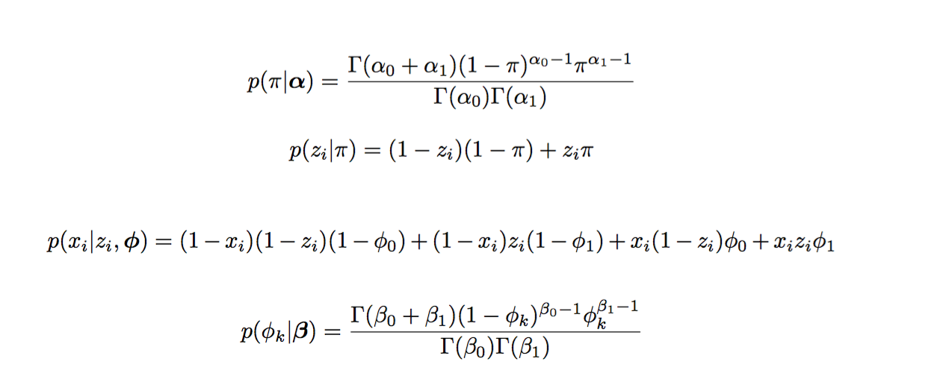
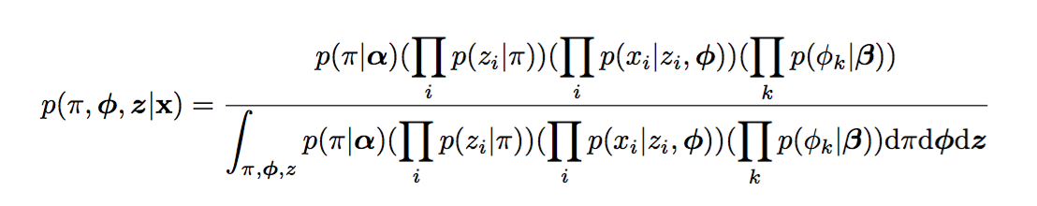

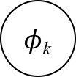
Model
$φ$_{k}
2
$$π$$
z_{i}
x_{i}
3
Observed data x_{i} are given, we want to know the posterior of variables 𝜋, z_{i} , $φ$_{k} .

Slide 2

Goal
However, this is intractable to compute, especially when the coins are tossed many times. Because number of terms in the product of the denominator grows as the experiment being repeated for many times. Thus the integral will be hard to calculate.
VMP assigns a factor q to each variable, and use product of these factors to estimate the posterior.
In the beginning, each variable is assigned an initial factor. Then VMP will update the factors iteratively until converges.
In each step, VMP pick some factors and update them to make the product of current factors closest to the posterior.

Slide 3
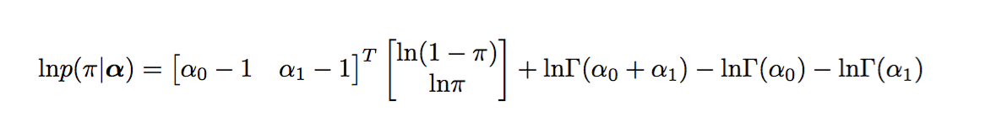
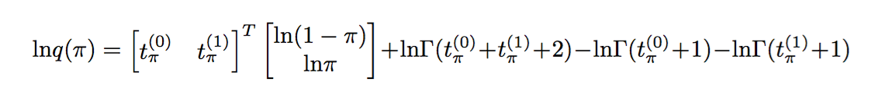
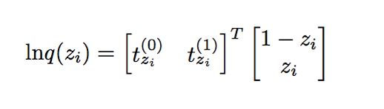
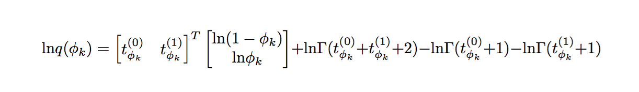
Exponential Conjugate
By limiting models to be exponential conjugate, the optimal factor assigned to any variable v in the graph would have the same functional form as p(v | pa_{v} ). Here pa_{v} is the list of v’s parents in the graph model.
For example,
Thus we know that,
Similarly,

Slide 4
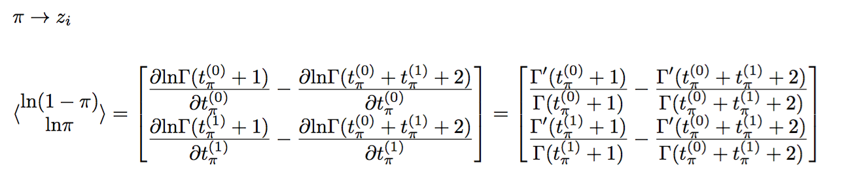
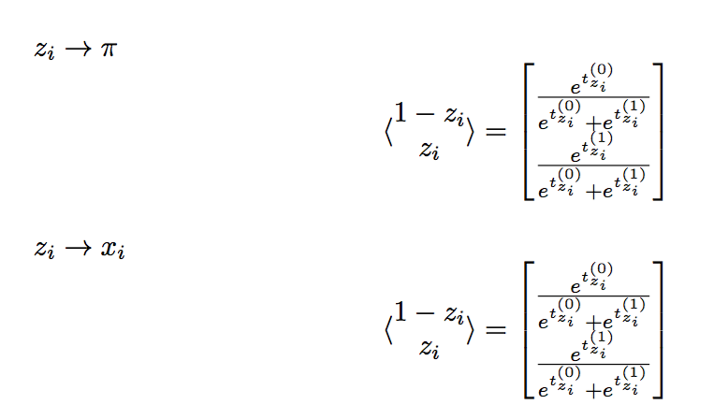

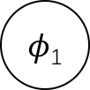
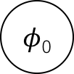
Message Passing
Note that all factors are determined by the t vectors. What VMP does is simply updating these t vectors using messages from children and parents of each vertex. The messages sent by each vertex is calculated according to its distribution, i.e. the functional form of its factor.
From now on, we use ⟨x⟩ to represent expectation of variable x with respect to q, the product of all factors in the graph. Following lists the messages passing during updates.
$φ$₀
$φ$₁
(1)
x₀
x₁
x₂
z₀
z₁
z₂
(2)
$$π$$
(3)

Slide 5
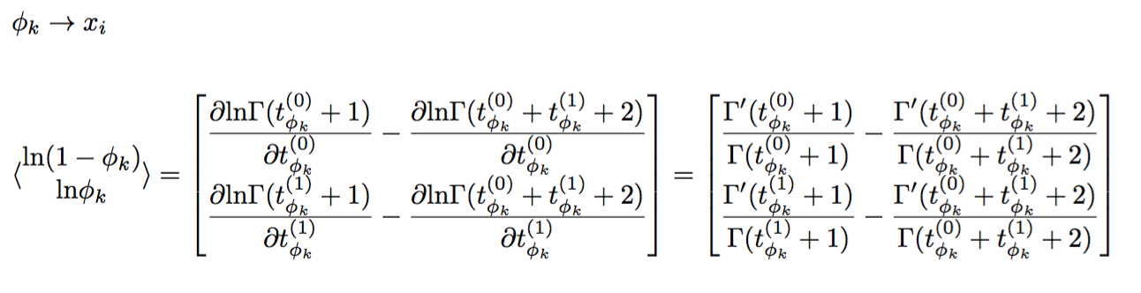
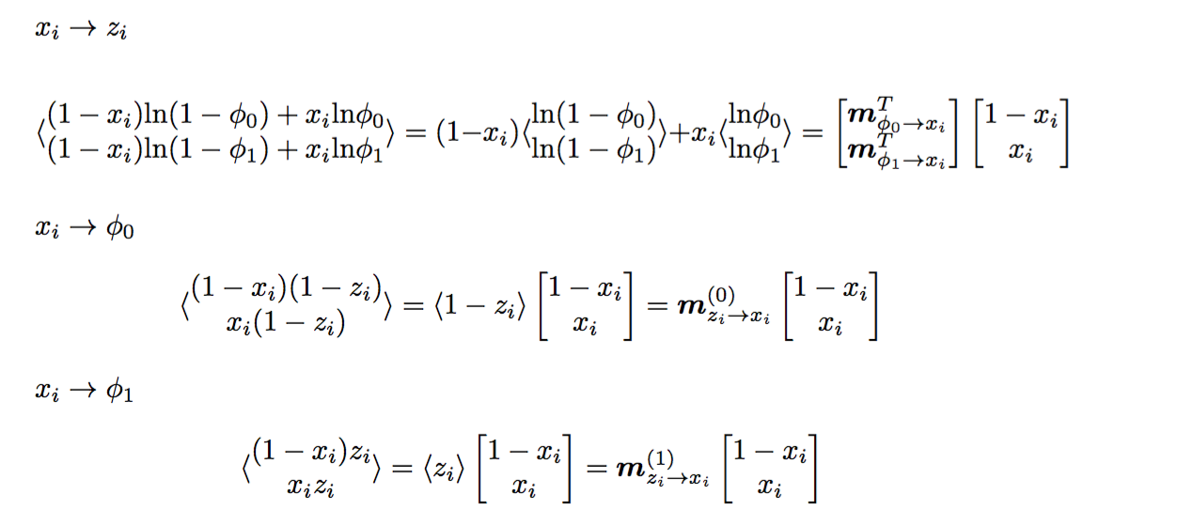
Message Passing
(4)
$φ$₀
$φ$₁
(5)
x₀
x₁
x₂
z₀
z₁
z₂
(6)
$$π$$
(7)

Slide 6
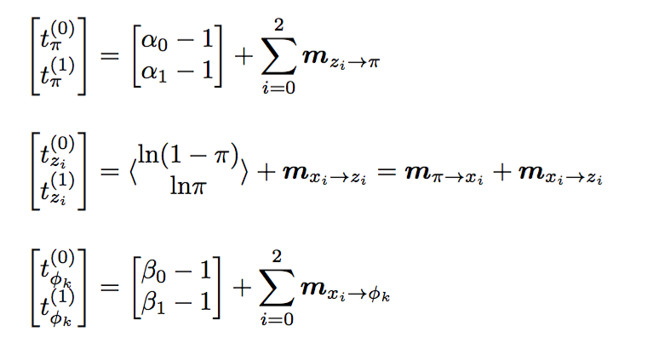
Update
After gathering messages from its children and parents, each vertex will update its t variables in following ways. Note that we use m_{x→y} to denote message passed from x to y, intead of using specific math formulas.
Again, in exponential conjugate models, how to update a factor is determined by its functional form.
(8)
$φ$₀
$φ$₁
(9)
x₀
x₁
x₂
(10)
z₀
z₁
z₂
$$π$$

Slide 7
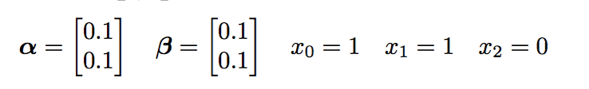
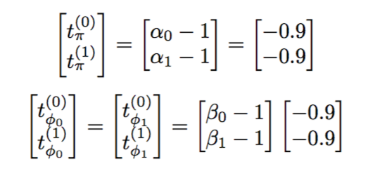



Demo
Parameters and Observed Data
$φ$₀
$φ$₁
Initialize Factors
x₀=1
x₁=1
x₂=0
z₀
z₁
z₂
$$π$$

Slide 8
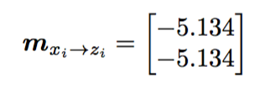
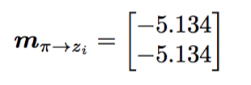
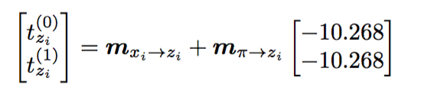
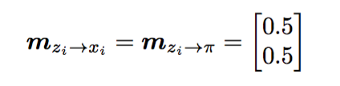
Demo
Step 1 Update z
According to (4) and (5)
According to (1)
$φ$₀
$φ$₁
Update z according to (9)
x₀=1
x₁=1
x₂=0
Prepare new messages according to (2) and (3)
z₀
z₁
z₂
$$π$$

Slide 9

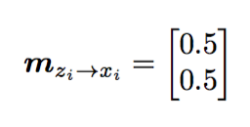
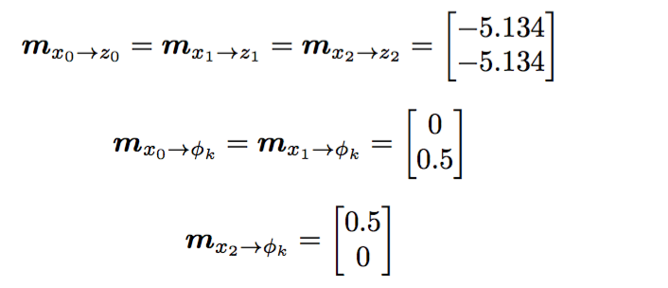
Demo
Step 2 Update x
According to (4)
$φ$₀
$φ$₁
From previous step
x₀=1
x₁=1
x₂=0
Prepare new messages according to (5), (6) and (7)
z₀
z₁
z₂
$$π$$

Slide 10
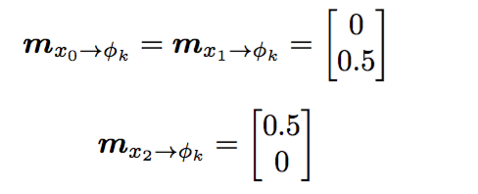
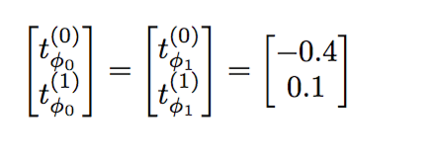
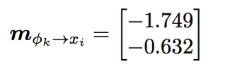
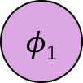
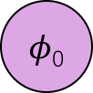
Demo
Step 3 Update φ
From previous step
$φ$₀
$φ$₁
x₀=1
x₁=1
x₂=0
Update φ according to (10)
z₀
z₁
z₂
Prepare new messages according to (4)
$$π$$

Slide 11

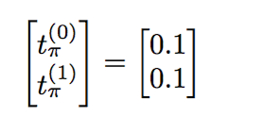
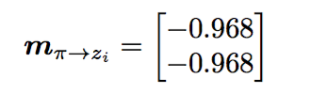



Demo
Step 4 Update $π$
From Step 1
$φ$₀
$φ$₁
Update $π$ according to (8)
x₀=1
x₁=1
x₂=0
Prepare new messages according to (1)
z₀
z₁
z₂
$$π$$

Slide 12
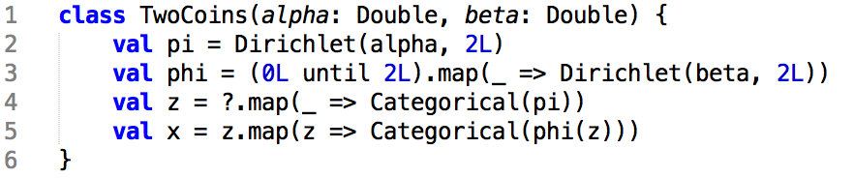
Demo
Repeat Step 1 to 4 until converge.
$φ$₀
$φ$₁
With InferSpark, all these can be done in four lines of code.
x₀=1
x₁=1
x₂=0
z₀
z₁
z₂
$$π$$

Slide 13

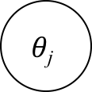
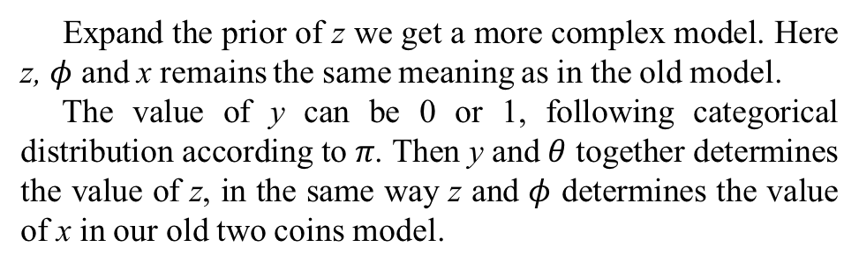

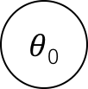
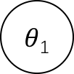
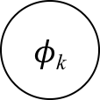
Expanded Two Coins
$φ$₀
$φ$₁
$$θ\text{j}$$
$φ$_{k}
2
2
x₀
x₁
x₂
$$π$$
y_{i}
z_{i}
x_{i}
3
$θ$₀
$θ$₁
Expand the prior of z we get a more complex model. Here z, $φ$ and x remains the same meaning as in the old model.
The value of y can be 0 or 1, following categorical distribution according to 𝜋. Then y and $θ$ together determines the value of z, in the same way z and $φ$ determines the value of x in our old two coins model.
z₀
z₁
z₂
y₀
y₁
y₂
$$π$$

Slide 14
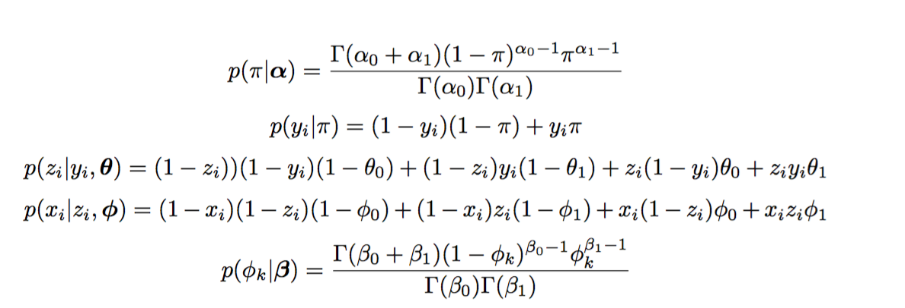
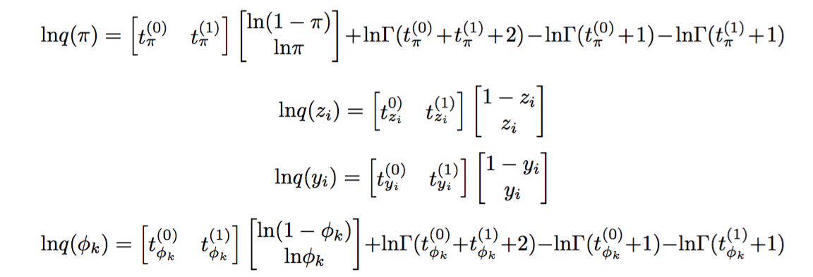
Functional Forms
The distributions of these vertices
$φ$₀
$φ$₁
x₀
x₁
x₂
$θ$₀
$θ$₁
z₀
z₁
z₂
By exponential conjugate
y₀
y₁
y₂
$$π$$

Slide 15
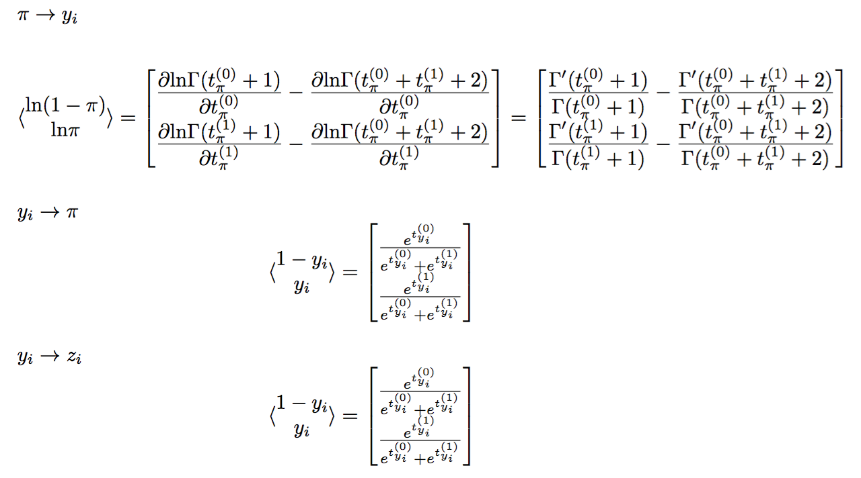

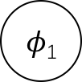
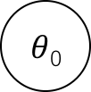
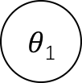
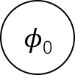
Message Passing
With the same notation, here we list the messages passed between the vertices.
$φ$₀
$φ$₁
x₀
x₁
x₂
$θ$₀
$θ$₁
z₀
z₁
z₂
y₀
y₁
y₂
$$π$$

Slide 16
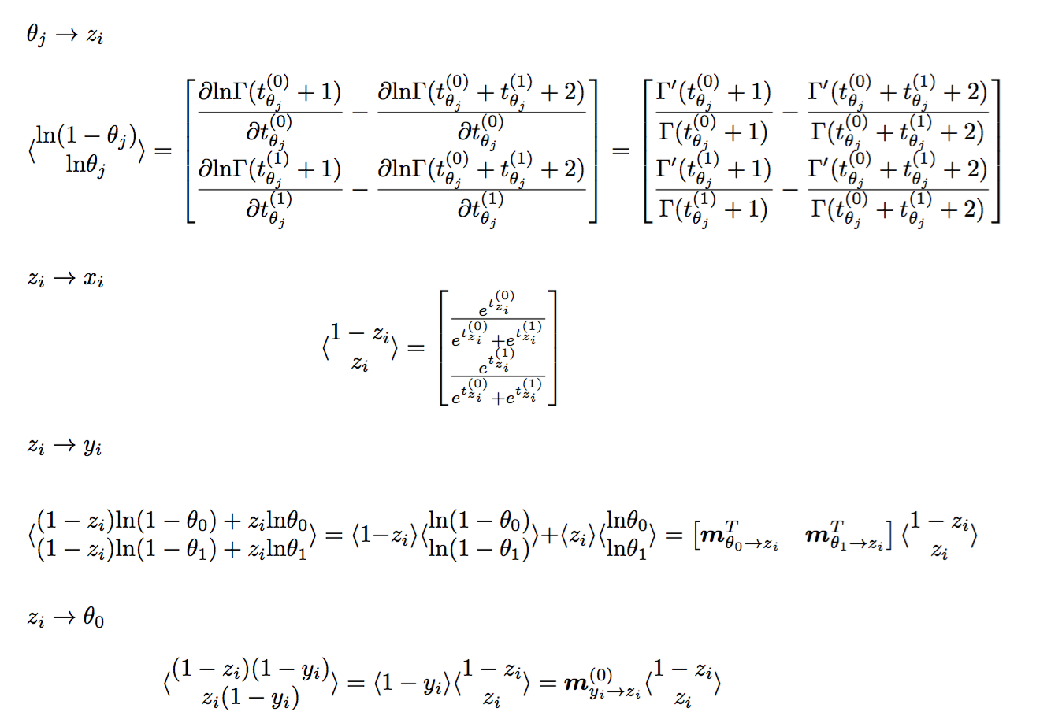
Message Passing
$φ$₀
$φ$₁
x₀
x₁
x₂
$θ$₀
$θ$₁
z₀
z₁
z₂
y₀
y₁
y₂
$$π$$

Slide 17
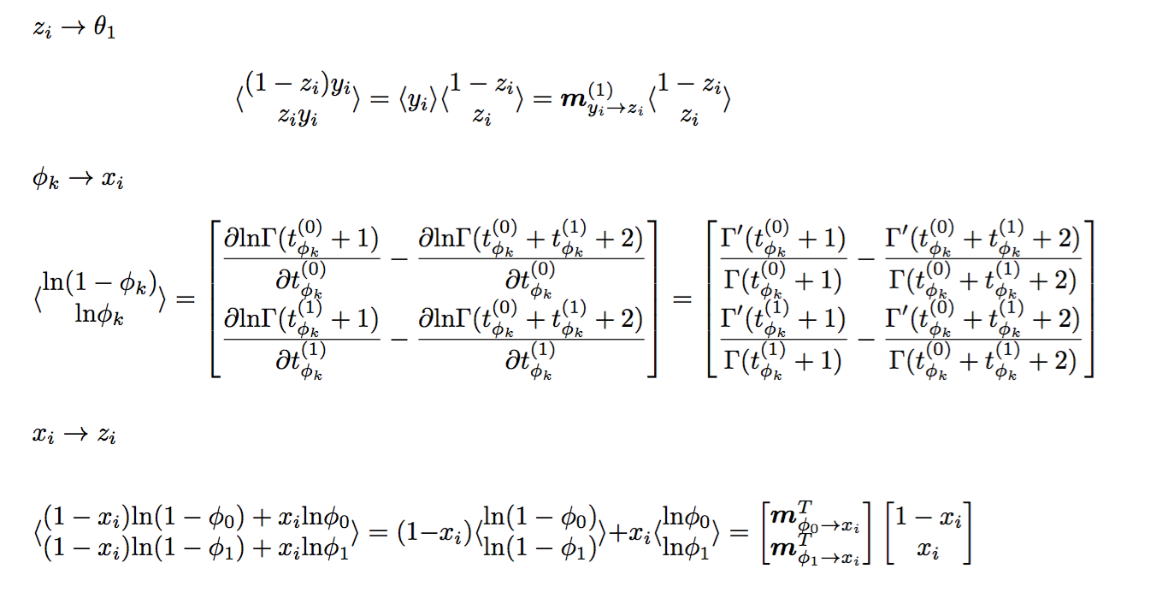
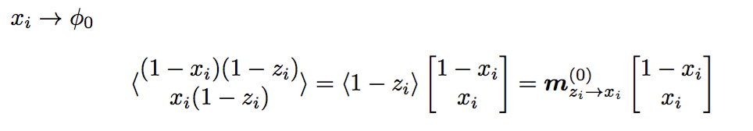
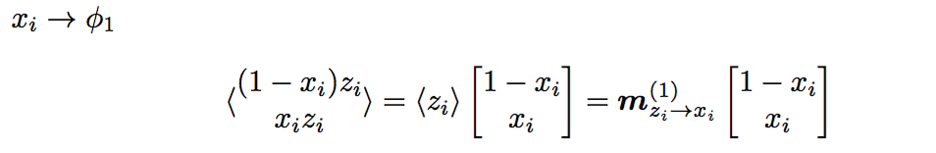

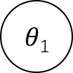
Message Passing
$φ$₀
$φ$₁
x₀
x₁
x₂
$θ$₀
$θ$₁
z₀
z₁
z₂
y₀
y₁
y₂
$$π$$

Slide 18
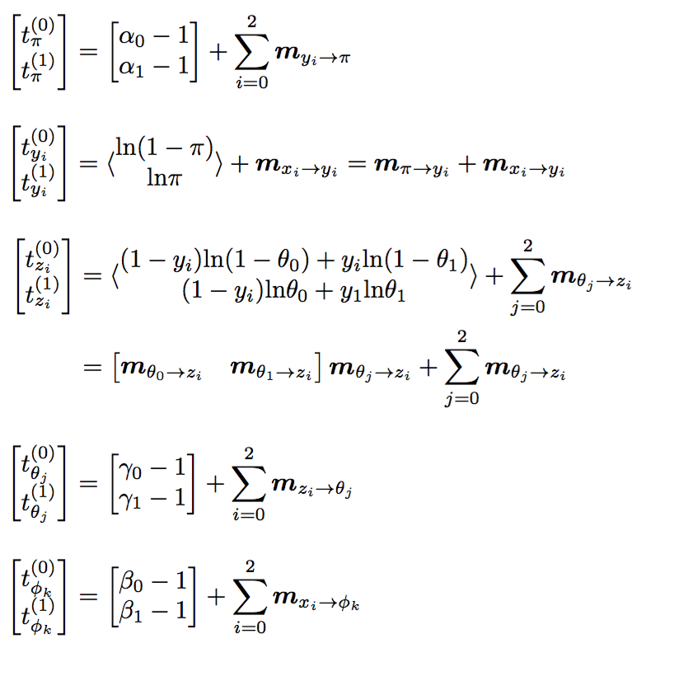
Update
$φ$₀
$φ$₁
x₀
x₁
x₂
$θ$₀
$θ$₁
z₀
z₁
z₂
y₀
y₁
y₂
$$π$$

