Slide 1
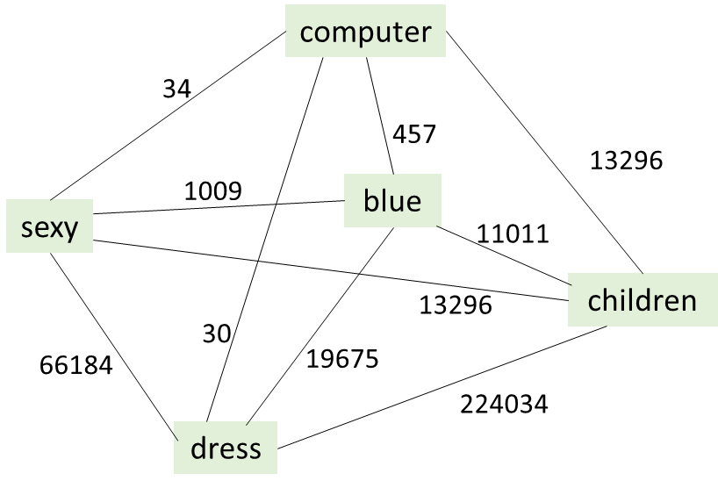


Rank using graph (score low-high)
children sexy dress
(儿童性感连衣裙)
children blue dress
（儿童蓝色连衣裙)
children cute dress
(儿童可爱连衣裙)
Annotation by crowd sourcing
children sexy dress
(儿童性感连衣裙)
children blue dress
（儿童蓝色连衣裙)
children cute dress
(儿童可爱连衣裙)
Preprocessing
children blue dress (儿童蓝色连衣裙)
……
children sexy dress (儿童性感连衣裙)
……
children cute dress (儿童可爱连衣裙)
Automatic generation
children sexy children cute
dress dress
(儿童性感 (儿童可爱
连衣裙) 连衣裙)
Raw Query Data
Adidas gym shoes (Adidas球鞋)
children blue dress (儿童蓝色连衣裙)
……
children sexy dress (儿童性感连衣裙)
3D printer (3维打印机)
……
children cute dress (儿童可爱连衣裙)
Additional Verification
by crowdsourcing
(children sexy dress , children cute dress)
(儿童性感连衣裙, 儿童可爱连衣裙)
store in CoCo

Slide 2
Rank using graph (score low-high)
children sexy dress
(儿童性感连衣裙)
children blue dress
（儿童蓝色连衣裙)
children cute dress
(儿童可爱连衣裙)
Annotation by crowd sourcing
children sexy dress
(儿童性感连衣裙)
children blue dress
（儿童蓝色连衣裙)
children cute dress
(儿童可爱连衣裙)
Preprocessing
children blue dress (儿童蓝色连衣裙)
……
children sexy dress (儿童性感连衣裙)
……
children cute dress (儿童可爱连衣裙)
Automatic generation
children sexy children cute
dress dress
(儿童性感 (儿童可爱
连衣裙) 连衣裙)
Raw Query Data
Adidas gym shoes (Adidas球鞋)
children blue dress (儿童蓝色连衣裙)
……
children sexy dress (儿童性感连衣裙)
3D printer (3维打印机)
……
children cute dress (儿童可爱连衣裙)
Additional Verification
by crowdsourcing
(children sexy dress , children cute dress)
(儿童可爱连衣裙, 儿童性感连衣裙)
store in CoCo

