Slide 1
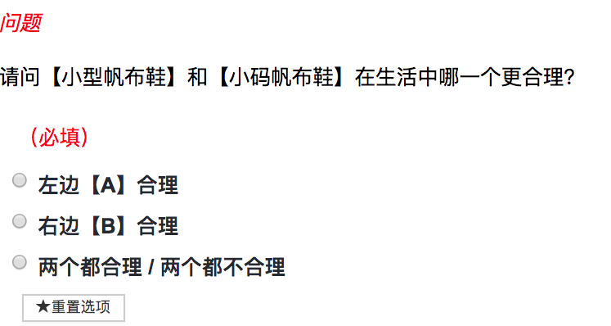
Question
【儿童可爱连衣裙】
“small ” and “small size canvas shoes”

Slide 2
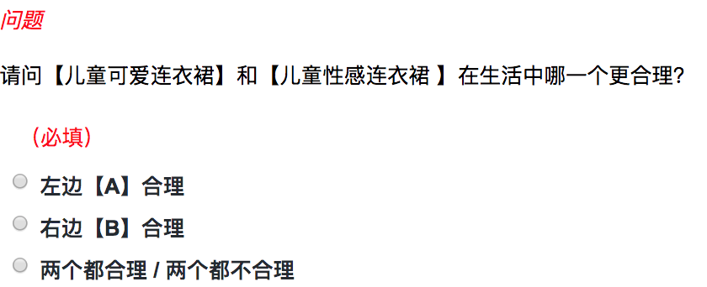
Question
Which one between【children cute dress】and【children sexy dress】is more reasonable in our life ?
Left one 【A】
Right one 【B】
Both are reasonable / not reasonable

