Slide 1
Category
Dress
Skirt
...
Light-fixture

Slide 2
Category
Dress
Skirt
...
Light-fixture
Property Key
Brand
Style
...
Material
Nike,
Adidas,
…
Sexy,
Cute,
…
Glass,
Plastic,
…
Property Value
...

Slide 3
Category
Light fixture
Tools for baking
...
Dresses & Skirt
Property Key
Material
...
Style
Glass,
Plastic,
…
NONE
Sexy,
Cute,
…
Property Value
...

Slide 4
Light fixture
灯 具
Tools for baking
烘 焙 工 具
Dresses & Skirt
裙 子
...
Category
Material
材 质
...
Style
Property Key
Glass,
Plastic,
…
NONE
Sexy,
Cute,
…
Property Value
...

Slide 5
Light fixture
Tools for baking
Skirt
Bedside
lamp
Ceiling
light
Egg
beaters
Oven
Dress
Short skirts
Category
Secondary Category

Slide 6
Tools for baking
Skirt
Bedside
lamp
Ceiling
light
Egg
beaters
Oven
Dress
Short skirts
Light fixture
Category
Secondary Category

Slide 7
Secondary
Category
Secondary
Category
Secondary
Category
Category
Category
Category
Beside lamp
Egg beaters
skirt
Light
fixture
Tools for
baking
Dresses & Skirt
Ceiling light
oven
dress

Slide 8
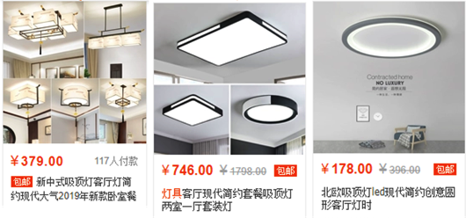
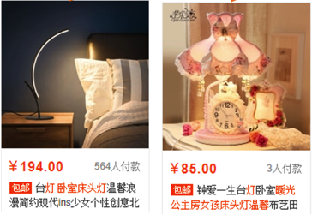
Category
Light fixture
(灯 具)
Secondary Category
Ceiling light
( 吸 顶 灯)
Beside lamp
(床 头 灯)
Items

Slide 9
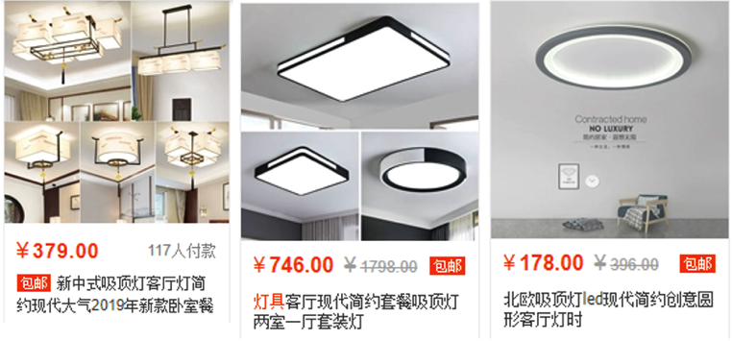
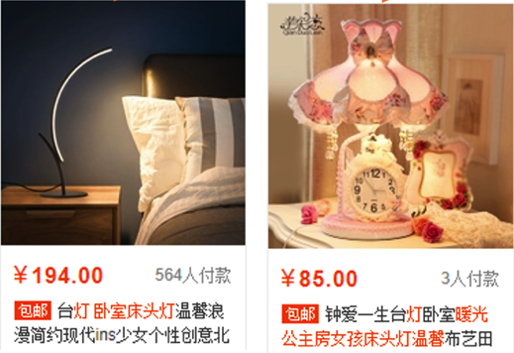
Category
Light fixture
(灯 具)
Ceiling light
( 吸 顶 灯)
Beside lamp
(床 头 灯)
Secondary Category
Items

Slide 10
Category
Light fixture
(灯 具)
Topic:
Glass light fixture
玻 璃 灯 具
PV CG
Ceiling light
( 吸 顶 灯)
Beside lamp
(床 头 灯)
Secondary Category
Items

Slide 11
Light fixture
(灯 具)
Topic:
Glass light fixture
玻 璃 灯 具
PV CG
Category
Ceiling light
( 吸 顶 灯)
Bedside lamp
( 床 头 灯)
Secondary Category
Items

Slide 12
Category
Skirt
...
Light fixture
Secondary Category
Dress
Short Skirt
Bedside lamp
Short Skirt
Property Key
Brand
Style
...
Material
Nike,
Adidas,
…
Sexy,
Cute,
…
Glass,
Plastic,
…
Property Value
...

Slide 13
Tools for baking
Category
Light fixture
Tools for baking
Skirt
Bedside lamp
Ceiling light
…
Oven
Egg beaters
…
Short skirt
dress
…
Secondary Category
Property Key
Brand
Style
...
Material
Nike,
Adidas,
…
Sexy,
Cute,
…
Glass,
Plastic,
…
Property Value
...

Slide 14







Encoder
Input
$$x_{1}$$
$$x_{2}$$
…
$$x_{m}$$
SEP
$$s_{1,1}$$
$$s_{1,2}$$
…
$$s_{u,i}$$
$$s_{u,i+1}$$
…
One-way Encoding Architecture
[图大概是这个意思 需要美化]

