Slide 1
1st seminar Contents
Hardware design flow-Using VHDL
Paper 1: RICH-IP
Paper 2: SPIRAL

Slide 2
Hardware design flow
General design flow for hardware design, my project are mainly focus on the first three steps
Design Entry
Not satisfied
Not satisfied
Functional Simulation
Synthesis
Implementation

Slide 3

Hardware design flow
Step 1- Design Entry
Input the design into a machine-readable format.
Using schematic capture, HDL entry(VHDL/Verilog).
In our course, we will use VHDL/Verilog.

Slide 4
Hardware design flow
Step 2- Functional Simulation
Verify that logical behavior of the circuit.
Do not contain physical implementation detail.
Do not contain include delay timing information.
If there are any issues with the functionality, we may need to modify the VHDL codes.

Slide 5
Hardware design flow
Step 3- Synthesis
Interpret/ compile the VHDL, design information and infer standard building blocks to implement the design.
Subtle differences in the VHDL description can result in different hardware being synthesized at this stage.

Slide 6
Hardware design flow
Drawbacks of tradition design:
The simulation and verification are the most time-consuming step, especially when design a complex algorithm.
Have basic building blocks in the design libraries only, inadequate for programming large, complex and common algorithms.

Slide 7
Paper1:Rich-IP
A rapid, interactive, configurable and high-level IP synthesis system was proposed here. It offers a friendly front-end and high levels of abstraction when designing complex IP cores.
The system has a two-level compiler, which allows users to interactively configure important design parameters in order to generate optimized cores that best suit the user’s requirements.

Slide 8
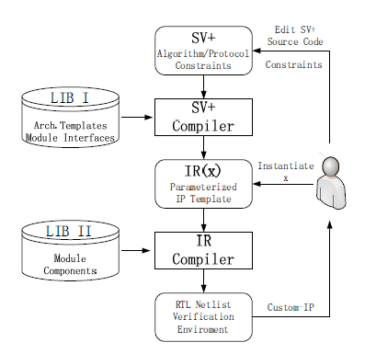
Paper1:Rich-IP
The architecture of our project
The IP designer describes the algorithm, IP interface as well as constrains in SV+.
The SV+ code gets preprocessed by an SV+ preprocessor, named SV+ compiler here.
The designer instantiate the variables using a configuration file.
In the fine IP generation step, the fully instantiated IR is compiled into RTL .

Slide 9
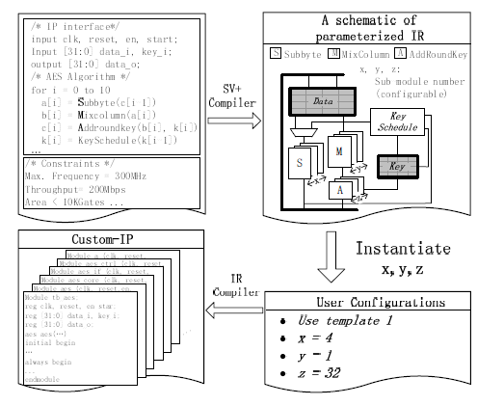
Paper 1: Rich-IP
An example: AES algorithm
The AES algorithm IP cores includes for main functions: Subbytes, Mixcolumn,Addroundkey and Shiftrows

Slide 10
Paper 2: SPIRAL
SPIRAL automatically generates high performance code that is tuned to the given platform.
Similar to a human expert, for a specified transform, SPIRAL “intelligently” generates and explores algorithmic and implementation choices to find the best match to the computer’s microarchitecture.
SPIRAL generates high performance code for a broad set of DSP transforms including the discrete Fourier transform, other trigonometric transforms, filter transforms, and discrete wavelet transforms.

Slide 11
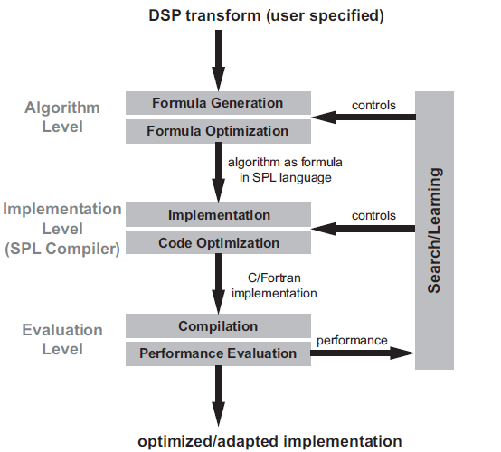

Paper 2: SPIRAL
Architecture of SPIRAL
Mathematic framework

Slide 12

Paper 2: SPIRAL
DSP transform, such as DFT-2n
Formula,
SPL language, To express products of structured sparse matrices using a small set of constructs and symbols

Slide 13
Paper 2: SPIRAL
Conclusions:
A large number of formulas for a given transform.
Difference in runtime between implementations.
Compiler vectorization is limited.
High performance of SPIRAL.

Slide 14

1ST Similar

