Slide 1
Biperpedia
Kangqi Luo

Slide 2
Content
Goal
Framework
Algorithm
Enhancement
Experiments
Conclusion
Notes:
scenario → why not freebase → ideal goal → framework → algorithm & enhancement → exp → conclusion

Slide 3
Why Not Freebase?
Capital
Area
Anthem
Country
Freebase is too narrow
Only contains a small fragment of attributes.
Brittle
Single way of modeling entities, cclasses, attrs.
mapping queries to FB can be hard.
China
Notes:
100-200 attr. for country, while BP found 10K-20K

Slide 4
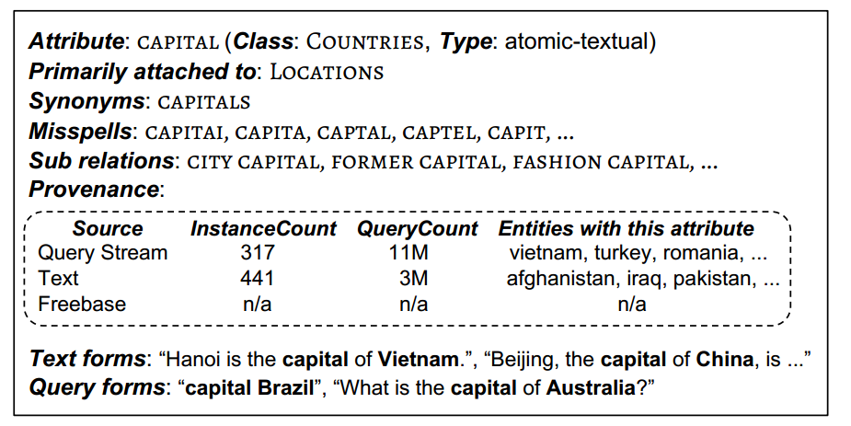
Goal
Long-tail binary attribute dictionary (for every class)

Slide 5
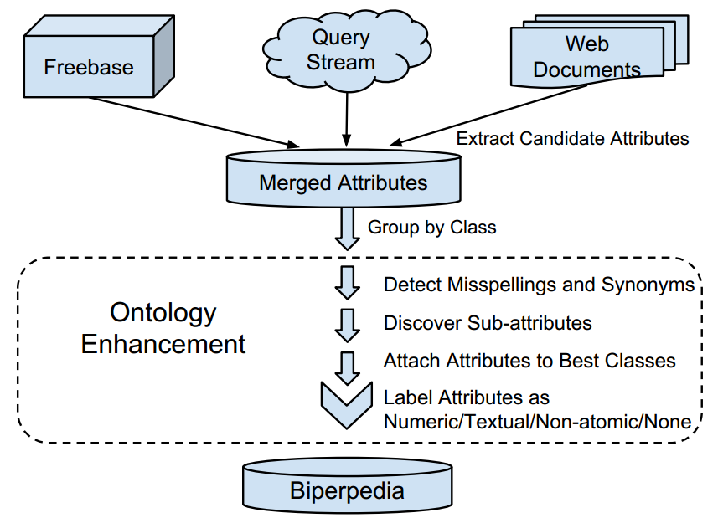
Framework
Notes:
2 phases: information collection (building), and ontology enhancement

Slide 6
Building BP: Extraction
Assuming an ontology of classes (From FB)
Country, US President, Red wine, …
Insert all the attributes from Freebase
Name, domain, range, English description…
Notes:
maybe we need to explain the domain/range notion in the FB intro slide

Slide 7
Extraction from Query Stream
Initial collection: find queries of the form “X Y” (or “Y X”) where:
X denotes an entity
Y is something might be an attribute
Appeared in the form “what is the Y of Z?”
usually ask “(the) el Salvador coffee production”
omit “ ’s ”
Notes:
where are the queries from?

Slide 8
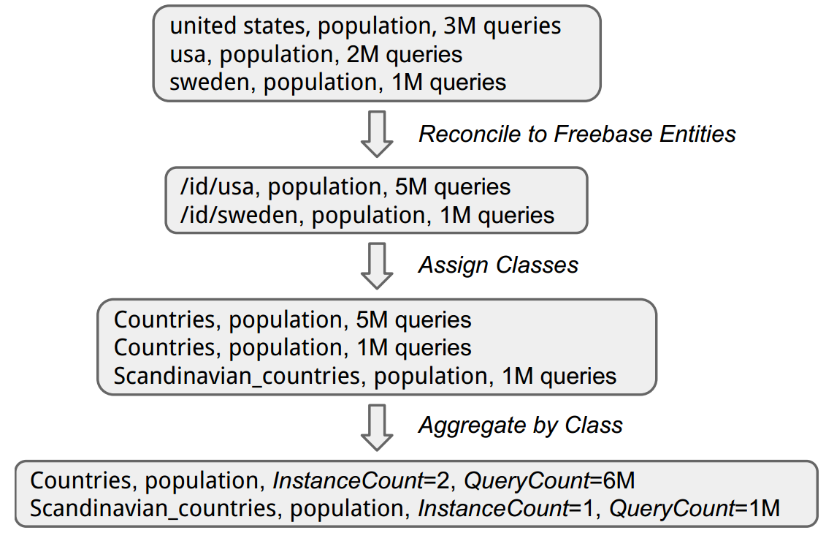
Aggregation by Class
Notes:
the method of entity linking? only choose the best?

Slide 9
Extraction from Web Text
Consider the top attributes from queries
Learn text patterns expressing them:
“the gdp of X rose by Z”
Find similar sentences but with different attributes: (Expanding)
“the coffee production of X rose by Z”
Aggregation by Class
Notes:
distant supervision (explain)
extraction can be noisy
question: can we leverage existing open-domain systems? (NO)

Slide 10
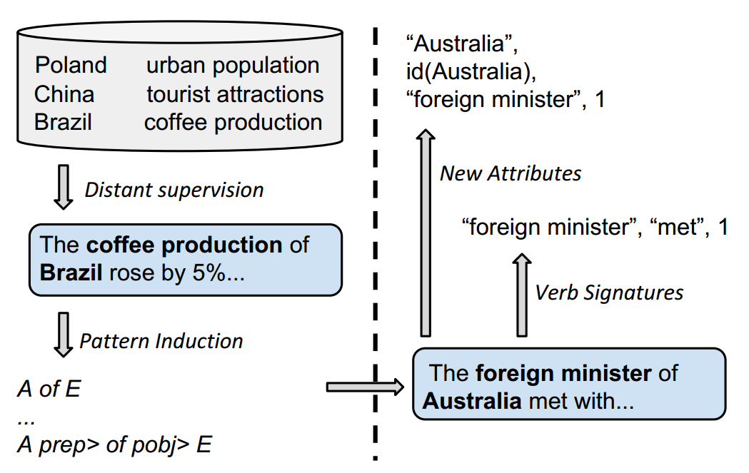
Extraction from Web Text
Notes:
when converge? (2500 patterns in total, the top 200 patterns matches 99% case)

Slide 11
Classification

Slide 12
Enhancement

Slide 13
Experiments & Evaluation

Slide 14
Conclusion

Slide 15
Thanks!

