Slide 1
Cosmos and SCOPE Data! I need more data!
Cosmos Team

Slide 2
Search in a nutshell
Given one or two keywords…

Slide 3
Search in a nutshell
Given one or two keywords…
Show the best result…

Slide 4
Search in a nutshell
Given one or two keywords…
Show the best result…
From 20 billion web pages

Slide 5
Search in a nutshell
Given one or two keywords…
Show the best result…
From 20 billion web pages
And make some money

Slide 6
Things get tough quickly
This may be easy for queries like “Microsoft”…

Slide 7
Things get tough quickly
This may be easy for queries like “Microsoft”…
But gets tricky very quickly
What do you put for “car insurance”
Geico, USAA, CarInsurance.com, … ?
What about “news”
cnn, msnbc, foxnews, news.google (gasp!), … ?

Slide 8
Things get tough quickly
This may be easy for queries like “Microsoft”…
But gets tricky very quickly
What do you put for “car insurance”
Geico, USAA, CarInsurance.com, … ?
What about “news”
cnn, msnbc, foxnews, news.google (gasp!), … ?
And gets harder for rogue queries
Unfortunately this is where we prove ourselves

Slide 9
Search is powered by data
Data drives search and advertising
Web pages
Links, text, titles, etc
Search logs
What people searched for, what they clicked, etc
IE logs
What sites people visit, the browsing order, etc
Advertising logs
What ads do people click on, what was shown, etc

Slide 10
How much data are we collecting?
We collect >1 PB every month
SearchUX is ~200 TB
Toolbar is ~100 TB
Search is ~300 TB
Web snapshots are ~100 TB
MSN, Hotmail, IE, web, etc…

Slide 11
More data = better data
Suppose you flipped a coin 10 times…
Would you be surprised to get 50% heads?
How about 70% heads?
What about 80% heads?
Now supposed you flipped it 100,000 times…
Now you’d be surprised to get 70% heads!! Why?
How does this apply to search data?

Slide 12
Talk outline
Cosmos
Storage (Concepts and Implementation)
Computations (Concepts and Implementation)
Virtual Clusters
Client tools
Workshop
Goal: Everybody should be able to write a script!
Scope
I/O
Processing using SELECT
Custom processing

Slide 13
Cosmos
Fault-tolerant distributed storage and computational platform

Slide 14
Cosmos “Fault-tolerant distributed storage and computational platform”
Fault-tolerant
Resilient to hardware and software errors
Failures tolerated at multiple levels
Distributed
10,800 commodity servers in a single environment
And multiple production environments
Storage
Cosmos manages “streams” of data (think files)
Data is 3x replicated for reliability
Computation
Supports mechanisms to analyze data in place

Slide 15
Cosmos – Service Integration
Most teams integrate Cosmos into a business workflow:
Upload raw data into Cosmos
Crunch the numbers within Cosmos
Download results to external systems
Persist results within Cosmos
Cosmos pipelines handle log and web data
standard business reporting – Data Mining Pipelines
“how many queries / sec today vs yesterday”?
Experimentation – Foray
“if we make the box red, how many more queries do users do?”
Relevance, Index Gen
Experiment with different classifiers and feature extractors for web pages

Slide 16
Architecture
Virtual Cluster Web Service
Cosmos Store Manager
Cosmos Job Scheduler
JM #1
JM #2
JM #3

Slide 17
Distributed Storage 101
Terminology:
Streams
Extents
Concepts
Cosmos Implementation

Slide 18
Streams and Extents
“Streams” are named collections of data (“Cosmos files”)
Just an array of bytes
Streams have path names
/projects/searchMerged/2010/01/search_24.log
Paths are *case sensitive*
Extents are the physical unit of storage
Streams are a list of “extents”
Extents are roughly 250 MB
Data in extents is compressed
Multiple streams can contain the same extent (linking)

Slide 19
Storage: How a stream is divided
Original stream is ~2 GB and is broken into 8 extents

Slide 20
Storage: How a stream is divided
Original stream is ~2 GB and is broken into 8 extents
The 1st Extent is placed on machine 2, 4, and 5

Slide 21
Storage: How a stream is divided
Original stream is ~2 GB and is broken into 8 extents
The 2nd Extent is placed on machine 1, 2, and 3

Slide 22
Storage: How a stream is divided
Original stream is ~2 GB and is broken into 8 extents
The 3rd Extent is placed on machines 1, 2, and 5

Slide 23
Storage: How a stream is divided
Original stream is ~2 GB and is broken into 8 extents
The extents are spread uniformly around the cluster

Slide 24
Storage: Fault tolerance
N-1 Failures can be tolerated
3x replication, 2 failures can be tolerated

Slide 25
Cosmos Storage Manager
Stream & Directory
APIs
Stream metadata
Extent replication
Fault-tolerance
Consistency
CSM
Machines handle “extents” & compression

Slide 26
CSM
Primary node “elected”
by other CSM nodes using
PAXOS algorithm.
Only this node is empowered to respond to external requests
Stream & Directory
APIs
Metadata is stored on all machines and all machines are involved in achieving consensus

Slide 27
Distributed Computations 101
Introduce Map/Reduce concept
Show why standard approaches don’t work
Show how to break computations apart
How SCOPE leverages these concepts

Slide 28
Quick Map/Reduce Lesson
We want to compute the count of (Query, URL) pairs that were clicked. How can we do this using a cluster of machines?
At one time just knowing this information really improved the results because it boosted results that were clicked over those that weren’t clicked

Slide 29
Naïve Approach: Try running existing scripts in parallel
Machine #1
Machine #2
Machine #3
Machine #4
Extent
Extent
Extent
Extent
GetPairs
GetPairs
GetPairs
GetPairs
Sort
Sort
Sort
Sort
Count
Count
Count
Count
Output

Slide 30
Naïve Approach: A merge operation is required!
Machine #1
Machine #2
Machine #3
Machine #4
Extent
Extent
Extent
Extent
GetPairs
GetPairs
GetPairs
GetPairs
Sort
Sort
Sort
Sort
Count
Count
Count
Count
Merge
“Merge” is required because the same Pair (i.e. “wikipedia”, “www.wikipedia.org”) might exist on multiple machines!
Output

Slide 31
Naïve Approach: Merges are not parallel
Machine #1
Machine #2
Machine #3
Machine #4
Extent
Extent
Extent
Extent
GetPairs
GetPairs
GetPairs
GetPairs
Sort
Sort
Sort
Sort
Count
Count
Count
Count
This is 4 partitions. Now, multiply by 1000 and you see that Aggregation operations can be expensive!!
Merge
Output

Slide 32
A Scalable Approach:
Map/Reduce is an algorithm that allows us to do everything in parallel

Slide 33
Map/Reduce: Think of this like bucket and count
MAP Pairs to different machines
Machine #1 has all of the Pair_A items
Machine #2 has all of the Pair_B items
Machine #3 has all of the Pair_C items
REDUCE the data
All rows with a given Pair are bucketed on (only) one machine
Therefore grouping, sorting and counting or other aggregation works correctly!
This greatly reduces the amount of data!

Slide 34
Map/Reduce: Runs everything in parallel
Machine #1
Machine #2
Machine #3
Machine #4
Extent
Extent
Extent
Extent
GetPairs
GetPairs
GetPairs
GetPairs
Map
Map
Map
Map
Sort
Sort
Sort
Sort
Count
Count
Count
Count
Output

Slide 35
Map/Reduce: Maps the NGrams to unique buckets
Machine #1
Machine #2
Machine #3
Machine #4
Extent
Extent
Extent
Extent
“Map” puts all of the same Pairs onto one machine. This allows you to group by those 2 fields in subsequent processes
GetPairs
GetPairs
GetPairs
GetPairs
Map
Map
Map
Map
Sort
Sort
Sort
Sort
Count
Count
Count
Count
Output

Slide 36
Map/Reduce: Runs everything in parallel
Machine #1
Machine #2
Machine #3
Machine #4
Extent
Extent
Extent
Extent
GetPairs
GetPairs
GetPairs
GetPairs
Map
“Count” REDUCES the amount
of data since each Pair is
only output once
Map
Map
Map
Sort
Sort
Sort
Sort
Count
Count
Count
Count
Output

Slide 37
Map/Reduce: Map=Bucket and Reduce=Count
Machine #1
Machine #2
Machine #3
Machine #4
Extent
Extent
Extent
Extent
GetPairs
GetPairs
GetPairs
GetPairs
MAP
Map
Map
Map
Map
Sort
Sort
Sort
Sort
REDUCE
Count
Count
Count
Count
Output

Slide 38
SCOPE leverages MAP – REDUCE
Sample SCOPE syntax:
SELECT A, SUM(B) AS sum_b
“Map” on A
“Group” on A (implicit in SCOPE)
“Reduce” by summing values of B
COMBINE x WITH y ON x.A == y.A
“Map” on x.A and “Map” on y.A
“Group” on x.A and “Group” on y.A
“Join” the rows together
REDUCE x ON A
“Map” on A
“Group” on A (implicit in SCOPE)
“Reduce” as defined by the reduce operation

Slide 39
Executing a SCOPE script in Cosmos
A SCOPE script is submitted to Cosmos
The script is compiled into a job graph
Each statement translates into a set of operations
The job graph is optimized
The physical plan can vary from run to run
The job graph is executed by “Job Manager”
The Job Manager schedules the work chunks (“vertices”)
Processing initial inputs may require > 100,000 vertices
JM handles passing data between layers of mapping, aggregation, etc.
JM handles failed nodes and retry logic
Results saved to a Cosmos stream

Slide 40
Virtual Clusters 101
VC == The abstraction of resources available to a team
A layer of security
Authorization by corpnet credentials (or PHX in special cases)
Authentication by Security Group membership
Data Access permissions (i.e. Read Only, Write, Delete, etc.)
Data must be explicitly shared between VCs
A resource allocation mechanism among teams
“VC” has a separate queue, can run 1 or more jobs in parallel
VC members can manage jobs in the queue
The execution resource allocation varies by VC

Slide 41
Virtual Clusters – Virtual Paths
Mapping from a “VC” path to a “Cosmos” path
User
Sends a request for logical file
“vc://coprod2/Search/log.txt”
VCWS
Sends a request for physical file
“cosmos://vol1/A/B/log.txt”
CSM
CSM knows where the extents are located

Slide 42
Virtual Clusters – Virtual Paths
Security
User
Sends a request for logical file
“vc://coprod2/HR/salaries.txt”
VCWS
User not authorized to read from HR virtual cluster and the access is blocked
CSM

Slide 43
Virtual Clusters – Job Queues
Each VC has its own job queue
VC “execution tokens”
A guaranteed *minimum* number of nodes a job can recruit from the cluster
When the job is executing a step that can’t use many nodes in parallel, the “excess” machines are loaned out to other jobs.
And when *your* job step needs more machines, it might be able to borrow machines beyond your allocation.
This is a *number* of nodes, not a list of specific ones.
VC job queue can be configured to run multiple jobs at a time
In which case, the allocation is shared by those jobs.
And you can specify a percentage of allocation for your job.

Slide 44
Virtual Clusters - Job Queues
Logical job queues
User
Submits a job for vc://coprod2/Search
VCWS
Compiles the job and sends it to Cosmos Job Scheduler
CJS
Jobs are queued on a VC basis
VC1
VC2
VC3
Jobs are run independently but respect VC machine allocation
Job1_A
Job1_B
Job3_A

Slide 45
Tools for Developing Applications

Slide 46
Integrating Cosmos with External Apps
SCOPE.exe as a command-line tool
SCOPE COPY <localFile> <VCPath>
SCOPE SUBMIT –i <myScript> -vc <VCName>
AppExecClient
Unattended, recurring job submission with dependencies checking
VcClient.DLL
.NET framework classes for managing streams and jobs in the Cosmos cluster
Cosmos Data Loader (CDL)
Unattended data upload for continuous sources such as service logs

Slide 47
Stream APIs (VcClient.dll)
VC namespace:
Connect session to Cosmos
Upload to / download from Cosmos
Get stream and/or directory information
StreamInfo class:
Length
CreateTime
ExpireTime (i.e. when Cosmos will delete the stream)
NumExtents
Name

Slide 48
SCOPE
Structured Computations Optimized for Parallel Execution

Slide 49
Microsoft’s SCOPE
Goes beyond Map/Reduce
Allows flexible computations
Leverage .NET functionality
Type safety
Arbitrary C# expressions
Error handling
SELECT statements
Joins
Aggregations
Transforms
Filtering
User-defined operators
When SELECT, JOIN and GROUP BY aren’t enough!

Slide 50
SCOPE: Simple example (1)
This query:
Produces:
Scope handles MIN, MAX, COUNT, SUM…
SELECT Query, COUNT() AS Count
FROM "search.log"
USING LogExtractor;
The LogExtractor is used to extract “Query” column from the search.log stream
“free beer” | 251
“micro brew” | 1073
“rolling rock” | 22
“alaskan amber” | 329

Slide 51
SCOPE: Simple example (2)
…and if you want to sort the results in descending order
SELECT Query, COUNT() AS Count
FROM "search.log"
USING LogExtractor
ORDER BY Count DESC;
Simple ORDER BY expression is used
“micro brew” | 1073
“alaskan amber” | 329
“free beer” | 251
“rolling rock” | 22

Slide 52
SCOPE: Simple example (3)
…and if you wanted only queries with Count between 1000 and 2000
SELECT Query, COUNT() AS Count
FROM "search.log"
USING LogExtractor
HAVING Count >= 1000 AND Count <= 2000
ORDER BY Count DESC;
Filters output using c# expressions with AND
“micro brew” | 1073

Slide 53
SCOPE: Simple example (4)
…and if you want only the first 3 characters of queries containing 10 or more characters
Uses a c# expression to get the first 3 characters
SELECT Query.Substring(0,3) AS Query,
COUNT() AS Count
FROM "search.log"
USING LogExtractor
WHERE Query.Length >= 10
ORDER BY Count DESC;
Filters input on queries with 10 or more characters

Slide 54
Scaling
SCOPE automatically generates
query plans that scale linearly with the number of machines

Slide 55
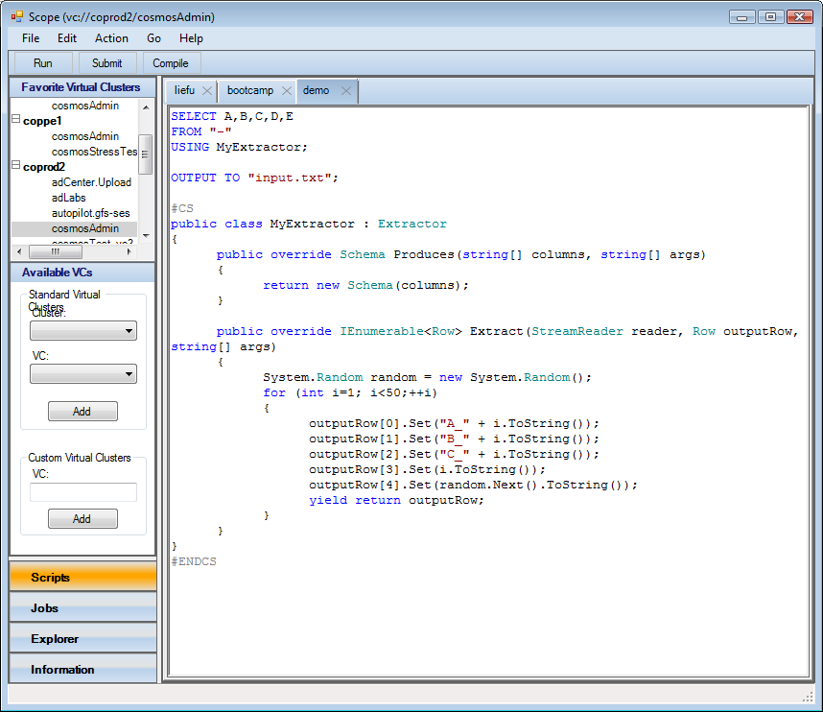
Scope Environment

Slide 56
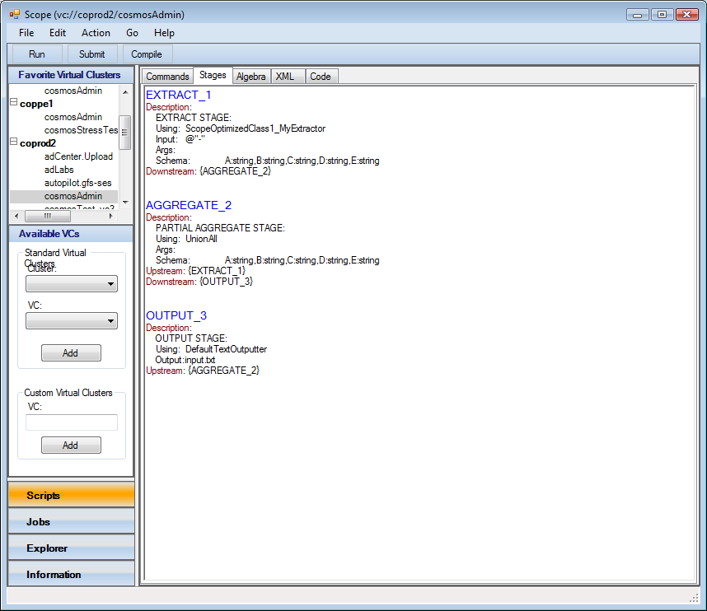
Demo (Compiling – F3)

Slide 57
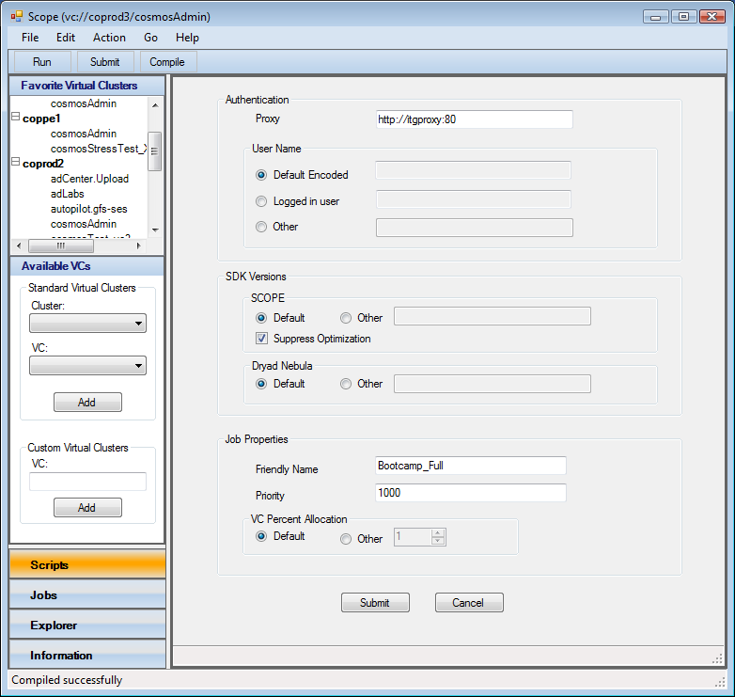
Demo (Submitting – F4)

Slide 58
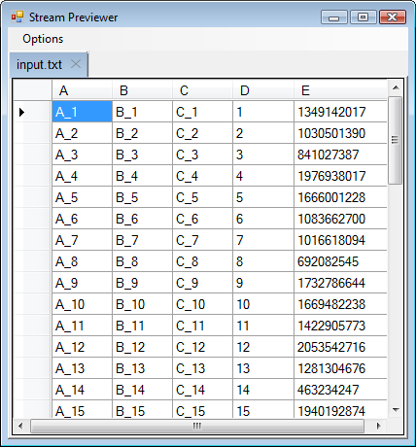
Demo (Running – F5)

Slide 59
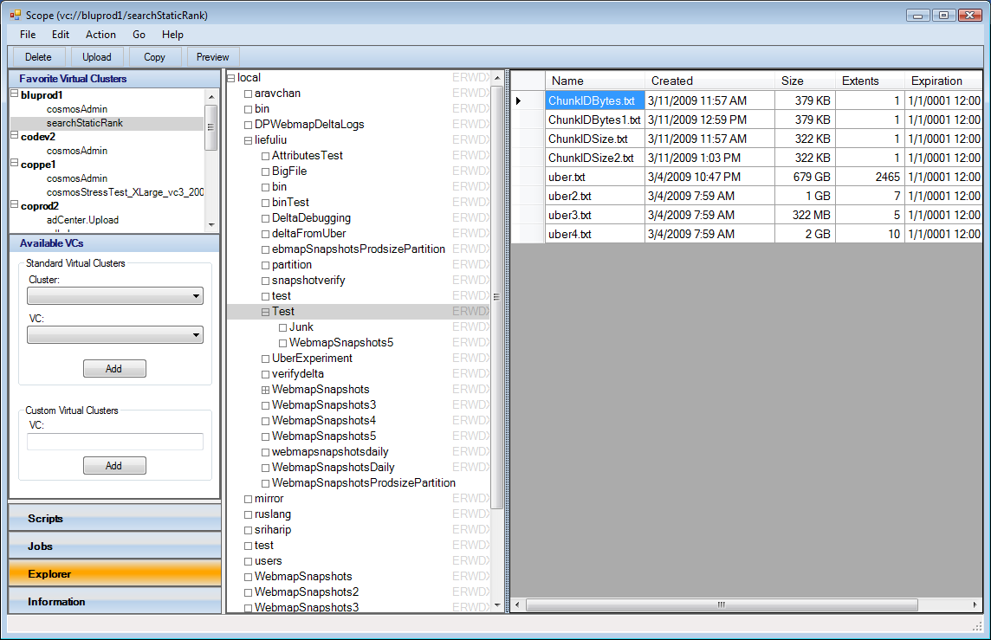
Demo (Browsing – F7)

Slide 60
SCOPE: Command Summary
I/O
EXTRACT – read data from stream, file
OUTPUT – write data to stream, file
Processing Data
SELECT – the “One Ring”
Custom Processing Commands (SCOPE objects)
PROCESS – invoke user-written Processor object
REDUCE – invoke Reducer
COMBINE – invoke Combiner
Dependencies
REFERENCE – load .Net assembly
RESOURCE – provide arbitrary file to user-written object

Slide 61
SCOPE Command Chaining
Result of one command can be assigned to a named variable, scripts not strictly sequential
a, b, c are RowSets (defined in ScopeRuntime namespace)
a = SELECT a,b,c
FROM "myInput.txt"
USING DefaultTextExtractor;
b = SELECT a, COUNTIF (a.Contains("xyz")) AS ACount
FROM a;
c = SELECT a, COUNTIF (a.Contains("qrs")) AS BCount
FROM a;

Slide 62
SCOPE: I/O

Slide 63
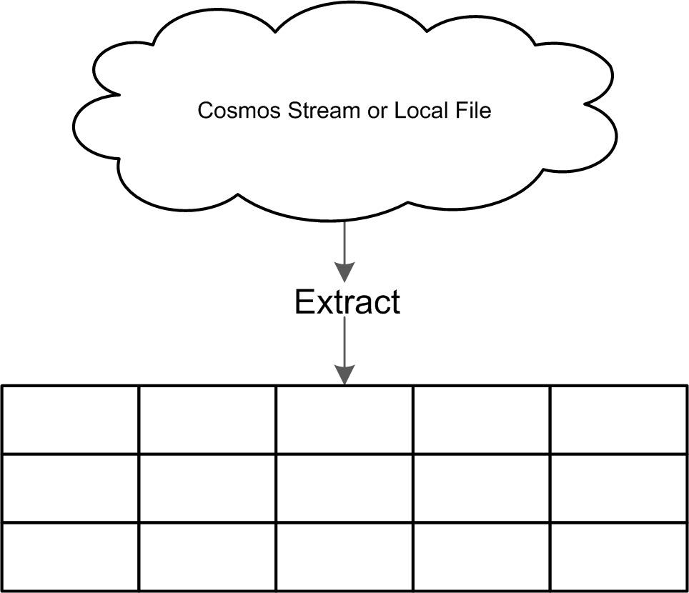
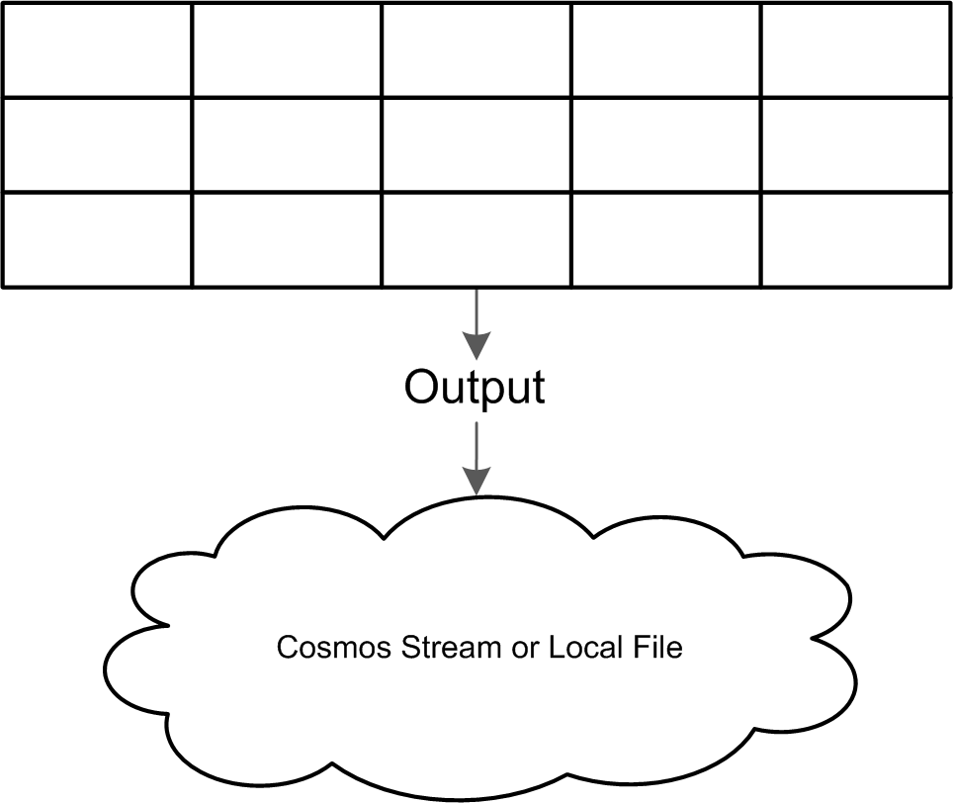
I/O:
Rows are used to store and pass data through the system
Use an EXTRACT command to convert a stream into a RowSet
All other commands work only with RowSets
Use an OUTPUT command to convert RowSets into a stream

Slide 64
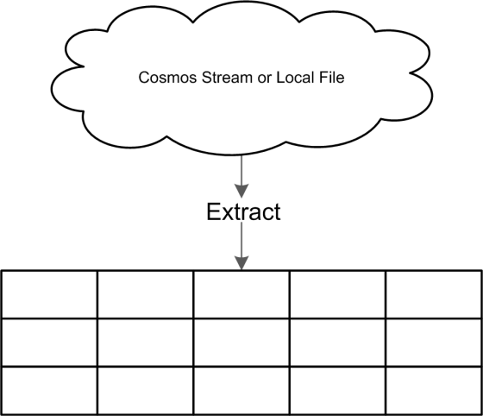

I/O: Script Example (1)
Use an EXTRACT command to convert a stream into Rows
EXTRACT A,B,C,D,E
FROM "sample.in"
USING MyExtractor;
OUTPUT TO "sample.out";
Use an OUTPUT command to convert Rows into a stream

Slide 65
I/O: Script Example (2)
What does the MyExtractor code look like?
EXTRACT A,B,C,D,E
FROM "sample.in"
USING MyExtractor;
OUTPUT TO "sample.out";

Slide 66
I/O: Writing an Extractor
public class MyExtractor : Extractor
{
public override Schema Produces( string[] requestedColumns
, string[] args)
{
return new Schema(requestedColumns);
}
public override IEnumerable<Row> Extract(StreamReader reader, Row outputRow, string[] args)
{
string line;
while ((line = reader.ReadLine()) != null)
{
string[] tokens = line.Split(',');
for (int i = 0; i < tokens.Length; ++i)
{
outputRow[i].UnsafeSet(tokens[i]);
}
yield return outputRow;
}
}
}
What columns (and types!) will this produce?
The Extractor can populate the columns in any way.
“yield” is the C# magic that allows Row objects to be passed through the system.

Slide 67
Why “yield” is powerful (1)
public class MyExtractor : Extractor
{
... IEnumerable<Row> Extract ...
{
...
yield return outRow1;
}
}
Extract is what’s called when the consumer calls input.Rows
“inRow” is the “outRow1” object yielded by MyExtractor
foreach (Row inRow in input.Rows)
{
...
yield return outRow2;
}
Now “outRow2” can be consumed by somebody downstream

Slide 68
Why “yield” is powerful (2)
This will pull Rows from whomever is upstream
foreach (Row row in input.Rows)
{
...
yield return outRow;
}
This will push Rows to whomever is downstream.

Slide 69
Why “yield” is powerful (3)
Tell the upstream object to start pushing Rows
You can connect lots of RowSets together and pass Rows through the system without serializing/deserializing
Extract
RowSet
RowSet
Rows are returned from the upstream RowSet

Slide 70
SCOPE: Analyzing with SELECT

Slide 71
SELECT:
Can be used for:
Input
Transforming
Filtering
Aggregation
Joining
Ordering before an OUTPUT command
Scope handles:
Building the sub-graphs
Ensuring proper scaling behavior

Slide 72
SELECT: I/O
SELECT can be used in place of EXTRACT
Provides a lot more power in one statement!
SELECT A,B, COUNT() AS C
FROM "sample.in"
USING MyExtractor
WHERE A != "foo"
HAVING Count > 5;
EXTRACT A,B
FROM "sample.in"
USING MyExtractor;
s = SELECT A,B, COUNT() AS C
WHERE A != "foo"
HAVING Count > 5;
Only one SELECT statement is needed to:
Pull out fields A and B from “sample.in”
Filter those Rows based on A != “foo”
Aggregate the remaining rows on A,B
Filter the output on C > 5

Slide 73
SELECT: Transforming data
SCOPE can handle arbitrary C # expressions within a SELECT statement
You can use system or custom .NET libraries
You can write your own custom functions
UrlDecode is contained in the GAC assembly System.Web.dll
REFERENCE "System.Web.dll";
SELECT int.Parse(A) AS C,
System.Web.HttpUtility.UrlDecode(URL) AS CleanURL
1.0 * Clicks / Impressions AS ClickRate,
GetDomain(URL) AS Domain;
Custom function will be defined in #CS block
Arbitrary c# expressions can be compiled and evaluated!

Slide 74
SELECT: User functions in #CS Blocks
REFERENCE "System.Web.dll";
SELECT int.Parse(A) AS C,
System.Web.HttpUtility.UrlDecode(URL) AS CleanURL
1.0 * Clicks / Impressions AS ClickRate,
GetDomain(URL) AS Domain;
#CS
public static string GetDomain(string url)
{
int index = url.IndexOf(".com");
return url.Substring(0,index);
}
#ENDCS
Custom functions are defined in #CS blocks. These functions must be public!

Slide 75
SELECT: Filtering
WHERE filters data entering the statement
HAVING filters the data leaving the statement
For all commands!
EXTRACT A,B
FROM "sample.in"
USING MyExtractor;
SELECT A,B, COUNT() AS C
WHERE A != "foo"
HAVING Count > 5;
EXTRACT A,B
FROM "sample.in"
USING MyExtractor
HAVING A != "foo";
SELECT A,B, COUNT() AS C;
SELECT *
WHERE Count > 5;
WHERE and HAVING are not equivalent

Slide 76
SELECT: Aggregating
SELECT can perform aggregate functions
MIN, MAX, SUM, COUNT, COUNTIF, AVG, STDEV
GROUP BY A,B is implied
Since A and B are non-aggregated columns
Expressions can be evaluated within an aggregation and outside an aggregation
SELECT A AS A,
B AS B,
SUM(B+C) AS SumBC
1+AVG(B) AS AvgB
FROM s;
SELECT A AS A,
B AS B,
SUM(B+C) AS SumBC
1+AVG(B) AS AvgB
FROM s
GROUP BY A,B;

Slide 77
SELECT: Joins (1)
Suppose you wanted to join two data sets…
Convert stream to Rowsets using SELECT statements
// Extract a table from the first file
table1 = SELECT A,B
FROM "File1.txt"
USING DefaultTextExtractor;
// Extract a table from the second file
table2 = SELECT A,C
FROM "File2.txt"
USING DefaultTextExtractor;
// Join the two tables on the A field
SELECT table1.A AS A, B, C
FROM table1, table2
WHERE table1.A == table2.A;
Join the two files (INNER) on the A columns

Slide 78
SELECT: Joins (2)
Or use an alternate syntax!
// Extract a table from the first file
table1 = SELECT A,B
FROM "File1.txt"
USING DefaultTextExtractor;
// Extract a table from the second file
table2 = SELECT A,C
FROM "File2.txt"
USING DefaultTextExtractor;
// Join the two tables on the A field
SELECT table1.A AS A, B, C
FROM table1 INNER JOIN table2
ON table1.A == table2.A;
SCOPE supports INNER, OUTER, LEFT, RIGHT

Slide 79
SELECT: Ordering output
SELECT can order output data
It cannot order data on intermediate commands!
Therefore, ORDER BY must be followed by an OUTPUT
SELECT A,B, COUNT() AS C
FROM "sample.in"
HAVING Count > 5
ORDER BY C DESC, A, B ASC;
OUTPUT TO "sample.out";
Order by the aliased columns. You can also use “ASC” or “DESC”. The default is ASC if nothing is specified.

Slide 80
SCOPE: Custom Processing

Slide 81
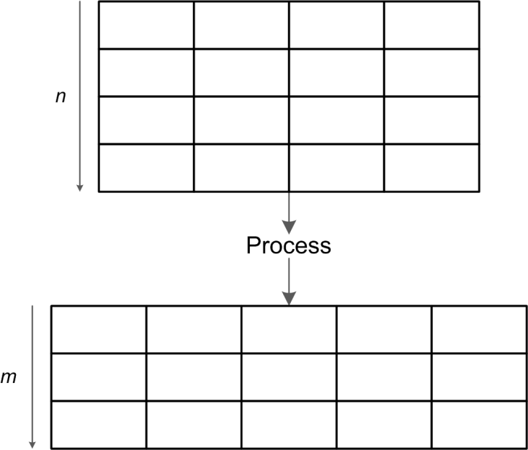
PROCESS: 1 RowSet in, 1out
A set of Rows in arbitrary order is streamed into a PROCESS command
Use a PROCESS to:
Filter or Expand Rows
Add/Remove columns
Compute values
A set of Rows in arbitrary order is streamed out of a PROCESS command

Slide 82

PROCESS: Script Example (1)
Use a PROCESS command to add a column, filter data, expand data, etc
PROCESS
PRODUCE A,B,C,D,E
USING MyProcessor;

Slide 83
PROCESS: Script Example (2)
PROCESS
PRODUCE A,B,C,D,E
USING MyProcessor
WHERE X > Y
HAVING A != B AND C.StartsWith("abc");
WHERE filters the input RowSet
HAVING filters the output RowSet

Slide 84
PROCESS: Script Example (3)
What does the MyProcessor code look like?
PROCESS
PRODUCE A,B,C,D,E
USING MyProcessor
WHERE X > Y
HAVING A != B AND C.StartsWith("abc");

Slide 85
PROCESS: Writing a Processor
public class MyProcessor : Processor
{
public override Schema Produces(string[] columns, string[] args
, Schema upstream)
{
return new Schema("A:int,B:double,C,D,E");
}
public override IEnumerable<Row> Process(RowSet input
, Row outputRow, string[] args)
{
foreach (Row row in input.Rows)
{
int A = row[0].Integer + 5;
double B = A * row[1].Double;
string C = row[0].String + row[3].String;
string D = C + B.ToString();
string E = C + row[2].String;
if (A > 10 || C.Contains("foo"))
{
outputRow[0].Set(A);
outputRow[1].Set(B);
outputRow[2].Set(C);
outputRow[3].Set(D);
outputRow[4].Set(E);
yield return outputRow;
}
}
}
}
Specify names and types
Transforms the data and adds an additional column
Filter the data
“yield” is the C# magic that allows Row objects to be passed through the system

Slide 86
REDUCE: 1RowSet in, 1 out
REDUCE commands are used to process all Rows in the system matching a key.
The input is grouped on keys and fed into a REDUCE command one key group at a time
Reduce
The Reducer can output zero or more Rows per key group

Slide 87
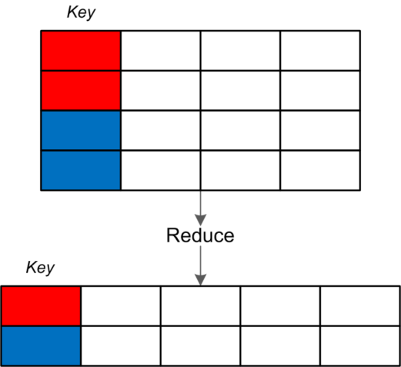
REDUCE: Script Example (1)
Use a REDUCE command to group on CID and output aggregated quantities
REDUCE
ON CID
PRODUCE CID,Queries,URLS,AvgTime,TotalTime
USING MyReducer;

Slide 88
REDUCE: Script Example (2)
REDUCE
ON CID
PRODUCE CID,Queries,URLS,AvgTime,TotalTime
USING MyReducer
PRESORT URL;
Use PRESORT to make sure that all Rows sharing CID are sorted by URL prior to entering the Reducer

Slide 89
REDUCE: Writing a Reducer
public class MyReducer : Reducer
{
public override Schema Produces(string[] columns
, string[] args
, Schema upstream)
{
return new Schema("A:int,B:double,C,D,E");
}
public override IEnumerable<Row> Reduce(RowSet input
, Row outputRow
, string[] args)
{
int count = 0;
foreach (Row row in input.Rows)
{
if (++count == 1)
{
row.Copy(outputRow);
}
}
outputRow[4].Set(count);
yield return outputRow;
}
}
Method signatures are almost identical to a Processor
Loop over the input data and perform whatever logic is necessary. Here were just appending one column with the count
Commonly, “yield” is used after processing all input Rows

Slide 90
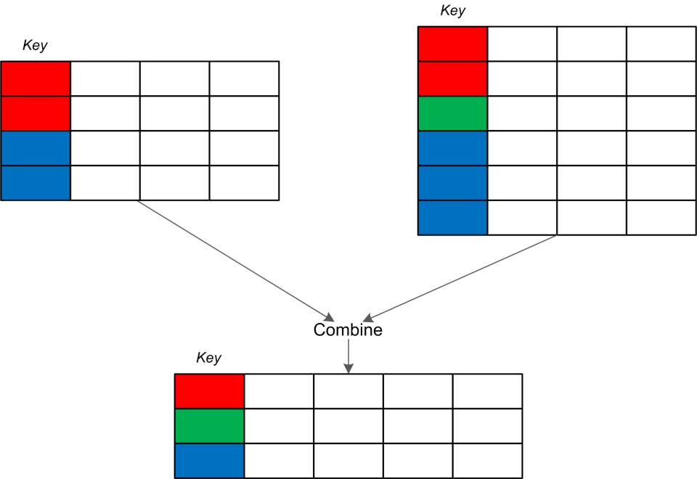
COMBINE: 2 RowSets in, 1 out
Takes two RowSets and produces zero or more Rows based on grouping keys
SCOPE guarantees that all Rows sharing a key will be processed in one call to the Combiner

Slide 91
COMBINE: Example
table1 = EXTRACT A,B,C,D
FROM "vol1/users/brams/sample.in"
USING DefaultTextExtractor;
table2 = EXTRACT A,B,C,D
FROM "vol1/users/brams/sample.in"
USING DefaultTextExtractor;
COMBINE table1 WITH table2
ON table1.A == table2.A
USING MyCombiner;
Group both inputs on the A columns

Slide 92
COMBINE: Writing a Combiner
#CS
public class MyCombiner : Combiner
{
public override Schema Produces( string[] columns, string[] args
, Schema left, string leftAlias
, Schema right, string rightAlias)
{
return new Schema(columns);
}
RowList list = new RowList();
// Make the RowList a member variable so its memory is reused by the many calls to Combine on this machine
public override IEnumerable<Row> Combine(RowSet left
, RowSet right
, Row output, string[] args)
{
_rowList.Load(right);
foreach(Row leftRow in left.Rows) { list.Add(leftRow); }
foreach(Row rightRow in right.Rows)
{
outputRow[1].Set(rightRow[0].String);
foreach(Row leftRow in list.Rows)
{
output[0].Set(leftRow [0].String);
yield return output;
}
}
}
}
#ENDCS
Note : Since we’re streaming Rows, you can only read a stream through once.

Slide 93
SCOPE: Views

Slide 94
Views
Like SQL Views, can filter or transform the underlying data
Unlike SQL, can have parameters
Type checked to avoid code injection
Can provide access to data you do not have direct access to
Most likely way your data is accessed
View Level Security handled by VCWS

Slide 95
Views: Writing a view
Parameters can be passed into the view
EXTRACT A,B
FROM @@input@@
USING MyExtractor;
EXPORT reduce = REDUCE extract
USING MyReducer
ON A
PRODUCE A,B,C;
Output variables must be named and must have an EXPORT attribute

Slide 96
Views: Using a view
EXTRACT A,B
FROM @@input@@
USING MyExtractor;
EXPORT reduce =
REDUCE extract
USING MyReducer
ON A
PRODUCE A,B,C;
Specify which “view” to use. Note, this is probably a VC path.
IMPORT "MyView.script" AS TheView
PARAMS input="sample.in";
SELECT C
FROM TheView.reduce;
EXTRACT A,B
FROM "sample.in"
USING MyExtractor;
EXPORT reduce =
REDUCE extract
USING MyReducer
ON A
PRODUCE A,B,C;
Specify which “view” to use.

Slide 97
SCOPE: References and Resources

Slide 98
USING and REFERENCE:
REFERENCE loads (.NET) assemblies. You can also refer to system assemblies as well
REFERENCE and USING can be in the same statement or different statements.
REFERENCE "MyLibrary.dll";
REFERENCE "System.Web.dll";
REFERENCE "MyLibrary2.dll" USING A.B.C;
USING System.Xml;
USING statement behaves like the C# “using” and simplifies SELECT, WHERE, and HAVING statements. It disambiguates object references in the USING clause of EXTRACT, PROCESS, REDUCE, etc.

Slide 99
RESOURCE:
RESOURCE allows you to provide metadata to your script
RESOURCE "urls.txt";
REFERENCE "MyLibrary.dll";
REFERENCE "System.Web.dll";
REFERENCE "MyLibrary2.dll" USING A.B.C;
USING System.Xml;

Slide 100
More information
http://cosmos
mailto:cosmos

Slide 101
Workshop
Let’s write some scripts!

Slide 102
Workshop 101
Please create a new directory
mkdir Scope
cd Scope
Get SCOPE and other Cosmos client tools
Copy \\sasch1034101\Releases\Cosmos2ClientTools\Versions\Current\amd64 (sorry about the long path, you’ll never have to type it again)
Update
Get workshop files
Copy \\sasch1034101\Releases\ScopeWorkshops\101
Run SCOPE
Just type “scope”

Slide 103
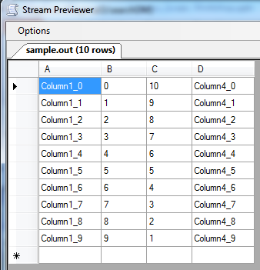
Hello World: Extract
Load “exercise1.script”:
Run by hitting F5
Observe results grid
Compare with text in sample.in!
EXTRACT A,B,C,D
FROM "sample.in"
USING DefaultTextExtractor;
OUTPUT TO "sample.out";

Slide 104
Hello World: SELECT
Change the script and run again:
Notice that the output is the same!
You’ll rarely need to use EXTRACT.
SELECT A,B,C,D
FROM "sample.in"
USING DefaultTextExtractor;
OUTPUT TO "sample.out";

Slide 105
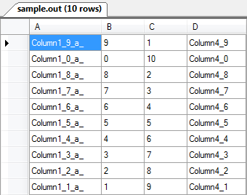
Hello World: SELECT (2)
You can have (C#) expressions in SELECT list
You can sort output:
But watch out for numeric strings!
SELECT A + "_a_" AS A,B,C,D
FROM "sample.in"
USING DefaultTextExtractor;
OUTPUT TO "sample.out";
SELECT A + "_a_" AS A,B,C,D
FROM "sample.in"
USING DefaultTextExtractor ORDER BY C;
OUTPUT TO "sample.out";

Slide 106
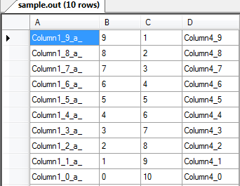
Hello World: SELECT (3)
Change the script and run:
Notice that the third column is now integer
Sorting obeys data type
SELECT A + "_a_" AS A, B, int.Parse(C)AS C,D
FROM "sample.in"
USING DefaultTextExtractor;
OUTPUT TO "sample.out";

Slide 107
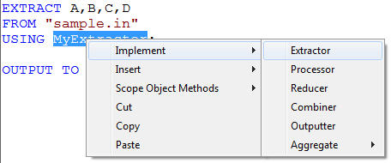
SCOPE Objects: Extractor
Reload exercise1.script (or exercise1_backup.script)
Save as MyExtractor.script (so you can keep it)
Then:
Highlight “DefaultTextExtractor”
Replace with “MyExtractor”
Right click on “MyExtractor”
Select “Implement”
Select “Extractor”
Admire inserted text
#CS / #ENDCS section
Class Extractor implements Produces() and Extract() methods.
Does it run?

Slide 108
The “Produces” Method
Declares the output RowSet column types
Called at Compile-time only
Returns whatever columns it was called with (but all Strings)
Ignores user’s list of columns, but specifies data type of output RowSet
public override Schema Produces(string[] columns, string[] args)
{
return new Schema(columns);
}
return new Schema("A,B,C:int,D,X:int");

Slide 109
The “Extract” Method
Provides the content of each row at runtime
This one simply parses columns from tab-delimited text lines.
public override IEnumerable<Row> Extract(StreamReader reader, Row output, string[] args)
{
string line;
while ((line = reader.ReadLine()) != null)
{
string[] tokens = line.Split('\t');
for (int i = 0; i < tokens.Length; ++i)
{
output[i].Set(tokens[i]);
}
yield return output;
}
}

Slide 110
Parameters in SCOPE Objects
Note the: string[]args) in parameter list
You can pass parameters into SCOPE objects!
Exercise: Add a “-toUpper” parameter to MyExtractor which forces all columns to upper case.
Hint: String.ToUpper()
Run script with and without the parameter value, compare results

Slide 111
Aggregates – SUM, MIN, MAX, AVG, Count
Familiar aggregates are available
But our data has distinct keys, what to group by?
Let’s make up non-distinct keys!
Modify exercise1.script
Add SELECT
Or open aggregate_exercise
Run and observe A_Key column
statement1 = EXTRACT A,B,C,D
FROM "sample.in"
USING DefaultTextExtractor;
SELECT A
, int.Parse(B) AS B
, int.Parse(C) AS C
, D
, (int.Parse(A.Substring(8)) % 3) AS A_Key
FROM statement1;
OUTPUT TO "sample.out";

Slide 112
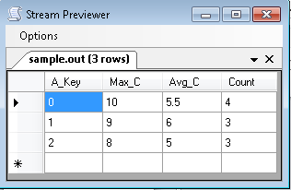
Aggregates – SUM, MIN, MAX, AVG, Count
Now add this statement:
Don’t need GROUP BY, SCOPE automatically groups by all non-aggregate columns.
(But you can specify GROUP BY, if you must.)
SELECT A_Key
, MAX(C) AS Max_C
, AVG(C) AS Avg_C
, COUNT()AS Count;

Slide 113
REDUCE and Reducer
REDUCE processes all rows with same set of keys. Your Reducer can do *any* calculation involving those rows!
For this exercise, let’s return A from the current row and D from the immediately previous row within the same key.
Yes, you could do this with a self-join, but maybe not on 5 billion rows!
From exercise_aggregate.script, remove the SELECT statement and add:
Highlight “MyReducer”
Right-click
Select Implement→Reducer
REDUCE //A, B, C, D, A_Key
ON A_Key
PRODUCE A_Key, Cur_A, Prev_D
USING MyReducer
PRESORT A; // note: bad for perf, good for sample!

Slide 114
The “Produces” Method
Says what the output types should be
Called at Compile-time only
This Reducer always returns A_Key:int, Cur_A:String, Prev_D:String
public override Schema
Produces(string[] columns, string[] args, Schema input)
{
return new Schema("A_Key:int, Cur_A, Prev_D");
}

Slide 115
The “Reduce” Method
This exercise returns A from the current row and D from the previous row within the same key.
public override IEnumerable<Row> Reduce(RowSet input, Row output, string[] args)
{
bool firstRow = true;
String prev_D = "uninitialized";
foreach(Row row in input.Rows)
{
if (! firstRow)
{
row[4].CopyTo(output[0]); // A_Key <-- key for the group
row[0].CopyTo(output[1]); // Cur_a <-- col A from input
output[2].Set(prev_D); // Prev_d <-- col D from previous row
yield return output;
}
prev_D = row[3].String;
firstRow = false; // why not rowCount ++ ?
}
}

Slide 116
Conclusion:
There’s a lot of data out there
Use it to improve your service!

