Slide 1
Evaluation of Commonsense Knowledge Statements
Joint Reasoning for Multi-Faceted Commonsense Knowledge
ADAPT Seminar ∙ 21st October 2020
Ilena (Yanzhu Guo)

Slide 2
Outline
Motivation
Multi-faceted CSK model
Joint reasoning approach
Experiements
Results
Conclusions
Discussions

Slide 3
Commonsense Knowledge Bases (CSKBs)
Store structured knowledge about general-world concepts
Lions; eat; chicken
Lions; attack; humans
Lions; drink; water
Construction of CSKBs has received a lot of attention in recent years
ConceptNet(MIT), TupleKB(AllenAI), Quasimodo(MPII), ...
Shortcomings:
1.Underspecified or narrow evaluation metrics
2.Statements extracted/consolidated independently

Slide 4
Evaluation metrics
The semantics we apply to tuples (and which we explain to Turkers) is one of plausibility: if the fact is true for some of the arg1’s, then score it as true.
[TupleKB]
Remarkability of terms is captured via inverse document frequency (IDF)
[Information theory 101]
/r/CapableOf | Something that A can typically do is B.
/r/AtLOcation | A is a typical location of B, or A is the inherent location of B.
/r/Causes | A and B are events, and it is typical for A to cause B.
/r/LocatedNear | A and B are typically found near each other. Symmetric.
In WebChild’s evaluations we asked for plausibility
[WebChild]
The goal of this model is to advance the automatic acquisition of salient commonsense properties from online content of the internet.
[Quasimodo]
[ConceptNet]

Slide 5


Evaluation metrics :
Plausibility, Typicality, Remarkability, Salience
Plausibility :
Is the property valid at least for some instances of the concept, for at least some spatial, temporal or socio-cultural contexts?
Lions; eat; meat
Lions; read; books

Slide 6
Evaluation metrics :
Plausibility, Typicality, Remarkability, Salience
Typicality :
Does the property hold for most (or ideally all) instances of the concept for most contexts?
Lions; drink; water
Lions; attack; humans

Slide 7
Evaluation metrics :
Plausibility, Typicality, Remarkability, Salience
Remarkability :
What are specific properties of a concept that sets the concept apart from highly related concepts like taxonomic generalizations (hypernyms in a concept hierarchy)?
Lions; eat; meat
Lions; live; in prides

Slide 8
Evaluation metrics :
Plausibility, Typicality, Remarkability, Salience
Salience :
When humans are asked about a concept, would a property be listed among the concept’s most notable traits?
Lions; drink; water
Lions; hunt; in packs

Slide 9
What are these four dimensions useful for ?
Example :
language understanding for chatbots
Plausibility helps to detect absurd statements and react adequately.
Typicality helps a chatbot to infer missing context.
Remarkability can be a signal for the chatbot to infer which concept the human is talking about.
Salience enables the chatbot to focus on key properties.

Slide 10
Form of CSK statements : (s, p) pairs
Prior works : SPO triple model
Combintion of P and O into property :
The split between P and O is often arbitrary
lions; live in; prides vs. lions; live; in prides
CSK is so diverse that predicate names have highly varying granularities

Slide 11



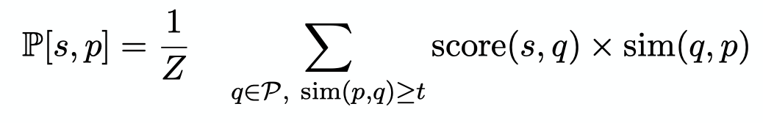

Multi-Faceted CSK model : Basic scores
score(s, p) : Confidence score based on observation frequencies / human assessment
: Necessity : Sufficiency
: Entailment
: Taxonomy-based information gain

Slide 12
Multi-Faceted CSK model : Score aggregation
Regression model
Basic scores Prior scores
Training data : small set of hand-annotated CSK statements
π(s,p) : plausibility
τ(s,p) : typicality
ρ(s,p) : remarkability
σ(s.p) : salience

Slide 13
Isolated statement treatment
Problem :
For each candidate statement, evidence is collected independantly
Resulting CSKBs are incoherent
Resulting CSKBs are sparse

Slide 14

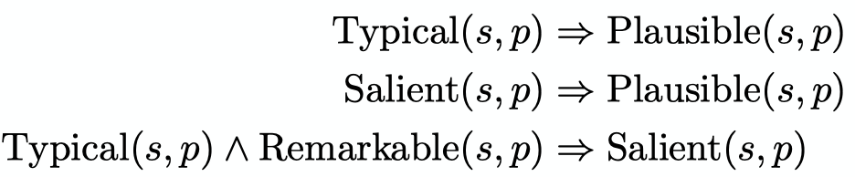
Joint reasoning :
Concept-dimension dependencies

Slide 15
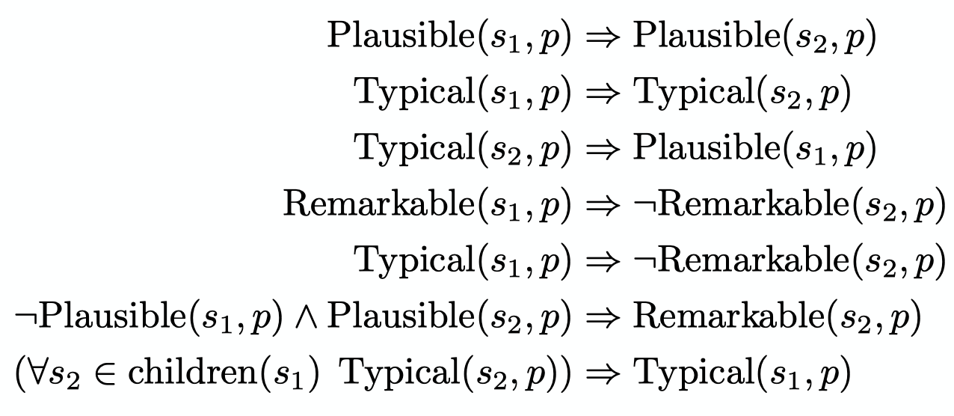
Joint reasoning :
Parent-child dependencies

Slide 16

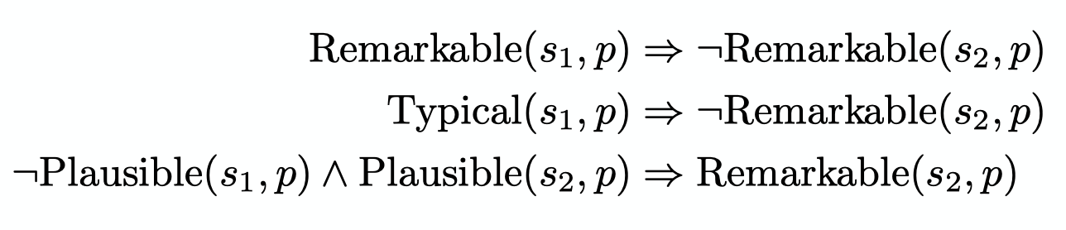
Joint reasoning :
Sibling dependencies

Slide 17

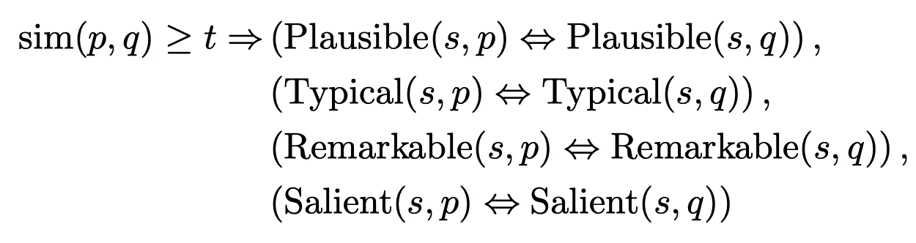
Joint reasoning :
Expansion to similar properities

Slide 18
Joint reasoning :
Grounding of constraints with candidate statements
Existing (s,p) pairs from previous CSK collections
Taxonomic expansions from high-confidence relationships of the WebIsALOD taxonomy
Similarity expansions for pairs of predicates exceeding a similarity threshold
Deals with noise and sparsity

Slide 19
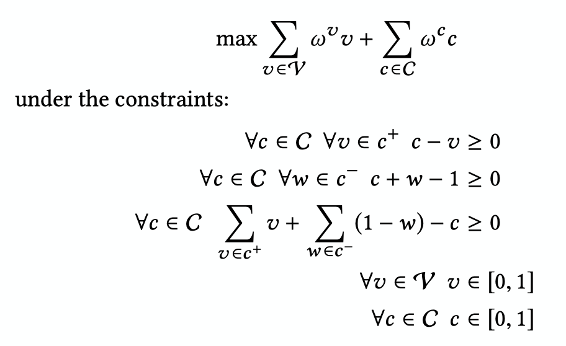
Joint reasoning : Implementation
Constraint reasoning encoded into MaxSAT
Efficient solving via ILP

Slide 20
Experiments: Evaluation
ConceptNet, Quasimodo, TupleKB, Music-manual
Crowdsourcing project using Amazon Mechanical Turk
Pairwise statement preference
Which of the following is more typical?
Lions drink water.
Lions kill humans.
200 concepts each with 2 properties from each of the CSK collections

Slide 21
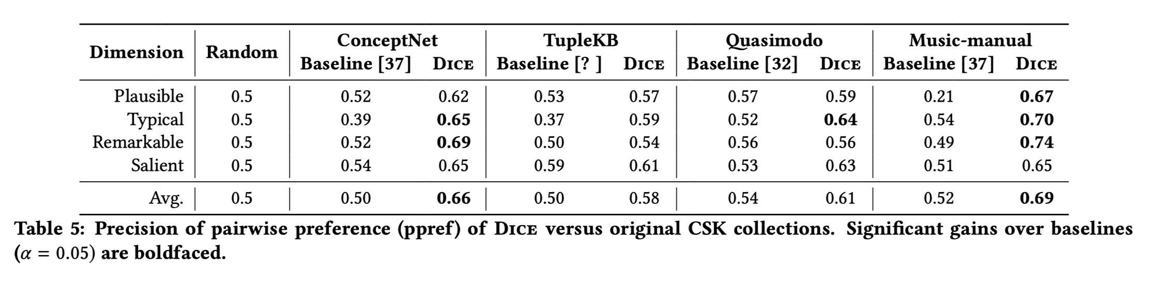
Results: Quality of rankings

Slide 22
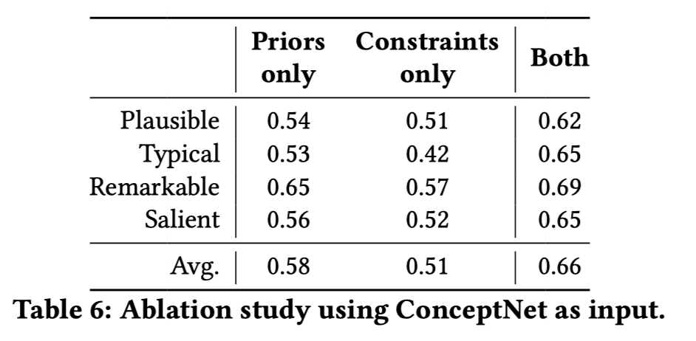
Results: Ablation Study

Slide 23
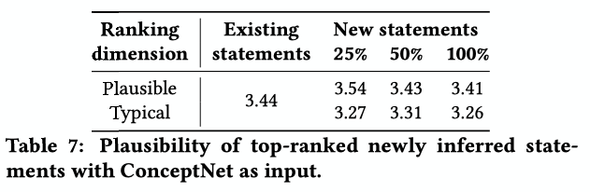
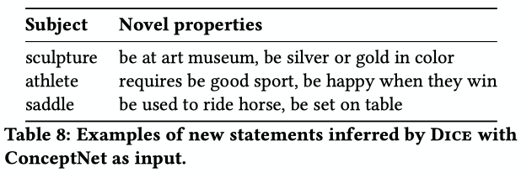
Results: Enrichment potential

Slide 24
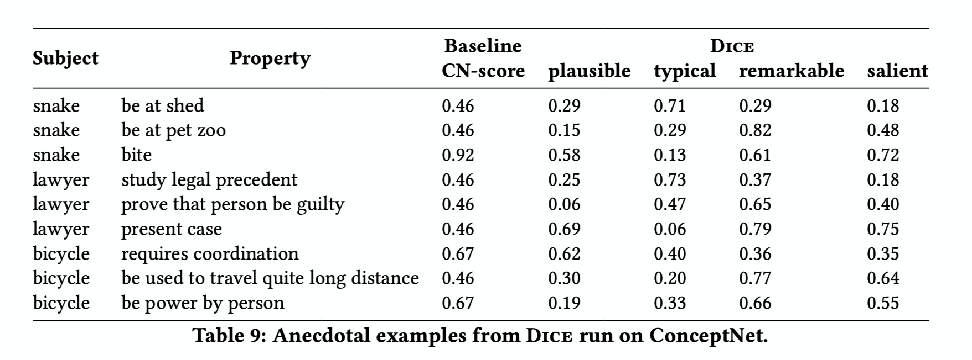
Results: Anecdotal examples

Slide 25
Conclusions
Dice : A joint reasoning framework for CSK that incorporates inter-dependencies between statements
Captures more expressive meta-properties of concept-property statements along the four dimensions of plausibility, typicality, remarkability and saliency
Helps deal with noise and sparsity of prior CSK collections
Useful for downstream tasks

Slide 26
Discussions :
Based on Open-review comments
Salience is too subjective : depends on cultural and social backgrounds
Using word-level embeddings for similarity computation is not generalizable
Scores are not comparable across the four dimensions

