Slide 1
False Rumor Detection on Sina Weibo by Propagation Structures
Wu Ke keer236@126.com
Yang Song blue-snow@sjtu.edu.cn

Slide 2
Overview
Introduction
Problem Definition
Approach
Propagation structures
Graph kernel
Features
Hybrid Kernel
Evaluation

Slide 3
Introduction
Some Examples of false rumor:
女性月经期间洗头会加速致癌机率
拍死正在吸血的蚊子可致人死亡
吃转基因食物等于慢性自杀
将银行卡密码倒着输入ATM机可报警
膨大增甜剂导致西瓜爆炸, 危害人体神经系统
Rumor: A currently circulating story or report of uncertain or doubtful truth
False rumor: A rumor that turn out to be false.
(misinformation, disinformation)

Slide 4
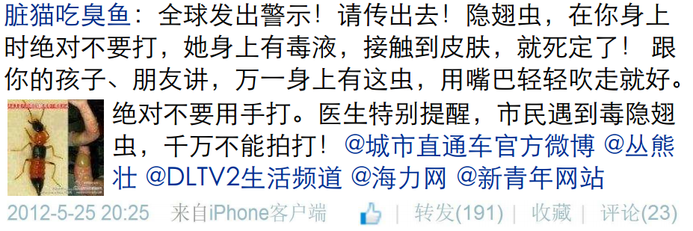
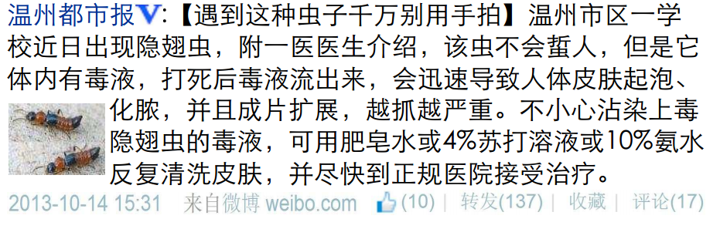
Introduction
So…This is a difficult problem, even for human!

Slide 5
Problem Definition
Whole weibo data = Forest of message propagation trees W
A message thread = A propagation tree T
Each message text = One node of propagation tree m
Original message = Root of propagation tree Root(T)
Reposting relationship = Father-child relationship
Each message is associated with its creator, its create time, client from which the message is sent and optional images
= meta data of m (u, t, c, i)

Slide 6
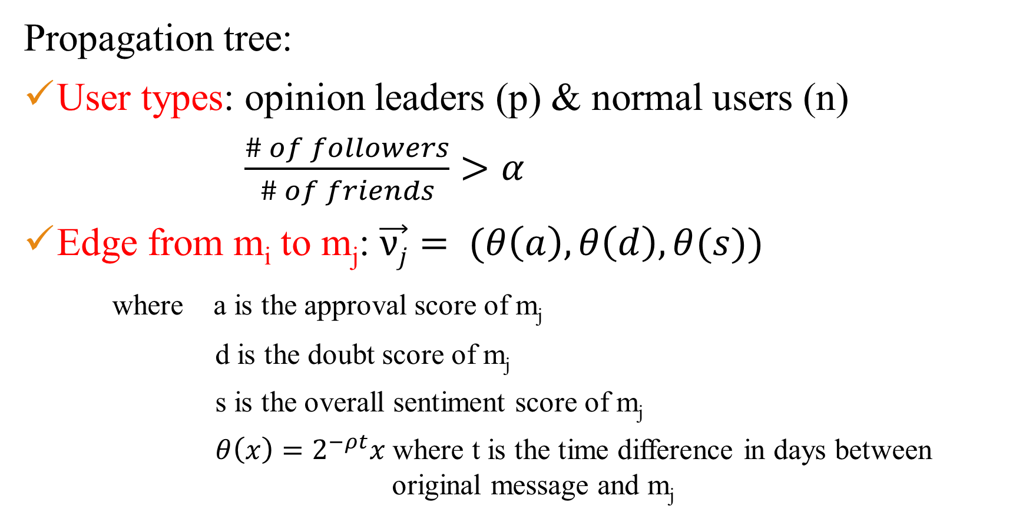
Approach
Propagation tree:
User types: opinion leaders (p) & normal users (n)
$\frac{\# of followers}{\# of friends}>α$
Edge from m_{i} to m_{j}: $\vec{νj}= (θ\left(a\right),θ\left(d\right),θ(s))$
where a is the approval score of m_{j}
d is the doubt score of m_{j}
s is the overall sentiment score of m_{j}
$θ\left(x\right)=2^{−ρt}x$ where t is the time difference in days between original message and m_{j}

Slide 7
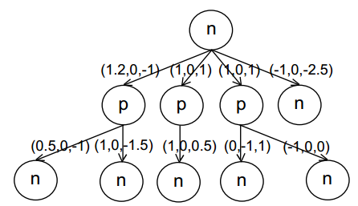
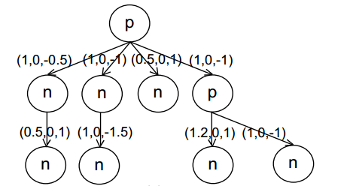
Approach
False rumor:
Normal message:

Slide 8
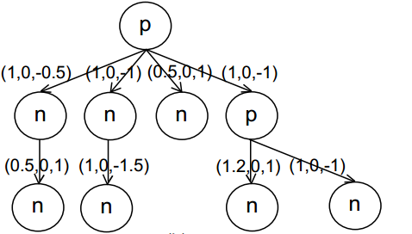
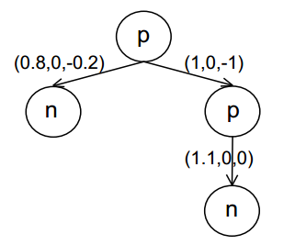
Approach
Sina weibo: 50 million active users
The propagation tree of a popular message might gets extremely large
Simplify a tree by lumping adjacent normal user nodes together to form one super node

Slide 9
Approach
Idea: If two trees are similar, then they might be both false rumors or normal messages
Similarity of two trees:
Tree kernel: subset tree, subtree
Graph kernel: random walk

Slide 10
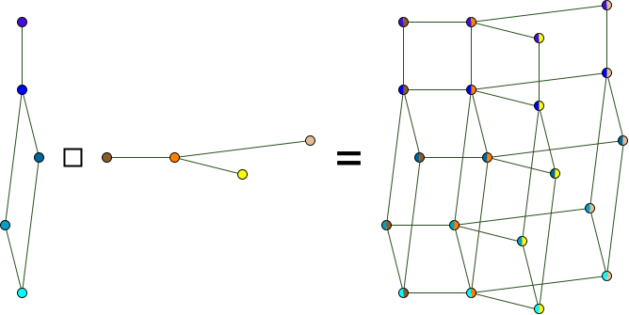


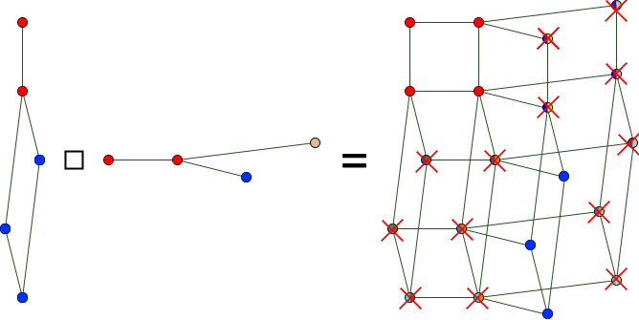
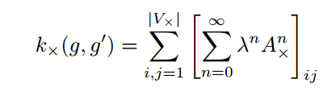
Approach
Basic idea:
If two men start random walking at the roots of two tress, how much possibility that they will walk the same path (same node type, similar edge)

Slide 11
Approach
Extract 23 features from each message propagation tree to build a vector for Radial Basis Function(RBF) kernel.
Message based: has URL, client, time span, etc.
User based: is verified, gender, number of followers, etc.
Repost based: number of reposts, average sentiment, etc.

Slide 12
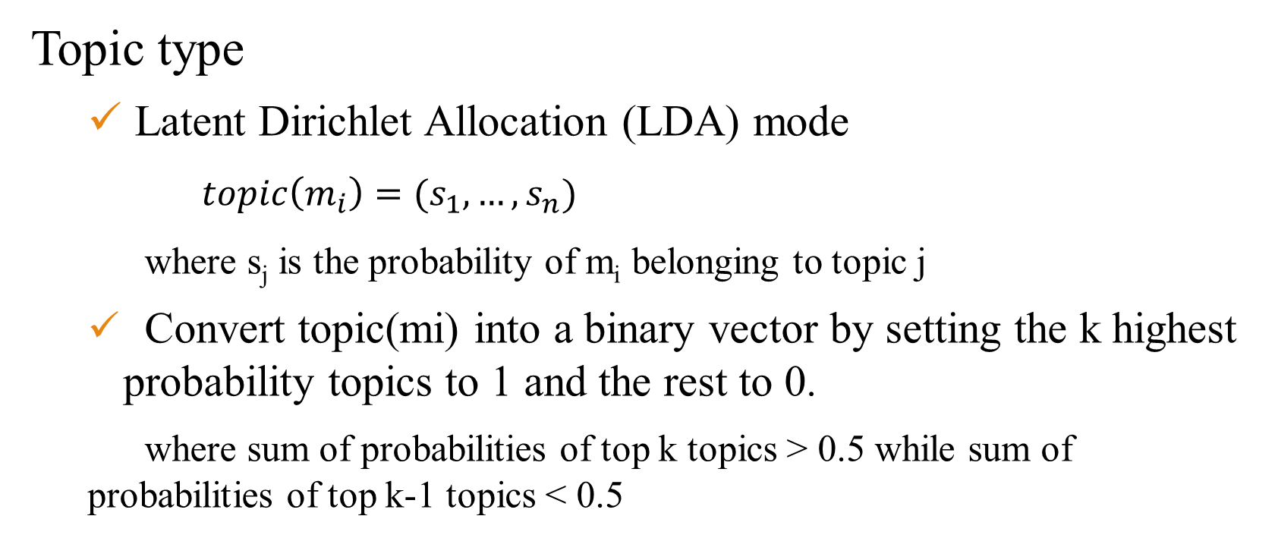
Approach
Topic type
Latent Dirichlet Allocation (LDA) mode
$topic\left(m_{i}\right)=(s_{1},…,s_{n})$
where s_{j} is the probability of m_{i} belonging to topic j
Convert topic(mi) into a binary vector by setting the k highest probability topics to 1 and the rest to 0.
where sum of probabilities of top k topics > 0.5 while sum of probabilities of top k-1 topics < 0.5

Slide 13
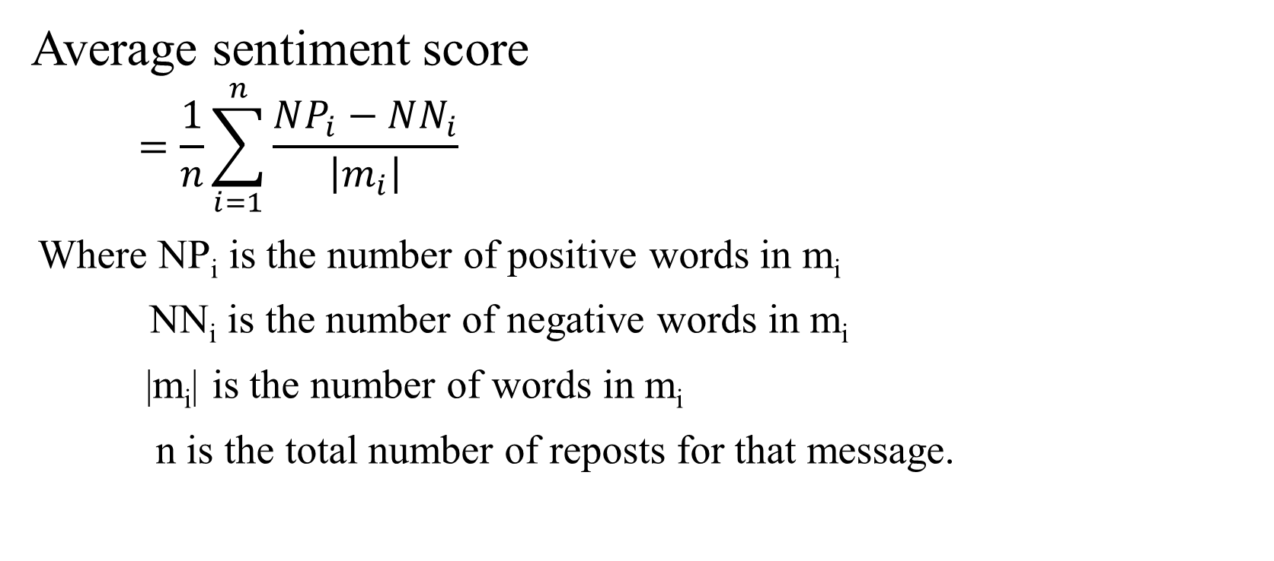
Approach
Average sentiment score
$$=\frac{1}{n}\sum_{i=1}^{n}{\frac{NP_{i}−NN_{i}}{\left|m_{i}\right|}}$$
Where NP_{i} is the number of positive words in m_{i}
NN_{i} is the number of negative words in m_{i}
|m_{i}| is the number of words in m_{i}
n is the total number of reposts for that message.

Slide 14
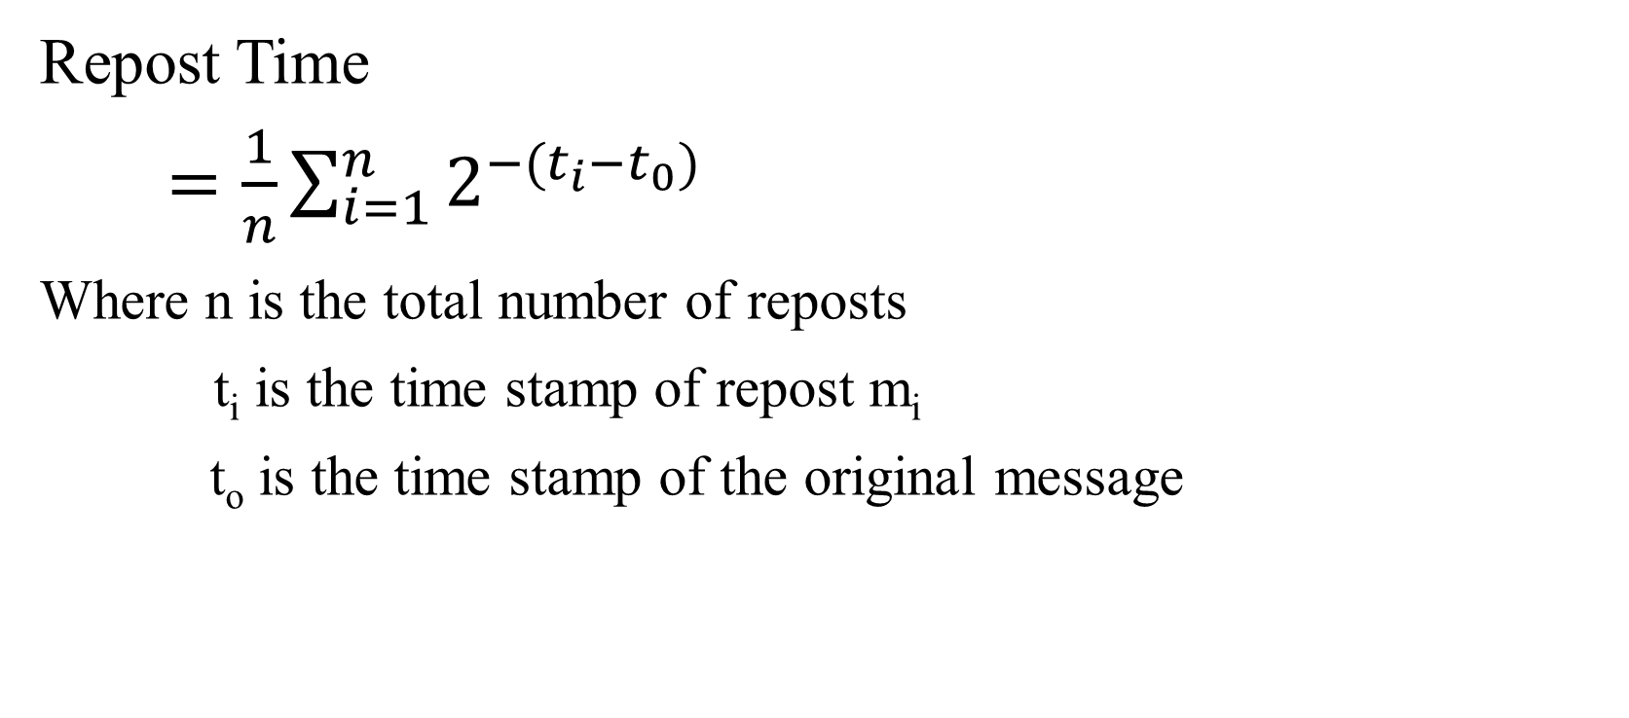
Approach
Repost Time
$=\frac{1}{n}\sum_{i=1}^{n}{2^{−(t_{i}−t_{0})}}$
Where n is the total number of reposts
t_{i} is the time stamp of repost m_{i}
t_{o} is the time stamp of the original message

Slide 15
Approach
Hybrid kernel:
Where T_{i} is the propagation tree of m_{i}
X_{i} is the feature vector of m_{i}

Slide 16
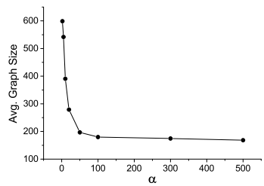
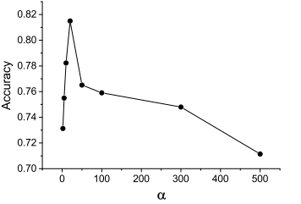
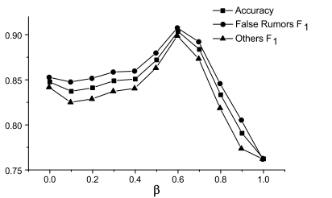

Evaluation
Training parameters:
$\frac{\# of followers}{\# of friends}>α$
$α$ = 20
$K\left(T_{i},T_{j}\right)=βK\left(T_{i},T_{j}\right)+\left(1−β\right)K\left(X_{i},X_{j}\right)$
β = 0.6

Slide 17
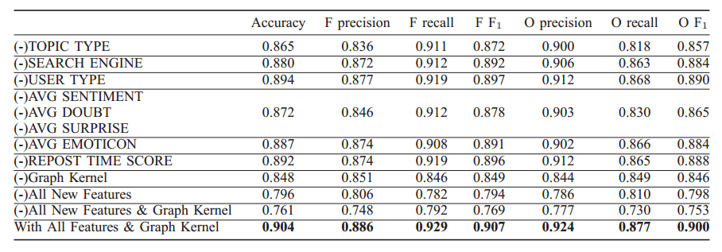
Evaluation
Feature selection:

Slide 18
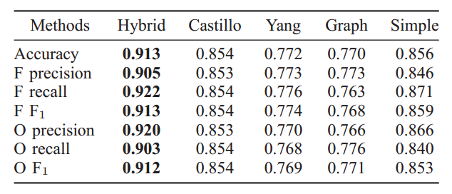
Evaluation
End-to-end comparison:
Dataset: 2601 false rumors and 2536 normal messages manually labeled
Two other false rumor detection algorithms: Castillo, 2011 and Yang, 2012
Baselines: using only Graph kernel, using simple graph features instead of graph kernel

Slide 19
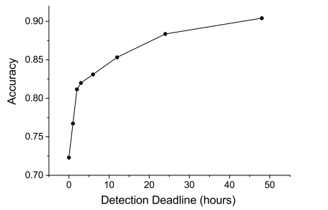
Evaluation
False rumor early detection:
Given a detection deadline, we assume all reposts and related information published after this deadline are invisible when testing the model of the classifier.
The sooner the deadline, the less data of reposts and hence the propagation structures can be used.
A deadline of 0 hours means that we will not use any repost data except the original messages themselves.

Slide 20
Thanks for listening!
Wu Ke keer236@126.com
Yang Song blue-snow@sjtu.edu.cn

