Slide 1
Action Conceptualization
Yu Gong, Kaiqi Zhao, Kenny Q. Zhu
Notes:
Good afternoon everyone, this talk I will present is about the project I did called Action Conceptualization.
It was submitted to ICDE 2014.

Slide 2
Outline
Introduction
Problem Definition
Approach
Experiment Setup
Evaluation
Future Work
Notes:
The outline of the talk is as follows.
First, I will give the introduction.
Second, I will present the definition of our problem.
And the approach we proposed in the paper.
Then, I will discuss the experiment and evaluation.
In the last, I will talk about some future work.

Slide 3



Introduction
Why we need action conceptualization?
Backgrounds
Most work on text understanding focuses on the semantics of nouns or noun phrases.
They always leverage popular noun-centric knowledge bases.
e.g. YAGO, TextRunner, Google Knowledge Graph and Probase
Notes:
So why we need action conceptualization?
Here are some backgrounds:
First,…
Second, …

Slide 4
Introduction
Why we need action conceptualization?
Limitation
However, capturing nouns can be insufficient in understanding a sentence.
Example 1. mary didn’t wear the ring today.
Example 2. mary is wearing pink today.
Notes:
However, capturing nouns can be insufficient in understanding s sentence.
Take the following examples.
Example 1: mary didn’t wear the ring today
Example 2: mary is wearing pink today

Slide 5
Introduction
Why we need action conceptualization?
Limitation
However, capturing nouns can be insufficient in understanding a sentence.
Example 1. mary didn’t wear the ring today.
Example 2. mary is wearing pink today.
an accessory, a novel
or a movie
…
an style,
a popular singer,
or a magazine
…
Notes:
Without the verb wear, the ring can refer to either an accessory, a novel or a movie.
While, pink can be anything from a style, a popular singer or a magzine.

Slide 6
Introduction
Why we need action conceptualization?
Limitation
However, capturing nouns can be insufficient in understanding a sentence.
Example 1. mary didn’t wear the ring today.
Example 2. mary is wearing pink today.
If we know the noun concepts,
Example 1
[person] [accessory]
Example 2
[person] [style]
Notes:
Even if we knew that the ring is an accessory and pink is a style, we are still not able to capture the meaning of the entire sentence.
Like the noun concepts we obtain from the two examples, a person could buy or steal an accessory; and a person could wear, like or even
hate a style.
So, without specifying the verb, the meaning of the sentence is incomplete.

Slide 7

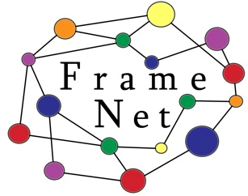

Introduction
Why we need action conceptualization?
Conclusion
To fully understand a sentence, we not only needs to understand the nouns but also the verbs.
Notes:
So we can conclude that, to fully understand a sentence, we not only needs to understand the nouns but also the verbs.

Slide 8
Introduction
Related Techniques (SRL & ReVerb)
Semantic Role Labeling (SRL)
Use a lexicon to define the semantic roles of the arguments of that verb.
e.g. FrameNet, PropBank or ReVerb
Notes:
Here are some techniques we can use.
The first one is semantic role labeling.
It captures the semantics of verbs by automatically identifying the sense of a verb
and annotating the roles of the arguments of that verb.
It will use a lexicon to define the semantic roles of the arguments of that verb.
For example, FrameNet, PropBank or ReVerb

Slide 9
Introduction
Related Techniques (SRL & ReVerb)
Semantic Role Labeling (SRL)
Three limitations of such lexicons:
Human annotation is required, which limits their scales.
The frames are course-grained, making them unable to tell the difference between two close senses.
Semantic roles in SRL are used as labels only, which is not readable by human.
Notes:
However, there are three main limitations of such lexicons:
First, human annotating is required, which limits their scales.
Second, the frames are course-grained, making them unable to tell the difference between two close senses.
Moreover, semantic roles in SRL are used as labels only, which is not readable by human.

Slide 10
Introduction
Related Techniques (SRL & ReVerb)
ReVerb
It is too fine-grained.
It is an open information extraction system to discovers verb triples from web.
It is lack of abstraction:
a system powered by ReVerb will not recognize a verb and its arguments unless it has this triple in the knowledge.
Notes:
If SRL lexicons provide only coarse-grained semantics, then ReVerb lies on the other end of the spectrum.
ReVerb is an open information extraction system to discovers verb triples from web.
It is lack of abstraction, so a system powered by ReVerb will not recognize a verb and its arguments
unless this triple is in the knowledge.

Slide 11
Introduction
Definition
Action Instance
a verb and its immediate argument such as subject or object
e.g. wear/pink
Action Concept
a high level abstraction of action instances, which contains the verb and the abstract concepts of its subject or object
e.g. wear/style
Notes:
In this paper, we define action instance as a verb and its immediate argument such as subject or object.
And action concept as a high level abstraction of action instances,
which contains the verb and abstract concepts of its subject or object.
For example, wear/pink is action instance and wear/style is the corresponding action concept.

Slide 12
Introduction
The Goal
To develop a framework to produce a general purpose, human readable, and machine computable lexicon of action concepts that documents the semantics of common verbs.
The lexicon will overcome the limitations of SRL lexicons and ReVerb.
Notes:
In this paper, our goal to develop a framework to produce a general purpose, human readable, and machine computable lexicon of action concepts that documents the semantics of common verbs.
Furthermore, the lexicon will overcome the limitations of SRL lexicons and ReVerb.

Slide 13
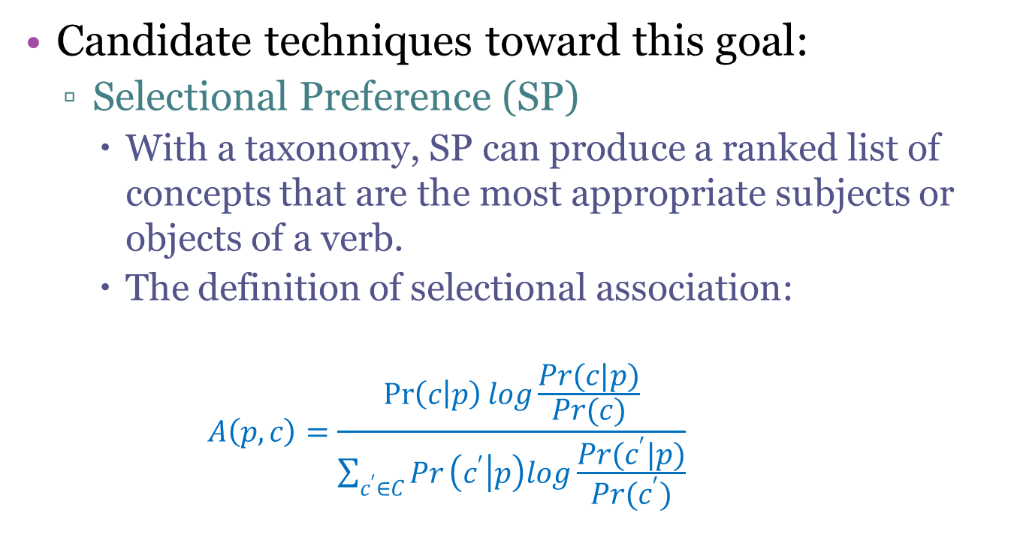
Introduction
Candidate techniques toward this goal:
Selectional Preference (SP)
With a taxonomy, SP can produce a ranked list of concepts that are the most appropriate subjects or objects of a verb.
The definition of selectional association:
$$A\left(p,c\right)=\frac{\operatorname{Pr}\left(c | p\right)log\frac{Pr(c|p)}{Pr(c)}}{\sum_{c^{′}∈C}{Pr}\left(c^{′} | p\right)log\frac{Pr(c^{′}|p)}{Pr(c^{′})}}$$
Notes:
One candidate technique toward this goal is selectional preference originally proposed by Resnik.
Together with a taxonomy, SP can produce a ranked list of concepts that are the most appropriate subjects or objects of a verb.
And the definition of the selectional association is as follows.

Slide 14
Introduction
Candidate techniques toward this goal:
Selectional Preference (SP)
The limitations:
Not consider the diversity of concepts, which may give a list of concepts with the same meaning.
It assumes every argument to the verb is correct and contributes to the selectional strength, but action instances obtained by parsing are often noisy and contain errors.
Notes:
But the drawbacks of SP are that:
First, it dosen’t consider the diversity of concepts, which may give a list of concepts with the same meaning.
Second, it assumes every argument to the verb is correct and contributes to the selectional strength,
But action instances obtained by parsing are often noisy and contain errors.

Slide 15
Introduction
Candidate techniques toward this goal:
Action Conceptualization (AC)
It is defined well in our paper.
We model the action conceptualization problem as a combinational optimization problem.
It is proved NP-hard.
We propose an efficient algorithm to solve it approximately.
Notes:
Therefore, in this paper we propose a problem called Action Conceptualization.
It is defined well in our paper.
Then we model the action conceptualization problem as a combinational optimization problem. And it is proved NP-hard.
So, we propose an efficient algorithm to solve it approximately.

Slide 16
Introduction
Example object concepts/roles/types from 4 lexicons
Verb | Action (Concepts) | FrameNet (Roles) | ReVerb (Types) | SP (Concepts)
eat | food plant dish | Ingestible | art subject Organism class character species | food word habit
wear | clothing style accessory | Clothing | garment Invention collection category | competition clothing item clothing
spend | time money fund | Resource | industry organization sector art subject | time period time period
Notes:
Here is the example from the 4 lexicons.
In the table, you can find that FrameNet is too course-grained, but ReVerb is too fine-grained.
While SP may generate some similar concepts, like the verb spend.
Meantime, SP may obtain the wrong concepts, because it assumes every argument to the verb is correct
and contributes to the selectional strength.
Like the verb eat, which prefers the concept “word”, which actually is a mixture of many wrong terms captured under SP.

Slide 17
Introduction
Applications of the lexicon:
Argument identification
e.g. XXX wears a rhinestone pin
rhinestone pin isA accessory
wear/accessory wear/rhinestone pin
Word sense disambiguation
Verb clustering to get action frames
Term similarity computation
Notes:
The action concept lexicon developed in this paper can be useful in several ways.
First, it can be used to determine whether a term is a logical argument of a verb, even though we have never seen the term used with the verb before.
Take the following example, we have never seen “wear a rhinestone pin”.
But since the lexicon tells us “accessory” is a permissible concept to act as object for the verb “wear”, and a common taxonomy tells us “rhinestone pin” is a kind of accessory, we can then conclude that “rhinestone pin” is a potential object for the “wear”.

Slide 18
Problem definition
Informal definition
Given a collection of argument instances (either subjects or objects) for a verb;
Pick k concepts from the taxonomy that cover as many instances as possible;
We would like these k concepts to have little overlap against each other.
Notes:
We begin with an informal definition of the action conceptualization problem

Slide 19
Problem definition
Informal definition
Intuition
Each of the k selected concepts represents a unique semantic and the k concepts collectively cover majority of the uses of that verb.
Example
Action Instances:
wear/{t-shirt, hoodie, hat, bracelet, ear ring, pink}
Action Concepts:
wear/{clothing, accessory, style}
Notes:
The intuition is that …
For example, if we have action instances like wear t-shirt, wear hat, wear bracelet, wear ear ring and wear pink.
Then the action concepts should be wear clothing, wear accessory and wear style.

Slide 20
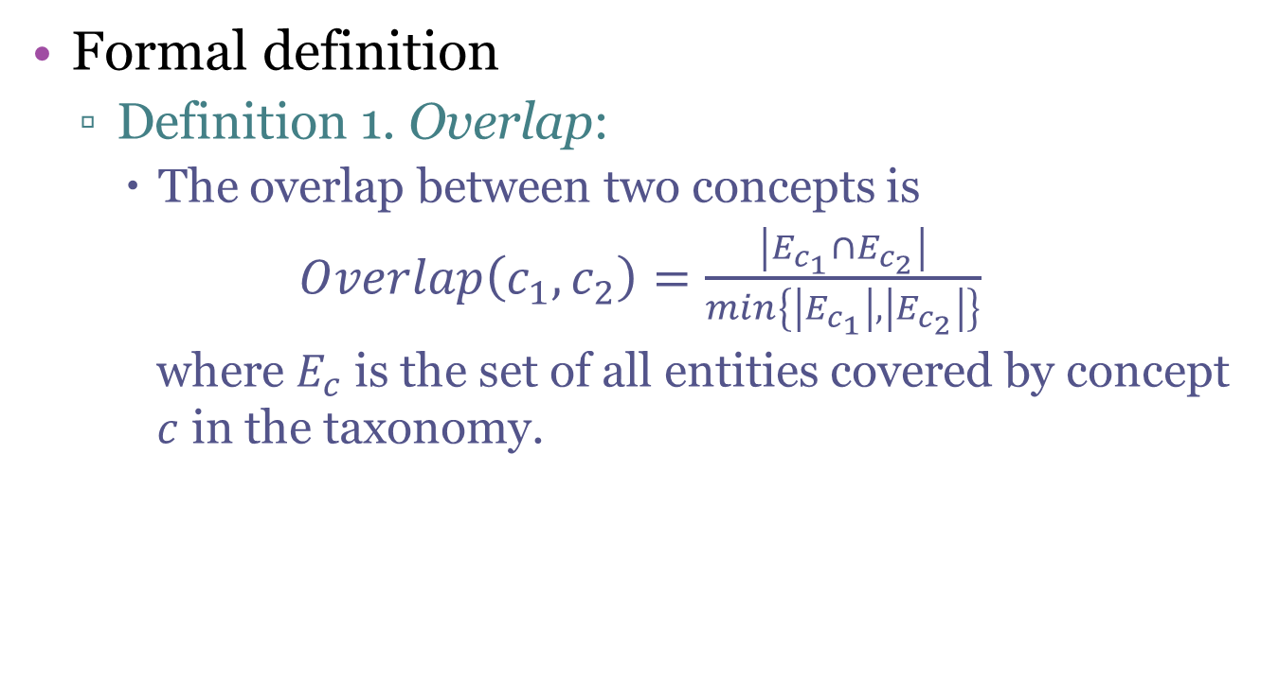
Problem definition
Formal definition
Definition 1. Overlap:
The overlap between two concepts is
$Overlap\left(c_{1},c_{2}\right)=\frac{\left|E_{c_{1}}∩E_{c_{2}}\right|}{min\left\{\left|E_{c_{1}}\right|, \left|E_{c_{2}}\right|\right\}}$
where $E_{c}$ is the set of all entities covered by concept $c$ in the taxonomy.
Notes:
Now we first give the definition of the overlap between two concepts.
The overlap between concept c1 and c2 is the size of Ec1 intersected with Ec2 divided by the smaller size of Ec1 and Ec2.
Where Ec is the set of all entities covered by concept c in the taxonomy.

Slide 21
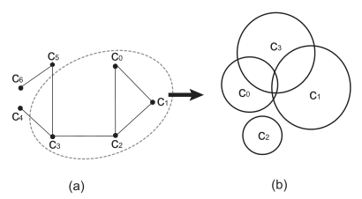
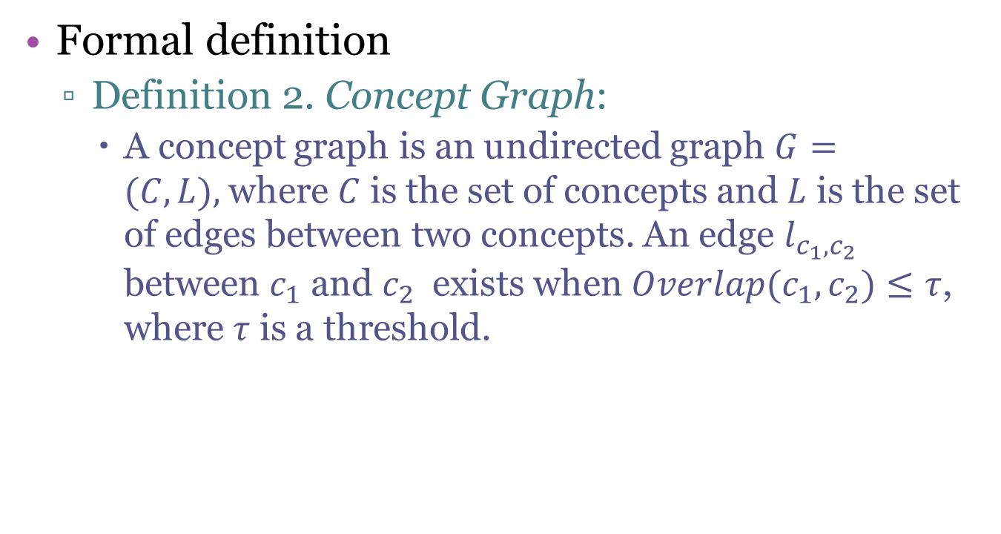
Problem definition
Formal definition
Definition 2. Concept Graph:
A concept graph is an undirected graph $G=(C,L),$where $C$ is the set of concepts and $L$ is the set of edges between two concepts. An edge $l_{c_{1},c_{2}}$ between $c_{1}$ and $c_{2}$ exists when $Overlap(c_{1}, c_{2})≤τ$, where $τ$ is a threshold.
Notes:
Next, we define concept graph, which is a graph of concepts with limited overlap.
A concept graph is …
Take this figure as an example, (a) is a concept graph containing 7 concepts
and (b) illustrates the concepts c0 to c3 in the entity space.
We can see that the overlap between c0, c1 and c2 is very small, so they are connected with each other in the concept graph.

Slide 22
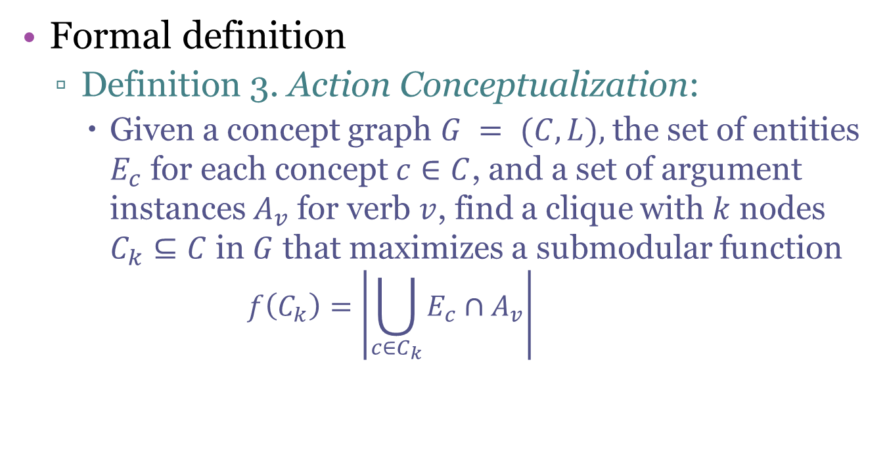
Problem definition
Formal definition
Definition 3. Action Conceptualization:
Given a concept graph $G = (C,L),$the set of entities $E_{c}$ for each concept $c∈C$, and a set of argument instances $A_{v}$ for verb $v$, find a clique with $k$ nodes $C_{k}⊆C$ in $G$ that maximizes a submodular function
$$f\left(C_{k}\right)=\left|\bigcup_{c∈C_{k}}{E_{c}∩A_{v}}\right|$$
Notes:
So the action conceptualization can be formulated as a modified k-clique problem:
Given a concept …

Slide 23
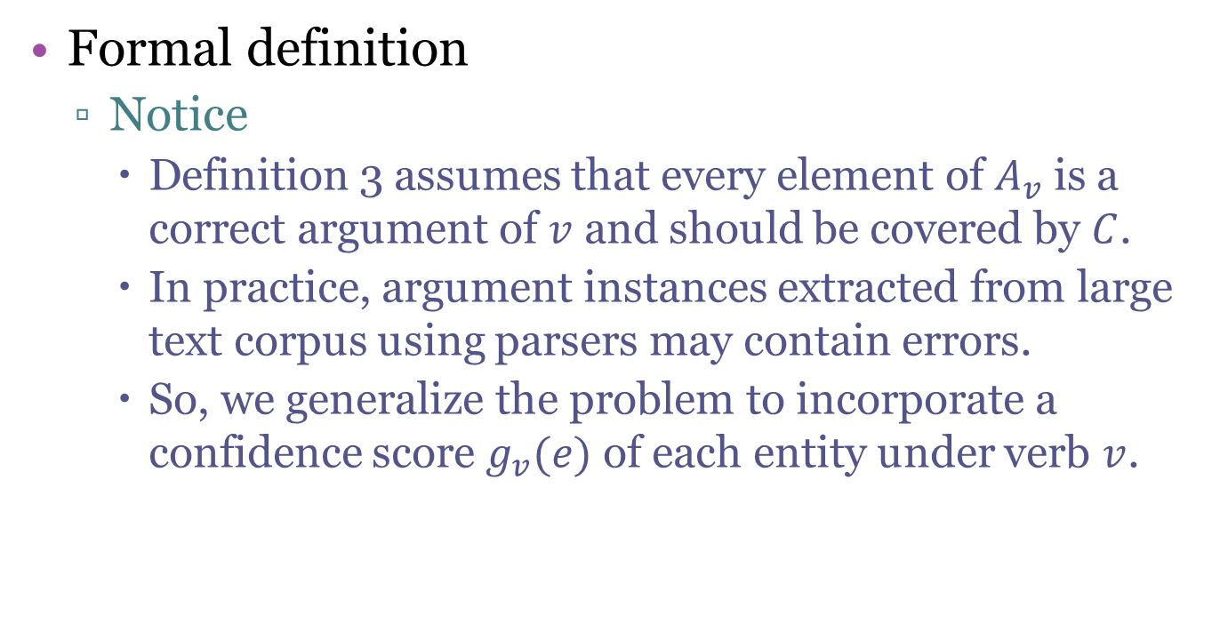
Problem definition
Formal definition
Notice
Definition 3 assumes that every element of $A_{v}$ is a correct argument of $v$ and should be covered by $C$.
In practice, argument instances extracted from large text corpus using parsers may contain errors.
So, we generalize the problem to incorporate a confidence score $g_{v}(e)$ of each entity under verb $v$.
Notes:
The above definition assumes that every element of Av is a correct argument of v and should be covered by Ck.
However, in practice, argument instances extracted from large text corpus using parsers may contain errors.
In order to handle such noise,
we generalize the problem to incorporate a confidence score gv(e) of each entity under verb v.

Slide 24
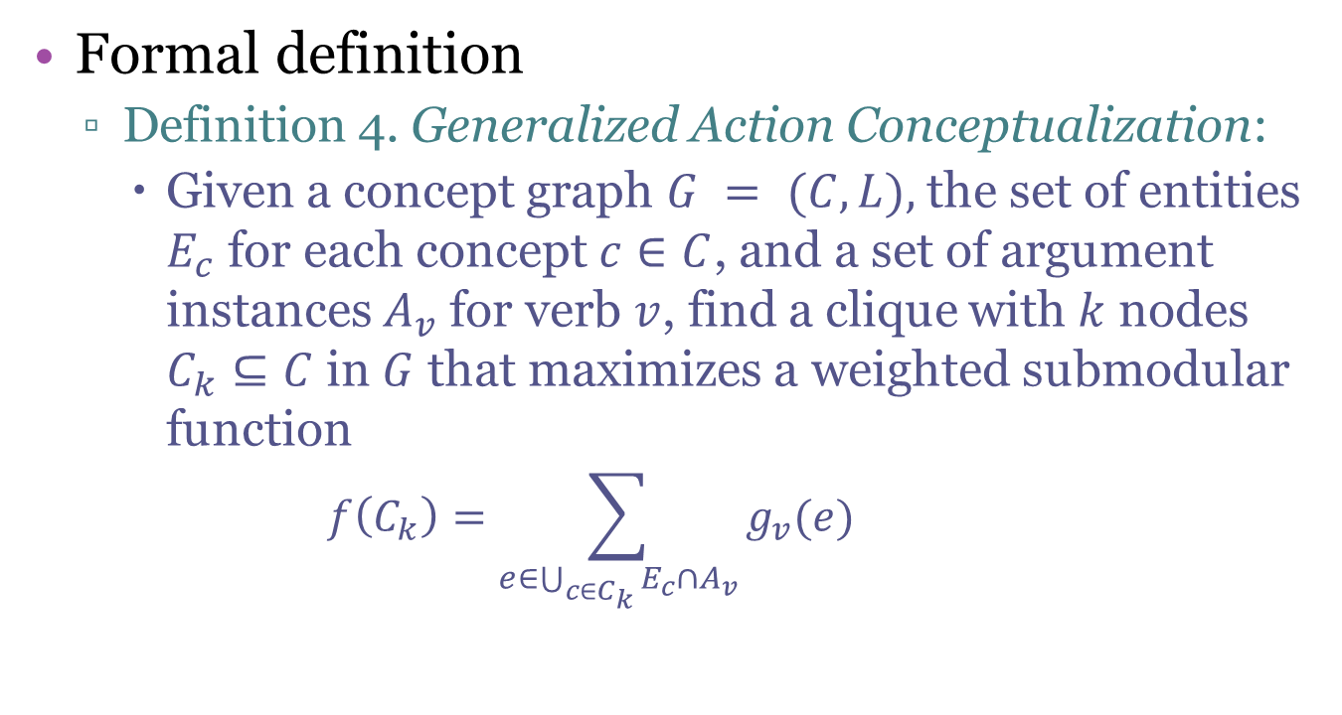
Problem definition
Formal definition
Definition 4. Generalized Action Conceptualization:
Given a concept graph $G = (C,L),$the set of entities $E_{c}$ for each concept $c∈C$, and a set of argument instances $A_{v}$ for verb $v$, find a clique with $k$ nodes $C_{k}⊆C$ in $G$ that maximizes a weighted submodular function
$$f\left(C_{k}\right)=\sum_{e∈\bigcup_{c∈C_{k}}{E_{c}∩A_{v}}}{g_{v}(e)}$$
Notes:
Here is the definition of Generalized Action Conceptualization.
Given a concept graph …

Slide 25
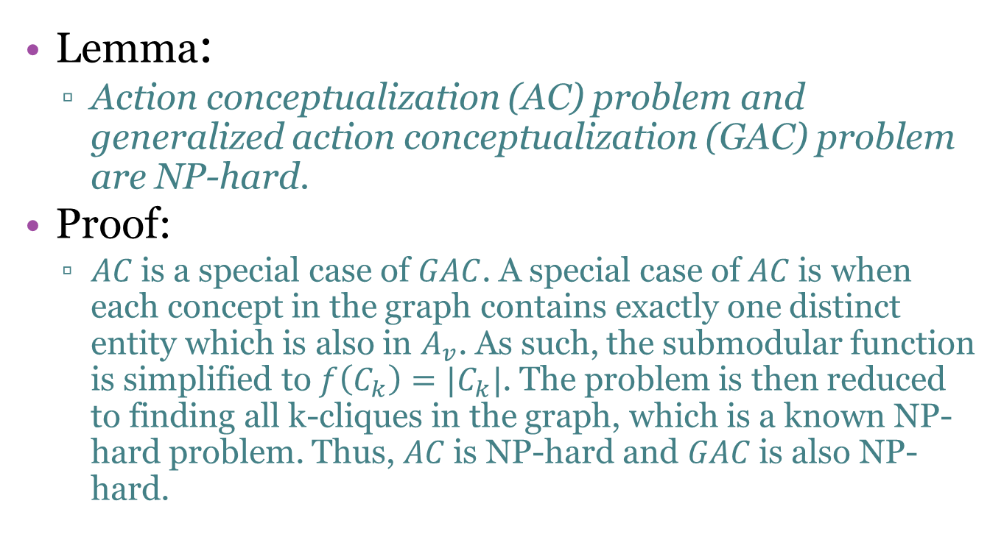
Problem definition
Lemma:
Action conceptualization (AC) problem and generalized action conceptualization (GAC) problem are NP-hard.
Proof:
$AC$is a special case of $GAC$. A special case of $AC$is when each concept in the graph contains exactly one distinct entity which is also in $A_{v}$. As such, the submodular function is simplified to $f\left(C_{k}\right)=|C_{k}|$. The problem is then reduced to finding all k-cliques in the graph, which is a known NP-hard problem. Thus, $AC$is NP-hard and $GAC$is also NP-hard.
Notes:
We can prove that AC and GAC are all NP-hard problem.
Because by adding some condition, we can reduce the problem to the problem of finding all k-cliques in the graph,
Which is a known NP-hard problem.

Slide 26
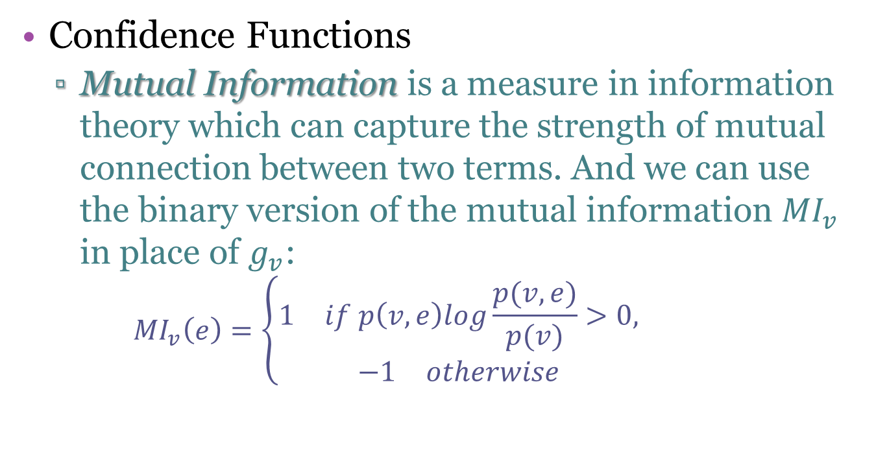
Approach
Confidence Functions
Mutual Information is a measure in information theory which can capture the strength of mutual connection between two terms. And we can use the binary version of the mutual information ${MI}_{v}$ in place of $g_{v}$:
$${MI}_{v}\left(e\right)=\left\{\begin{aligned}\begin{matrix}1 & if p\left(v,e\right)log\frac{p(v,e)}{p(v)}>0,\end{matrix} \\ \begin{matrix}−1 & otherwise\end{matrix}\end{aligned}\right.$$
Notes:
Now let me describe the approach proposed in our paper.
First, I will talk about Confidence Functions. To define the confidence function gv for a verb v,
we suppose that the arguments that are relevant and correct to the verb are more “informative” than those that are not.
So we can adopt an information theory method, called Mutual Information. And in our paper, we use the binary version of it.
If it is larger than 0, than the score should be 1, otherwise the score should be negative 1.

Slide 27
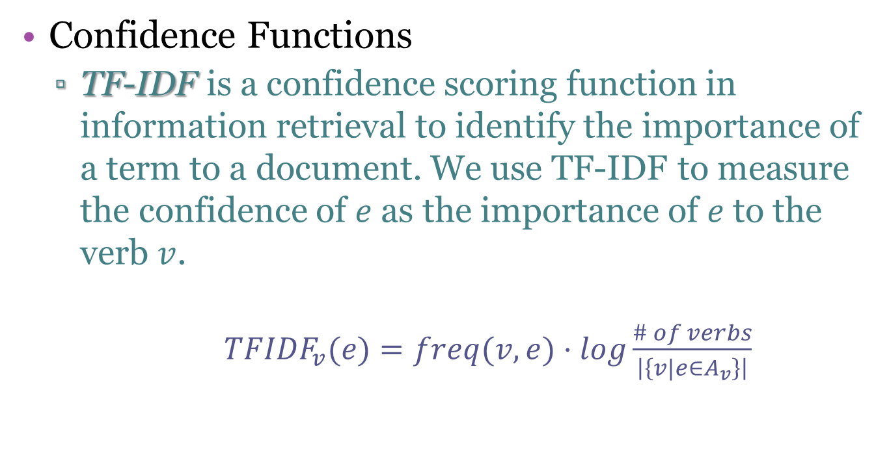
Approach
Confidence Functions
TF-IDF is a confidence scoring function in information retrieval to identify the importance of a term to a document. We use TF-IDF to measure the confidence of $e$as the importance of $e$to the verb $v$.
${TFIDF}_{v}(e)=freq(v,e)⋅log\frac{\# of verbs}{\left|\left\{v|e∈A_{v}\right\}\right|}$
Notes:
Another confidence function can be TF-IDF,
it is a confidence scoring function in information retrieval to identify the importance of a term to a document.
And the definition of it is shown as follows.
In the definition, we regard the verb as document, and the entity as term.

Slide 28
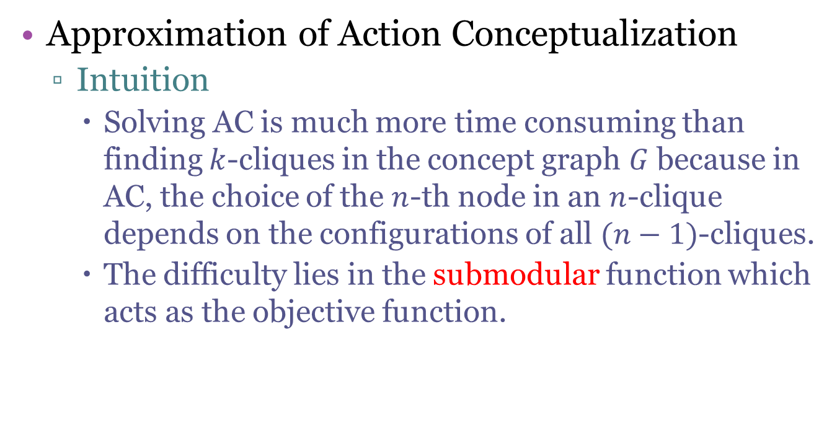
Approach
Approximation of Action Conceptualization
Intuition
Solving AC is much more time consuming than finding $k$-cliques in the concept graph $G$because in AC, the choice of the $n$-th node in an $n$-clique depends on the configurations of all $(n−1)$-cliques.
The difficulty lies in the submodular function which acts as the objective function.
Notes:
As we can see,
solving AC is much more time consuming than finding k-cliques in the concept graph G because in AC, the choise of the n-th node in an n-clique depends on the configurations of all (n-1)-cliques.
Actually, the difficulty lies in the submodular function which acts as the objective function.

Slide 29
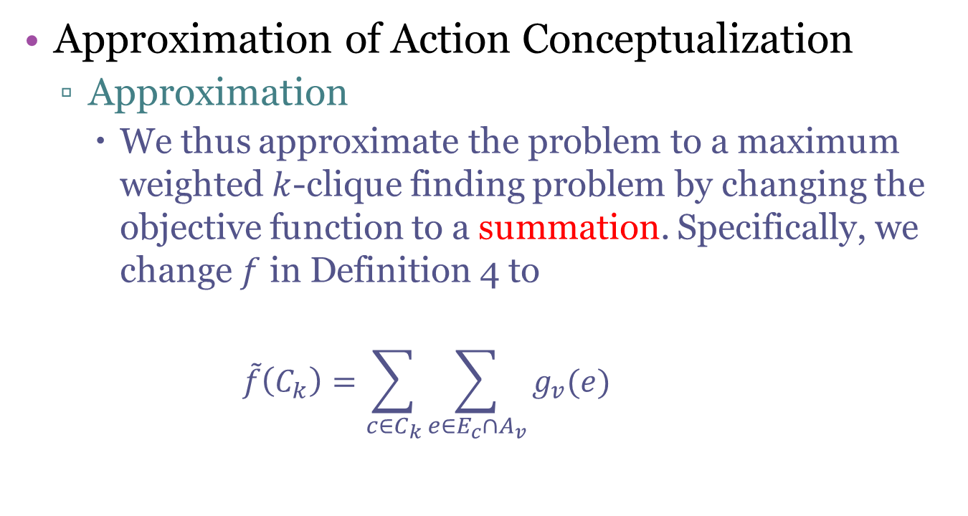
Approach
Approximation of Action Conceptualization
Approximation
We thus approximate the problem to a maximum weighted $k$-clique finding problem by changing the objective function to a summation. Specifically, we change $f$ in Definition 4 to
$$\tilde{f}\left(C_{k}\right)=\sum_{c∈C_{k}}{\sum_{e∈E_{c}∩A_{v}}{g_{v}(e)}}$$
Notes:
Therefor, we approximate the problem to a maximum weighted k-clique finding problem by changing the objective function to a summation.
And we change f in Definition 4 to the following formula.

Slide 30
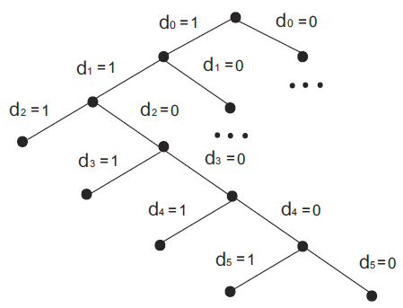

Approach
A Branch-and-Bound Algorithm
The Branch
We model a solution as a binary vector of size $|C|$ in which exactly $k$ elements of the vector is set to $1$ while others set to $0$.
The search space is represented by a decision tree where the nodes at each level represent the decision to include a concept in the solution or not.
A path in the tree is a potential solution.
Notes:
In this paper, we propose a branch-and-bound algorithm to solve the approximated action conceptualization problem.
The two key features of branch and bound algorithm are the Brand method and Bound method.
For the branch process, we model a solution …
And the search space is represented by …
So a path in the tree …
You can see the figure is an example of the decision tree.

Slide 31
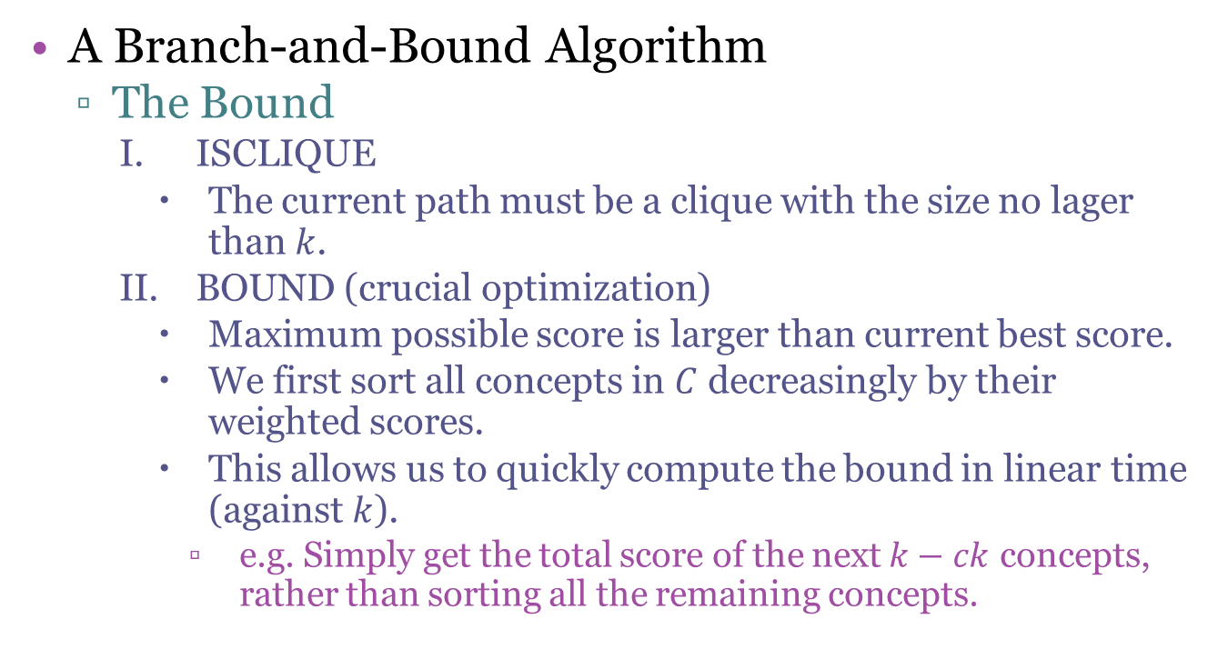
Approach
A Branch-and-Bound Algorithm
The Bound
ISCLIQUE
The current path must be a clique with the size no lager than $k$.
BOUND (crucial optimization)
Maximum possible score is larger than current best score.
We first sort all concepts in $C$ decreasingly by their weighted scores.
This allows us to quickly compute the bound in linear time (against $k$).
e.g. Simply get the total score of the next $k−ck$ concepts, rather than sorting all the remaining concepts.
Notes:
Here we propose two bound mechanisms.
The first one is that the current path must be a clique with the size no larger than k.
The second one, which is a crucial optimization of our approach,
is to satisfy that maximum possible score is larger than current best score.
To achieve it more efficiently, we first sort all concept in C decreasingly by their weighted scores.
This allows us to quickly compute the bound in linear time. For, it just simply gets the total of the next k-ck concepts,
Rather than sorting all the remaining concepts.

Slide 32

Experiment Setup
Two taxonomies
Notes:
Before discussing the evaluation, we first talk about the experiment setup.
In our project, we use Probase and WordNet as two alternative isA taxonomies.

Slide 33
Experiment Setup
Two datasets
Web senences
Google syntactic n-gram
49,911,718 verb-subject pairs
65,035,827 verb-object pairs
130,436,458
N-grams
32,731,395 verb-subject pairs
43,580,062 verb-object pairs
165,758,215 sentences
Notes:
All our experiments are based on two large datasets from Web sentences and Google syntactic N-gram data, respectively.
The sentence or n-gram will first be parsed, then obtain the verb-subject pairs and verb-object pairs.
This slide also shows the scale of our datasets.

Slide 34

Experiment Setup
Verb Sets
Verb-3734 (For web)
Verb-2323 (For google)
Verb-20
Notes:
And we use the following verb sets for the experiment.

Slide 35
Experiment Setup
Verbs, taxonomies, and datasets for each experiment
Experiment | Verb Sets | Taxonomies | Datasets
Accuracy & Overlap | Verb-20 | Probase | Web, Google
Execution Times | Verb-4734, Verb-2323 | Probase, WordNet | Web, Google
Verb Sense Matching | Verb-3734 | WordNet | Web
Argument Identification | Verb-20 | Probase | Web
WSD | Verb-3734 | WordNet | Web
Verb Frame Generation | Verb-3734 | Probase | Web
Term Similarity | Verb-3734 | Probase | Web
Notes:
Because the following experiments are conducted on lexicons learned from different combinations of verb sets, taxonomies and datasets.
For your convenience, the configurations of these experiments are shown in this table.
You can just scan it quickly.

Slide 36
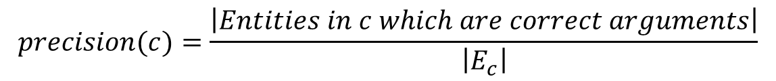
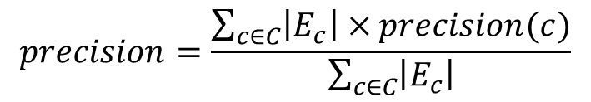
Evaluation
Accuracy (P-R) and Overlap (vs. SP)
Precision
For a given verb, a good concept for an argument type (subject or object) not only covers as many as arguments in the dataset, but also contains few entities that are invalid for that verb.
$$precision(c)=\frac{\left|Entities in c which are correct arguments\right|}{\left|E_{c}\right|}$$
$$precision=\frac{\sum_{c∈C}{\left|E_{c}\right|×precision(c)}}{\sum_{c∈C}{\left|E_{c}\right|}}$$
Notes:
In this section, we use precision, recall and F1 measure to evaluate our algorithm and the generated lexicon against the baseline SP.
So first, precision score in our paper represents that
For a given verb, a good concept for an argument type not only covers as many as arguments in the dataset, but also contains few entities
that are invalid for that verb.
The formal definition is shown there, you can see it quickly.

Slide 37
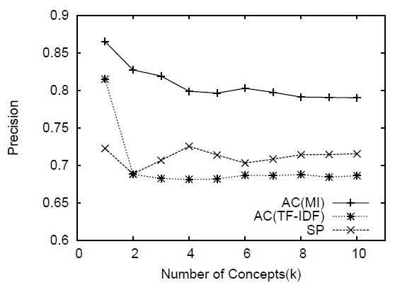
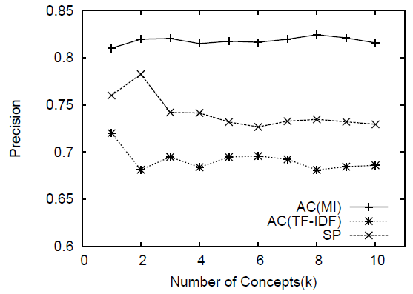
Evaluation
Accuracy (P-R) and Overlap (vs. SP)
Precision
Precision - Web
Precision - Google
Notes:
The overall precision of the 20 verbs is reported in the two figures.
You can see in the figures,
In both datasets, AC(MI) outperforms AC(TF-IDF) and SP a lot.
AC(TF-IDF) gives low precision, perhaps because the TF-IDF scoring doesn’t penalize the incorrect arguments,
But instead prefers to select more general concepts to maximize the objective.

Slide 38
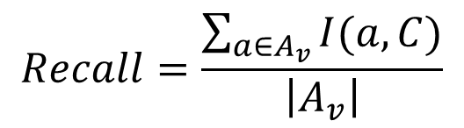
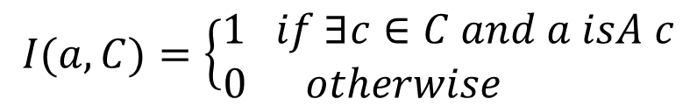
Evaluation
Accuracy (P-R) and Overlap (vs. SP)
Recall
Recall measures the coverage of correct arguments of a verb by the lexicons.
$$Recall=\frac{\sum_{a∈A_{v}}{I(a,C)}}{\left|A_{v}\right|}$$
$$I(a,C)=\left\{\begin{aligned}1 if ∃c∈C and a isA c \\ 0 otherwise \end{aligned}\right.$$
Notes:
In our paper, recall measures the coverage of correct arguments of a verb by the lexicons.

Slide 39
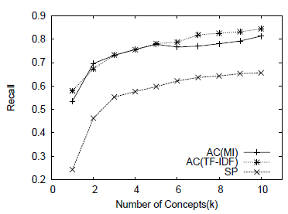
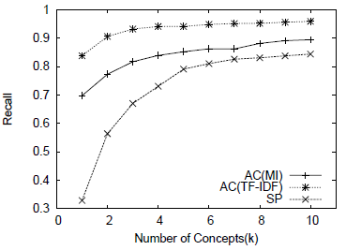
Evaluation
Accuracy (P-R) and Overlap (vs. SP)
Recall
Recall - Web
Recall - Google
Notes:
In the two figures, we can conclude that:
On both datasets, AC(MI) and AC(TFIDF) perform much better than SP.
Using TF-IDF as the confidence function achieves a higher recall, because it tends to select larger concepts,
which may decrease the precision on the contrary as we have discussed.

Slide 40
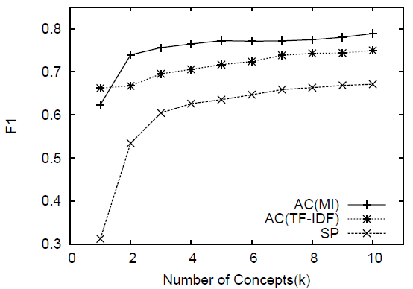
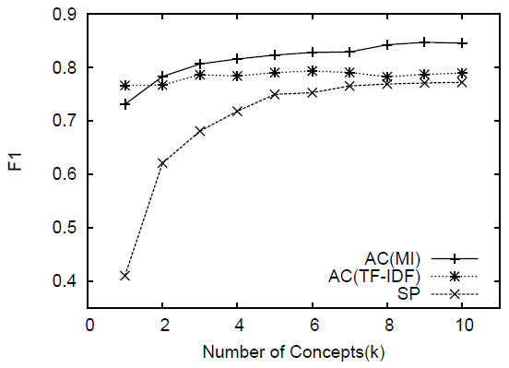
Evaluation
Accuracy (P-R) and Overlap (vs. SP)
F1 Measure
F1 - Web
F1 - Google
Notes:
The F1 measure of all three algorithms on the two datasets are summarized in these two figures.
From the figures, we conclude that AC(MI) and AC(TF-IDF) achieve higher accuracy than SP on both datasets.
Generally AC achieves much higher and more stable accuracy with different values of k than SP.
This is because we consider the concepts diversity of the concept lexicon,
while SP tends to have higher overlap with each other as we will show next.

Slide 41
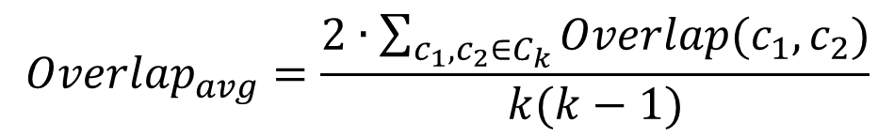
Evaluation
Accuracy (P-R) and Overlap (vs. SP)
Overlap
The overlap score reflects the concepts diversity of the generated lexicon. The intuition is that the more overlap the pairwise concepts have, the lower diversity does the lexicon have.
$${Overlap}_{avg}=\frac{2∙\sum_{c_{1},c_{2}∈C_{k}}{Overlap(c_{1},c_{2})}}{k(k−1)}$$
Notes:
The overlap score …
So we evaluate the average pairwise overlap between the extracted action concepts,
The definition is shown as follows.

Slide 42
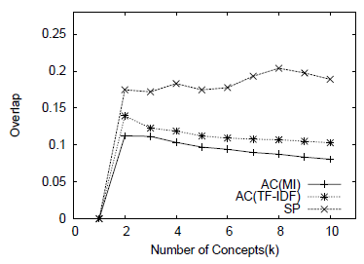
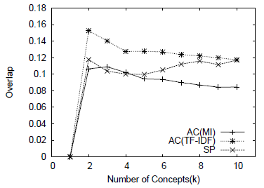
Evaluation
Accuracy (P-R) and Overlap (vs. SP)
Overlap
Overlap - Web
Overlap - Google
Notes:
The results are shown in these two figures.
The concepts generated by AC(MI) overlap much less with each other than AC(TF-IDF) or SP.
Because SP does not consider the diversity of concepts, the Overlap score is much higher.
As AC(TF-IDF) prefers general concepts, the Overlap score is also higher than AC(MI).

Slide 43
Evaluation
Execution Times
Datasets & Taxonomies | Avg. per Verb (sec) | Total (sec)
Web + Probase | 2.244 | 8380.513
Google + Probase | 1.132 | 2628.488
Web + WordNet | 0.003 | 12.363
Google + WordNet | 0.002 | 5.611
Notes:
As the time mathematically analysis of branch and bound is much difficult, we will show it in practice.
You can see from the table, typically the preprocessing takes just under 1 minute.
And our algorithm is efficient enough to generate the action concept lexicon for most verbs.
The running times on Probase are much longer than those on WordNet,
because the concept space of Probase is much larger than WordNet.

Slide 44
Evaluation
Verb Sense Matching
Intuition
The sense of a verb may be identified by the semantic class of its argument.
We evaluate our lexicon on its ability of identifying verb senses (synsets) with different action concepts.
Dataset
Each synset of a verb in WordNet contains a gloss, illustrating the use of the verb in a particular sense.
From these glosses, we extract verb-subject and verb-object pairs.
Notes:
Let’s come to the topic of Verb Sense Mathching.
The intuition is that the sense of a verb may be identified by the semantic class of its argument.
So we can evaluate our lexicon on its ability of identifying verb senses with different action concepts.
As for the dataset for this experiment, each synset of a verb …
So from these glosses, we extract verb-subject and verb-object pairs construct two test sets,
namely Verb-Subject and Verb-Object.

Slide 45
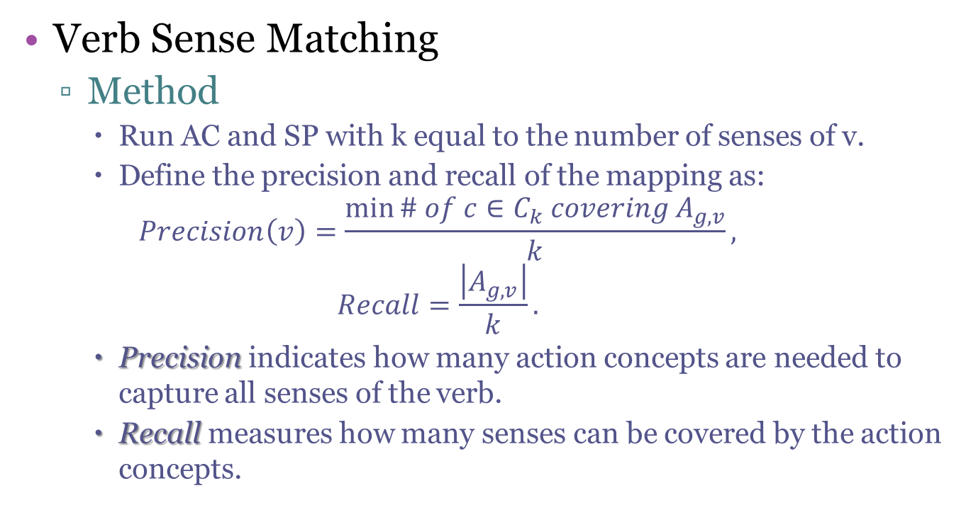
Evaluation
Verb Sense Matching
Method
Run AC and SP with k equal to the number of senses of v.
Define the precision and recall of the mapping as:
$$Precision\left(v\right)=\frac{\min{\# of c∈C_{k} covering A_{g,v}}}{k},$$
$$Recall=\frac{\left|A_{g,v}\right|}{k}.$$
Precision indicates how many action concepts are needed to capture all senses of the verb.
Recall measures how many senses can be covered by the action concepts.
Notes:
For each verb v in each test set, we run AC and SP with k equal to the number of senses of v,
which is essentially the number of glosses containing v.
And then we define the precision and recall of the mapping.
Precision indicates how many action concepts are needed to capture all senses of the verb.
Recall measures how many senses can be covered by the action concepts.

Slide 46
Evaluation
Verb Sense Matching
Result
Test Set | AC |  |  | SP
 | Precision | Recall | F1 | Precision | Recall | F1
Verb -Subject | 0.19 | 0.21 | 0.19 | 0.11 | 0.13 | 0.12
Verb-Object | 0.26 | 0.31 | 0.28 | 0.17 | 0.21 | 0.18
Average | 0.26 | 0.30 | 0.27 | 0.16 | 0.19 | 0.17
Notes:
We also compute the F1 score for the two AC and SP and summarize the results in this table.
AC achieves 0.27 f1 score, while SP gets 0.17 f1.
The reason is that SP selects general concepts which may have higher overlap against each other,
so they focus on a few senses but miss out other smaller, less popular senses.

Slide 47
Evaluation
Argument Identification (vs. SRL and ReVerb)
In the argument identification task, we use our lexicon to examine whether an argument is correct to a verb in a sentence.
We compare our lexicon with SP, ReVerb and SRL as follows:
AC & SP: Check if the object is an instance of the top k concepts of the target verb.
ReVerb: Check if the object is contained in the object list of the target verb in ReVerb.
SRL: We use SRL tool “Semafor” to label the sentence with frame defined by FrameNet, then we check if the object is labeled as a frame element of the target verb.
Notes:
In the argument identification task,
we use our lexicon to examine whether an argument is correct to a verb in a sentence.
In this experiment, we compare our lexicon with SP, ReVerb and SRL as follows:
For AC and SP, check if the object …
For ReVerb, check if the object …
For SRL, We use SRL tool “Semafor” to label …

Slide 48
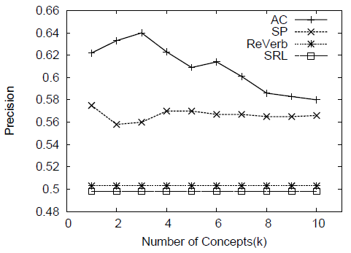
Evaluation
Argument Identification (vs. SRL and ReVerb)
Notes:
We can see from Figure 16 that the precision of AC is significantly higher than the precision of ReVerb and SRL.
In AC, the precision is higher with smaller k, indicating high quality concepts are ranked high in our algorithm.
Precision becomes stable when k reaches 7. But it also performs well than SP.

Slide 49
Evaluation
Action Frame Generation
Intuition
e.g. Top three concepts of buy and sell are the same product, service and property.
Use Action concepts as semantic feature to cluster the similar verbs, and adopt Vector Space Model (VSM) to represent the context.
Each dimension is a probability distribution score corresponding to a concept.
Do fuzzy clustering to capture the polysemy of verbs.
Notes:
As for the application of Action Frame Generation, we first give the intuition.
As an example, top three concepts of buy and sell are the same. They are product, service and property.
So we can use Action concepts as semantic feature to cluster the similar verbs, and assign each cluster an action frame.
We adopt Vector Space Model to represent the context. Each dimension is a probability distribution score corresponding to a concept.
In this application, we do fuzzy clustering to capture the polysemy of verbs.

Slide 50
Evaluation
Action Frame Generation
An example of verb clustering results
ID | Verb Cluster
1 | purchase, rent, sell, buy, ship
2 | propose, explain, adopt, model, repeat, illustrate, describe
3 | estimate, subtract, decrease, measure, compute, predict
4 | complain, perceive, discourage, acknowledge, excuse, recall, mind, forbid, favor, wish
5 | crumple, unzip, zip, cling, vibrate, crimp, magnetize, buckle, flip
Notes:
This table shows an example of the clustering results.
As you can see, cluster 1 is the meaning of business deal,
Cluster 2 is something like presenting your idea.
Cluster 3 is the meaning of computation,
While cluster 4 is similar to the emotion.
And cluster 5 represent the meaning of operation.

Slide 51
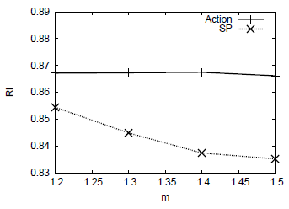
Evaluation
Action Frame Generation
Use Levin’s Classes as gold standard.
Use Rand Index (RI) to evaluate.
Measures the percentage of correct assignment of verbs to clusters.
Notes:
To evaluate the quality of the action frames, we adopt a subset of Levin’s Verb Classes as golden standard data.
And then we use the Rand Index as a metric to evaluate the clustering result,
which measures the percentage of correct assignment of verbs to clusters.
As shown in the figure,
the performance of verb clustering using action concepts as feature is better than using SP concepts.

Slide 52
Evaluation
Term Similarity Computation
Intuition
e.g. company and stock have the same verbs: sell and release.
Noun based method
Based on Probase
Entities or concepts as the term’s context
Verb based method
Action Concepts as the term’s context
Noun + Verb based method
The Average Method
Notes:
As to the application of Term Similarity Computation, our intuition is that:
Take company and stock as examples, they do have some relation for the business sense.
And in our lexicon, they have the same verbs: sell and release.
Therefore, we can use our lexicon as the context for terms to calculate the similarity.
Unlike the noun based method propose by Peipei, which is based on Probase, and use entities or concepts as the term’s context,
the verb based method we proposed use the verbs in our lexicon as the term’s context.
Further more, we can combine the two method by an average method.

Slide 53
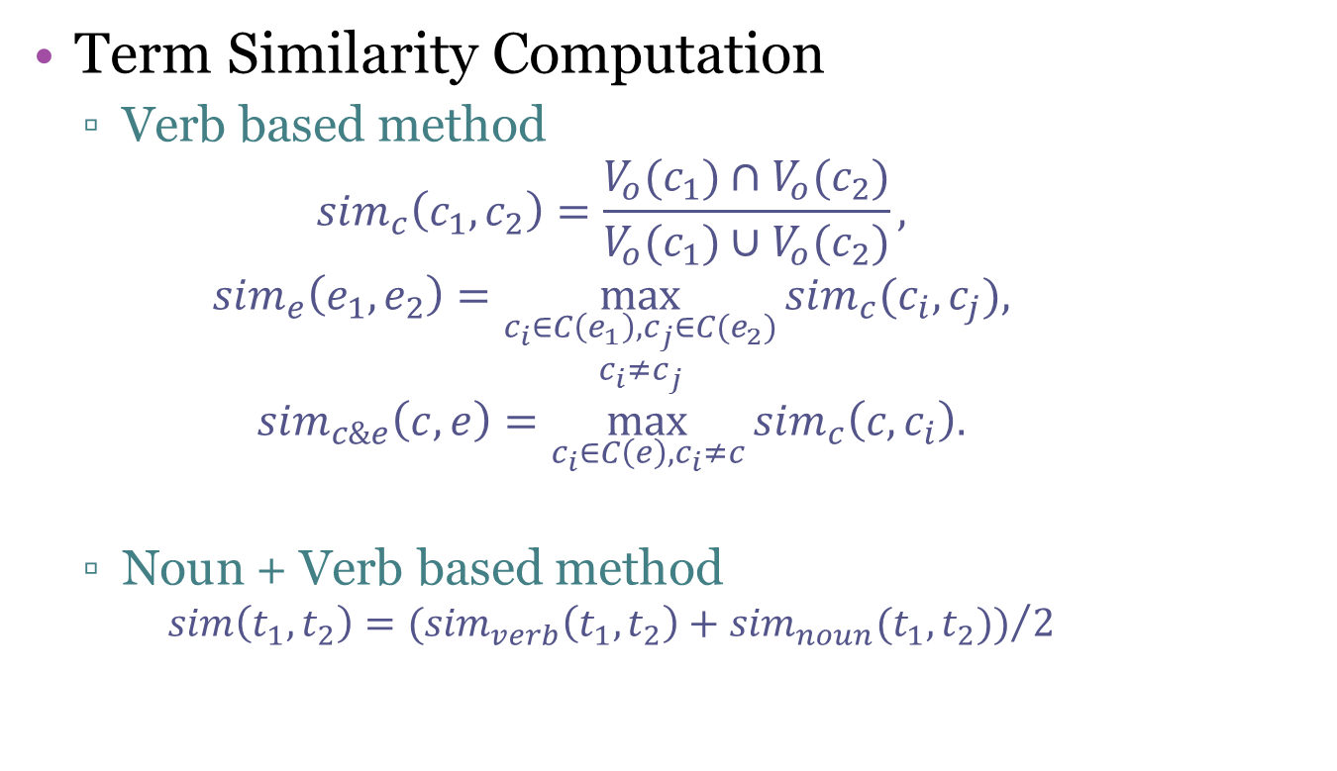
Evaluation
Term Similarity Computation
Verb based method
$${sim}_{c}\left(c_{1},c_{2}\right)=\frac{V_{o}(c_{1})∩V_{o}(c_{2})}{V_{o}(c_{1})∪V_{o}(c_{2})},$$
$${sim}_{e}\left(e_{1}, e_{2}\right)=\max_{\begin{aligned}c_{i}∈C\left(e_{1}\right),c_{j}∈C(e_{2}) \\ c_{i}≠c_{j}\end{aligned}}{{sim}_{c}(c_{i},c_{j}}),$$
$${sim}_{c\&e}\left(c,e\right)=\max_{c_{i}∈C\left(e\right),c_{i}≠c}{{sim}_{c}\left(c,c_{i}\right).}$$
Noun + Verb based method
$$sim\left(t_{1}, t_{2}\right)={({sim}_{verb}\left(t_{1}, t_{2}\right)+{sim}_{noun}(t_{1}, t_{2}))}/2$$
Notes:
We apply different similarity functions on terms according to their types (whether concepts or entities).
And the combined method is the average of Noun based method and Verb based method.

Slide 54
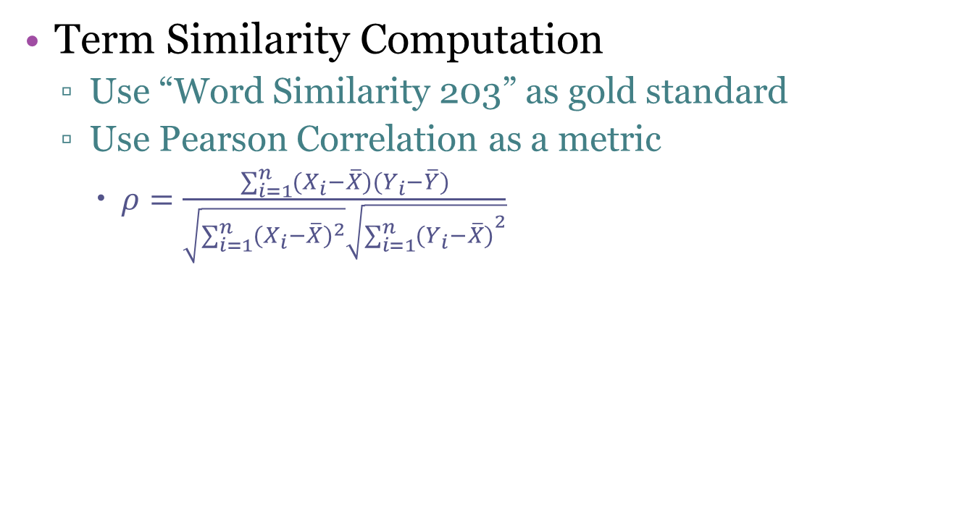
Evaluation
Term Similarity Computation
Use “Word Similarity 203” as gold standard
Use Pearson Correlation as a metric
$ρ=\frac{\sum_{i=1}^{n}{(X_{i}−\overline{X})(Y_{i}−\overline{Y})}}{\sqrt{\sum_{i=1}^{n}{{(X_{i}−\overline{X})}^{2}}}\sqrt{{\sum_{i=1}^{n}{(Y_{i}−\overline{X})}}^{2}}}$
Noun based | Verb based | Combined
0.72 | 0.57 | 0.76
Notes:
To evaluate the similarity result, we use a word similarity label dataset “Word Similarity 203” as gold standard.
And use Pearson correlation as the evaluation metric.
The result is shown in the table.
We can see that, by combining the knowledge provided by Probase and our action concept lexicon,
we can get a better similarity result.

Slide 55
Future Work
Google buys Motorola.
Buy
Subject: Google
Object: Motorola
Action Instance
Buy
Subject: Company
Object: Company
Action Concept
acquisition
Further conceptualize the actions
Notes:
The last topic I will discuss is the future work.
I am now considering the problem of transforming the action concept to a noun concept, which is a further conceptualization.
Take this sentence as an example,
Google buys Motorola.
The shallow extraction is action instance, then we can conceptualize it as company buy company.
In the future, I will further conceptualize “company by company” as a noun concept “acquisition”.

Slide 56
Thanks!
http://adapt.seiee.sjtu.edu.cn/~kzhu/ac/
Notes:
OK, thanks to listen to my talk. And we release our data and lexicon on this site. If you are interesting, you can have a look.

