Slide 1
Action Conceptualization
Yu Gong
supervisor: Yonghong Song
Kenny Zhu

Slide 2
Outline
Objective of Action Conceptualization
Related Work
Problem definition and approach
Action Instance Extraction
Action Conceptualization
Action Concept Ranking
Experimental results and evaluation
The applications

Slide 3
Outline
Objective of Action Conceptualization
Related Work
Problem definition and approach
Action Instance Extraction
Action Conceptualization
Action Concept Ranking
Experimental results and evaluation
The applications

Slide 4
Objective of Action Conceptualization
Why we need action conceptualization?
Argument Identification
Tell whether a phrase is an argument of a verb
Is it proper to use “Microsoft” as the subject of eat? No!
However we often say Microsoft produce XXX.
Word Sense Disambiguation
Disambiguate the arguments of a verb
E.g. The engineer is eating apple
Apple can not be Apple Inc. here because we know we cannot eat a company

Slide 5
Objective of Action Conceptualization
Short text understanding
Google buys Motorola.
Normal conceptualization
(noun phrase based)
Action-based conceptualization
Google, Motorola
Buy
Subject: Google
Object: Motorola
Action
company
Buy
Subject: Company
Object: Company
Action Concept
acquisition
Further conceptualize the actions

Slide 6
Objective of Action Conceptualization
The goal:
Given a verb, obtain the following structure:
Verb + object concepts
Subject concepts+ verb

Slide 7
Outline
Objective of Action Conceptualization
Related Work
Problem definition and approach
Action Instance Extraction
Action Conceptualization
Action Concept Ranking
Experimental results and evaluation
The applications

Slide 8
Related Work
Semantic role labeling (SRL)
The role is too general, and not always to be a concept.
The lexicon is manually constructed(E.g. FrameNet).
ReVerb
The predicate extracted are often too specific.
Without distinguishing concepts/senses of the arguments.
Selectional Preference
Not consider the diversity of concepts, may give a list of concepts with the same meaning.
Not a set of concepts, just a score for each concept.

Slide 9
Related Work
What’s the difference between our work and related works?
More fine grained concepts compare to SRL
Contains a concept level compare to ReVerb
The verbs can be scaled up
The lexicon is human readable and machine computable

Slide 10
Related Work
Top 3 Concepts for selected Verbs from 3 Lexicons
Verb | Action | FrameNet | ReVerb
connect | device person attribute | Items Concepts | invention cvg platform organization select
operate | business facility system | Instrument System | organization business operation field of study
play | game factor role | Role Competition Sound_maker | field of study organization sector genre
wear | clothing jewelry stuff | Clothing | garment invention collection category

Slide 11
Outline
Objective of Action Conceptualization
Related Work
Problem definition and approach
Action Instance Extraction
Action Conceptualization
Action Concept Ranking
Experimental results and evaluation
The applications

Slide 12
Problem definition and approach
Informal definition:
Given a collection of argument instances (either subjects or objects) for a verb
Pick a smallest set of abstract concepts O from a taxonomy to cover all these argument instances by IsA relation.
We require that the overlap between any two concepts in O to be as small as possible

Slide 13
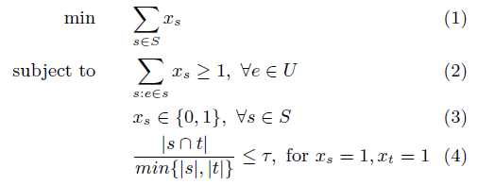
Problem definition and approach
Formal definition(optimization form):

Slide 14
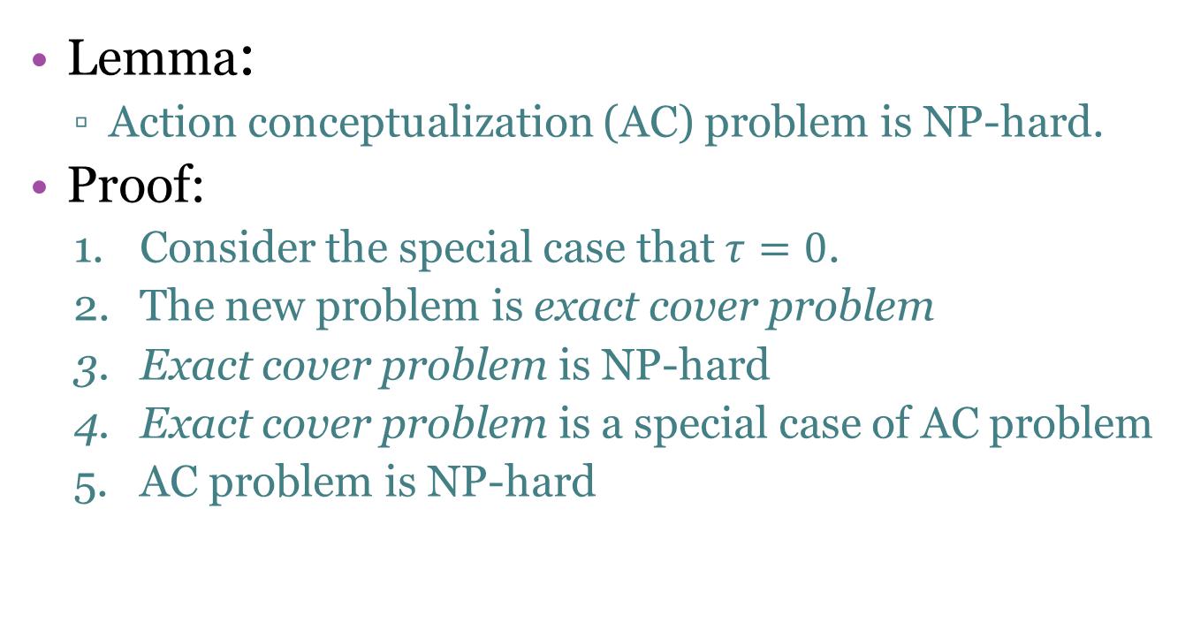
Problem definition and approach
Lemma:
Action conceptualization (AC) problem is NP-hard.
Proof:
Consider the special case that $τ=0$.
The new problem is exact cover problem
Exact cover problem is NP-hard
Exact cover problem is a special case of AC problem
AC problem is NP-hard

Slide 15
Problem definition and approach
Overall approach:
Action Instance Extraction
Action Conceptualization
Action Concept Ranking

Slide 16
Outline
Objective of Action Conceptualization
Related Work
Problem definition and approach
Action Instance Extraction
Action Conceptualization
Action Concept Ranking
Experimental results and evaluation
The applications

Slide 17
Action Instance Extraction
A Probase taxonomy
2.7 million categories
item
product
healthy food
food
IsA
fruit
vegetable
egg
IsA graph

Slide 18
Action Instance Extraction
Web pages
Google syntactic n-gram
Two dataset
3,473,595 sentences
165,758,215 sentences

Slide 19
Action Instance Extraction
Input: sentences in corpus, a given verb list
Output: a set of action instances (verb + arguments)
Filter bad sentences
Run dependency parser
Find Probase terms by Sliding Window

Slide 20
Action Instance Extraction
Dependencies of Stanford parser used to extract Action Instance
Subject:
nsubj(verb, subj_head)
nominal subject
E.g. Sam ate an apple.
nsubj(ate, Sam)
agent(verb, subj_head)
complement of a passive verb.
E.g. The man is arrested by police.
agent(arrested, police)
Object:
dobj(verb, obj_head)
direct object
E.g. He gave you a book.
dobj(gave, book)
nsubjpass(verb, obj_head)
passive nominal subject
E.g. The man is arrested by police. nsubjpass(arrested, man)

Slide 21
Action Instance Extraction
Find Probase term
Example:
Sentence: They join vigorously, liberating much heat as they burn with a pale green flame.
burn
prep_with
flame
However, a pale green flame is not a Probase term.
det
amod
a pale green flame
amod
a
pale
green
We get Probase term by using a sliding window with an initial size of the whole phrase and decrease the size in each iteration.

Slide 22
Outline
Objective of Action Conceptualization
Related Work
Problem definition and approach
Action Instance Extraction
Action Conceptualization
Action Concept Ranking
Experimental results and evaluation
The applications

Slide 23
Action Conceptualization
Input:
Argument set of a given verb(Action Instances)
Output:
Concept set for the given verb(Action Concepts)

Slide 24
Action Conceptualization
A greedy solution
Candidate Concept Set
concept
Pick a concept
A
Move the concept if satisfy overlap
Cover most
Cover least
Arguments waiting to be covered
Arguments already be covered
Selected concepts list
Move the arguments
B
C
D

Slide 25
Action Conceptualization
Local search by Simulated Annealing
Overall processing
Representative Score
Initialization
Local search

Slide 26
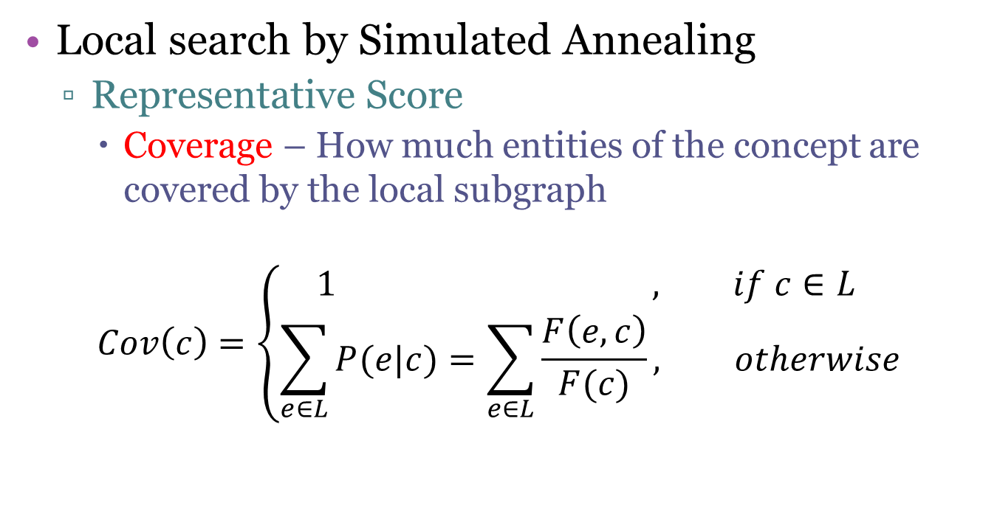
Action Conceptualization
Local search by Simulated Annealing
Representative Score
Coverage – How much entities of the concept are covered by the local subgraph
$$Cov\left(c\right)=\left\{\begin{aligned}1 , if c∈L \\ \sum_{e∈L}{P(e|c)}=\sum_{e∈L}{\frac{F\left(e,c\right)}{F(c)}}, otherwise\end{aligned}\right.$$

Slide 27
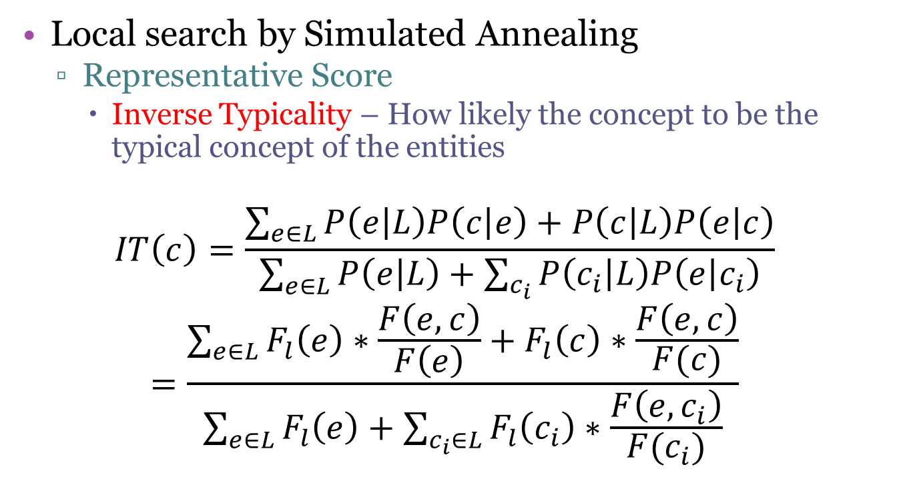
Action Conceptualization
Local search by Simulated Annealing
Representative Score
Inverse Typicality – How likely the concept to be the typical concept of the entities
$$IT\left(c\right)=\frac{\sum_{e∈L}{P\left(e | L\right)P\left(c | e\right)+P\left(c | L\right)P\left(e | c\right)}}{\sum_{e∈L}{P\left(e | L\right)+\sum_{c_{i}}{P\left(c_{i} | L\right)P\left(e | c_{i}\right)}}}$$
$$=\frac{\sum_{e∈L}{F_{l}\left(e\right)∗\frac{F\left(e,c\right)}{F\left(e\right)}+F_{l}\left(c\right)∗\frac{F\left(e,c\right)}{F(c)}}}{\sum_{e∈L}{F_{l}\left(e\right)+\sum_{c_{i}∈L}{F_{l}\left(c_{i}\right)∗\frac{F\left(e,c_{i}\right)}{F(c_{i})}}}}$$

Slide 28

Action Conceptualization
Local search by Simulated Annealing
Representative Score
How good a concept is.
$$RS\left(c\right)=Cov\left(c\right)∗IT\left(c\right)∗F_{l}(c)$$

Slide 29
Action Conceptualization
Local search by Simulated Annealing
Initialization
Greedy based method
Pick the concept one by one according to their Representative Score as long as satisfy the overlap constraint until cover all the arguments.

Slide 30
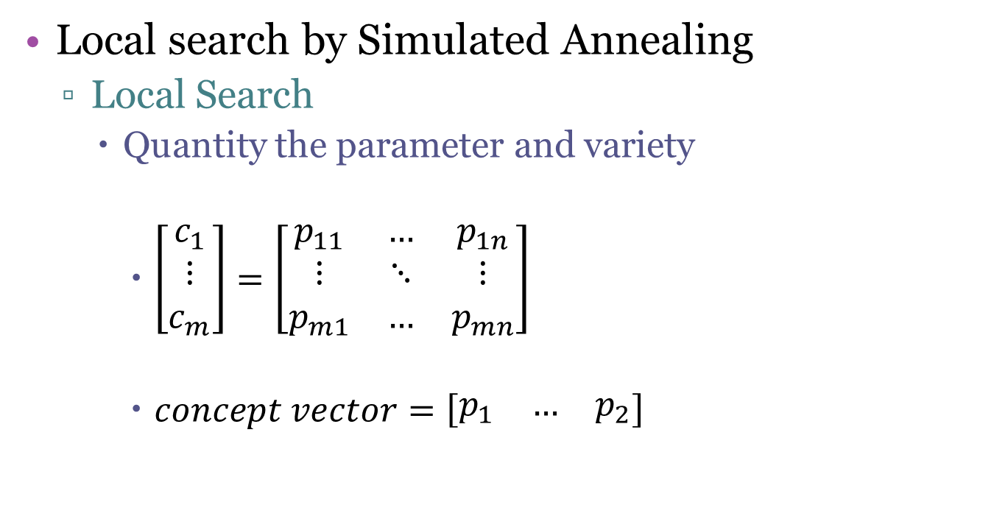
Action Conceptualization
Local search by Simulated Annealing
Local Search
Quantity the parameter and variety
$\left[\begin{matrix}c_{1} \\ ⋮ \\ c_{m}\end{matrix}\right]=\left[\begin{matrix}p_{11} & … & p_{1n} \\ ⋮ & ⋱ & ⋮ \\ p_{m1} & … & p_{mn}\end{matrix}\right]$
$concept vector=\left[\begin{matrix}p_{1} & … & p_{2}\end{matrix}\right]$

Slide 31
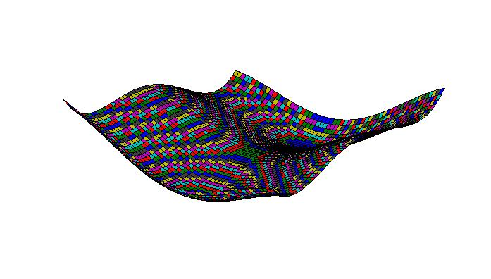
Action Conceptualization
Local search by Simulated Annealing
Local Search
Simulated Annealing (SA)

Slide 32
Outline
Objective of Action Conceptualization
Related Work
Problem definition and approach
Action Instance Extraction
Action Conceptualization
Action Concept Ranking
Experimental results and evaluation
The applications

Slide 33
Action Concept Ranking
Input: The resulting concepts after local search step
Output: A ranked concept list
Algorithm:
Rank the resulting concept according to Representative Score
Pick arguments one by one and remove the picked arguments
Rank the concept list according to the number of arguments their picked

Slide 34
Outline
Objective of Action Conceptualization
Related Work
Problem definition and approach
Action Instance Extraction
Action Conceptualization
Action Concept Ranking
Experimental results and evaluation
The applications

Slide 35
Experiment result
Action concept lexicon(3735 verbs)
http://202.120.38.145:4082/ac/
A snapshot of Action Concept
Verbs | Subject | Object
define | document, parameter, section, object, user | term, parameter, function, purpose, method
perform | person, service, group, artist, company | task, procedure, work, process, test
play | person, factor, player, band, game | game, factor, role, character, part
spend | person, group, company, time, department | time, life, money, game, point
wear | person, part, information, model, class | clothing, jewelry, stuff, color, shoe

Slide 36
Experiment result
Experiment verbs
Random sample 20 verbs
eat, perform, play, submit, wear, release, define, keep, carry, cut, report, select, operate, bring, visit, hit, help, spend, read, connect

Slide 37
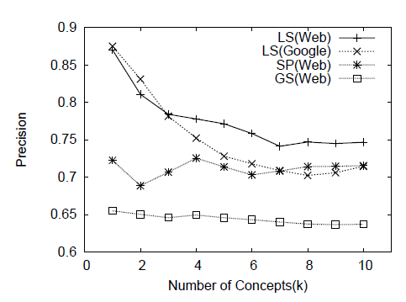
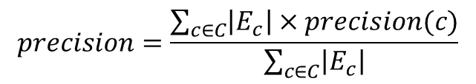
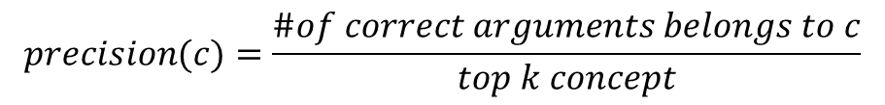
Experiment result
Accuracy(P-R) and Overlap(vs. SP)
Precision
$$precision(c)=\frac{\#of correct arguments belongs to c}{top k concept}$$
$$precision=\frac{\sum_{c∈C}{\left|E_{c}\right|×precision(c)}}{\sum_{c∈C}{\left|E_{c}\right|}}$$

Slide 38
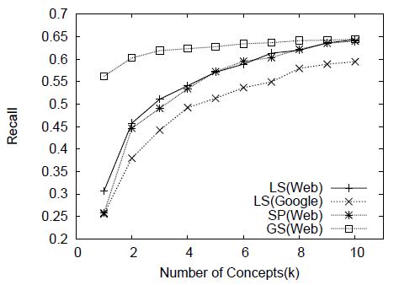
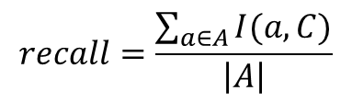

Experiment result
Accuracy(P-R) and Overlap(vs. SP)
Recall
$$recall=\frac{\sum_{a∈A}{I(a,C)}}{\left|A\right|}$$
$$I(a,C)=\left\{\begin{aligned}1 if ∃c∈C and a isA c \\ 0 otherwise \end{aligned}\right.$$

Slide 39
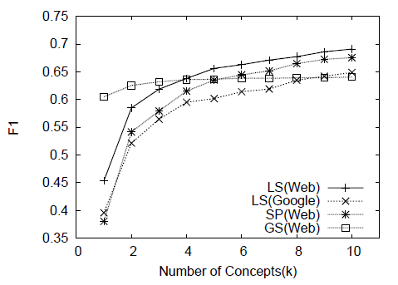
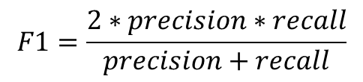
Experiment result
Accuracy(P-R) and Overlap(vs. SP)
F1
$$F1=\frac{2∗precision∗recall}{precision+recall}$$

Slide 40
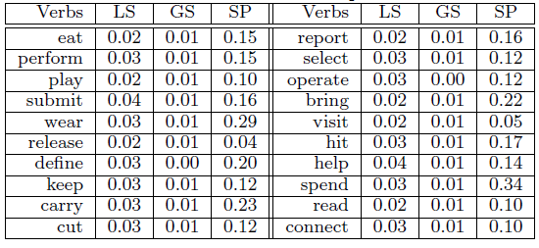
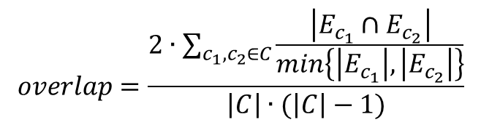
Experiment result
Accuracy(P-R) and Overlap(vs. SP)
Overlap
$$overlap=\frac{2∙\sum_{c_{1},c_{2}∈C}{\frac{\left|E_{c_{1}}∩E_{c_{2}}\right|}{min\left\{\left|E_{c_{1}}\right|,\left|E_{c_{2}}\right|\right\}}}}{\left|C\right|∙(\left|C\right|−1)}$$

Slide 41
Outline
Objective of Action Conceptualization
Related Work
Problem definition and approach
Action Instance Extraction
Action Conceptualization
Action Concept Ranking
Experimental results and evaluation
The applications

Slide 42
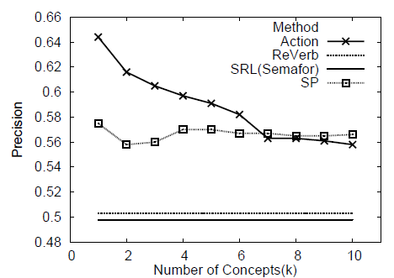
The applications
Argument Identification(vs. SRL and ReVerb)
Generate a set of annotated<verb, obj>pairs from sentences extracted from Wikipedia articles
An exchange based method to generate artificial wrong examples

Slide 43
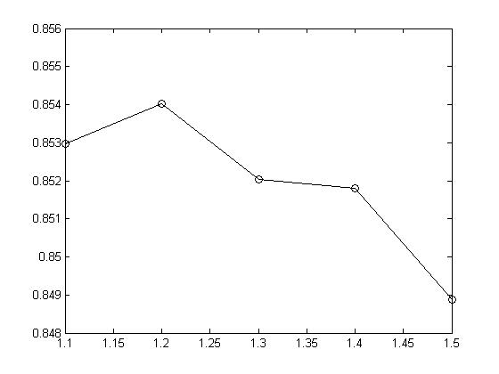

The applications
Verb fuzzy clustering
E.g. Top three concepts of buy and sell are the same product, service and property.
Use Action concepts as semantic feature to cluster the similar verbs
Do fuzzy clustering to capture the polysemy of verbs
Use Levin’s Classes as gold standard
Use Rand Index to evaluate
$RI=\frac{TP+TN}{TP+FP+TN+FN}$

Slide 44
The applications
Term Similarity Computation
E.g. company and stock have the same verbs: sell and release
Action Concept can be used to compute similarity
Noun based method
Based on Probase
Entities or concepts as the term’s context
Verb based method
Action Concepts as the term’s context
Noun + Verb based method
The Max-Max method

Slide 45
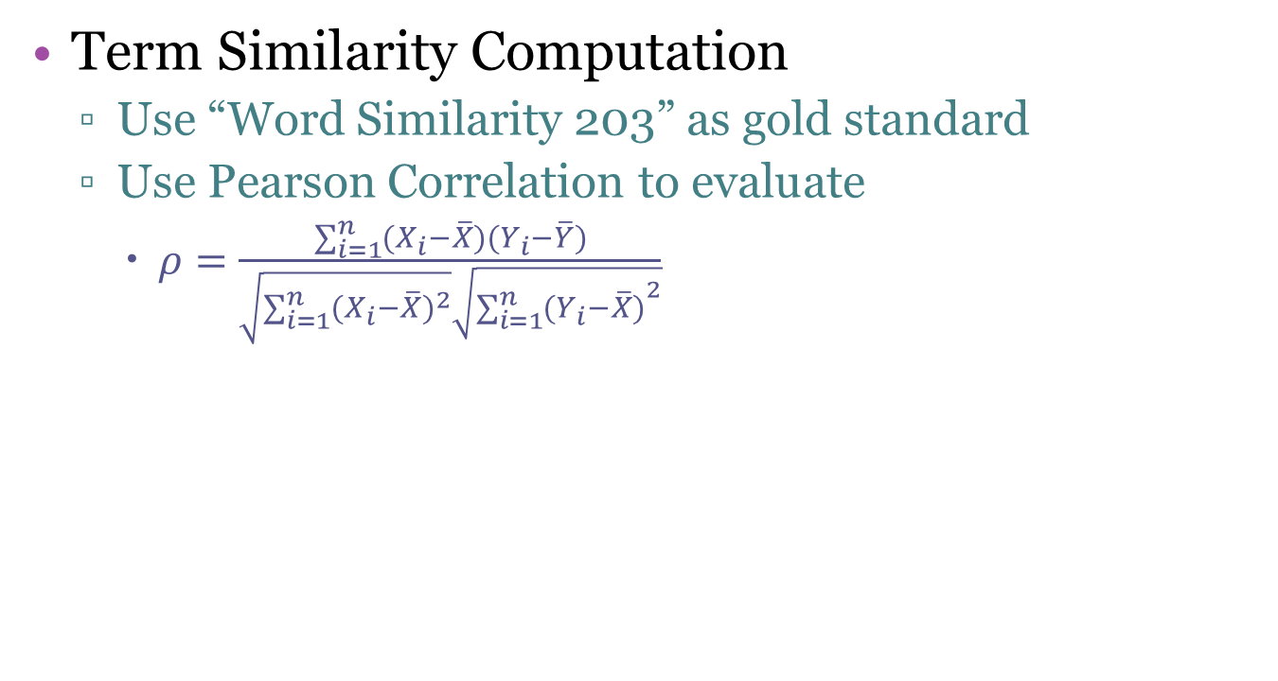
The applications
Term Similarity Computation
Use “Word Similarity 203” as gold standard
Use Pearson Correlation to evaluate
$ρ=\frac{\sum_{i=1}^{n}{(X_{i}−\overline{X})(Y_{i}−\overline{Y})}}{\sqrt{\sum_{i=1}^{n}{{(X_{i}−\overline{X})}^{2}}}\sqrt{{\sum_{i=1}^{n}{(Y_{i}−\overline{X})}}^{2}}}$
Noun based | Verb based | Combined
0.27 | 0.24 | 0.35

Slide 46
Thanks!

